Slide 1
1914-1918: The World at War

Slide 2
Causes of the War

Slide 3
We are Reviewing the Situation
France had been isolated by Germany, but when Bismarck was ousted and the Reinsurance Treaty had been allowed to lapse, France leapt at the chance to gain a friend…(remember that France had been financing Russian development)
Britain and France had a relationship based on cooperation from Africa and now against German expansion.
Germany had tried to isolate France by allying with A/H, and separately with Russia. New alliance with Italy gave Wilhelm/Caprivi the illusion they were ok without Russia (no chance Czarist Russia allies with republican France (OOPS)

Slide 4
The Alliance System
Triple Entente:
Triple Alliance:

Slide 5
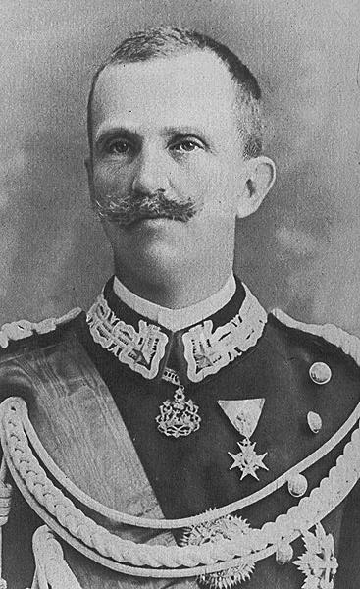
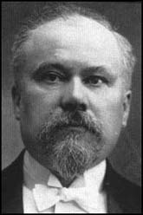
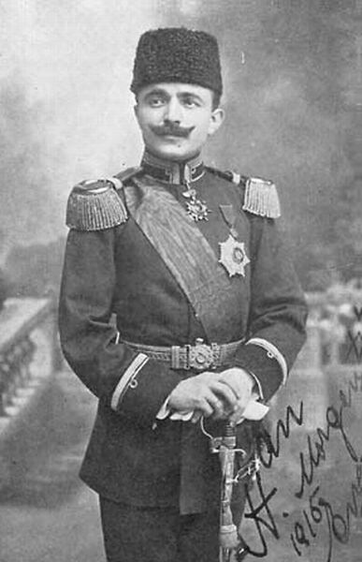
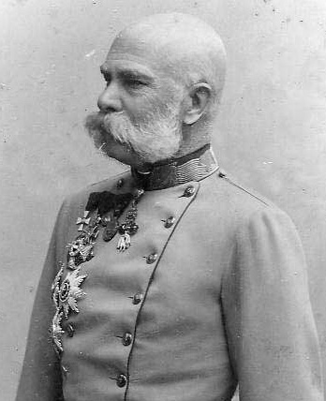
The Major Players: 1914-17
Allied Powers:
Central Powers:
Nicholas II [Rus]
George V [Br]
Wilhelm II [Ger]
Victor Emmanuel II [It]
Enver Pasha [Turkey]
Pres. Poincare [Fr]
Please note the result of inbreeding…how much George and Nick look like each other
Franz Josef [A-H]

Slide 6
Europe in 1914

Slide 7
Militarism & Arms Race
Total Defense Expenditures for the Great Powers [Ger., A-H, It., Fr., Br., Rus.] in millions of £s.
1870 | 1880 | 1890 | 1900 | 1910 | 1914
94 | 130 | 154 | 268 | 289 | 398
 | 1910-1914 Increase in Defense Expenditures
France | 10%
Britain | 13%
Russia | 39%
Germany | 73%

Slide 8
Economic & Imperial Rivalries

Slide 9
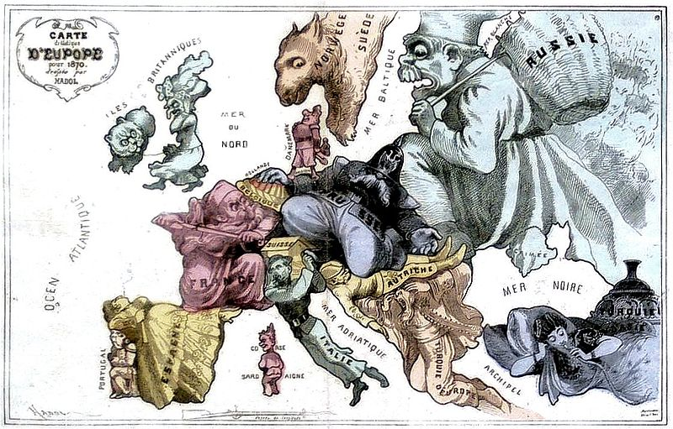
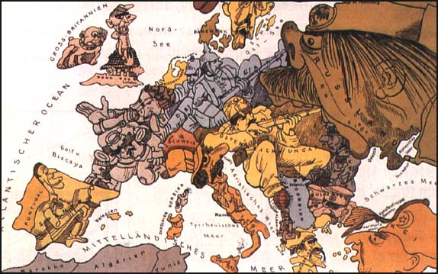
Aggressive Nationalism

Slide 10
Pan-Slavism: The Balkans, 1914
The “Powder Keg” of Europe

Slide 11
The “Spark”

Slide 12
Archduke Franz Ferdinand & His Family

Slide 13
Assassination
It is important to realize that assassinations were “common” way of addressing issues of leadership. This was by no means the first! Queen Victoria survived 7 attempts
Assassin | Victim | Position | Year | Cool Stuff
Felice Orsini (Bombs) | Napoleon III (Survived) | Emperor | 1858 | blamed Napoleon for failure to help unification
John Wilkes Booth (Gun) | Lincoln | US President | 1865 | 1st US President killed
Giovanni Passannte (Knife) | Umberto I (survived) | King Italy | 1878 | fended off attacker with his sword - only wounded
Ignacy Hrynieweicki (Bomb) | Alexander III | Tsar | 1881 | after several attempts
Tsuda Sanzo (Sabre) | Nicholas II (Survived) | Tsar | 1891 | happened in Japan
Luigi Lucheni (knife) | Elisabeth | Empress Austria | 1898 | tight corset - didn't know she was hurt until she collapsed 2 hours later
Gaetano Bresci (Gun) | Umberto I | King Italy | 1900 | revenge for rewarding a general who put down a revolt
Alexandro Schinas (Gun) | George I | King Greece | 1913 | he was shot at close range in the back. No clear political motive

Slide 14
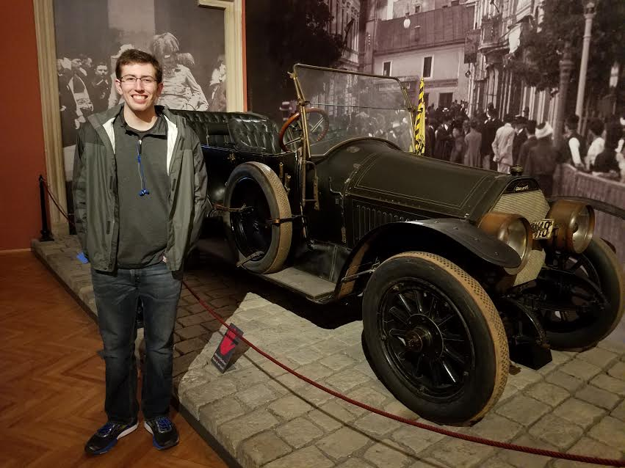
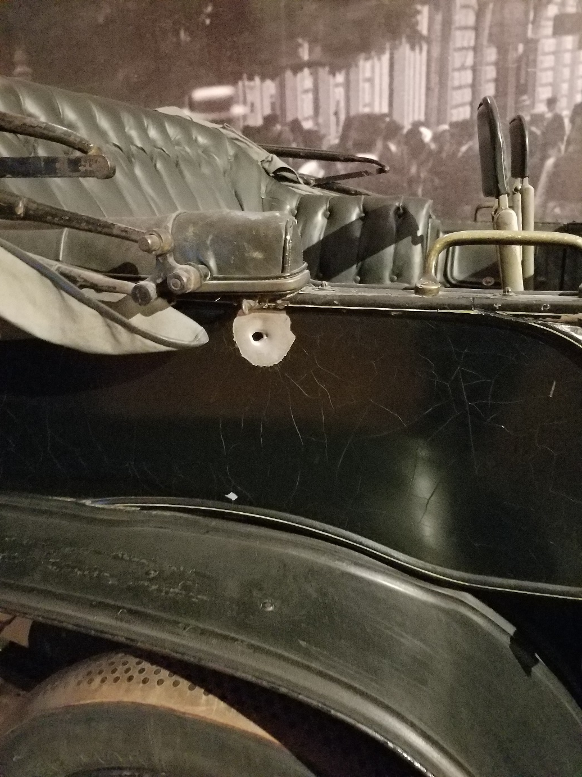
The Assassination:Sarajevo

Slide 15
The Assassin:
Gavrilo Princip

Slide 16
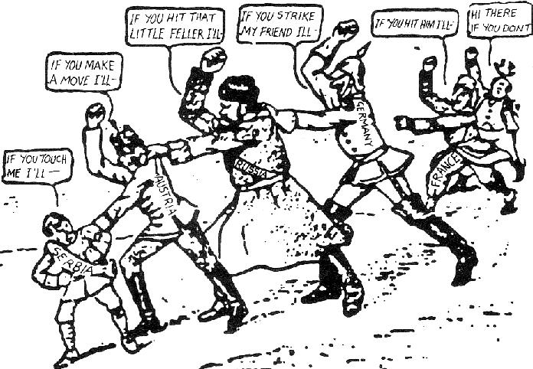
Who’s To Blame?

Slide 17
The Schlieffen Plan

Slide 18
Timeline…
July 28 1914 Austria declares war.
Serbia turns to Russia who mobilizes troops along German border
August 1st Germany declares war on Russia and next day on France (implement Schlieffen Plan)
To invade France Germany goes thru Belgium (violates neutrality).
August 4th Britain declares war on Germany
Mobilization
Home by Christmas!
No major war in 50 years!
Nationalism!

Slide 19
Recruitment Posters

Slide 21
Women and the War Effort

Slide 22
Financing the War

Slide 23
For Recruitment

Slide 24
Munitions Workers

Slide 25
French Women Factory Workers

Slide 26
German Women Factory Workers

Slide 27
Working in the Fields

Slide 28
A Woman Ambulance Driver

Slide 29
Women in the Army Auxiliary

Slide 30
Posters: Wartime Propaganda

Slide 31
Australian Poster

Slide 32
German Poster
Think of Your Children!

Slide 33
The Western Front A “War of Attrition”

Slide 34
A Multi-Front War

Slide 35
The Western Front

Slide 36
“I think I have seen today one of the most extraordinary sights that anyone has ever seen,” he wrote.
“About 10 o'clock this morning I was peeping over the parapet when I saw a German, waving his arms, and presently two of them got out of their trench and came towards ours.
“We were just going to fire on them when we saw they had no rifles, so one of our men went to meet them and in about two minutes the ground between the two lines of trenches was swarming with men and officers of both sides, shaking hands and wishing each other a happy Christmas.“

Slide 37
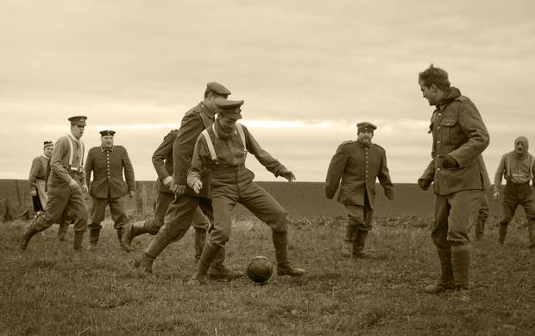
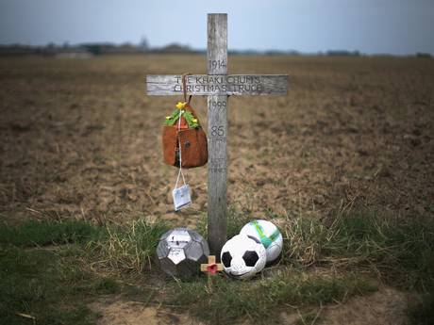

Slide 38
Trench Warfare

Slide 39
Trench Warfare
“No Man’s Land”

Slide 40
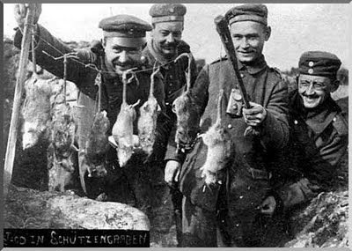
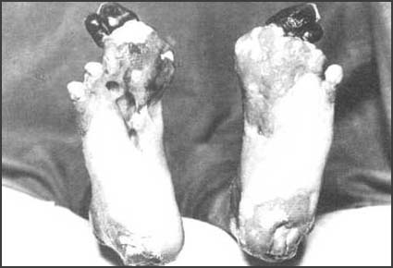
Life in the Trenches

Slide 41
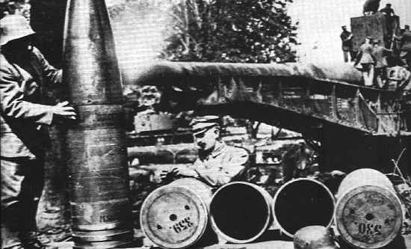
Krupp’s “Big Bertha” Gun

Slide 42
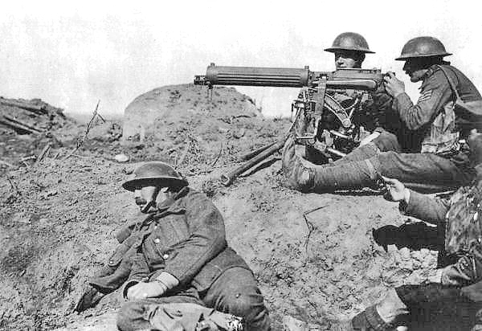
Machine Gun

Slide 43
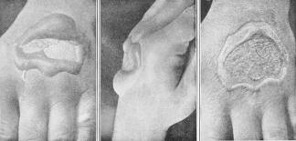
Poison Gas

Slide 44
Verdun – February, 1916
German offensive.
Each side had 500,000 casualties.

Slide 45
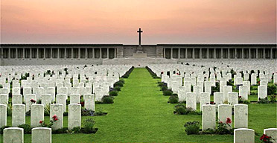
The Somme – July, 1916
60,000 British soldiers killed in one day.
Over 1,000,000 killed in 5 months.

Slide 47
The Third Front

Slide 48
The Gallipoli Disaster, 1915

Slide 49
Waltzing Matilda
Now when I was a young man I carried my pack, And I lived the free life of a rover From the Murray’s green basin to the dusty outback Well I waltzed my Matilda all over Then in nineteen fifteen my country said ‘Son It's time you stop rambling, there's work to be done.’ So they gave me a tin hat and they gave me a gun And they marched me away to the war. And the band played Waltzing Matilda As the ship pulled from the quay, And amidst all the cheers the flag waving and cheers, We sailed off to Gallipoli

Slide 50
How well I remember that terrible day How our blood stained the sand and the water. And how in that hell that they called Suvla Bay, We were butchered like lambs at the slaughter. Johnny Turk he was waiting, he primed himself well. He showered us with bullets, and he rained us with shells, And in five minutes flat he'd blown us all to hell. Nearly blew us right back to Australia! But the band played Waltzing Matilda When we stopped to bury our slain. We buried ours and the Turks buried theirs, Then we started all over again.

Slide 51
And those that were left, well we tried to survive In a mad world of blood, death and fire. And for ten weary weeks I kept myself alive, Though around me the corpses piled higher. Then a big Turkish shell knocked me arse over head, And when I woke up in my hospital bed And saw what it had done, I wished I was dead; Never knew there was worse things than dyin’! For no more I'll go waltzing Matilda All around the green bush far and free, For to hump tent and pegs, a man needs both legs No more waltzing Matilda for me

Slide 52
So they gathered the crippled, the wounded, the maimed, And they shipped us back home to Australia; The armless, the legless, the blind, the insane Those proud wounded heroes of Suvla. And as our ship pulled into Circular Quay, I looked at the place where my legs used to be And thank Christ there was nobody waiting for me To grieve and to mourn and to pity! But the band played Waltzing Matilda As they carried us down the gangway, But nobody cheered, they just stood and stared Then turned all their faces away

Slide 53
And so now every April I sit on my porch And I watch the parade pass before me. And I see my old comrades, how proudly they march, Reviving old dreams of past glory. And the old men march slowly, all bones stiff and sore They’re tired old heroes of a forgotten war. And the young people ask, "What are they marching for?" And I ask myself the same question. But the band plays Waltzing Matilda, And the old men answer to the call, But year after year more old men disappear, Some day no one will march there at all

Slide 54
Waltzing Matilda, Waltzing Matilda Who'll come a waltzing Matilda with me? And their ghosts may be heard as they pass by the Billabong Who'll come-a-waltzing Matilda with me?

Slide 55
The Eastern Front

Slide 56
The Tsar with General Brusilov

Slide 57
The Treaty Of Brest Litovsk

Slide 58
America Joins the Allies

Slide 59
Allied Ships Sunk by U-Boats
Unrestricted Submarine warfare: any ship approaching enemy waters was considered hostile no matter its country of origin
Abandoned in 1915 after…

Slide 60
The Sinking of the Lusitania
Unrestricted Submarine Warfare
Halted for the time being

Slide 61
The Zimmerman Telegram

Slide 62
The Yanks Are Coming!

Slide 63
Americans in the Trenches

Slide 64
The War of the Industrial Revolution: New Technology

Slide 65
French Renault Tank

Slide 66
British Tank at Ypres

Slide 67
U-Boats

Slide 68
The Airplane
“Squadron Over the Brenta” Max Edler von Poosch, 1917

Slide 69
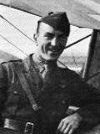
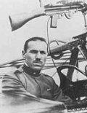
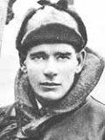
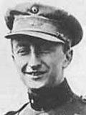
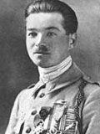
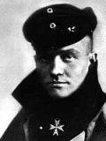
The Flying Aces of World War I
Eddie Rickenbacher, US
Francesco Barraco, It.
Eddie “Mick” Mannoch, Br.
Rene Pauk Fonck, Fr.
Manfred von Richtoffen, Ger. [The “Red Baron”]
Willy Coppens de Holthust, Belg.

Slide 70
Looking for the “Red Baron?”

Slide 71
The Zeppelin

Slide 72
Grenade Launchers
Flame Throwers

Slide 73
Poison Gas
Machine Gun

Slide 74
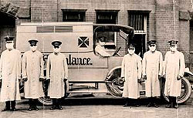
1918 Flu Pandemic: Depletes All Armies
Becomes Global…Why?
50,000,000 – 100,000,000 died

Slide 75
War Ends?

Slide 76
11 a.m., November 11, 1918
The Armistice is Signed!

Slide 77
9,000,000 Dead

Slide 78
The Somme American Cemetary, France
116,516 Americans Died

Slide 79
World War I Casualties
Look at the relative numbers!
Who ends the war as the dominant power?

Slide 80
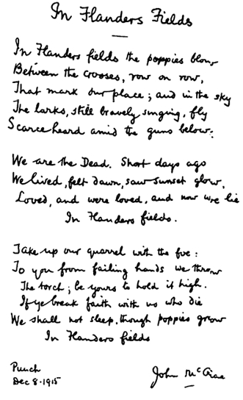
In Flanders Fields
By: Lieutenant Colonel John McCrae, MD
(1872-1918) Canadian Army
In Flanders Fields the poppies blow Between the crosses row on row, That mark our place; and in the sky The larks, still bravely singing, fly Scarce heard amid the guns below.
We are the Dead. Short days ago We lived, felt dawn, saw sunset glow, Loved and were loved, and now we lie In Flanders fields.
Take up our quarrel with the foe: To you from failing hands we throw The torch; be yours to hold it high. If ye break faith with us who die We shall not sleep, though poppies grow In Flanders fields.
The Story of the Poppy

Slide 81
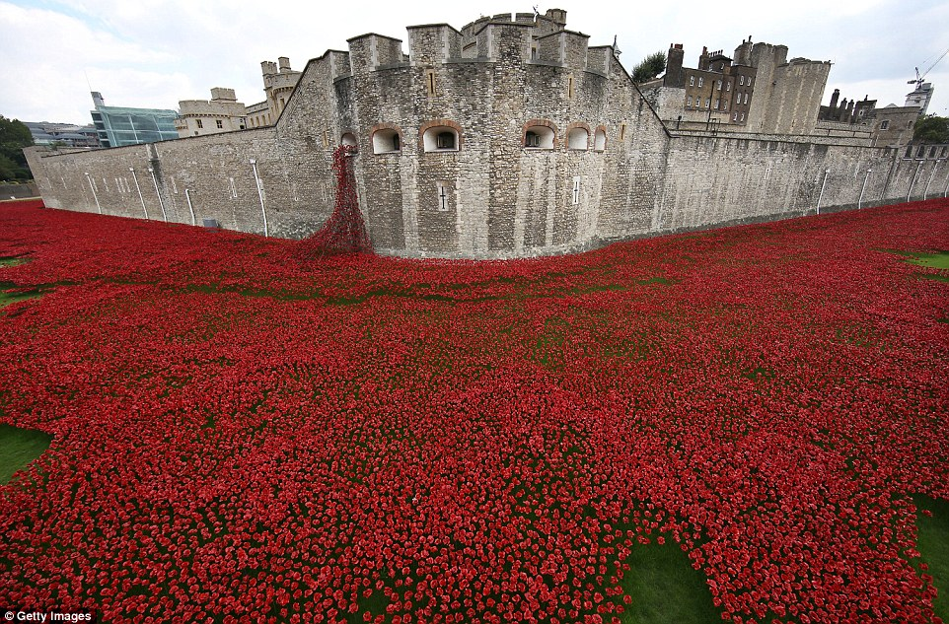
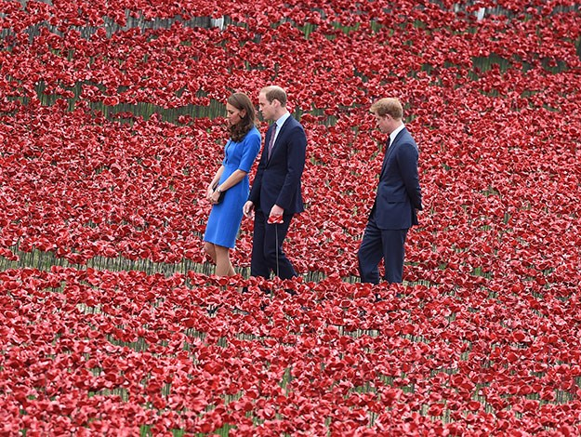
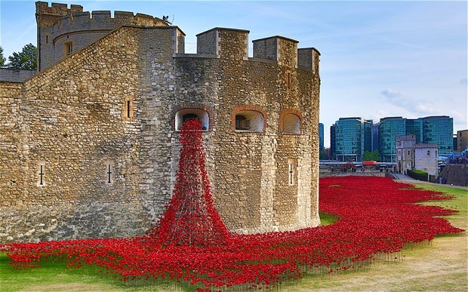

Slide 82
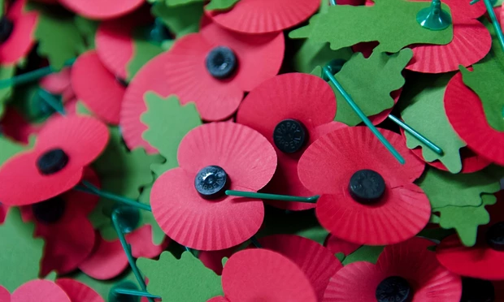
Wearing the red poppy of remembrance for me is acknowledging and remembering that, without those who lost their lives in both world wars, I would not be living with the choice to wear one. My husband is a soldier and as such I am more than aware of the recent sacrifices made by our forces in Afghanistan and Iraq. However it is for the veterans of wars that I did not live through that I wear my poppy. We owe them everything we have today.
Lisa Milner, Salisbury

Slide 83
The last living veteran of WW I was Florence Green, a British citizen who served in the Allied armed forces, and who died 4 February 2012, aged 110.
The last combat veteran was Claude Choules who served in the British Royal Navy and died 5 May 2011, aged 110.
The last veteran who served in the trenches was Harry Patch who died on 25 July 2009, aged 111.
The last Central Powers veteran, Franz Kunzler of Austria Hungary, died on 27 May 2008 at the age of 107.
The last US veteran was Frank Buckles died 28 February 2011 age 110

Slide 84
Turkish Genocide Against Armenians
A Portent of Future Horrors!

Slide 85
IF WW I WAS A BAR FIGHT…
Germany, Austria and Italy are standing together in the middle of a pub when Serbia bumps into Austria and spills Austria’s pint.
Austria demands Serbia buy it a whole new suit because of the new beer stains on its trouser leg.
Germany expresses its support for Austria’s point of view.
Britain recommends that everyone calm down a bit.
Serbia points out that it can’t afford a whole suit, but offers to pay for the cleaning of Austria’s trousers.
Russia and Serbia look at Austria.
Austria asks Serbia who it’s looking at.
Russia suggests that Austria should leave its little brother alone.

Slide 86
Austria inquires as to whose army will assist Russia in doing so.
Germany appeals to Britain that France has been looking at it, and that its sufficiently out of order that Britain not intervene.
Britain replies that France can look at who it wants to, that Britain is looking at Germany too, and what is Germany going to do about it?
Germany tells Russia to stop looking at Austria, or Germany will render Russia incapable of such action anymore.
Britain and France ask Germany whether it’s looking at Belgium.
Turkey and Germany go off into a corner and whisper. When they come back, Turkey makes a show of not looking at anyone.

Slide 87
Germany rolls up its sleeves, looks at France, and punches Belgium.
France and Britain punch Germany. Austria punches Russia. Germany punches Britain and France with one hand and Russia with the other.
Russia throws a punch at Germany, but misses and nearly falls over. Japan calls over from the other side of the room that it’s on Britain’s side, but stays there. Italy surprises everyone by punching Austria.
Australia punches Turkey, and gets punched back. There are no hard feelings because Britain made Australia do it.
France gets thrown through a plate glass window, but gets back up and carries on fighting. Russia gets thrown through another one, gets knocked out, suffers brain damage, and wakes up with a complete personality change.

Slide 88
Italy throws a punch at Austria and misses, but Austria falls over anyway. Italy raises both fists in the air and runs round the room chanting.
America waits till Germany is about to fall over from sustained punching from Britain and France, then walks over and smashes it with a barstool, then pretends it won the fight all by itself.
By now all the chairs are broken and the big mirror over the bar is shattered. Britain, France and America agree that Germany threw the first punch, so the whole thing is Germany’s fault . While Germany is still unconscious, they go through its pockets, steal its wallet, and buy drinks for all their friends.

