Slide 1
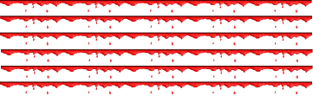
World
War
II

Slide 2
The Road
to
War:
1919-1939

Slide 3
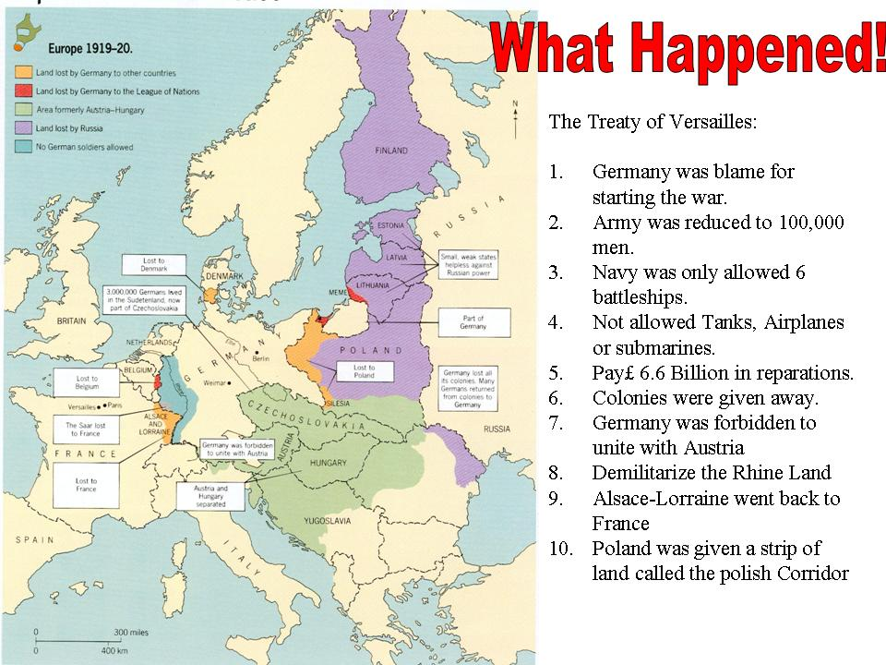
The Versailles Treaty

Slide 4
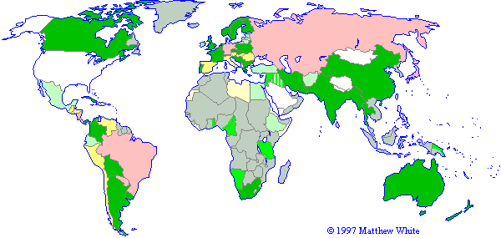
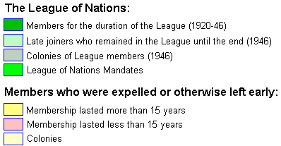
A Weak League of Nations

Slide 5
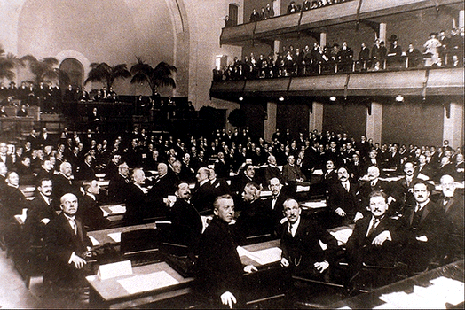
The Ineffectiveness of the League of Nations
Economic embargoes were a waste of time.
No effective military force.

Slide 6
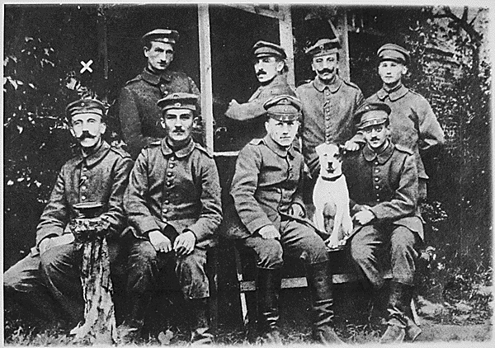
The “Stab-In-The-Back” Theory
German soldiers are dissatisfied.

Slide 7
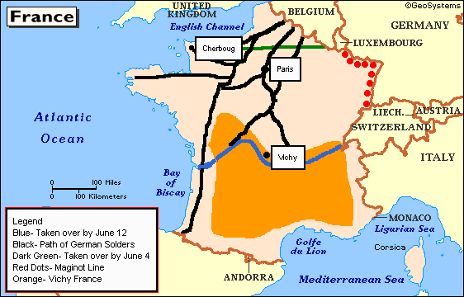
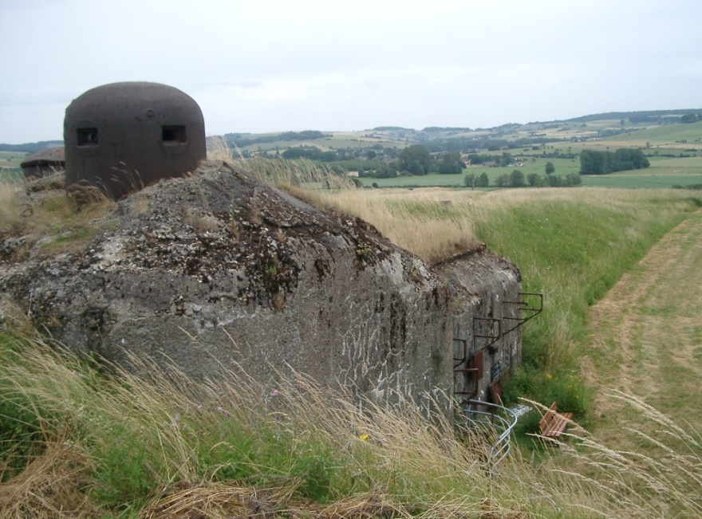
France – False Sense of Security?
The Maginot
Line

Slide 8
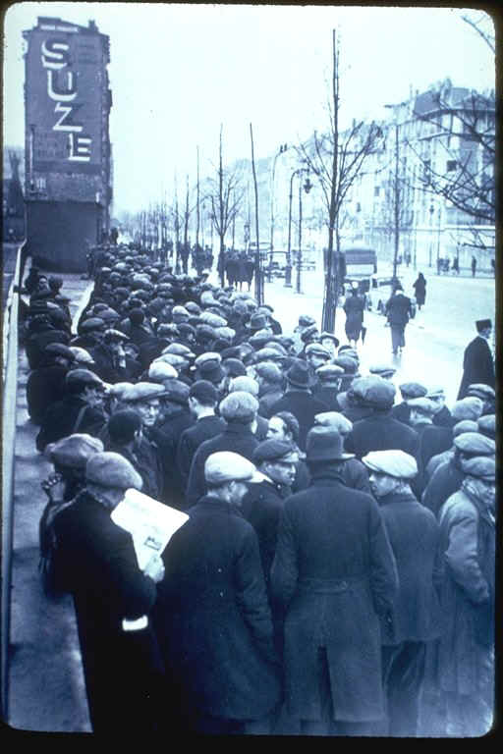
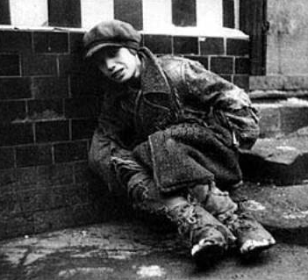
The Great Depression

Slide 9
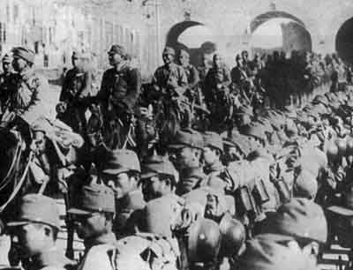
The Manchurian Crisis, 1931

Slide 10
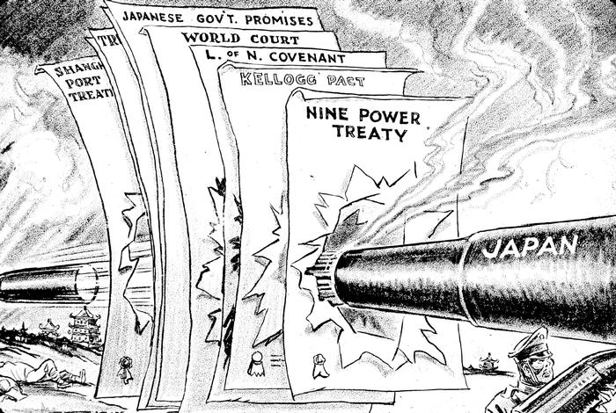
Japan Invades Manchuria, 1931

Slide 11
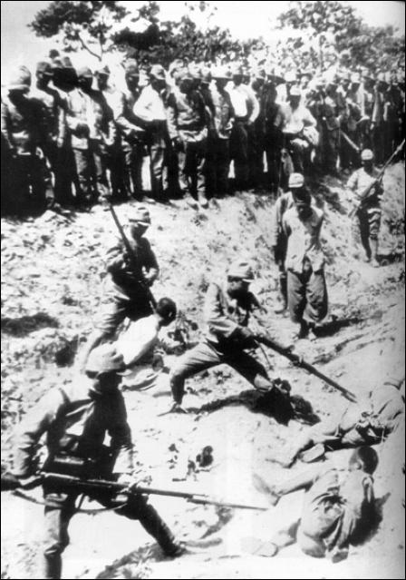
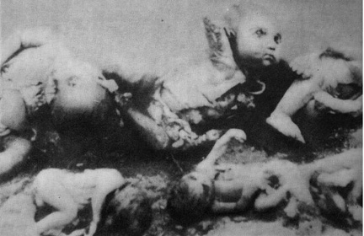
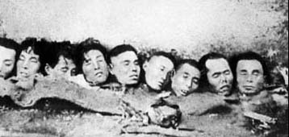
The Japanese Invasion
of China, 1937

Slide 12
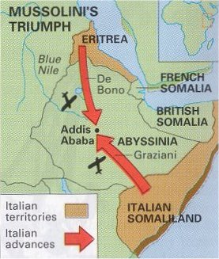
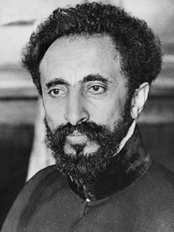
Italy Attacks Ethiopia, 1935
Emperor Haile Selassie

Slide 13
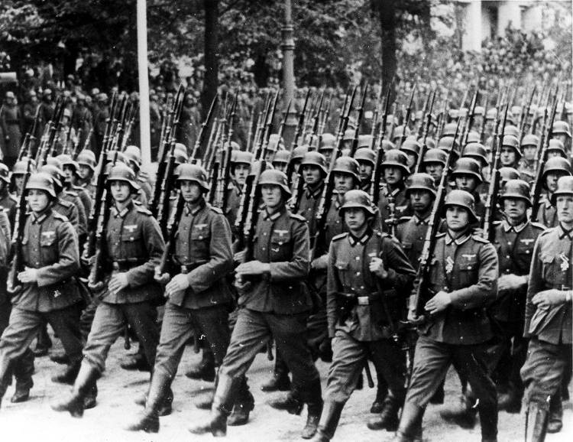
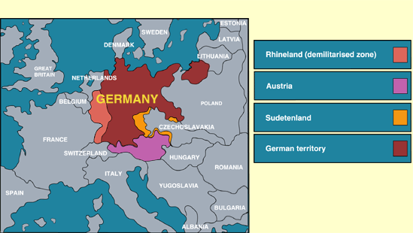
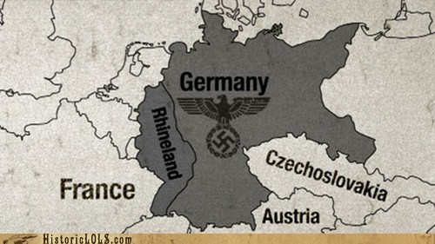
Germany Invades the Rhineland
March 7, 1936

Slide 14
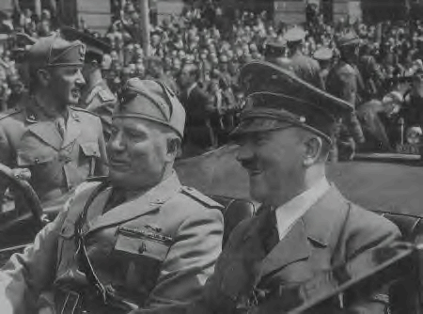
Rome-Berlin Axis, 1936
The “Pact of Steel”
The “Axis” Powers

Slide 15
The Spanish Civil War:
1936 - 1939
The
National
Front
[Nationalists]
The
Popular
Front
[Republicans]
Carlists [ultra-Catholic
monarchists].
Catholic Church.
Falange [fascist] Party.
Monarchists.
Anarcho-Syndicalists.
Basques.
Catalans.
Communists.
Marxists.
Republicans.
Socialists.

Slide 16
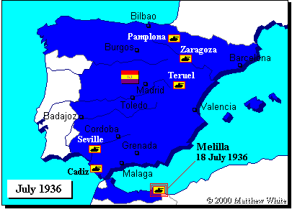
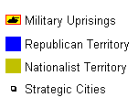
The Spanish Civil War

Slide 17
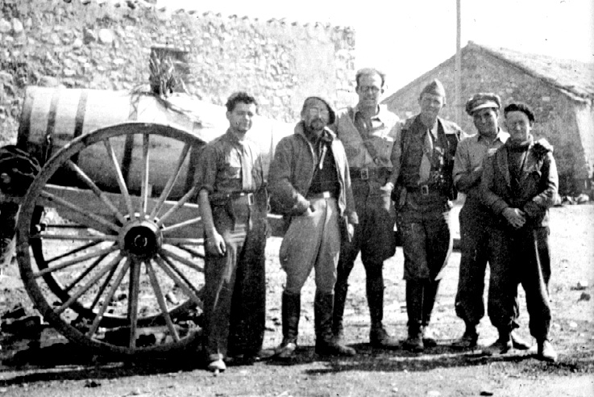
The Spanish Civil War: 1936 - 1939
The American “Lincoln Brigade”

Slide 18
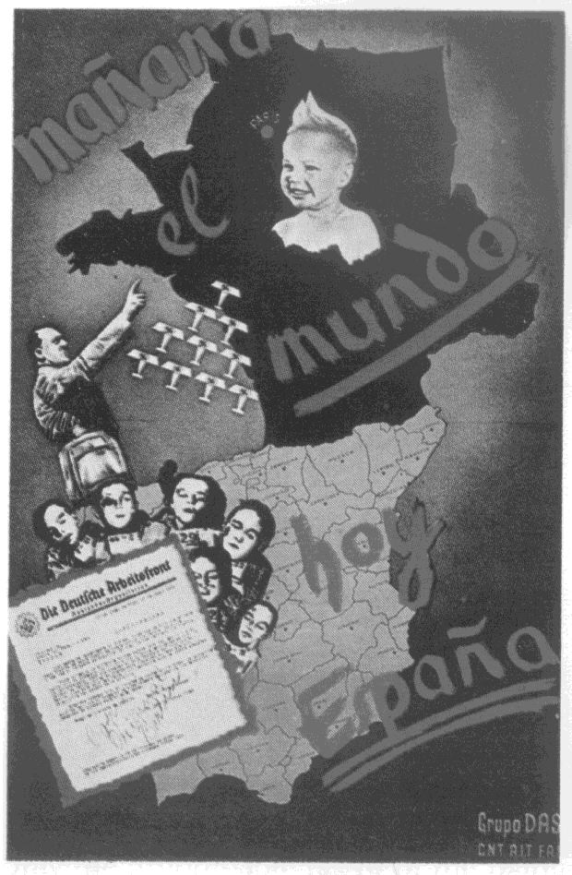
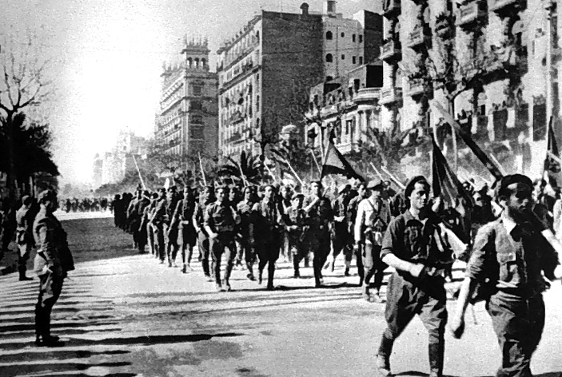
The Spanish Civil War:
A Dress Rehearsal for WW II?
Italian troops in Madrid

Slide 19
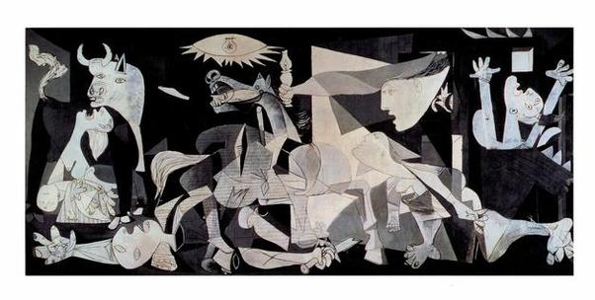
“Guernica” by Pablo Picasso

Slide 20
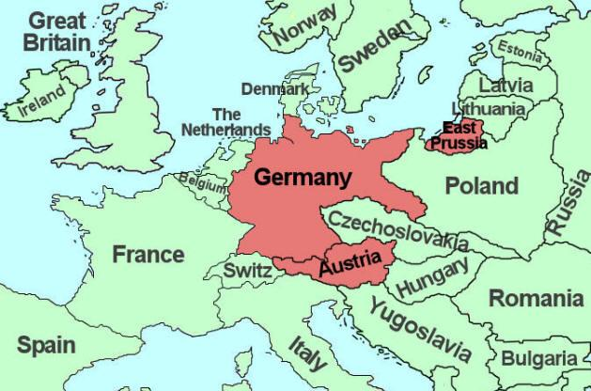
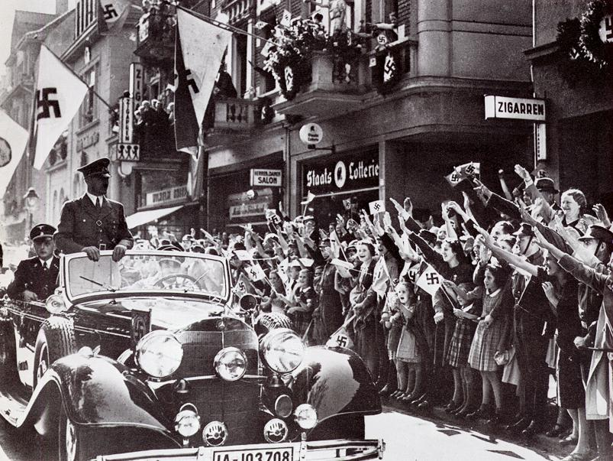
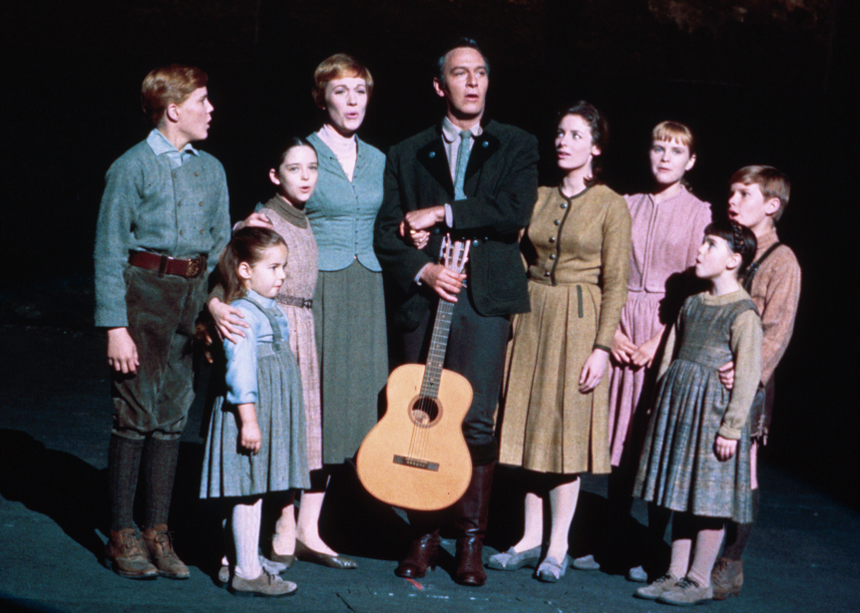
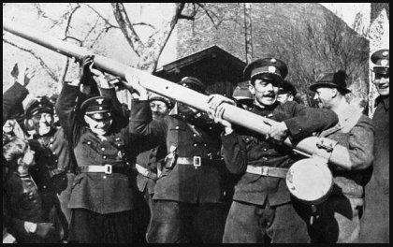
The Austrian Anschluss, 1938

Slide 21
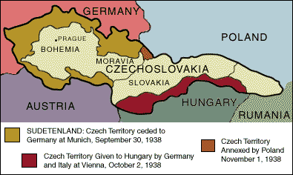
The “Problem” of the
Sudetenland

Slide 22
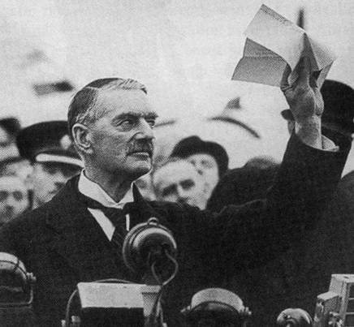
Appeasement: The Munich Agreement, 1938
British Prime Minister Neville Chamberlain
Now we have “peace in our time!” Herr Hitler is a man we can do business with.

Slide 23
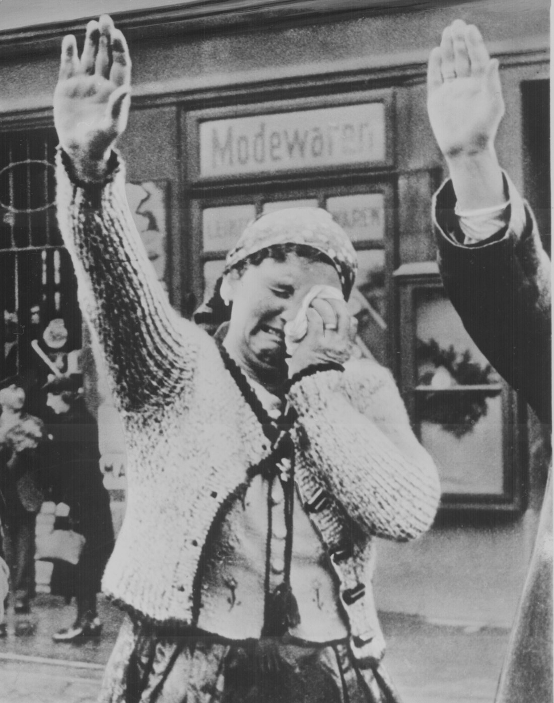
Czechoslovakia Becomes Part of the Third Reich: 1939

Slide 24
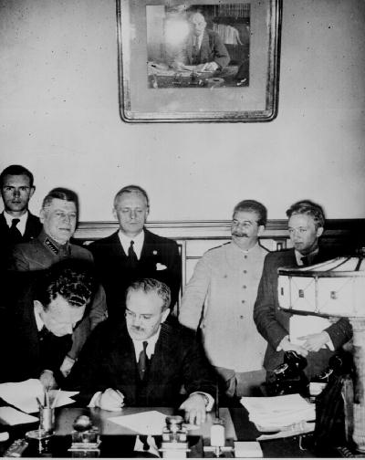
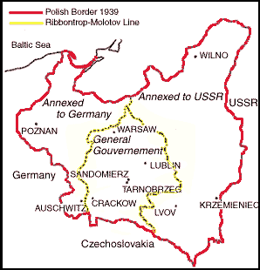
The Nazi-Soviet
Non-Aggression Pact, 1939
Foreign Ministers
von Ribbentrop & Molotov

Slide 25
The
War
Begins!

Slide 26
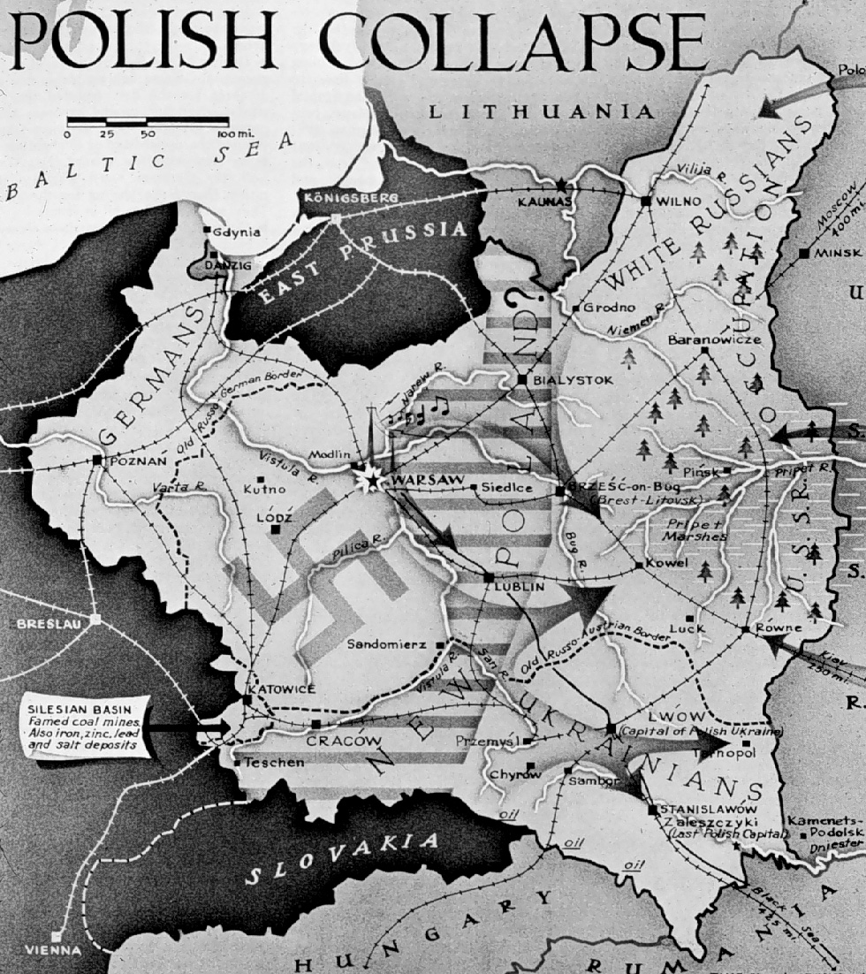
Poland Attacked: Sept. 1, 1939
Blitzkrieg [“Lightning War”]

Slide 27
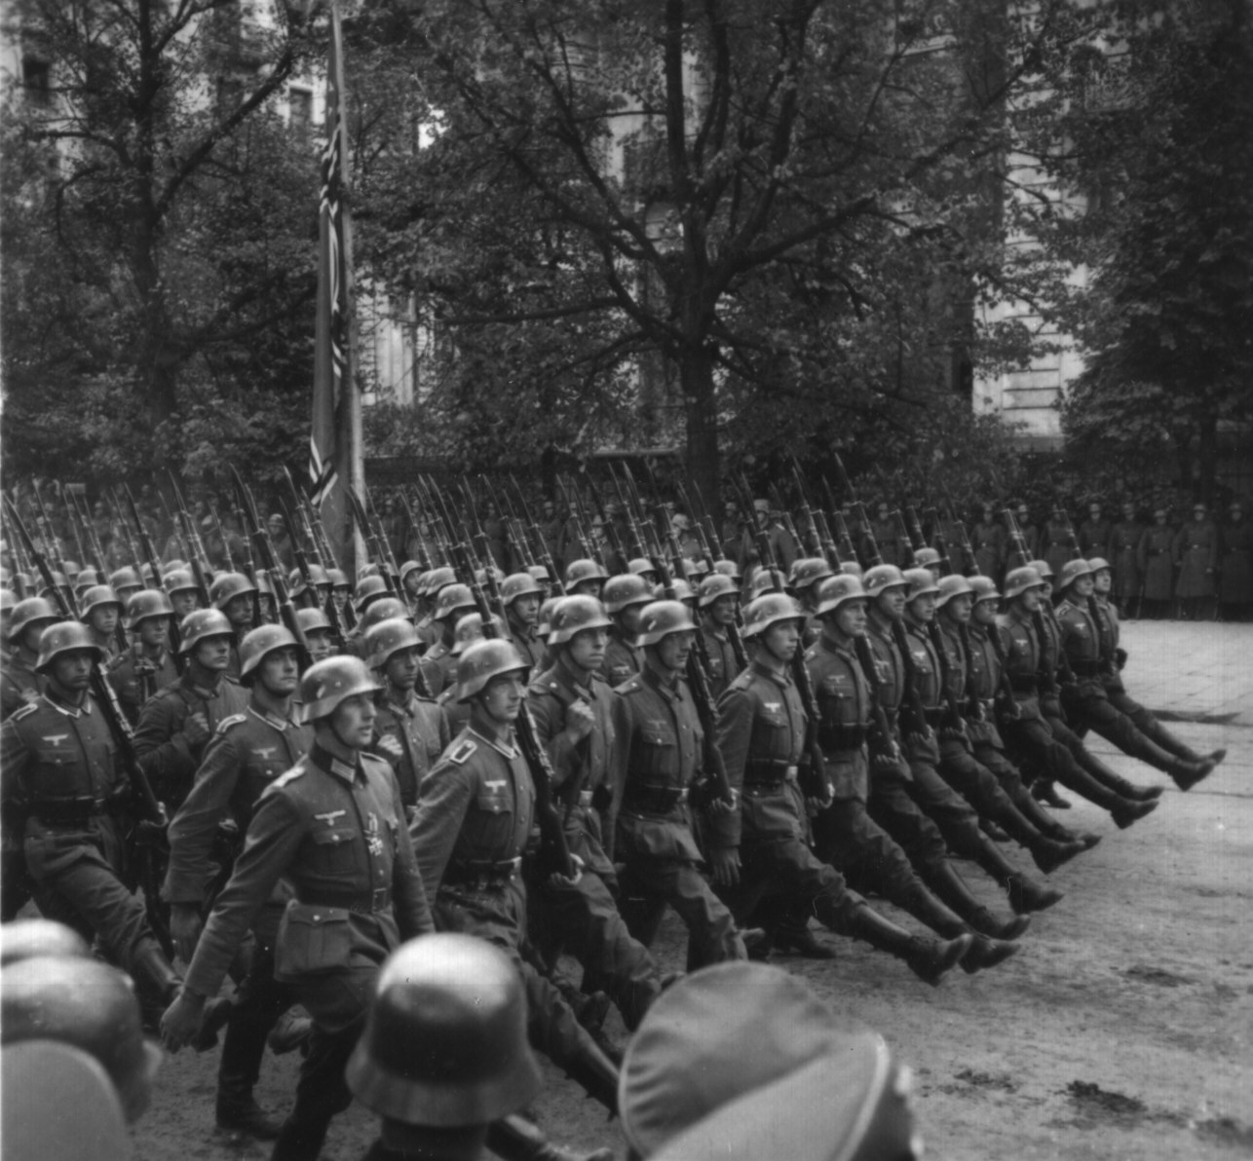
German Troops March into Warsaw

Slide 28
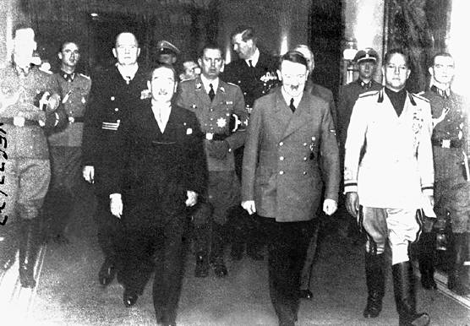
Rome-Berlin-Tokyo Axis, 1940
The Tripartite Pact

Slide 29
The European
& North African
Theaters

Slide 30
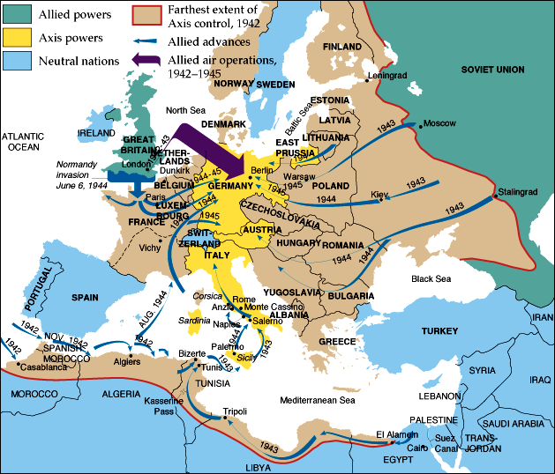
European Theater of Operations

Slide 31
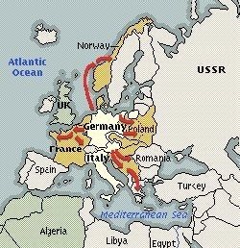
The “Phoney War” Ends:
Spring, 1940

Slide 32
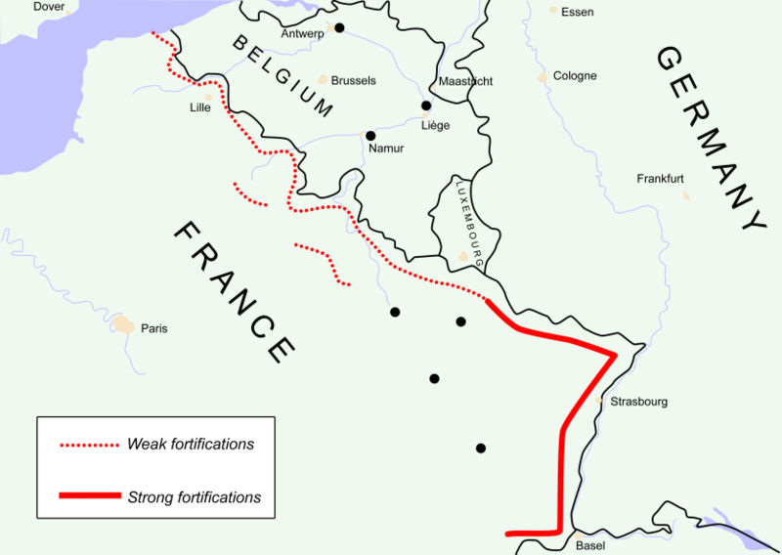
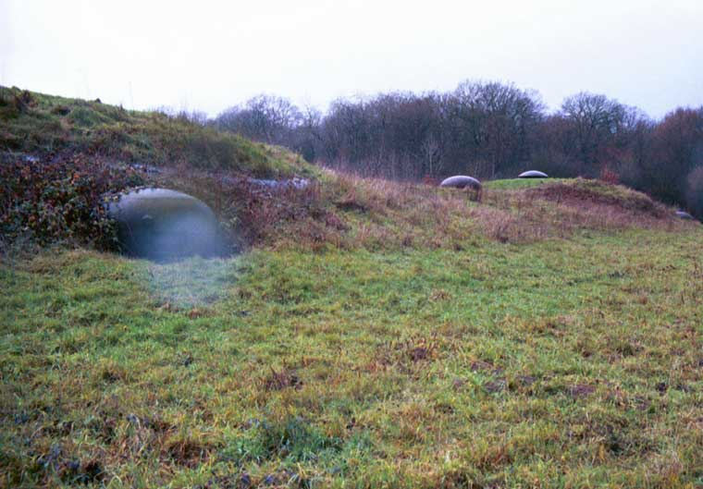

Slide 33
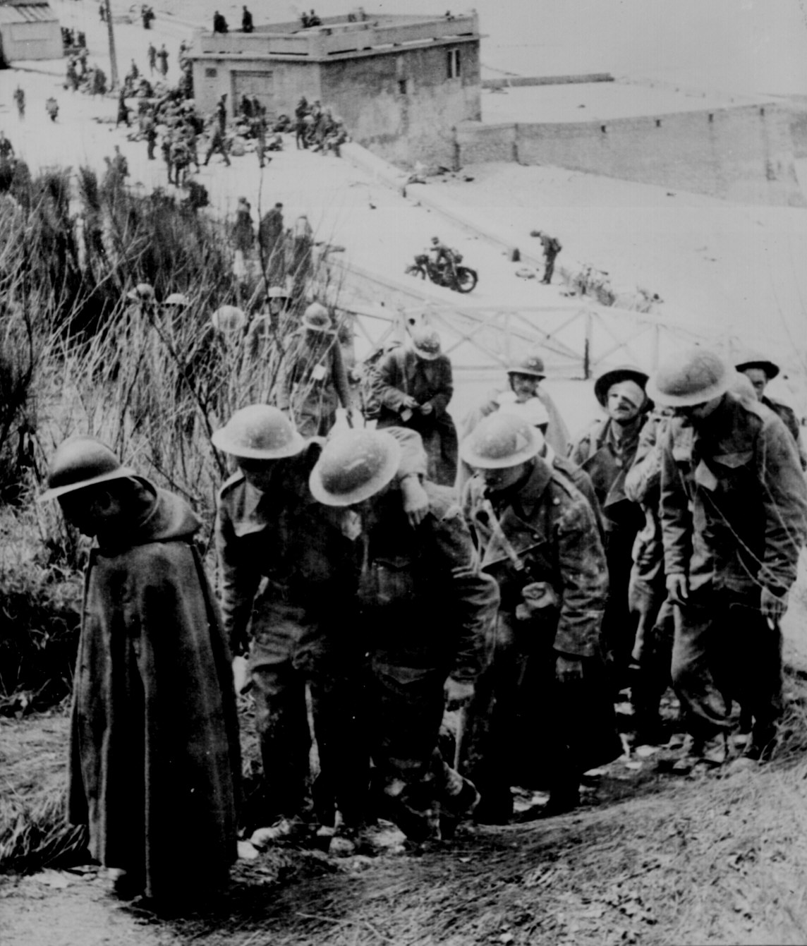
Dunkirk Evacuated
June 4, 1940

Slide 34
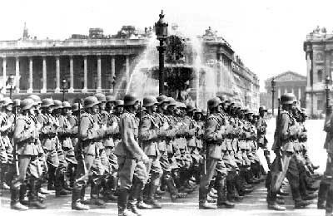
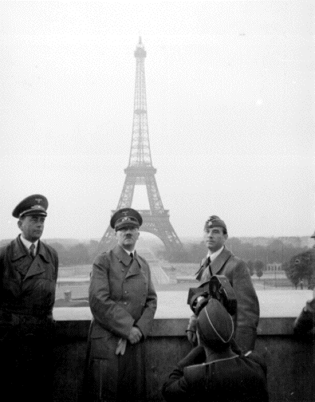
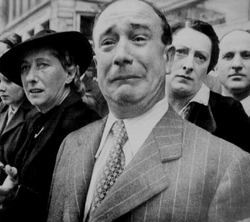
France Surrenders
June, 1940

Slide 35
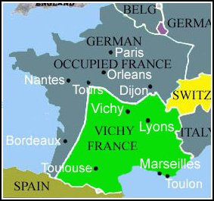
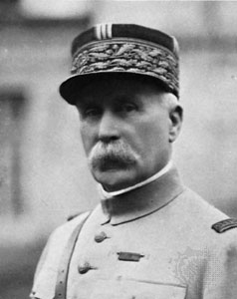
A Divided France
Henri Petain

Slide 36

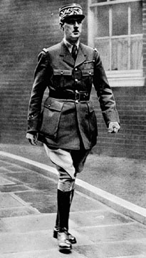

The French Resistance
The Free French
General Charles DeGaulle
The Maquis

Slide 37

Now Britain Is All Alone!

Slide 38

British Prime Minister Winston Churchill

Slide 39



The Royal Air Force

Slide 40


Battle of Britain:
The “Blitz”

Slide 41


Battle of Britain:
The “Blitz”

Slide 42

The London “Tube”:
Air Raid Shelters during the Blitz

Slide 43



Slide 44


The North Africa Campaign:
The Battle of El Alamein, 1942
Gen. Ernst Rommel,
The “Desert Fox”
Gen. Bernard Law
Montgomery
(“Monty”)

Slide 45

Operation Barbarossa:
Hitler’s Biggest Mistake

Slide 46

Operation Barbarossa:
June 22, 1941
3,000,000 German soldiers.
3,400 tanks.

Slide 47

Axis Powers in 1942

Slide 48


Battle of Stalingrad:
Winter of 1942-1943
German Army | Russian Army
1,011,500 men | 1,000,500 men
10,290 artillery guns | 13,541 artillery guns
675 tanks | 894 tanks
1,216 planes | 1,115 planes

Slide 49

Lend-Lease

Slide 50
U. S. Lend-Lease Act,
1941
Great Britain.........................$31 billion
Soviet Union..........................$11 billion
France..................................$3 billion
China..................................$1.5 billion
Other European......................$500 million
South America.......................$400 million
The amount totaled: $48,601,365,000

Slide 51

The Italian Campaign
[“Operation Torch”] :
Europe’s “Soft Underbelly”
Allies plan assault on weakest Axis area - North Africa - Nov. 1942-May 1943
George S. Patton leads American troops
Germans trapped in Tunisia - surrender over 275,000 troops.

Slide 52


The Battle for Sicily:
June, 1943
General
George S. Patton

Slide 53



The Battle of Monte Casino:
February, 1944

Slide 54



The Allies Liberate Rome:
June 5, 1944

Slide 55

Gen. Eisenhower Gives the Orders for D-Day [“Operation Overlord”]

Slide 56

D-Day (June 6, 1944)

Slide 57



Normandy Landing
(June 6, 1944)
German Prisoners
Higgins Landing Crafts

Slide 58


The Liberation of Paris:
August 25, 1944
De Gaulle in Triumph!

Slide 59


U. S. Troops in Paris, 1944

Slide 60

French Female Collaborators

Slide 61



The Battle of the Bulge:
Hitler’s Last Offensive
Dec. 16, 1944
to
Jan. 28, 1945

Slide 62

Yalta: February, 1945
FDR wants quick Soviet entry into Pacific war.
FDR & Churchill concede Stalin needs buffer, FDR & Stalin want spheres of influence and a weak Germany.
Churchill wants strong Germany as buffer
against Stalin.
FDR argues
for a ‘United
Nations’.
The “Big Three”

Slide 63

Mussolini &
His Mistress,
Claretta Petacci
are hanged in Milan, 1945

Slide 64

US & Russian Soldiers Meet at the Elbe River: April 25, 1945

Slide 65

Horrors of the Holocaust Exposed

Slide 66


Horrors of the Holocaust Exposed
Entrance to Auschwitz:
Work Makes You Free
Crematoria at Majdanek

Slide 67

Horrors of the Holocaust Exposed
Eli Wiesel
Slave Labor at Buchenwald

Slide 68

Horrors of the Holocaust Exposed
Mass Graves at Bergen-Belsen

Slide 69



Hitler’s “Secret Weapons”:
Too Little, Too Late!
V-1 Rocket:
“Buzz Bomb”
V-2 Rocket
Werner von Braun

Slide 70



Hitler Commits Suicide
April 30, 1945
Cyanide & Pistols
The Führer’s Bunker
Mr. & Mrs. Hitler

Slide 71


V-E Day (May 8, 1945)
General Keitel

Slide 72

V-E Day (May 8, 1945)

Slide 73
The
Pacific
Theater

Slide 74

Pearl Harbor

Slide 75

Admiral Isoroku Yamamoto

Slide 76

Pearl Harbor from the Cockpit of a Japanese Pilot

Slide 77

Pearl Harbor - Dec. 7, 1941
A date which will live in infamy!

Slide 78

President Roosevelt Signs the US Declaration of War

Slide 79

USS Arizona, Pearl Harbor

Slide 80

Pearl Harbor Memorial
2,887 Americans Dead!

Slide 81


Singapore Surrenders
[February, 1942]

Slide 82

U.S. Surrenders at Corregidor,
the Philippines [March, 1942]

Slide 83

Bataan Death March: April, 1942
76,000 prisoners [12,000 Americans] Marched 60 miles in the blazing heat to POW camps in the Philippines.

Slide 84


Bataan: British Soldiers
A Liberated British POW

Slide 85

Farthest Extent
of Japanese Conquests

Slide 86

Lt. Col. Jimmy Doolittle:
First U. S. Raids on Tokyo, 1942

Slide 87

Pacific Theater of Operations

Slide 88

Battle of the Coral Sea:
May 7-8, 1942

Slide 89

Battle of Midway Island:
June 4-6, 1942

Slide 90

Allied Counter-Offensive:
“Island-Hopping”

Slide 91


Japanese Kamikaze Planes:
The Scourge of the South Pacific
Kamikaze Pilots
Suicide Bombers

Slide 92

“Island-Hopping”: US Troops on Kwajalien Island

Slide 93

Gen. MacArthur “Returns” to the Philippines! [1944]

Slide 94

US Marines on Mt. Surbachi,
Iwo Jima [Feb. 19, 1945]

Slide 95

Potsdam Conference:
July, 1945
FDR dead, Churchill out of office as Prime Minister during conference.
Stalin only original.
The United States has the A-bomb.
Allies agree Germany is to be divided into occupation zones
Poland moved
around to suit
the Soviets.
P.M. Clement President Joseph
Atlee Truman Stalin

Slide 96



The Manhattan Project:
Los Alamos,
NM
For I have become
death,
destroyer
of worlds!
Major General
Lesley R. Groves
Dr. Robert Oppenheimer

Slide 97



Tinian Island, 1945
Little Boy Fat Man
Enola Gay Crew

Slide 98

Col. Paul Tibbets & the A-Bomb

Slide 99


Hiroshima – August 6, 1945
70,000 killed
immediately.
48,000 buildings.
destroyed.
100,000s died of
radiation poisoning &
cancer later.

Slide 100

The Beginning of the
Atomic Age

Slide 101


Nagasaki – August 9, 1945
40,000 killed
immediately.
60,000 injured.
100,000s died of
radiation poisoning
& cancer later.

Slide 102


Japanese A-Bomb Survivors

Slide 103



Hiroshima Memorials

Slide 104



V-J Day (September 2, 1945)

Slide 105

Japanese POWs, Guam

Slide 106

V-J Day in Times Square, NYC

Slide 107
Results
of
World War II

Slide 109


WW II Casualties: Europe
Each symbol indicates 100,000 dead in the appropriate theater of operations

Slide 110

WW II Casualties: Asia
Each symbol indicates 100,000 dead in the appropriate theater of operations

Slide 111
Country | Men in war | Battle deaths | Wounded
Australia | 1,000,000 | 26,976 | 180,864
Austria | 800,000 | 280,000 | 350,117
Belgium | 625,000 | 8,460 | 55,513¹
Brazil² | 40,334 | 943 | 4,222
Bulgaria | 339,760 | 6,671 | 21,878
Canada | 1,086,343⁷ | 42,042⁷ | 53,145
China³ | 17,250,521 | 1,324,516 | 1,762,006
Czechoslovakia | — | 6,683⁴ | 8,017
Denmark | — | 4,339 | —
Finland | 500,000 | 79,047 | 50,000
France | — | 201,568 | 400,000
Germany | 20,000,000 | 3,250,000⁴ | 7,250,000
Greece | — | 17,024 | 47,290
Hungary | — | 147,435 | 89,313
India | 2,393,891 | 32,121 | 64,354
Italy | 3,100,000 | 149,496⁴ | 66,716
Japan | 9,700,000 | 1,270,000 | 140,000
Netherlands | 280,000 | 6,500 | 2,860
New Zealand | 194,000 | 11,625⁴ | 17,000
Norway | 75,000 | 2,000 | —
Poland | — | 664,000 | 530,000
Romania | 650,000⁵ | 350,000⁶ | —
South Africa | 410,056 | 2,473 | —
U.S.S.R. | — | 6,115,000⁴ | 14,012,000
United Kingdom | 5,896,000 | 357,116⁴ | 369,267
United States | 16,112,566 | 291,557 | 670,846
Yugoslavia | 3,741,000 | 305,000 | 425,000
WW II Casualties
Civilians only.
Army and navy figures.
Figures cover period July 7, 1937 to Sept. 2, 1945, and concern only Chinese regular troops. They do not include casualties suffered by guerrillas and local military corps.
Deaths from all causes.
Against Soviet Russia; 385,847
against Nazi Germany.
Against Soviet Russia; 169,822
against Nazi Germany.
National Defense Ctr., Canadian
Forces Hq., Director of History.

Slide 112


Massive Human Dislocations

Slide 113


The U.S. & the U.S.S.R. Emerged as the Two Superpowers of the later 20^{c}

Slide 114

The Bi-Polarization of Europe: The Beginning of the Cold War

Slide 115

The Division of Germany:
1945 - 1990

Slide 116

The Creation of the U. N.

Slide 117

The Nuremberg War Trials:
Crimes Against Humanity

Slide 118


Japanese War Crimes Trials
General
Hideki Tojo

Slide 119


The Race for Space

Slide 120





The Emergence of Third World Nationalist Movements

Slide 121

The De-Colonization of
European Empires

Slide 122
The World
We Live in Today
Was Formed
by the Events
of World War II & its
aftermath!

