Slide 1
1914-1918: The World at War

Slide 2
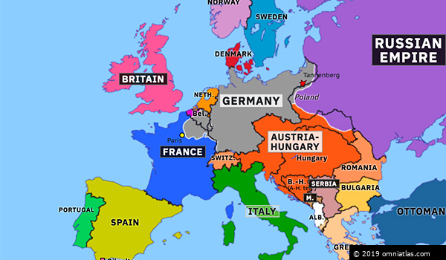
Europe in 1914

Slide 3
Causes of the War

Slide 4
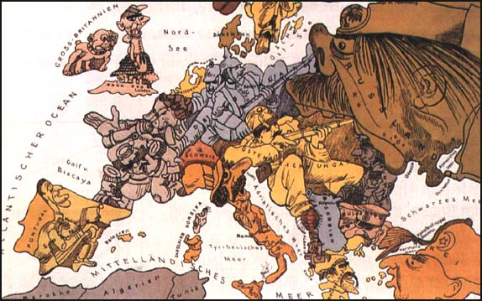
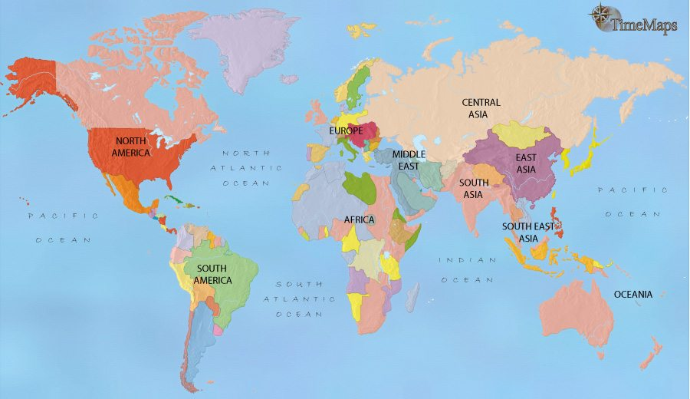
All of Europe locked in struggle for superiority. Took several forms:
Nationalism – Whose country is best?
Imperialism – Who has the most “stuff”?
Militarism – Whose guns are the biggest?
Alliances – Who is on whose side?
 | 1910-1914 Increase in Defense Expenditures
France | 10%
Britain | 13%
Russia | 39%
Germany | 73%

Slide 5
Alliance system
Britain isolated by choice – did not need anyone else!
Franco – Prussian war created rivalry
Despite winning, Germany worried – isolate France
Allies with Russia (separate), A/H and Italy
France desperate for friends – invests in Russia.
Russo-German alliance ends and France steps in.
Big problem for Germany!!
WHY?

Slide 6
The Schlieffen Plan

Slide 7
The Alliance System
Triple Entente:
Triple Alliance:

Slide 8
The Balkans 1914
Pan-Slavism: Slavic people want independence from Ottomans and A/H
Look at the racial group here and who they are ruled by…
The “Powder Keg” of Europe

Slide 9
The “Spark”

Slide 10
Archduke Franz Ferdinand & His Family

Slide 11
The Assassination: Sarajevo

Slide 12
The Assassin:
Gavrilo Princip?
Accounts claim this is him, but others say it was one of his accomplices after throwing a grenade.

Slide 13
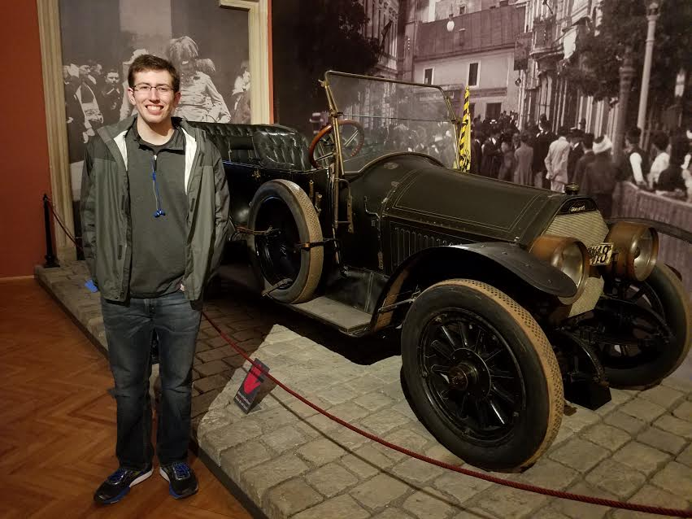
The car is in a museum in Vienna, Austria.

Slide 15
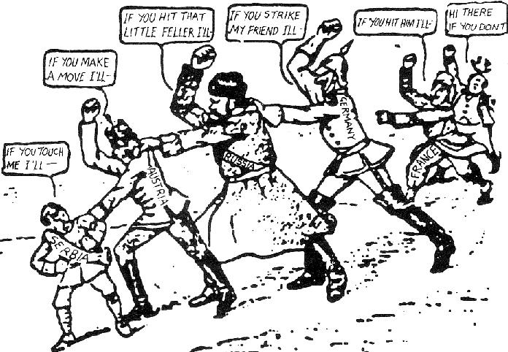
Who’s To Blame?
Is it fair to blame anyone?

Slide 16
Collapse to War
Austria issues ultimatum to SERBIA
Serbia rejects it counting on Russian support.
July 28 1914 Austria declares war.
Serbia turns to Russia who mobilizes troops along German border
August 1st Germany declares war on Russia and next day on France (implement Schlieffen Plan)
To invade France, Germany goes thru Belgium (violates neutrality).
August 4th Britain declares war on Germany

Slide 17
IF WW I WAS A BAR FIGHT…
Germany, Austria and Italy are standing together in the middle of a pub when Serbia bumps into Austria and spills Austria’s pint.
Austria demands Serbia buy it a whole new suit because of the new beer stains on its trouser leg.
Germany expresses its support for Austria’s point of view.
Britain recommends that everyone calm down a bit.
Serbia points out that it can’t afford a whole suit, but offers to pay for the cleaning of Austria’s trousers.
Russia and Serbia look at Austria.
Austria asks Serbia who it’s looking at.
Russia suggests that Austria should leave its little brother alone.
Austria inquires as to whose army will assist Russia in doing so.

Slide 18
Germany appeals to Britain that France has been looking at it, and that its sufficiently out of order that Britain not intervene.
Britain replies that France can look at who it wants to, that Britain is looking at Germany too, and what is Germany going to do about it?
Germany tells Russia to stop looking at Austria, or Germany will render Russia incapable of such action anymore.
Britain and France ask Germany whether it’s looking at Belgium.
Germany rolls up its sleeves, looks at France, and punches Belgium.
France and Britain punch Germany. Austria punches Russia. Germany punches Britain and France with one hand and Russia with the other.
To be continued…

Slide 19
Country | Allied with | Reason for entering War
Germany
Serbia
Russia
France
Britain
Austria / Hungary
Germany
Punish Serbia and assert control of region
Austria / Hungary
Support alliance with A/H
Self defense against A/H
Russia
Britain, France, Serbia
Help Slavic freedom
Chance to use allies to defeat Germany
Russia, Britain
Stop German aggression and limit rivalry
France, Russia

Slide 20
Allied Powers:
Central Powers:

Slide 21
The Schlieffen Plan

Slide 22
Everyone was keen to show “their stuff”
Wars were quick and decisive
No major war had been fought in Europe since Crimea 1850s and that was relatively small. Really since Napoleon! (1815)
No one remembered how awful war could be!
Everyone thought they would be home by Christmas…

Slide 23
A German Boy Pretends to Be a Soldier

Slide 24
“I think I have seen today one of the most extraordinary sights that anyone has ever seen,” he wrote.
“About 10 o'clock this morning I was peeping over the parapet when I saw a German, waving his arms, and presently two of them got out of their trench and came towards ours.
“We were just going to fire on them when we saw they had no rifles, so one of our men went to meet them and in about two minutes the ground between the two lines of trenches was swarming with men and officers of both sides, shaking hands and wishing each other a happy Christmas.“

Slide 25
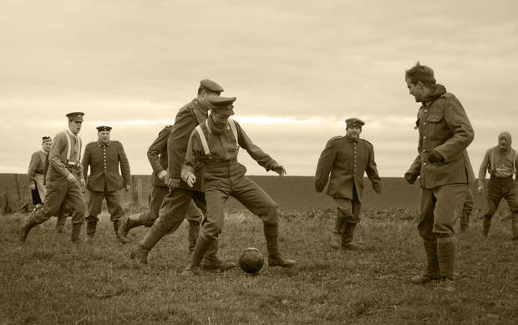
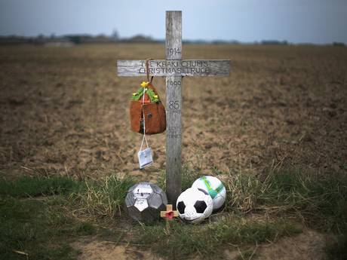

Slide 27
Women and the War Effort

Slide 28
German Women Factory Workers

Slide 29
Russian Women Soldiers

Slide 30
The Western Front: A “War of Attrition”

Slide 31
A Multi-Front War

Slide 32
The Western Front

Slide 33
The War of the Industrial Revolution: New Technology

Slide 34
Trench Warfare

Slide 35
Trench Warfare
“No Man’s Land”

Slide 36
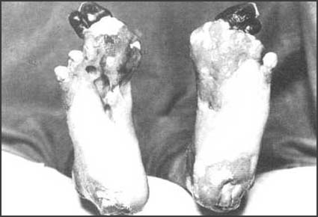
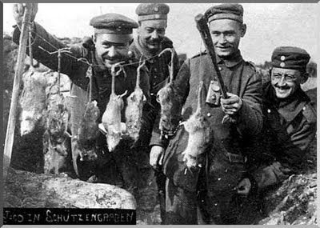
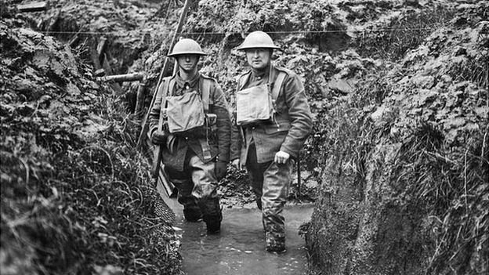
Life in the Trenches

Slide 37
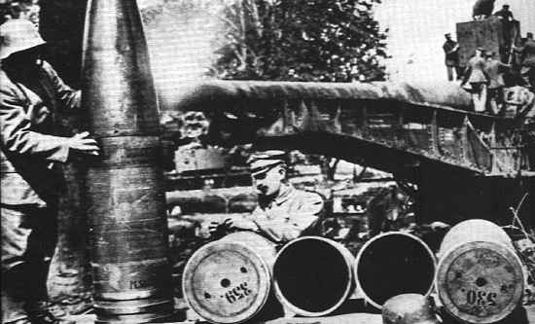
Krupp’s “Big Bertha” Gun

Slide 38
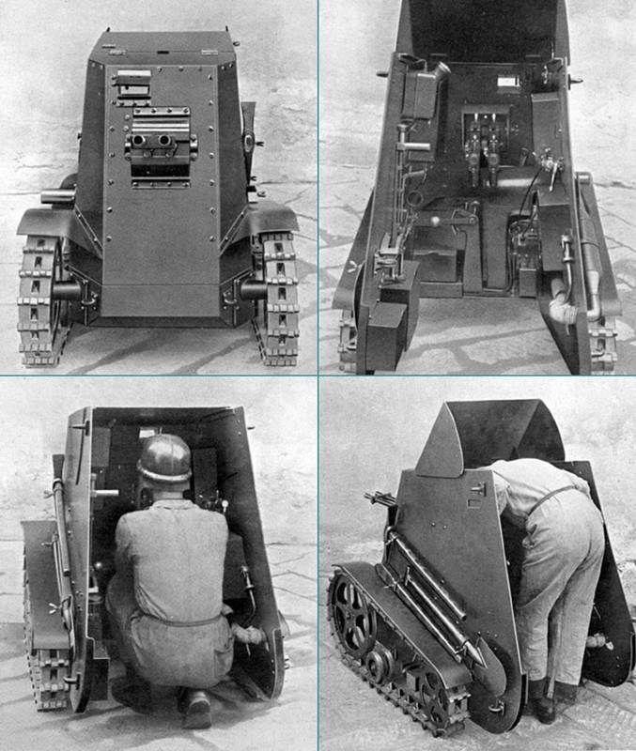
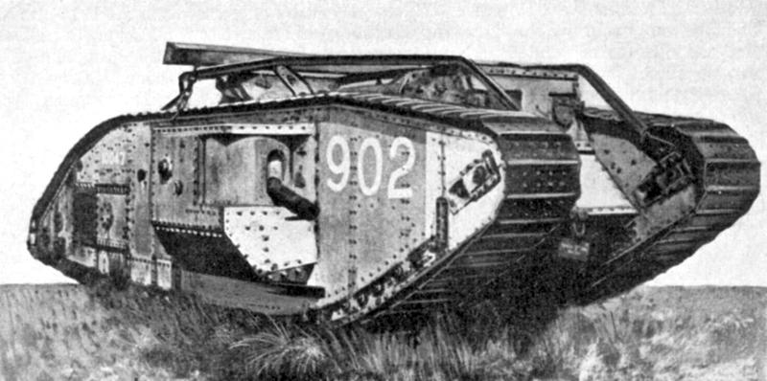
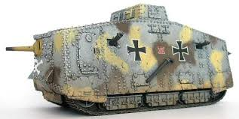
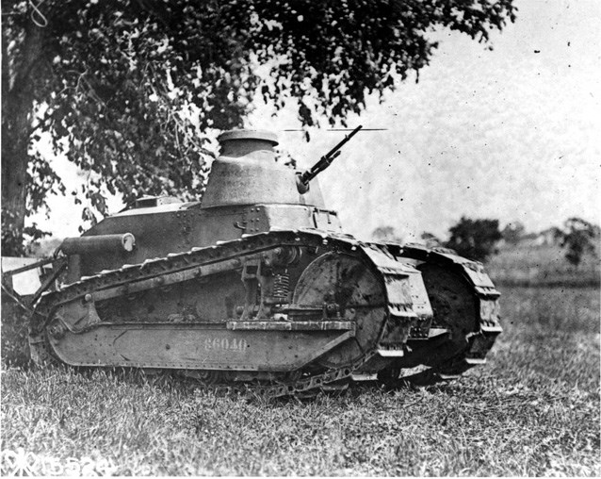
Tanks
Italy Britain Germany
America

Slide 39
French Renault Tank

Slide 40
U-Boats

Slide 41
Allied Ships Sunk by U-Boats

Slide 42
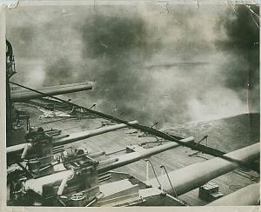
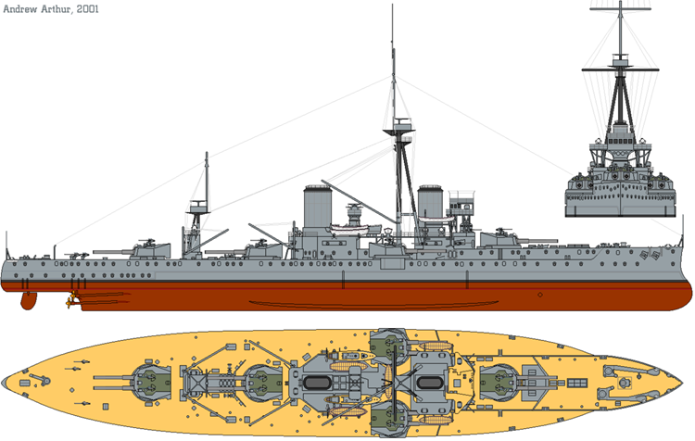
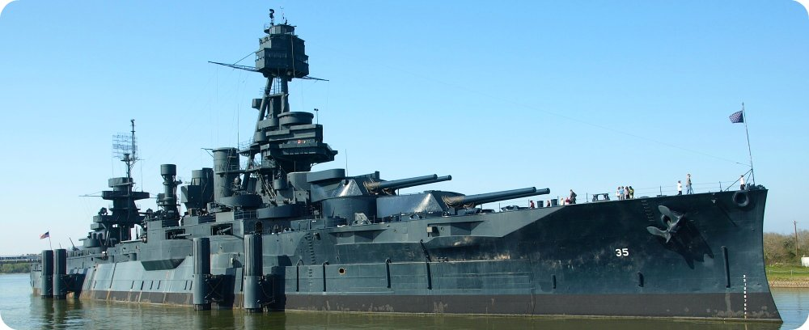
Dreadnought

Slide 43
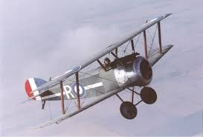
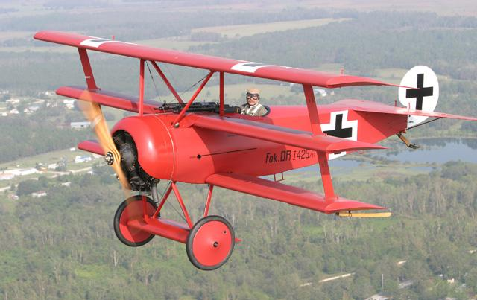
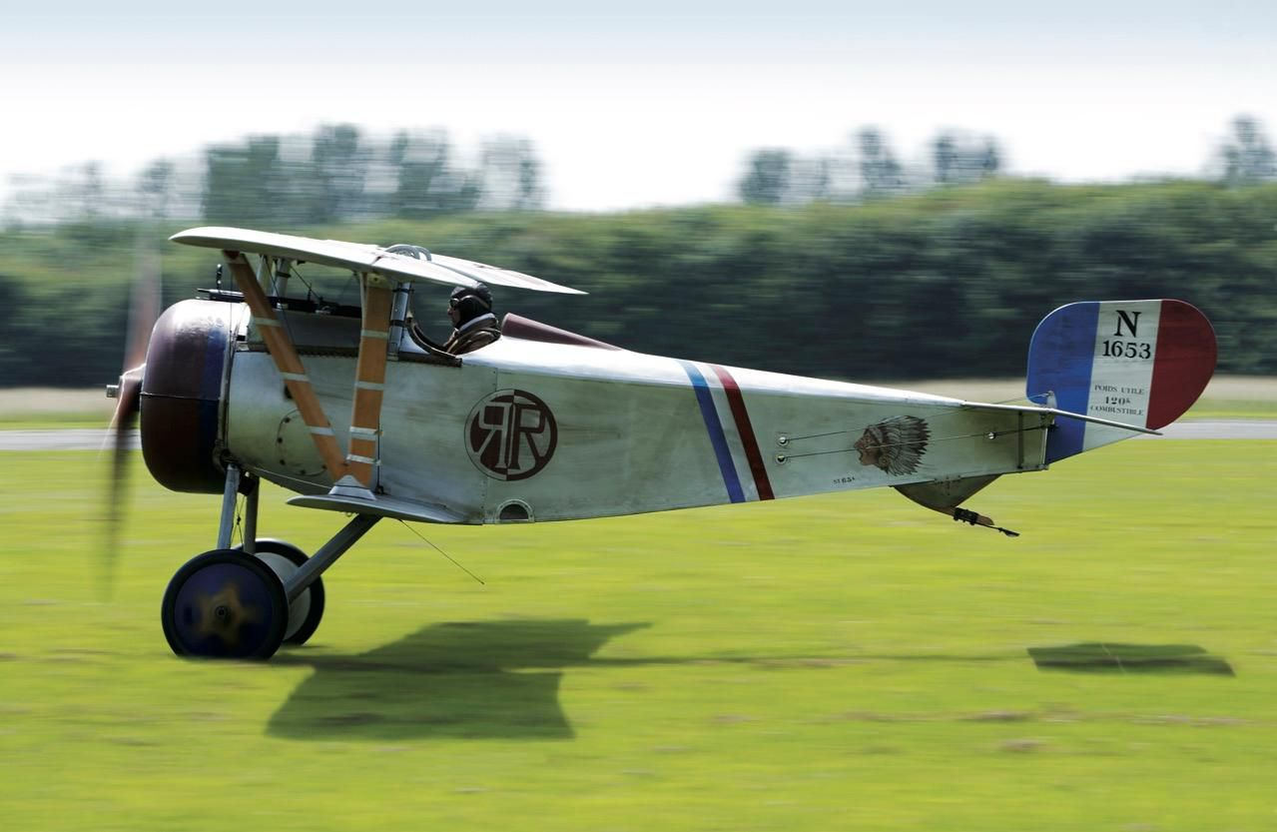
The Airplane
“Squadron Over the Brenta” Max Edler von Poosch, 1917

Slide 44
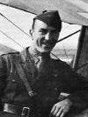
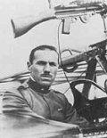
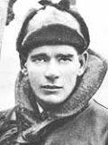
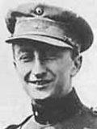
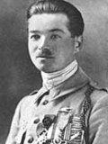
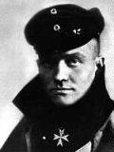
The Flying Aces of World War I
Eddie Rickenbacher, US
Francesco Barraco, It.
Eddie “Mick” Mannoch, Br.
Rene Pauk Fonck, Fr. (75)
Manfred von Richtoffen, Ger. [The “Red Baron”]
(80)
Willy Coppens de Holthust, Belg.

Slide 45
The Zeppelin

Slide 46
Flame Throwers
Grenade Launchers

Slide 47
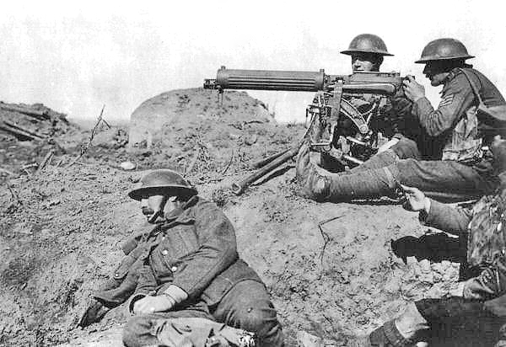
Machine Gun

Slide 48
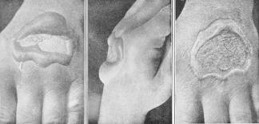
Poison Gas

Slide 49
Verdun – February, 1916
German offensive.
Each side had 500,000 casualties.

Slide 50
The Somme – July, 1916
60,000 British soldiers killed in one day.
Over 1,000,000 killed in 5 months.

Slide 51
War Is HELL!!

Slide 52
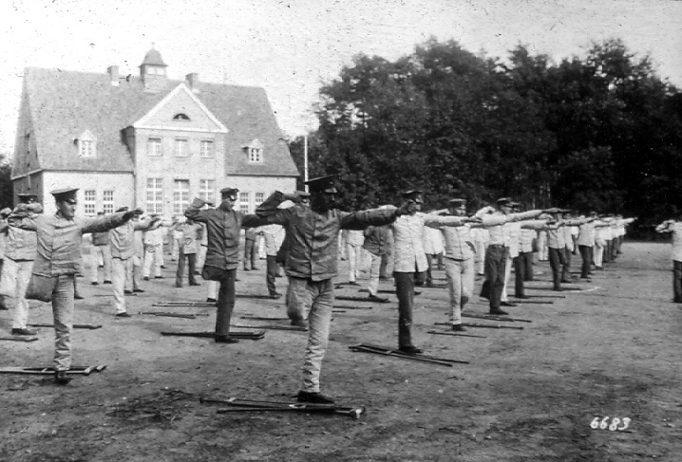
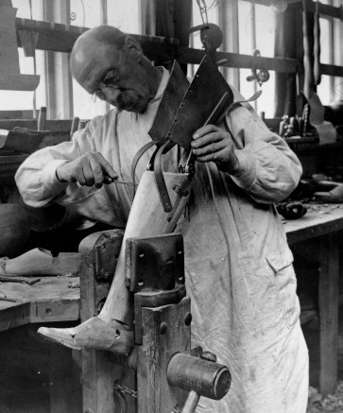
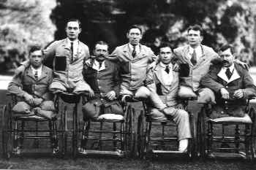
Sacrifices in War meant that there were positives…

Slide 53
The Gallipoli Disaster, 1915

Slide 54
And The Band Played Waltzing Matilda
When I was a young man I carried my pack, And I lived the free life of a rover From the Murray’s green basin to the dusty outback I waltzed my Matilda all over Then in nineteen fifteen my country said ‘Son It's time you stop rambling , there's work to be done.’ So they gave me a tin hat and they gave me a gun And they marched me away to the war. And the band played Waltzing Matilda As we pulled from the quay, And amidst all the cheers the flag waving and tears, We sailed off to Gallipoli

Slide 55
How well I remember that terrible day How our blood stained the sand and the water. And how in that hell that they called Suvla Bay, We were butchered like lambs at the slaughter. Johnny Turk he was ready, he primed himself well. He showered us with bullets, and he rained us with shells, And in five minutes flat he'd blown us all to hell. Nearly blew us right back to Australia! But the band played Waltzing Matilda As we stopped to bury our slain. We buried ours and the Turks buried theirs, Then we started all over again.

Slide 56
Now those that were left, well we tried to survive In a mad world of blood, death and fire. And for ten weary weeks I kept myself alive, But around me the corpses piled higher. Then a big Turkish shell knocked me arse over head, And when I woke up in my hospital bed And saw what it had done, I wished I was dead; Never knew there were worse things than dying! For no more I'll go waltzing Matilda All around the green bush far and near, For to hump tent and pegs, a man needs two legs No more waltzing Matilda for me

Slide 57
So they gathered the crippled, the wounded, the maimed, And they shipped us back home to Australia; The armless, the legless, the blind, the insane Those proud wounded heroes of Suvla. And as our ship pulled into Circular Quay, I looked at the place where my legs used to be And thanked Christ there was nobody waiting for me To grieve and to mourn and to pity! And the band played Waltzing Matilda As they carried us down the gangway, But nobody cheered, they just stood and stared Then turned all their faces away

Slide 58
And now every April I sit on my porch And I watch the parade pass before me. And I watch my old comrades, how proudly they march, Reviving old dreams of past glory. And the old men march slowly, their bones stiff and sore They’re forgotten heroes of a forgotten war. And the young people ask, "What are they marching for?" And I ask myself the same question. And the band plays Waltzing Matilda, And the old men answer t the call, But year after year more old men disappear, Some day no one will march there at all

Slide 59
Waltzing Matilda, Waltzing Matilda Who'll come a waltzing Matilda with me? And their ghosts may be heard as you pass the Billabong Who'll come-a-waltzing Matilda with me?

Slide 60
The last living veteran of WWI was Florence Green, a British citizen who served in the Allied armed forces, and who died 4 February 2012, aged 110.
The last combat veteran was Claude Choules who served in the British Royal Navy and died 5 May 2011, aged 110.
The last veteran who served in the trenches was Harry Patch who died on 25 July 2009, aged 111.
The last Central Powers veteran, Franz Kunzler of Austria Hungary, died on 27 May 2008 at the age of 107.
The last US veteran was Frank Buckles died 28 February 2011 age 110
There are no veterans of WWI left.

Slide 61
EASTERN FRONT
In Russia things were falling apart.
Russians struggling with:
Shortages of everything
Failures in the war
Tsar was absolutist so he was blamed.
Germany desperate to end war.
Transports a revolutionary into Russia to overthrow Tsar and make peace…LENIN!
It works – Treaty of Brest Litovsk

Slide 62
America Joins the Allies

Slide 63
The Sinking of the Lusitania

Slide 64
The Zimmerman Telegram

Slide 66
The Yanks Are Coming!

Slide 67
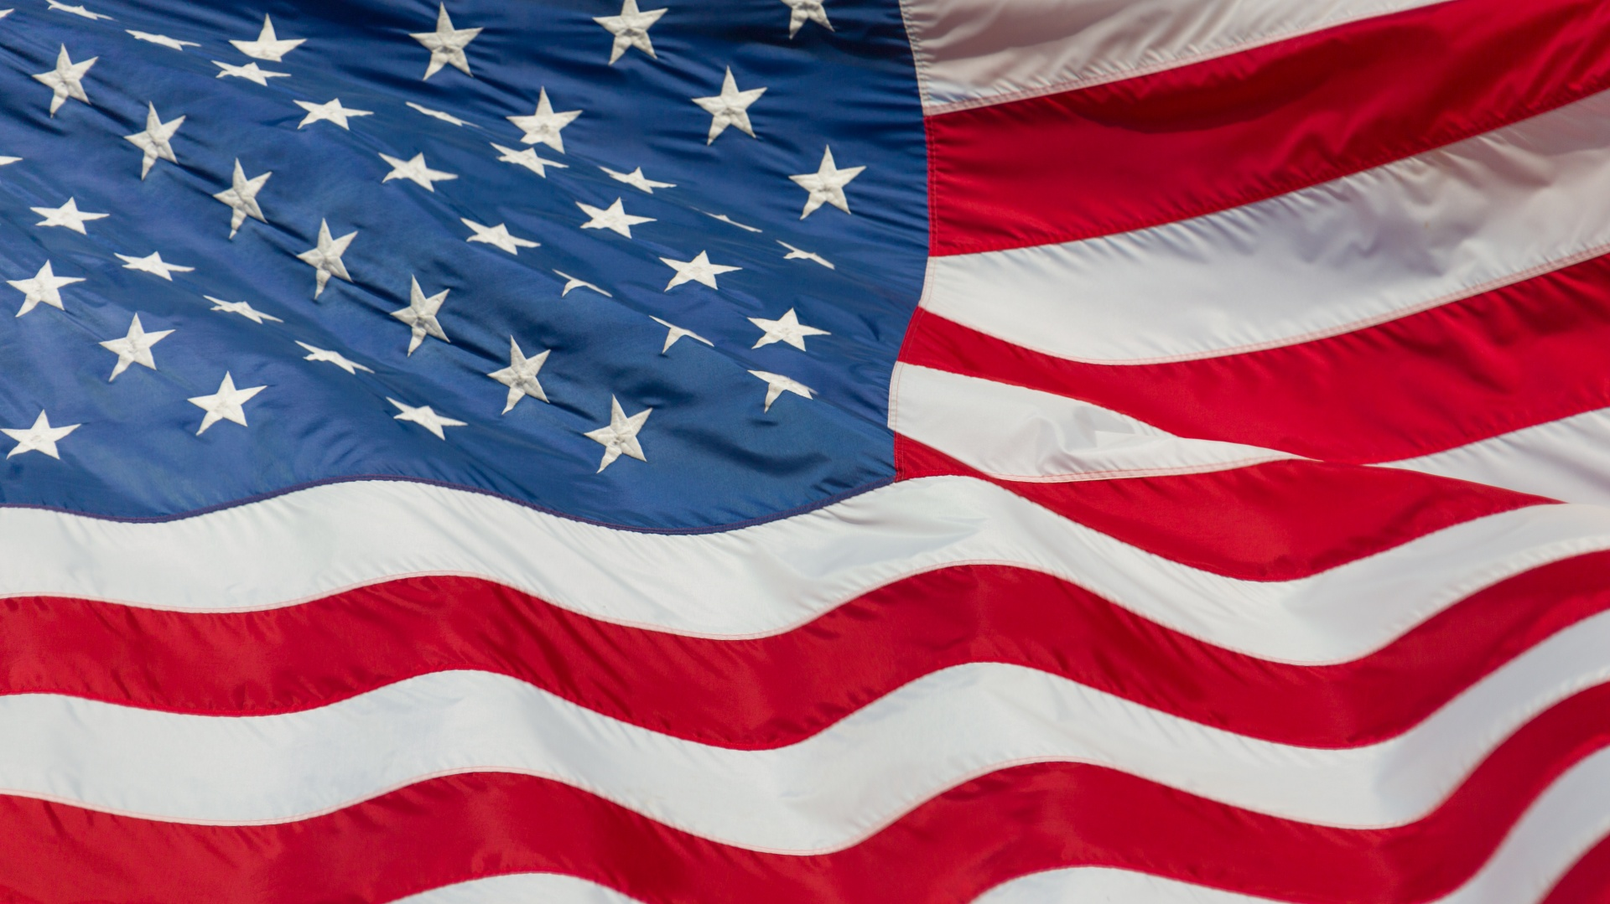
America in World War 1

Slide 68
Why didn’t America join the fight?
America was in a period of isolationism
10 percent of all Americans were of German descent
President Wilson did not want any entanglements with foreign nations
$$$$$$$

Slide 69
The First Americans To Go To War
The first Americans volunteered to fight in the French Foreign Legion. They joined in late 1915.
The first American pilots became the Lafayette Escadrille. It was formed in March of 1916. 38 pilots in total and they were a mixed race unit. Eugene Bullard was the first African American fighter pilot, but was not recognized by the U.S. military until 1994, when he was posthumously awarded a commission as an officer in the Air Force. Another pilot was James Dolittle. He became famous in WWII and later became the head of the Air Force.

Slide 70
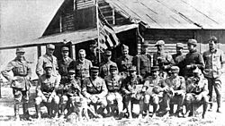
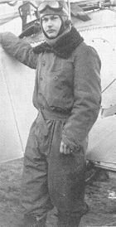
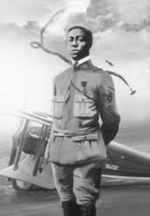
Lafayette Escadrille

Slide 71
Troop Numbers at the beginning of 1917
Russian Army 12,000,000 men
German Army 11,000,000 men
British Army 8,905,000 men
French Army 8,410,000 men
U.S. Army 90,000 men with state militias of 143,000

Slide 72
The Selective Service Act of 1917
All men between the ages of 21 and 30 were required to register with the government.
The goal was to raise an Army of 10,000,000 men as soon as possible.
15 Army bases were created for training purposes.
An Army of 4,700,000 men was raised by the time the war ended. 2,800,000 men went to Europe to fight.

Slide 73
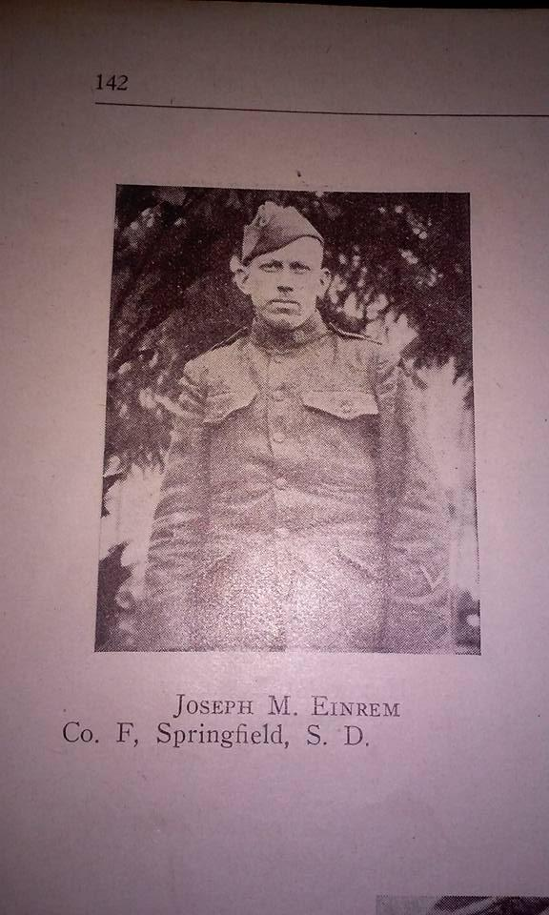
Joseph Einrem
Joined the 88th Division in June, 1917.
88th Division was a Division from North Dakota, South Dakota, Nebraska, Kansas, and Minnesota.
They were called the cloverleaf division.

Slide 74
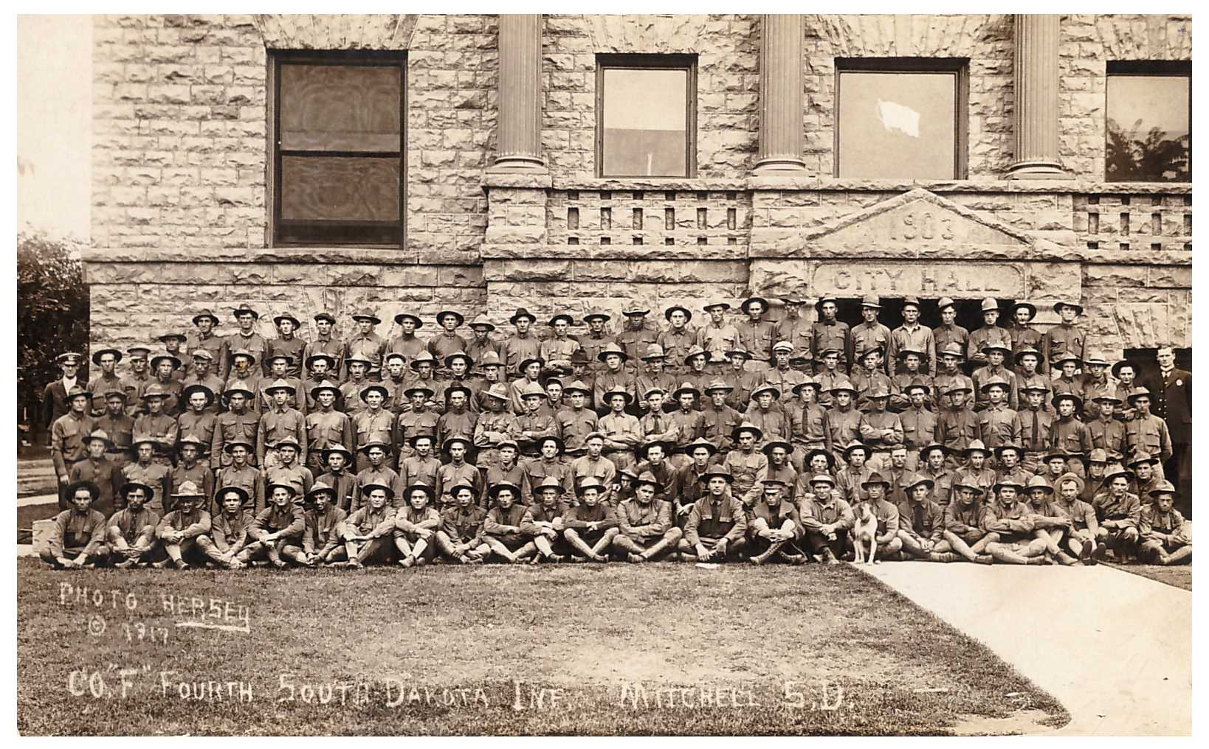
Ft. Dodge
Training took place at Ft. Dodge, Iowa for four weeks and the men were shipped off to France.

Slide 75
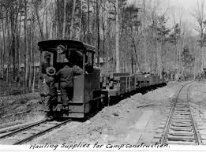
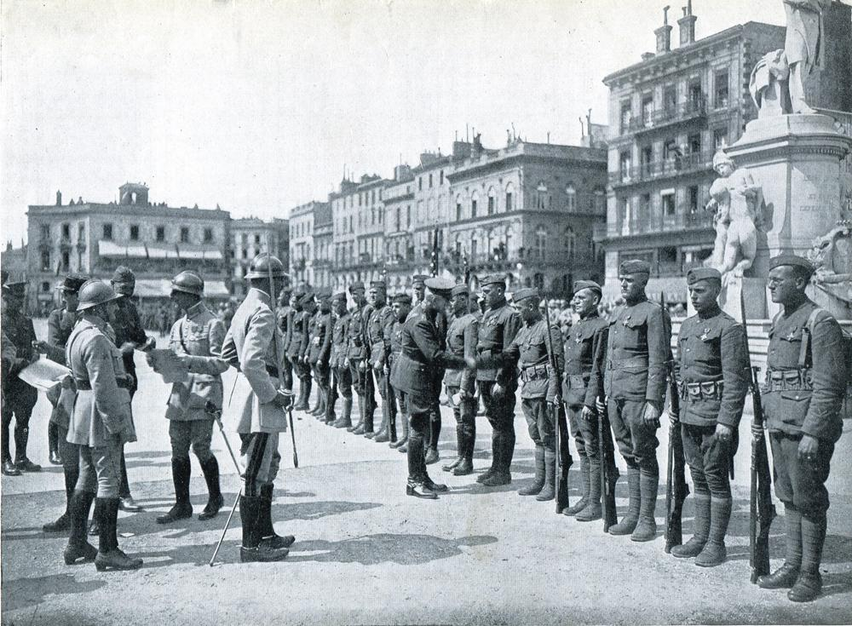
Semur, France
Arrived in France at the end of July, 1917. Commanded by Major Teddy Roosevelt jr. Worked as an engineer building rail lines for supply until Sept., 1919

Slide 76
Trenches from the air
https://www.youtube.com/watch?v=SdFwEfoIM3E
https://www.youtube.com/watch?v=zpRMJxiOyk0

Slide 77
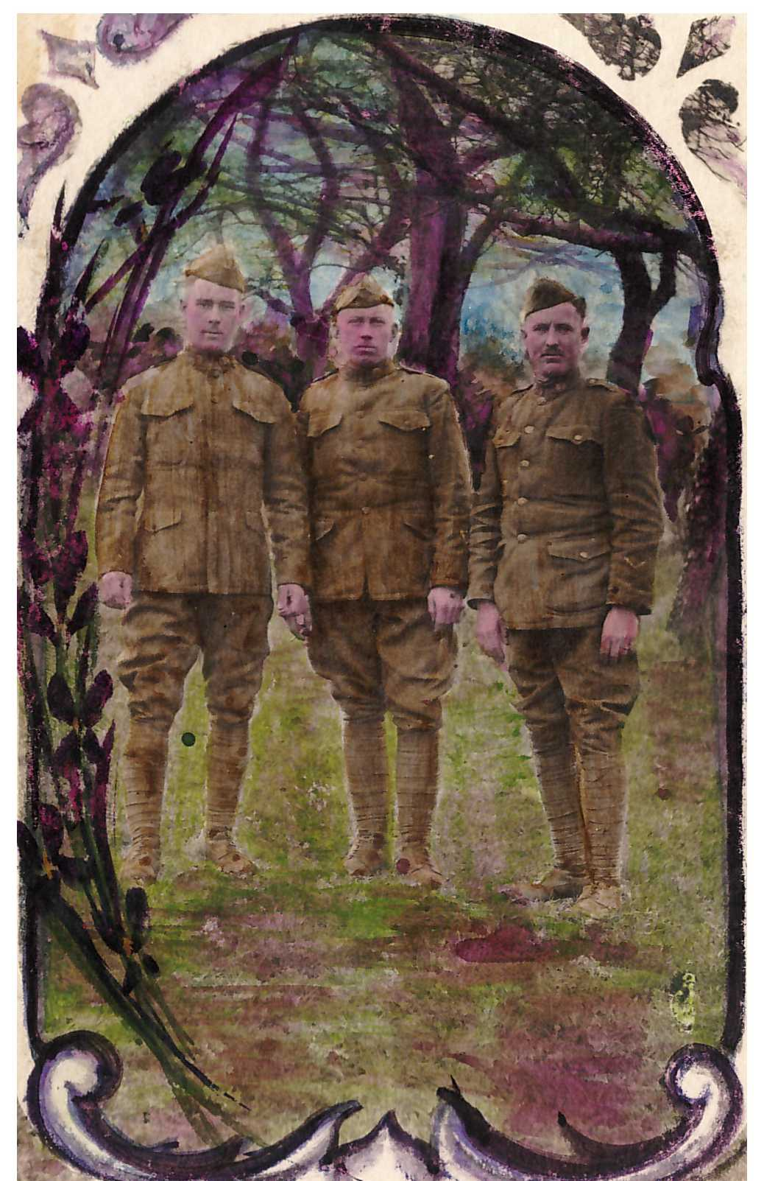
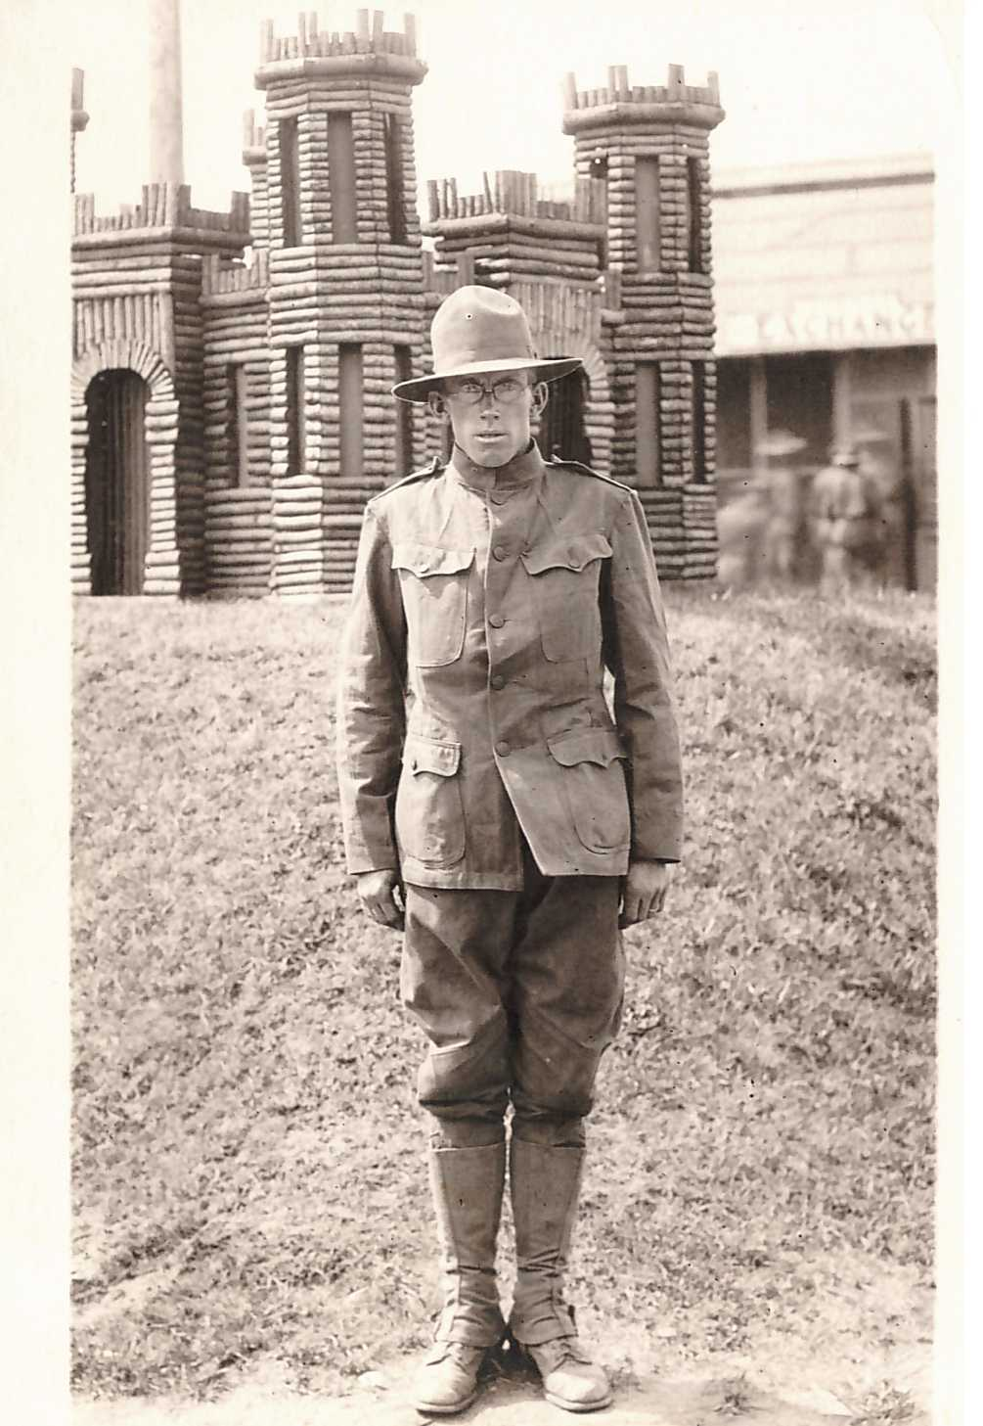
Artifacts

Slide 78
Americans in the Trenches

Slide 79
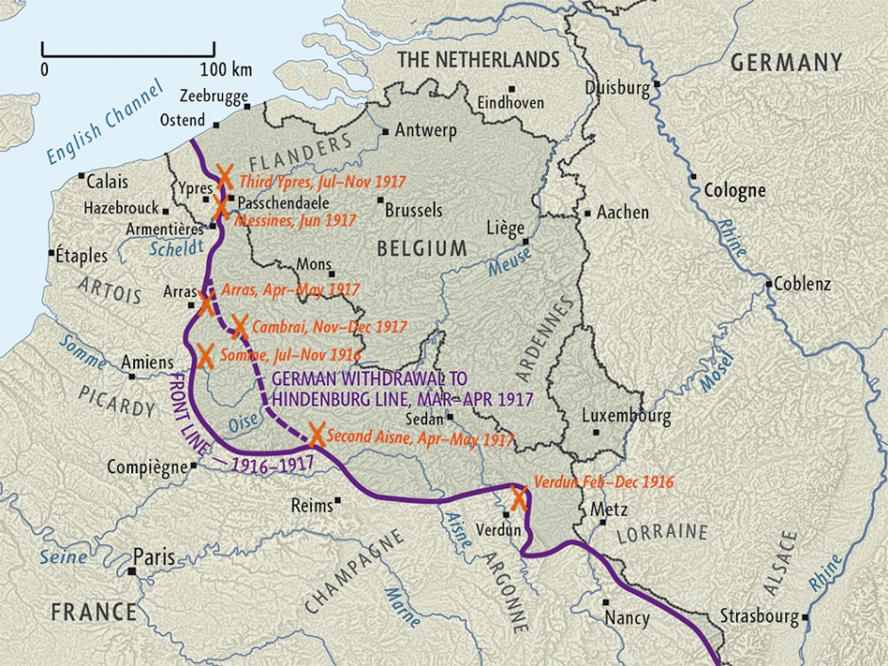
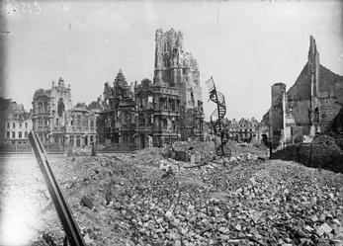
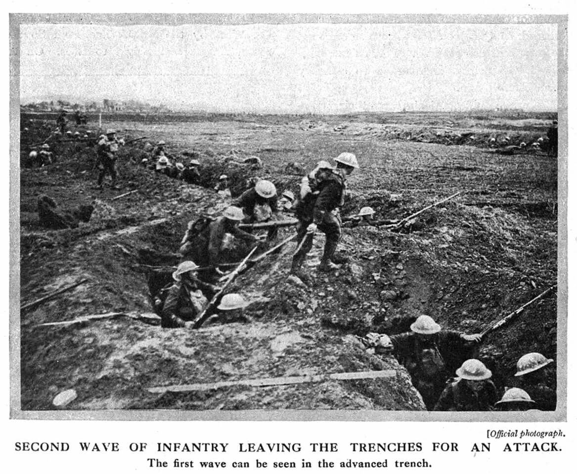
My grandfather fought here in April 1917. The letter mentions a bombed out town that they passed through…

Slide 80
War Ends?

Slide 81
11 a.m., November 11, 1918
The Armistice is Signed!

Slide 82
13,000,000 Dead

Slide 83
The Somme American Cemetery, France
116,516 Americans Died

Slide 84
World War I Casualties

Slide 85
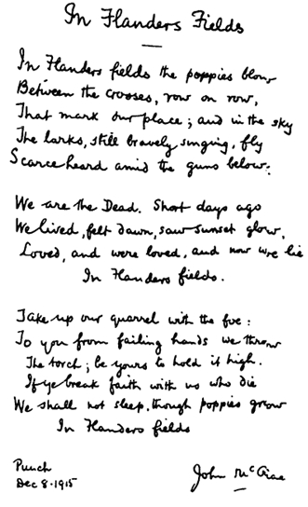
In Flanders Fields By: Lieutenant Colonel John McCrae, MD (1872-1918) Canadian Army
In Flanders Fields the poppies blow Between the crosses row on row, That mark our place; and in the sky The larks, still bravely singing, fly Scarce heard amid the guns below.
We are the Dead. Short days ago We lived, felt dawn, saw sunset glow, Loved and were loved, and now we lie In Flanders fields.
Take up our quarrel with the foe: To you from failing hands we throw The torch; be yours to hold it high. If ye break faith with us who die We shall not sleep, though poppies grow In Flanders fields.

Slide 86
Turkish Genocide Against Armenians
A Prediction of Future Horrors to Come!
Used as a blueprint…

Slide 87
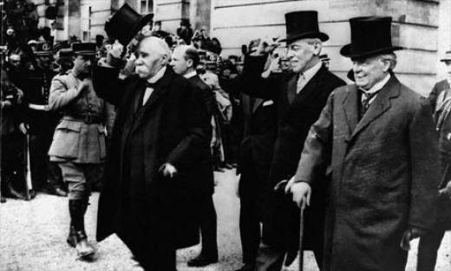
Peace?
Major countries met to figure out a peace agreement
USA – Wilson
14 points
New world leader
France – Clemenceau
Neuter Germany!
Revenge!
GB - Lloyd George
Hurt Germany
Get things back to the way they were
14 Points how to solve Europe’s problems.
Rearrange borders based on
self determination
The right of people to decide who should rule them. (Except the losers!!)

Slide 88
Results of WW I
Entire continent crippled
fiscally (there was no money!)
socially (huge numbers of dead and maimed)
productively (economies had been dedicated to war (TOTAL WAR), land and infrastructure destroyed or drastically altered)
Who was to pay for all this?
THE LOSERS!!!

Slide 89
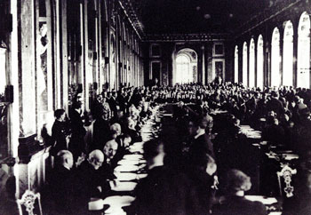
Treaty of Versailles
Italy wanted land but got none and left in a huff…FASCISM!
Brutal terms for Germans
Article 231 (“war guilt” clause)
$33 billion in reparations over 30 years
Germany loses land to France, Poland, Czechoslovakia and all its colonies.
Prohibited to have offensive military (worked for a short while, then they started making weapons 1930s)
“Stab in the Back Theory” – Military
Left Germany really angry!!!

Slide 90
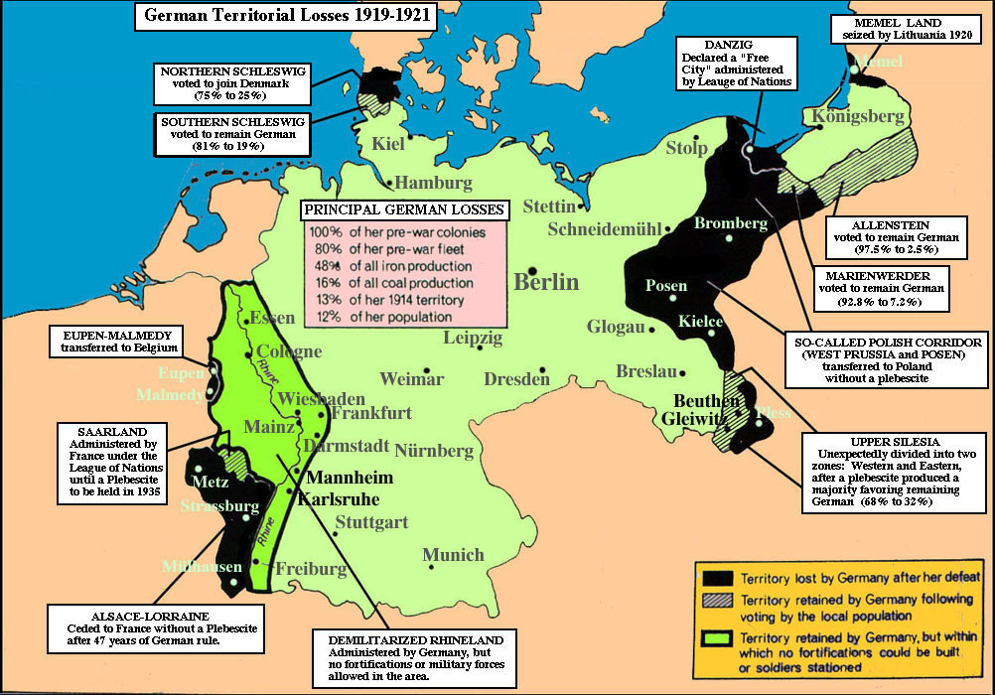
Self Determination was not applied in the areas in black! WHY?
Why is this important…

Slide 91
League Of Nations
It wasn’t! Several countries left out or opt out
US, USSR, Germany, Austria, Italy
(some are admitted in 1920s, others leave in 20s and 30s)
(it was the League of Some Nations)
There were other issues too
No way to enforce decisions. What could they do?
Sanctions were weak
No unity of purpose

Slide 92
Mandate system
Colonies had fought and hoped this would give them respect of colonial rulers and their independence
Instead Mandate System created territories to be administered by the Western powers until they were ready for independence
Middle East and North Africa
Asia
Sub Saharan Africa and Island nations
The number represented how close to independence they were!

Slide 93
USA
US one of two countries better off after WW I (Japan). It was #1
(that hurt to put in the slide!)
American people object to treaty as does Congress. (Wilson out of office)
US isolationist – stay out of world affairs
US focuses on itself (roaring 20s)
(more later)
How does this affect Versailles?

Slide 94
IF WW I WAS A BAR FIGHT…
Germany, Austria and Italy are standing together in the middle of a pub when Serbia bumps into Austria and spills Austria’s pint.
Austria demands Serbia buy it a whole new suit because of the new beer stains on its trouser leg.
Germany expresses its support for Austria’s point of view.
Britain recommends that everyone calm down a bit.
Serbia points out that it can’t afford a whole suit, but offers to pay for the cleaning of Austria’s trousers.
Russia and Serbia look at Austria.
Austria asks Serbia who it’s looking at.
Russia suggests that Austria should leave its little brother alone.

Slide 95
Austria inquires as to whose army will assist Russia in doing so.
Germany appeals to Britain that France has been looking at it, and that its sufficiently out of order that Britain not intervene.
Britain replies that France can look at who it wants to, that Britain is looking at Germany too, and what is Germany going to do about it?
Germany tells Russia to stop looking at Austria, or Germany will render Russia incapable of such action anymore.
Britain and France ask Germany whether it’s looking at Belgium.
Turkey and Germany go off into a corner and whisper. When they come back, Turkey makes a show of not looking at anyone.

Slide 96
Germany rolls up its sleeves, looks at France, and punches Belgium.
France and Britain punch Germany. Austria punches Russia. Germany punches Britain and France with one hand and Russia with the other.
Russia throws a punch at Germany, but misses and nearly falls over. Japan calls over from the other side of the room that it’s on Britain’s side, but stays there. Italy surprises everyone by punching Austria.
Australia punches Turkey, and gets punched back. There are no hard feelings because Britain made Australia do it.
France gets thrown through a plate glass window, but gets back up and carries on fighting. Russia gets thrown through another one, gets knocked out, suffers brain damage, and wakes up with a complete personality change.

Slide 97
Italy throws a punch at Austria and misses, but Austria falls over anyway. Italy raises both fists in the air and runs round the room chanting.
America waits till Germany is about to fall over from sustained punching from Britain and France, then walks over and smashes it with a barstool, then pretends it won the fight all by itself.
By now all the chairs are broken and the big mirror over the bar is shattered. Britain, France and America agree that Germany threw the first punch, so the whole thing is Germany’s fault . While Germany is still unconscious, they go through its pockets, steal its wallet, and buy drinks for all their friends.
Be sure you understand the analogy!

