Slide 1
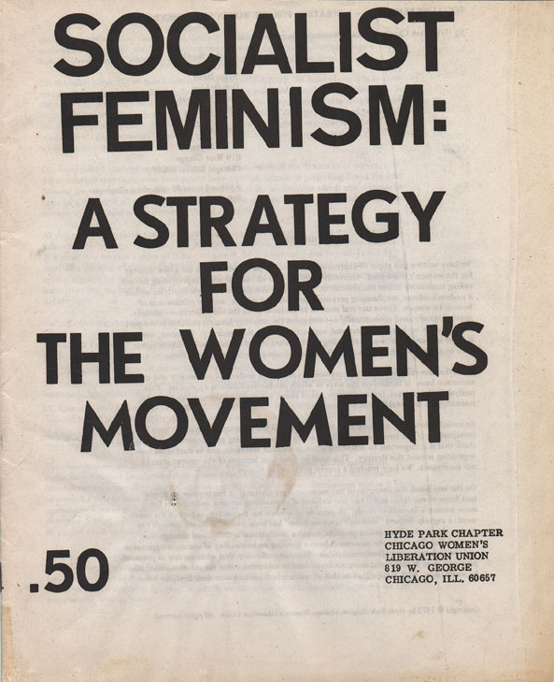

Slide 2
Women’s Movement
New Liberalism meant changes in thought about people
1800s saw the beginning of the “rights” movements:
Anti slavery – in Britain and colonies, later around the globe
Children – factory and mines acts
Labour – limited hours, increased pay, better conditions

Slide 3
Women’s Status
They had none!
No legal rights
No vote
(Had to obey laws that they had no say in)
Hypocritical - that was the basis for the Revolution 1776
Few occupational choices and earned fraction of man’s wage for the same job
Pay belonged to the husband / father.
Few educational opportunities. Could not go to University.
What did this mean for women?

Slide 4
Women’s place was in the home!
Known as the Cult of Domesticity
: True women were expected to possess the virtues of piety, purity, submissiveness, and domesticity was associated with the idea that women have the moral and temperament that are best expressed in the home – caring for and looking after the house and children
Identified the home as the "separate and proper sphere" for women, who were seen as better suited to parenting.
Although Biblical origin, became part of culture - in women's magazines, religious journals, newspapers, fiction and everywhere in popular culture. Concept of “Women’s work”

Slide 5
Employers paid women less! Why?
Were not wage earners
Unions did not allow women
Could not work as long or as hard as men
Did not account for
women as wage earners (Widows, sick/disabled husbands)
Laws to protect women made them less available/desirable to hire
Today, women still earn less than men for similar work. Although discrimination is illegal, companies often do not promote women to executive positions. This is known as the Glass Ceiling (you can see the stuff above you but cannot get there!)

Slide 6
Where Did Women Work? 4 main fields
Depended on class
Teaching – limited work for children meant they needed looking after.
Nursing – Florence Nightingale Crimean War 1850s
Poorer/Lower classes..
Domestic servant – cook, maid
Industry – mine, factory (textile, matches), laundry
Most powerful person on Earth?
Queen Victoria (could not vote!)

Slide 7
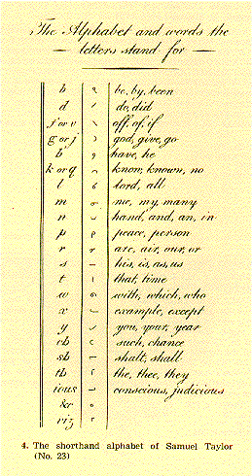
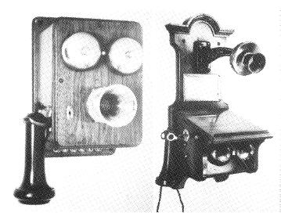
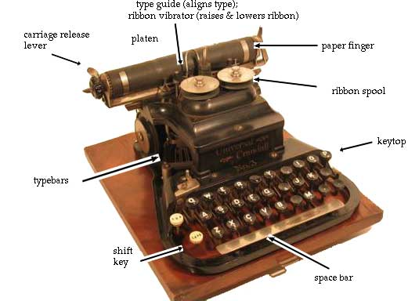
Things Begin to Change
Entrance to Universities – Zurich and London
New jobs created by change in business model. Aided by new inventions such as…

Slide 8
Some Things Did Not Change
Societal expectations helped control women.
Once married stop working
If pregnant stop working (Teachers)
Cult of Domesticity (Biblical role)
Concept of “women’s work”. Middle classes wanted women at home. WHY?
Women had power of the purse at home!
Target for the new advertizing industry.
To be replayed in the 50s

Slide 9
Temperance Movement
Again women piggy back. This time on Temperance (alcohol is bad and should be removed from society.)
This was an American idea!
Carrie Nation - saloon breaker
Lucretia Mott – abolitionist and women’s rights advocate
Cady Stanton – women’s rights for property
Susan B Anthony – abolitionist and women’s suffrage
Women all over the world began to push for suffrage. They were trapped and voting on issues meant their causes could be heard.

Slide 10
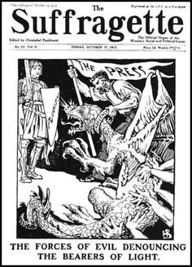
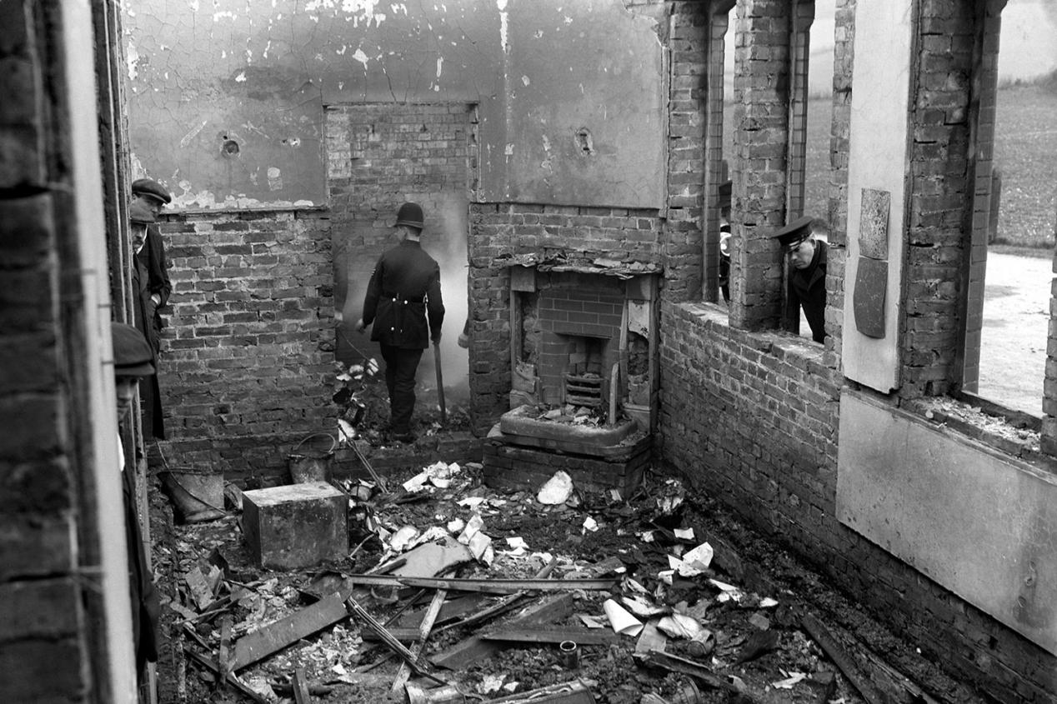
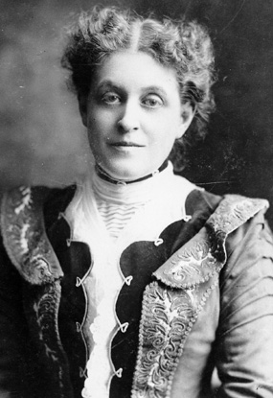
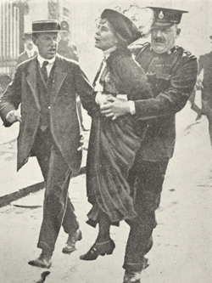
Suffrage Movement
Early 1900s saw a new more militant (achieve at all costs) version of the right to vote movement.
Women’s Social & Political Union. New tactics
Chaining themselves to “stuff”
Clothing
Hunger strikes
Destruction of government property
Disruption of daily life
Bombing
Martyrdom

Slide 11
Right to Vote
First countries to give the right to vote were New Zealand and Australia.
Why?
Wyoming did the same thing!
British MP - "This is a commercial and industrial country. But it could hardly be hoped that women could govern and manage our commerce and industry.
"If we were to have women in this House they would be legislating for these commercial industries of the management of which they know nothing."
WWI was vital in the suffragette movement…Why?
Women proved they could do the things men said they could not.
Most by 1920s…
France 1944
Switzerland 1973

Slide 12
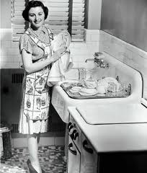
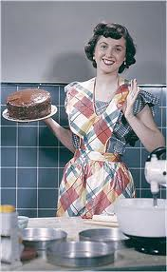
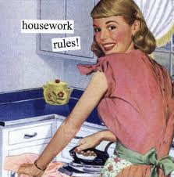
Modern Rights
Calm until 1960s (social change in US)
Betty Friedan – Feminine Mystique
Repression of women in working world
Why did women go to college?
To get an MRS.
Even those who graduated had limited opportunity!
N.O.W. created to get Equal Rights Amendment passed 1972. States failed to ratify it!
Find a husband

Slide 13
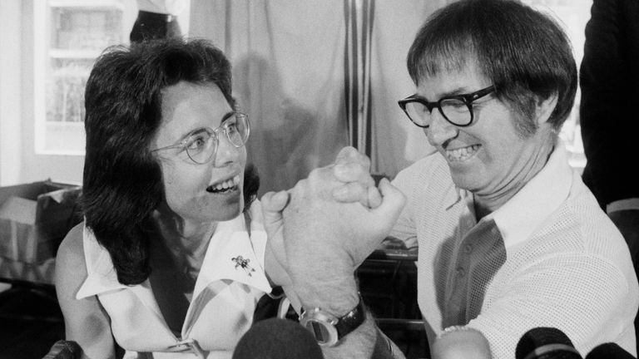
Modern Rights
1972 passage of Title IX
Equality in educational opportunity at State funded institutions.
Meant scholarship opportunities had to be the same!
SPORTS!
Financial rights
Until 1970s women could not get a loan or a credit card in their own name. Based on husband’s credit!
Battle of the Sexes 1973
1974 congress passed law
making discrimination based
on gender illegal.

Slide 14
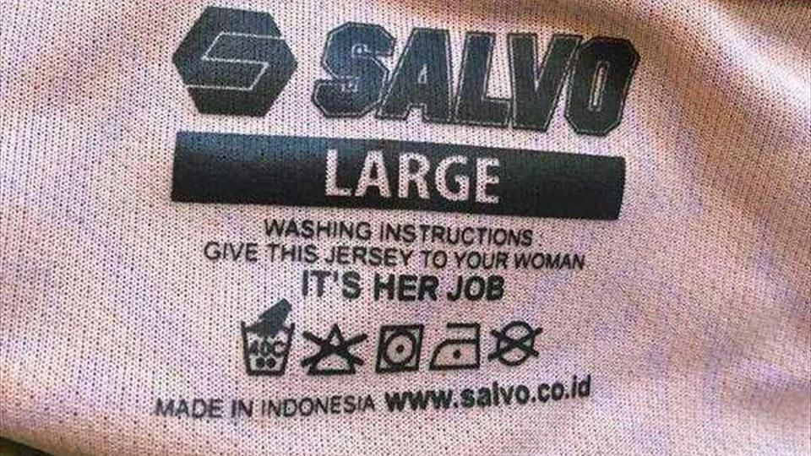
Present Day Issues
Is the world still too sexist? The US?
Is coverage of women’s sport a waste of time?
Sexist language – “Man up”, “Be a man” versus “don’t be a girl”, “cry like a little girl”.
Harassment
Why do women have to change their behavior when they are the victims? (nail polish, dress, drinking, going out alone)
Double Standards (sex, age)
2014 Stephen A Smith to Women: “Don’t do anything to ‘Provoke’ men into beating you!”
“It seems to be, first of all, from what I understand from doctors, it’s really rare. If it’s a legitimate rape, the female body has ways to try to shut the whole thing down.” Missouri Senate candidate Todd Akin, on abortion…claiming that women can shut down the reproductive process during rape to prevent pregnancy, 2012
“I’ve struggled with it myself for a long time, but I came to realize that life is that gift from God. And even when life begins in that horrible situation of rape, that it is something that God intended to happen.” Richard Mourdock on abortion 2012

