Slide 1
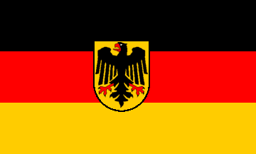
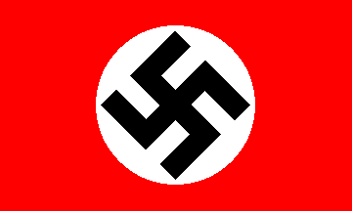
From Weimar to the Third Reich

Slide 2
New German Republic
First order of business: to sign peace treaty
Many Germans (including Hitler) saw this as an act of treason. (Stab in the Back theory)
Still, elections took place and the Reichstag (German parliament) was able to create a new constitution that was very democratic in nature

Slide 3
Weimar Constitution
Newest and best of democratic ideals:
President elected popularly
Chancellor appointed by President
Legislators elected through proportional representation to Reichstag
Article 48 - Temporary dictatorship to solve crises
Issues:
Dictatorship
Too many parties
A country that did not understand democracy

Slide 4
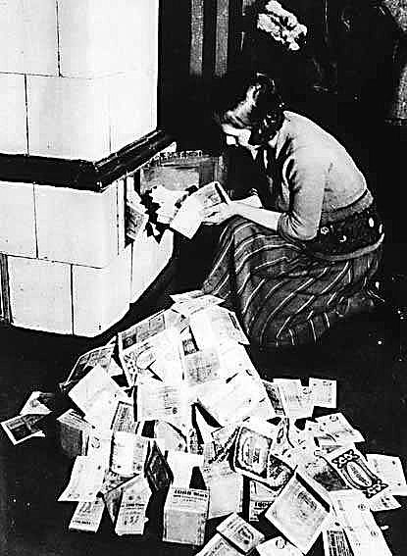
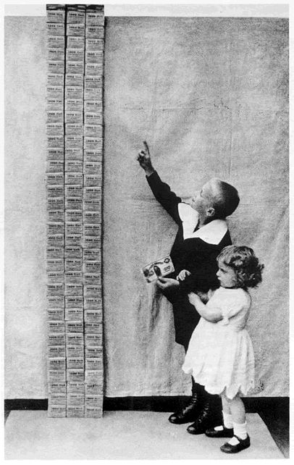
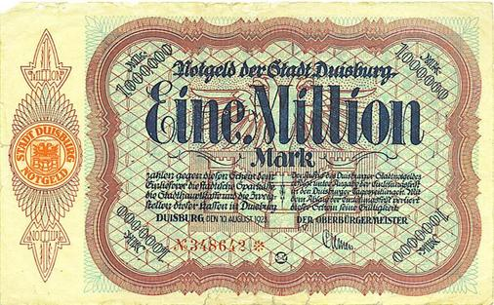
Early 1920’s
How to pay reparations?
Printed more money
Hyperinflation
Bad economic policies
Blamed allies, reparations,
and of course the Jews
Notes:
Print more money to support Ruhr
Hitler seized the first opportunity for action. On November 8 a rally was to be held in one of Munich's large beer cellars, the Buergerbraeukeller, to honor Kahr. Kahr was the featured speaker, along with General Lossow and Colonel Seisser, head of the police. Hitler surrounded the building with SA troops, broke in, took over the meeting, and melodramatically proclaimed: "The national revolution has broken out." Taking Kahr, Lossow, and Seisser into an adjoining room, Hitler pressured them to join him in overthrowing the national government. They refused until General Erich Ludendorff, who in Hitler's scheme for the new government was to be head of the army, came in to apply new pressure. Ultimately the three agreed and returned to the beer cellar with Hitler and Ludendorff to the acclaim of the audience. Hitler accepted their promises of support and allowed them to go free, much to his undoing. Circumstances changed dramatically for Hitler overnight. Although Ernst Roehm had seized the local army headquarters, the leadership of the army refused to support Hitler. Lossow, upon his release, telephoned Bavarian army headquarters for new troops to be sent to Munich to crush Hitler's revolt. Kahr also reneged on his promise. Hitler, faced with the complete collapse of his plans, tried a last desperate gamble by marching with Ludendorff and 2000 supporters through Munich to gain popular support for the coup.Their march was stopped by police barricades and after a brief gun battle the Hitler group, with the noticeable exception of General Ludendorff, ignominiously fled. The Beer Hall Putsch had collapsed. The leaders, including Hitler, were arrested. Some observers considered it the end of the upstart Austrian.The treason trial against Hitler, Ludendorff, and other leaders of the Kampfbund took place in February and March 1924. Considerable public attention became focused on the trial and gave Hitler the opportunity to establish his name outside of Bavaria. He used the publicity brilliantly to transform defeat into propaganda victory. At the trial, Hitler did not deny that he had planned to overthrow the national government. But he refused to admit that this had been an act of high treason. The real criminals, Hitler proclaimed, were the betrayers of Germany who had signed the Versailles treaty and perpetuated the Weimar Republic. Hitler also attacked the credibility of the state's chief witnesses, Kahr, Lossow, and Seisser, saying they all wanted the same thing he did. Hitler portrayed himself as the real patriot opposing the Weimar Republic, since he had had the courage to act: "I consider myself not a traitor but a German, who desired what was best for his people." But he was more than just a patriot, for he pictured himself as Germany's man of destiny:"I aimed from the beginning at something more than being a Minister. I wanted to become the destroyer of Marxism. I am going to achieve this task, and if I do, the title of Minister will be an absurdity for me."The right-wing judges were sympathetic to Hitler's words. Ludendorff was acquitted and Hitler was given the most lenient sentence possible for treason - five years in prison with an understanding of early probation.The putsch had failed, but Hitler had not. He would have time in prison to mull over the lessons of the past months and would emerge convinced that the real struggle for the soul of Germany was just beginning.

Slide 5
How bad was it?
Cost of a loaf of bread
1919 = 2 marks
1921 = 40 marks
1922 = 1500 marks
1923 = 4 million marks
Who was hurt the most?
Upper classes owned things (inflation proof)
Poor lived day to day
Middle classes because they saved money. If you had money saved in 1919 it was worthless now!

Slide 6
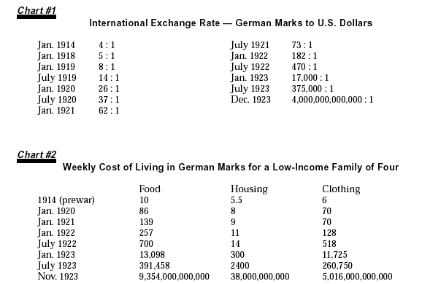
Hyperinflation - 1923

Slide 7
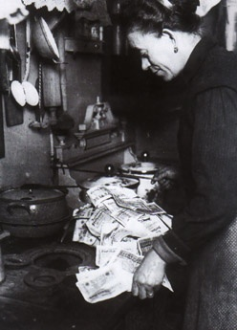
Hyperinflation

Slide 8
Late 1920’s
Hyperinflation recovery based upon American loans.
Dawes Plan
United States
War debts
loans
Charles Dawes
Britain and France
Weimar Republic
reparations

Slide 9
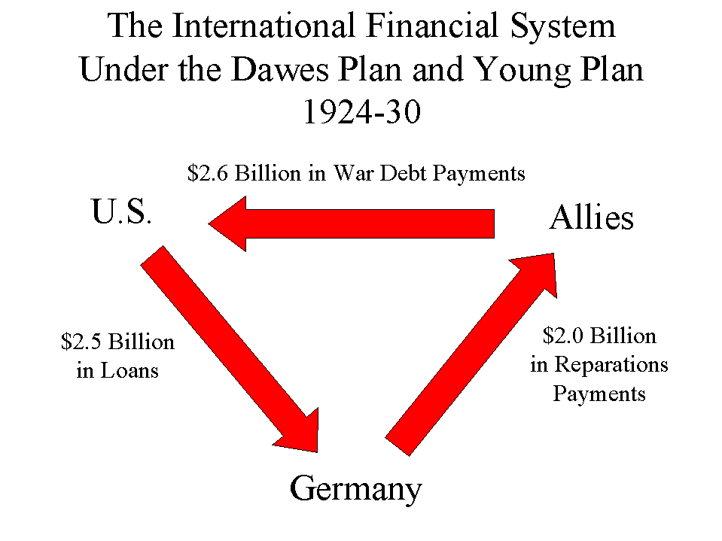
Late 1920’s
Dawes Plan and the later version, Young plan stabilized Germany finances.

Slide 10
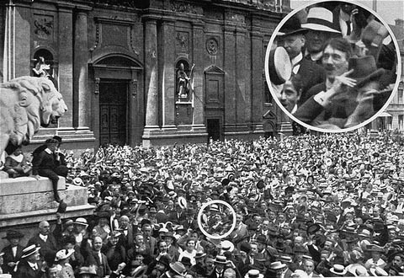
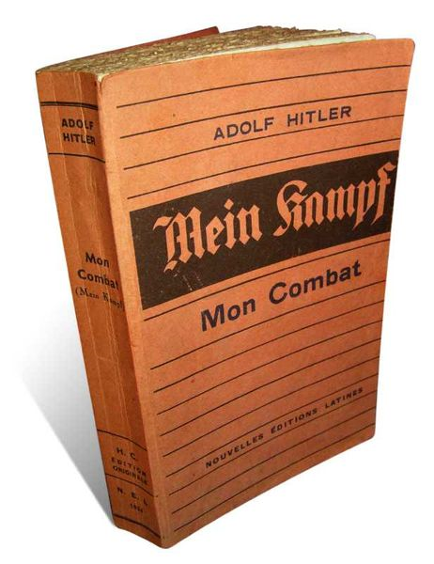
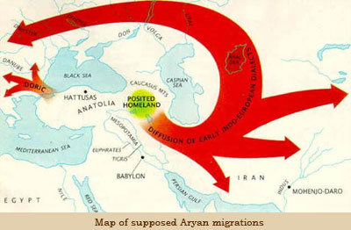
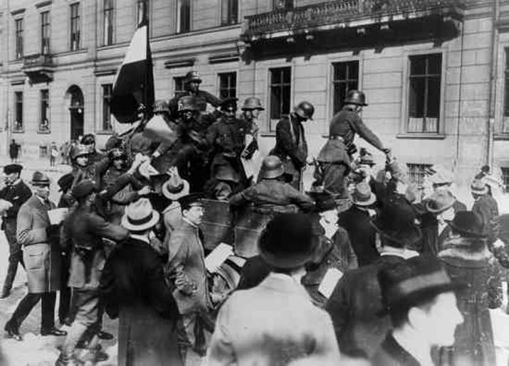
NSDAP
Post war Germany very bitter
Move to extremist political parties
Communist or Nationalist
Hitler spied on these groups for the Army, but liked the NSDAP
Charismatic speaker rises to lead
1923 Beer Hall Putsch
Fails and he goes to jail
Vows to gain power legally!
Mein Kampf – my struggle
Aryan myth
Lebensraum
Released to a new Weimar – prosperous
Extremist ideas no longer popular

Slide 11
Weimar in From the Cold
New chancellor/foreign minister (Stresemann - 1923-1929)
Introduced new currency that ended hyperinflation
Negotiated reduction in reparations
With Germany recovering, US takes leadership role
Locarno Treaties
Undo what Germany saw as worst parts of Versailles.

Slide 12
Peace?
Germany into League of Nations
Kellogg Briand Pact
‘renounce war as an instrument of national policy’
This upswing gave way to great cultural advances (Dada, Bauhaus,)

Slide 13
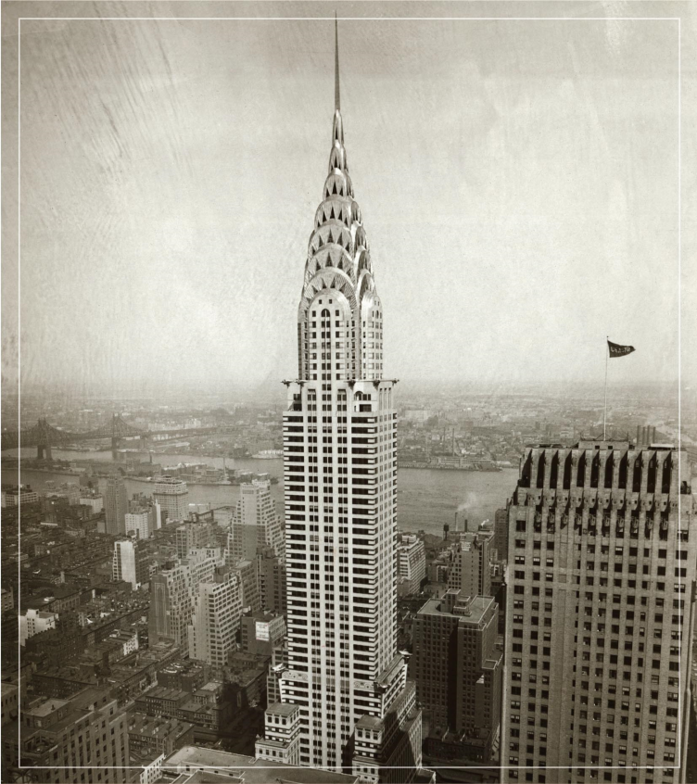
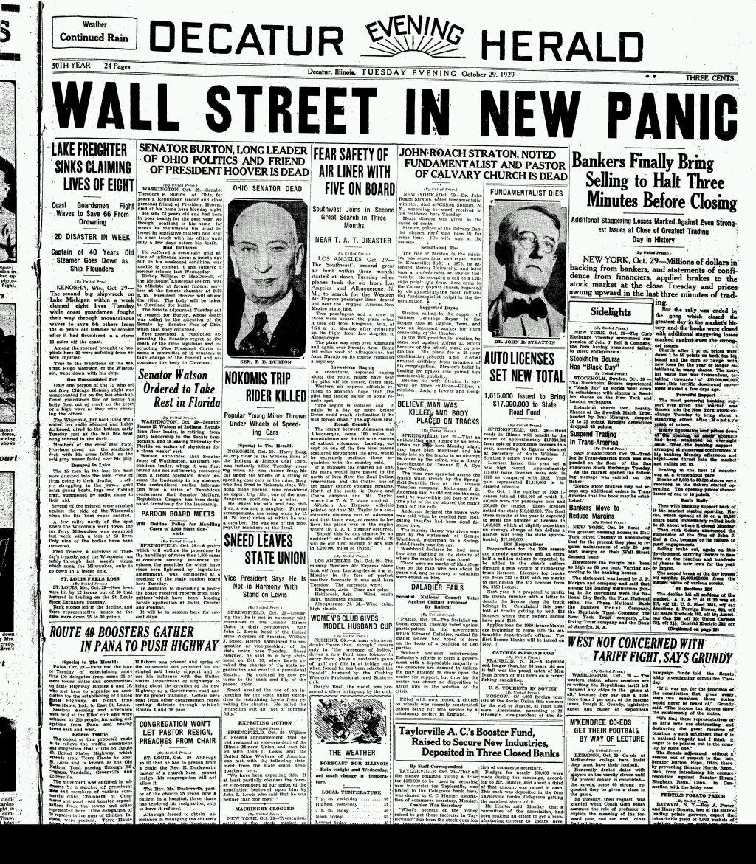
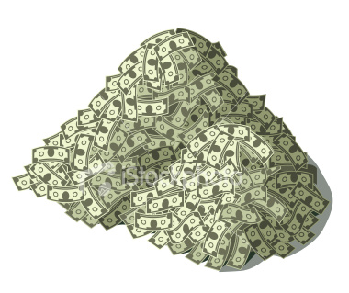
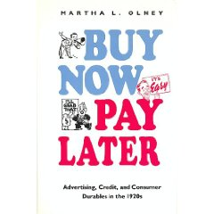
1929 Great Depression
Stock Market Crash
America was booming.
Companies producing lots of “stuff”
Issue – large amount of $ in the hands of few.
Everyone wanted to make money – invest in stocks! They will always rise in value
leverage everything (house etc.)
Demand drops
– create artificial demand
When that disappears….
Stocks plummet Oct 29 1929
Black Tuesday

Slide 14
The Ripple
United States
War debts
loans
Britain and France
Weimar Republic
reparations
The whole system collapsed

Slide 15
Political Crisis
Mass unemployment
Coalitions collapse
Parties unwilling to compromise
President Hindenburg and Article 48
Enabling Law
Extremists gaining power (Nazis and Communists)
Paramilitary groups roam, dominate cities

Slide 16
1932
Four parties vying for power
Nazis receive 37% of vote - 2nd
Hitler demands to be appointed Chancellor
President Hindenburg believes it would keep him in check

Slide 17
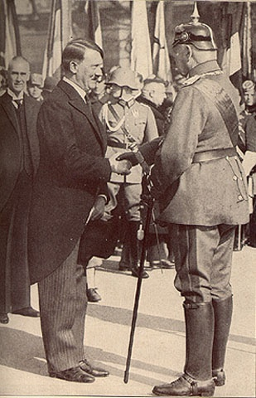
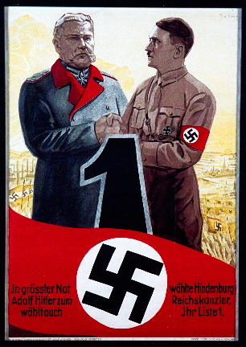

Slide 18
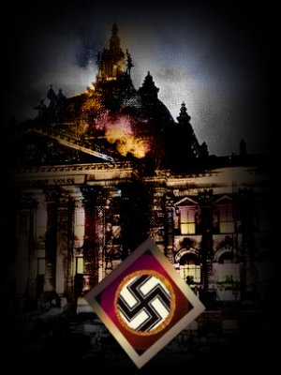
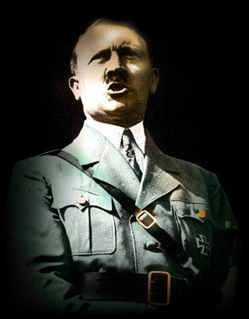
1933-34
Feb. 1933, Reichstag burned
Hitler blames communists
Nazis win election
Vote to give Hitler dictatorial power
Hitler declares himself Fuhrer
Nazis vote to eliminate Reichstag…

Slide 19
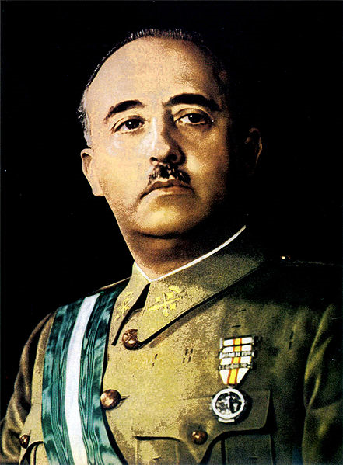
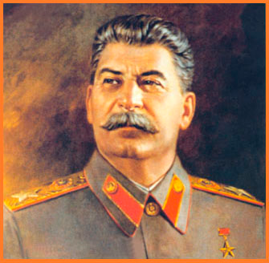
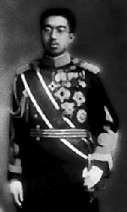
Other Dictators around the World
Hirohito: Emperor Japan
People were unable to handle their new freedoms
Dictators offered simple solutions
No decisions or responsibility
Solved economic problems with military spending.
As Mussolini said “one minute on the battlefield is worth a lifetime of peace. Weaker nations deserve to fall victim to the powerful.”
Stalin: the man of steel, USSR
General Francisco Franco: military takeover of Spain aided by Mussolini and Hitler (practice for WW II?)

Slide 20
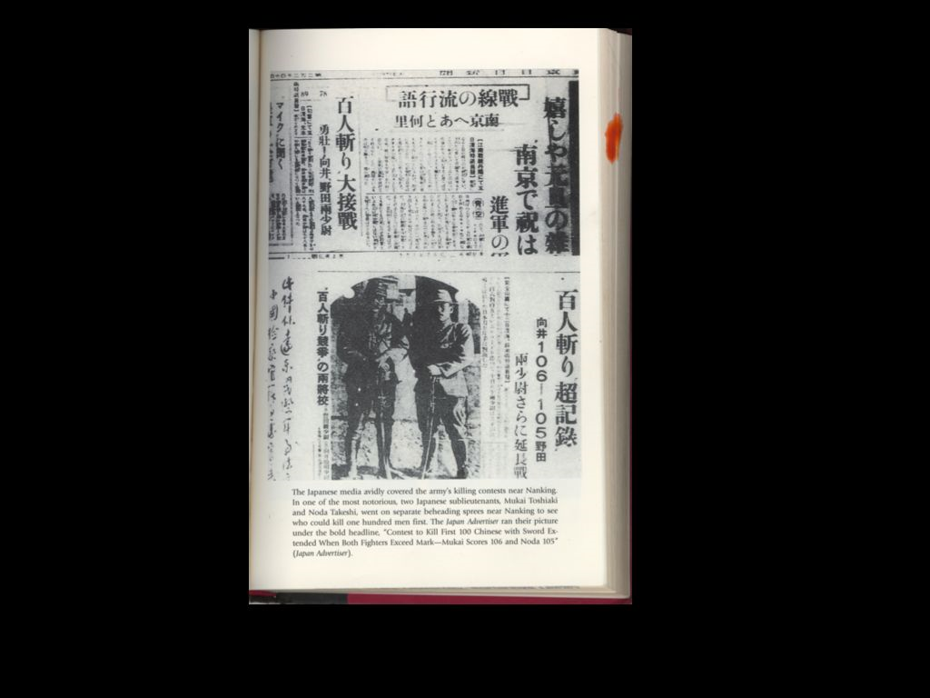
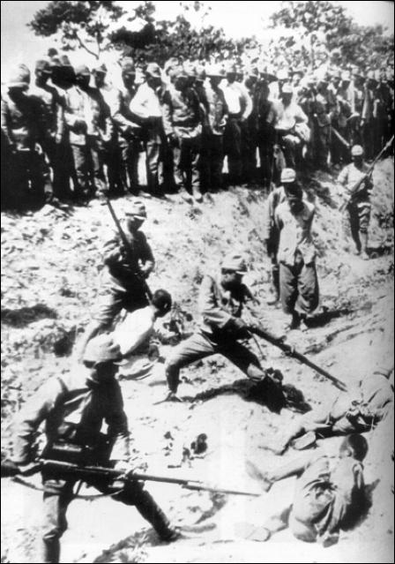
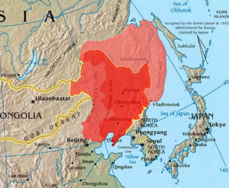
The Beginning of the End
As these dictators begin to consolidate their power, they start to push against the League of Nations
Japan attacked Manchuria. Idea of Empire (just like the Western powers). Greater East Asia Co Prosperity Sphere
Invasion continues into China. “Rape of Nanking”. Chinese fought back and were ‘punished’ by the Japanese. The holocaust no one knows about!
This newspaper headline talks about the two officers pictured who held a beheading contest…which of them could behead 100 victims fastest!

Slide 21
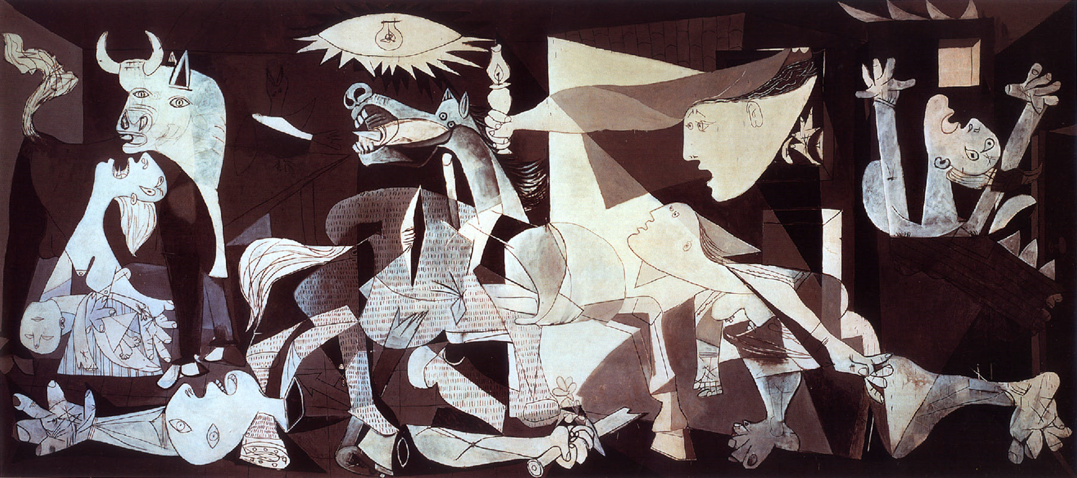
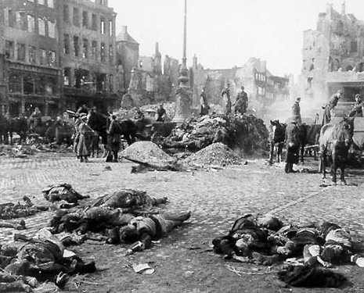
The Beginning of the End
In Spain 1936, Nationalists led by Franco stage uprising to overthrow Republican (like France Republican) government.
Franco aided by Hitler and Mussolini
For Germany and Italy, Spain was a testing ground for new methods of tank and air warfare.
First air attack on civilian target – Guernica.

