Slide 1
Wars Of Religion

Slide 2
Reasons for War
Irreconcilable differences! Neither side was prepared to give anything
Power, prestige and tradition versus recognition
Biblical interpretation
These differences were displayed in art and architecture
What was the new style of Art?
Simplicity of the protestant versus the new ornate Baroque style.

Slide 3
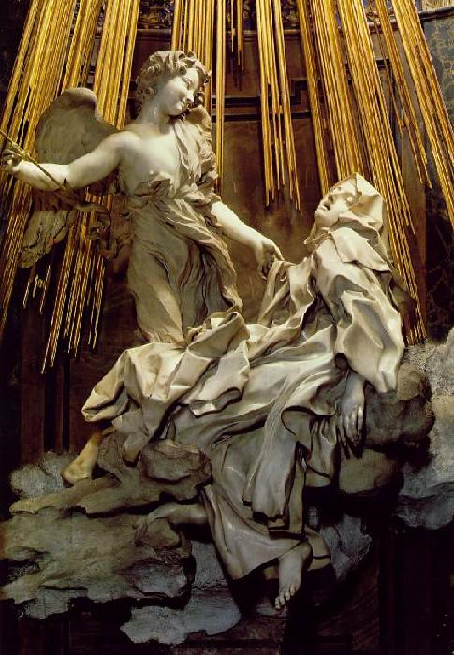
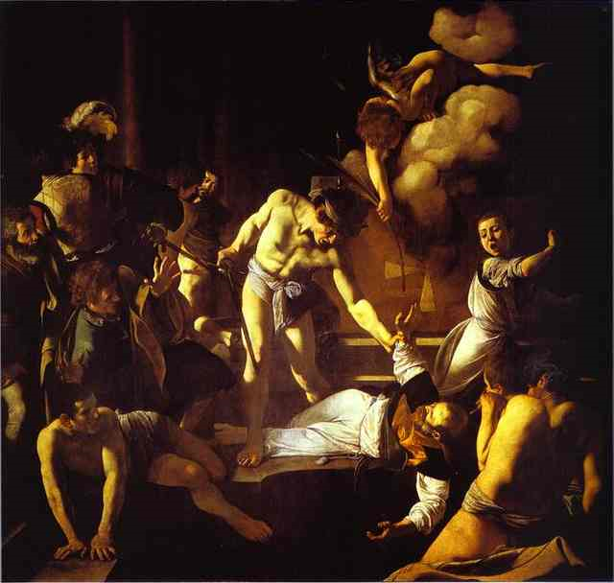
Baroque Style
Baroque style was designed to revitalize the Church with action and passion.
Ecstasy of St Teresa (Bernini)
Martyrdom of St Jerome (Caravaggio)

Slide 4
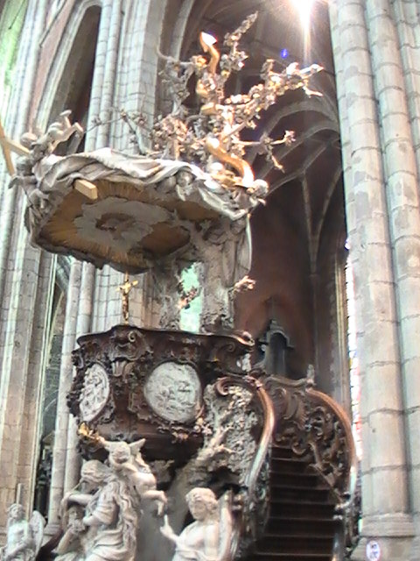
Pulpit in Ghent

Slide 5
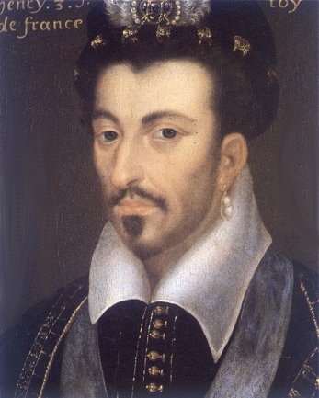
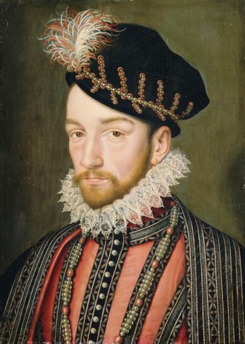
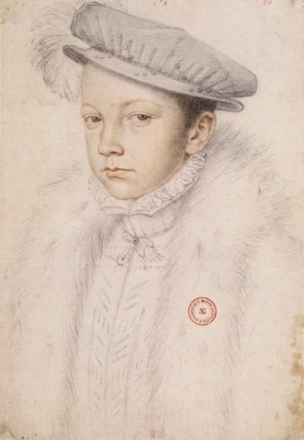
The Valois Family: The Beginning of the End
Predictably the trouble really started in France.
Need for money from wars with Spain and Italy
Francis I sold positions in nobility
Led to nobles of Robe and Blood
In a deal with the Pope, made Catholicism State religion for financial as much as religious reasons
Henri II last powerful Valois King dies in jousting accident.
Three weak sons followed:
Francis II
Charles IX
Henri III

Slide 6
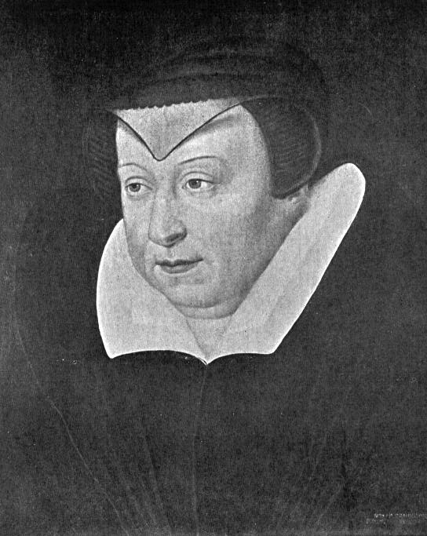
Catherine de Medici(s)
Catherine de Medici controlled the sons:
Was mother to the boys
Played both sides in the civil war
Developed a reputation for cruelty (looks like she would be cruel)

Slide 7
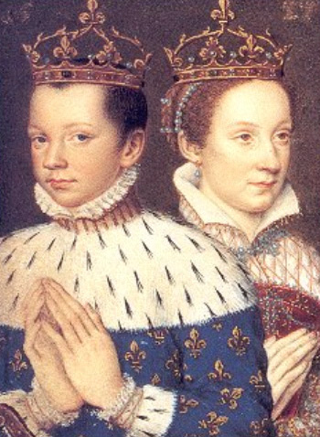
Francis II & His Wife, Mary Stuart
(more about her later)

Slide 8
The French Civil War
There were two sides, but 3 families:
Guise family led Catholics in North
Bourbon family led Huguenots in South supported by Montmerecy-Chatillons
Fighting for the royal inheritance
Catherine uses Protestant side against the Guise to be sure her family would retain the throne .
Changes sides and with the Guises tries to assassinate protestant leader - (Duke of Coligny).
Fails! Catherine convinces King, Charles IX of Protestant revenge
St. Bartholomew’s Day Massacre
August 24, 1572
20,000 Huguenots were killed
Henri of Navarre, a Bourbon, survived

Slide 9
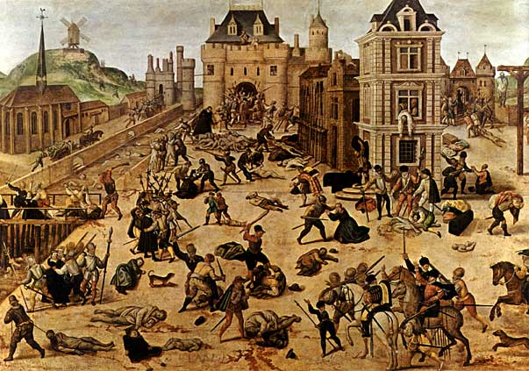
St. Bartholomew’s Day Massacre

Slide 10
The French Civil War 1574 The War of 3 Henries
After death of King Henri III, protestant Henri Navarre heir, by marriage to Henry II’s daughter
Pope and Phillip II join the Catholic League.
Henri of Navarre defeated Catholic League & becomes Henri IV of France.
Effects of Civil War:
France was left divided by religion
Royal power had weakened
Valois family now replaced by Bourbons
Catholic League
CIVIL WAR
Protestant Union

Slide 11
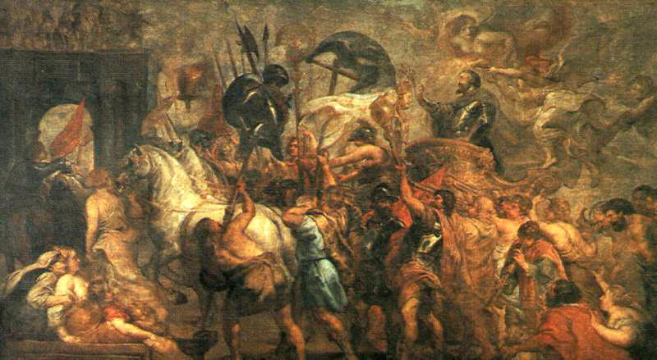
Triumphal Entry of Henri IV Into Paris – Peter Paul Reubens

Slide 12
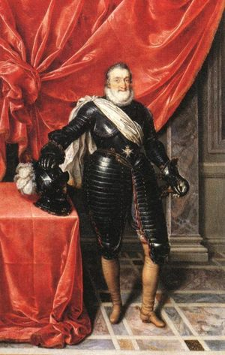
Henri IV of France
Ended Spanish interference in France
Converted to Catholicism :
Did this to compromise and make peace
“Paris is worth a mass.”
This was an example of politique [the interest of the state comes first before any religious considerations]
Passed Edict of Nantes in 1598:
Granted religious rights to Huguenots
Did not grant religious freedom for all

Slide 13
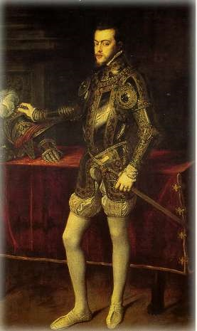
Spain
1556 Philip II (most Catholic of Kings)
Spain the most powerful European country. Phillip prepared to use power and wealth
for Pope. Examples are:
Defeats Ottomans at Lepanto
Jesuits
Support of RC in England
Suppression of Dutch
Duke of Alba and Council of Blood
War for independence
Pacification of Ghent
Treaty of Utrecht

Slide 14
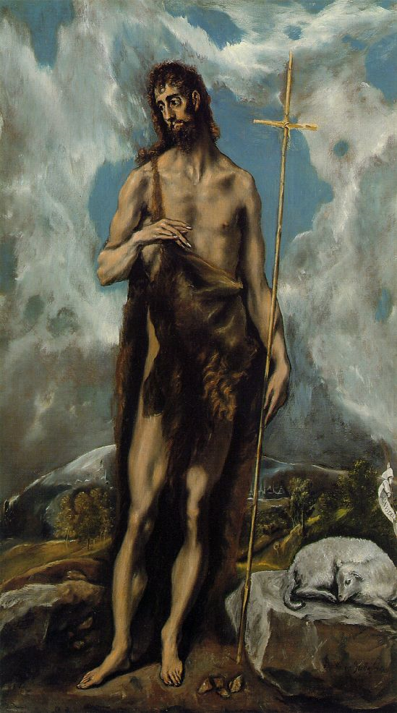
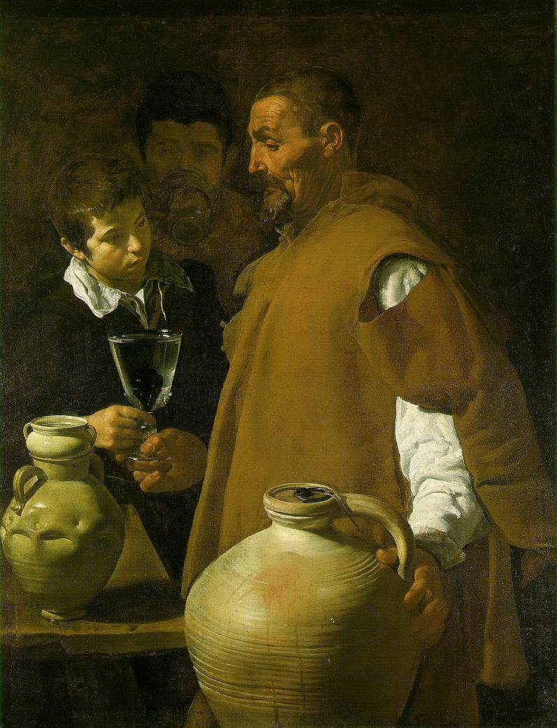
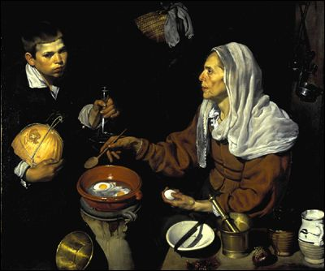
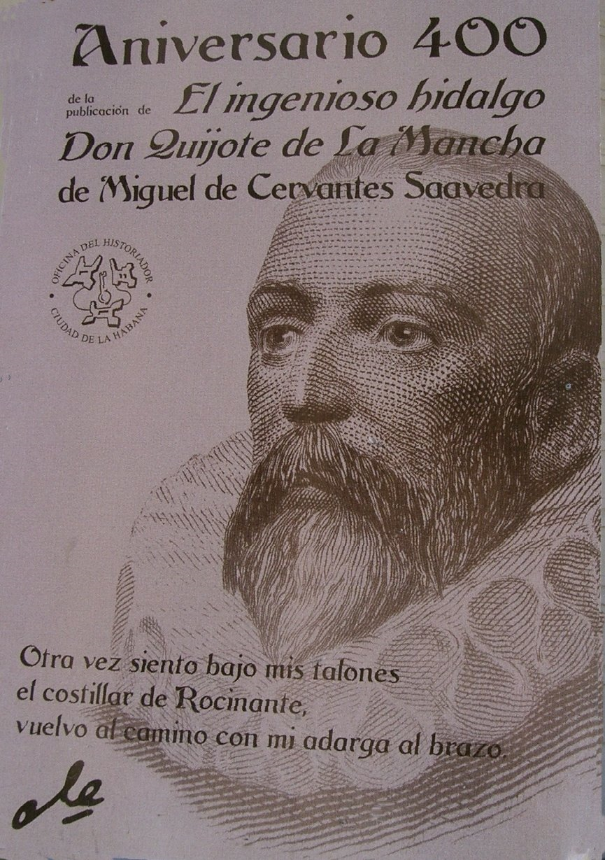
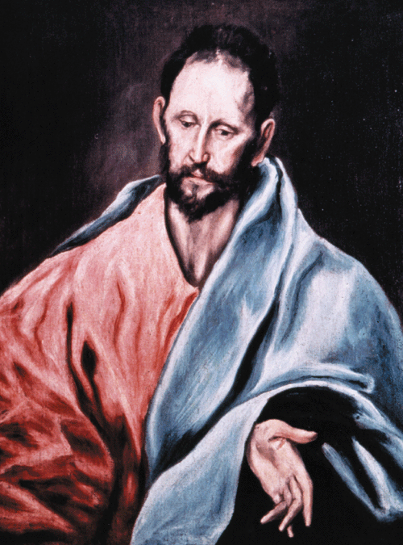
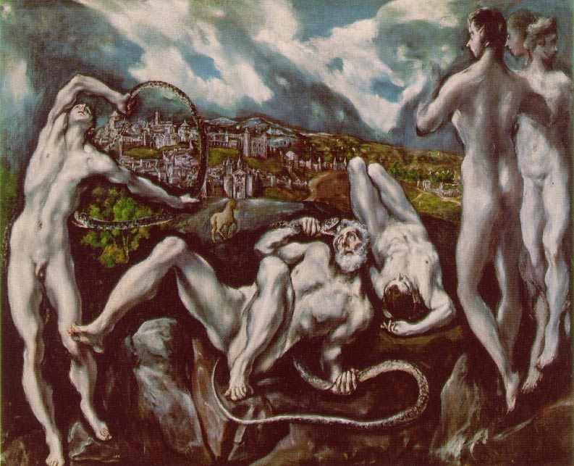
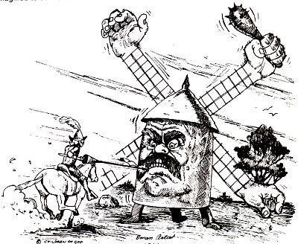
Spanish Renaissance

Slide 15
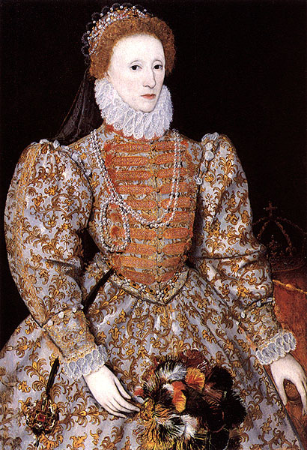
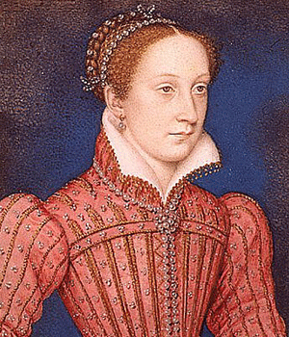
England
Liz I
Spanish wanted Mary Stuart to
inherit from Mary Tudor
Mary claimed throne, but Elizabeth
inherits and imprisons cousin.
Catholic plot to free Mary and
overthrow Liz results in execution.
Phillip proposes – REJECTED!!!
Pope offers bounty
Pirates and privateers (Drake, Raleigh and Hawkins) attack Spanish Main.
Phillip now poised to invade
Mary Stuart

Slide 16
Elizabeth’s Speech to the Troops Before the Armada
…therefore I am come amongst you, as you see, at this time, not for my recreation and disport, but being resolved, in the midst and heat of the battle, to live and die amongst you all; to lay down for my God, and for my kingdom, and my people, my honour and my blood, even in the dust. I know I have the body but of a weak and feeble woman; but I have the heart and stomach of a king, and of a king of England too, and think foul scorn that Parma or Spain, or any prince of Europe, should dare to invade the borders of my realm… I mayself will take up arms, I myself will be General, Judge and Rewarder of everyone of your virtues in the field.”

Slide 17
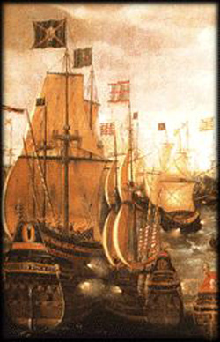
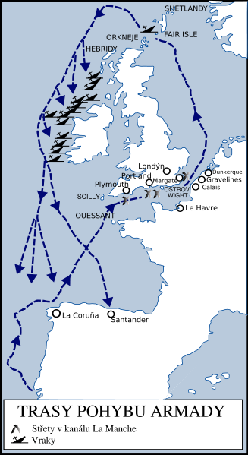
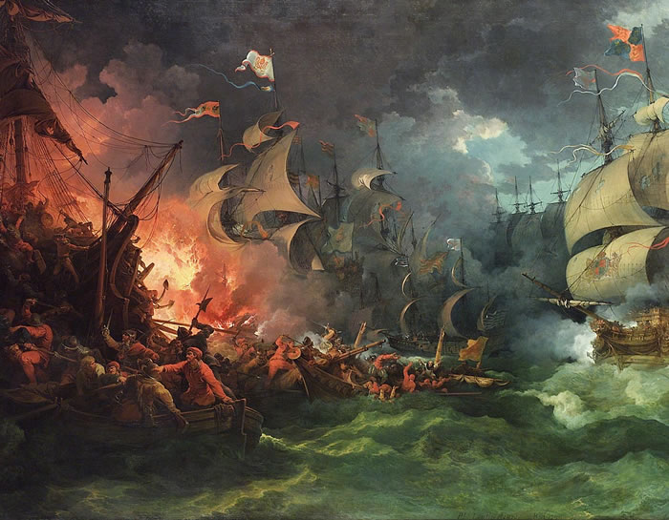
Spanish Armada 1588
Pope “What a valiant woman. She braves the two greatest kings by land and sea…It is a pity Elizabeth and I cannot marry: our children would have ruled the world.”
Other failed invasions follow till Philip’s death

Slide 18
Elizabethan England
The text of the Oath of Supremacy, 1559
I, do utterly testify and declare in my conscience that the Queen's Highness is the only supreme governor of this realm, and of all other her Highness's dominions and countries, a s well in all spiritual or ecclesiastical things or causes, as temporal, and that no foreign prince, person, prelate, state or potentate hath or ought to have any jurisdiction, power, superiority, pre-eminence or authority ecclesiastical or spiritual within this realm; and therefore I do utterly renounce and forsake all foreign jurisdictions, powers, superiorities and authorities, and do promise that from henceforth I shall bear faith and true allegiance to the Queen's Highness, her heirs and lawful successors, and to my power shall assist and defend all jurisdictions, pre-eminences, privileges and authorities granted or belonging to the Queen's Highness, her heirs or successors, or united or annexed to the imperial crown of this realm. So help me God, and by the contents of this Book.
People take an oath very seriously, and thus honest people are not inclined to swear to an oath they don't believe in. (See A Man for All Seasons for a graphic demonstration.)
Religion – Act + Oath of Supremacy, 39 Articles, Act of Uniformity (see website handout on religion)
Society – Wealth growing (PWE). London largest city in Europe 200K+.
Crime and punishment
Renaissance – Shakespeare, Marlowe
Names based on occupations
Expansion of “empire” in new world
From the report of a Venetian envoy, about 1500:
It abounds with every article of luxury, as well as with the necessities of life. But the most remarkable thing in London is the wonderful quantity of wrought silver. I do not allude to that in private houses, but to the shops of London. In one single street, named the Strand, leading to St Paul's, there are fifty-two goldsmith's shops, so rich and full of silver vessels, great and small, that in all the shops in Milan, Rome, Venice, and Florence put together, I do not think there would be found so many of the magnificence that are to be seen in London. And these vessels are all either salt cellars or drinking cups or basins to hold water for the hands, for they eat off that fine tin [pewter] which is a little inferior to silver.

Slide 19
The Thirty Years
War (1618-1648)

Slide 20
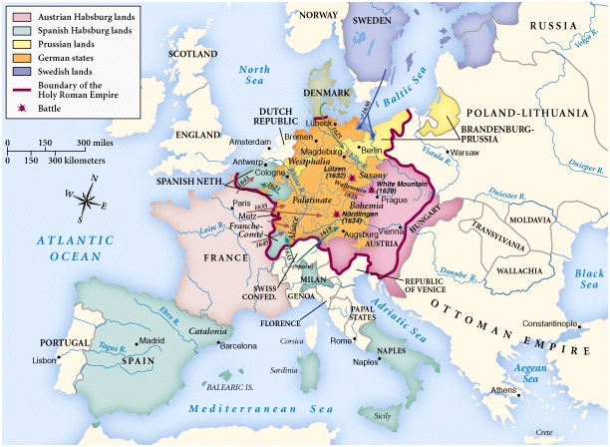
1618-1648

Slide 21
Overview of the Thirty Years War
The Holy Roman Empire was the battleground.
At the beginning → it was the Catholics vs. the Protestants.
Became as much a political war as a religious one
By the end → it was Habsburg power that was the threat.
Resolved by the Treaty of Westphalia in 1648.

Slide 22
The Bohemian Phase: 1618-1622
Ferdinand II HRE inherited Bohemia.
The Bohemians hated him.
Ferdinand refused to tolerate Protestants.
Defenestration of Prague →May, 1618
Bohemia named a new king, Frederick III a Calvinist. (not recognized by Augsburg).
Joins new alliance with English, Dutch and French against Spanish
Bavaria joins Catholic League as a counter
Ferdinand II borrowed an army from Bavaria and with support of Spanish relatives, went after Bohemia.
Frederick lost his lands in the fighting.
The rebellion in Bohemia inspired other protestants.

Slide 23
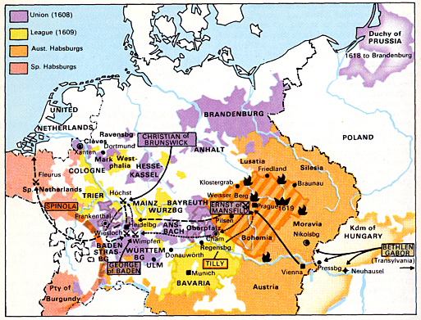
Bohemian Phase

Slide 24
The Danish Phase: 1625-1629
Ferdinand II tried to end all resistance.
Tried to crush Protestant northern Holy Roman Empire.
Resistance led by Christian IV of Denmark.
Ferdinand II used Albrecht von Wallenstein for the army.
Wallenstein defeated Protestants in north.
Edict of Restitution (1629):
Restored to Catholics all lands lost since 1552.
Deprived all Protestants, except Lutherans, of their religious and political rights. (reinstituted Augsburg?)
German princes feared Ferdinand’s power → he fired Wallenstein in effort to calm them.

Slide 25
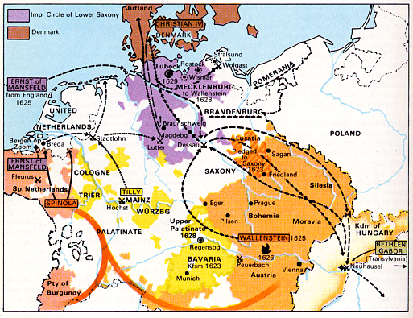
Danish Phase

Slide 26
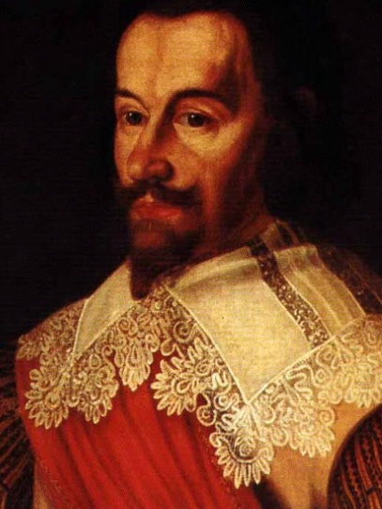
Albrecht von Wallenstein

Slide 27
The Swedish Phase: 1630-1635
France & Sweden now get involved.
Both want to stop Habsburg power.
Sweden led the charge.
France provided support (financial).
Gustavus Adolphus of Sweden invaded the HR Empire. (in revenge for Magdeberg)
“Empire Strikes Back” under Wallenstein.
Swedish advance was stopped at the Battle of Lutzen (Adolphus killed)
German princes still feared Ferdinand II. Wallenstein assassinated to appease them.
(ordered by Ferdinand II)

Slide 28
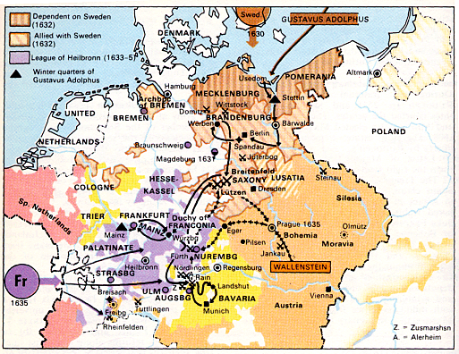
Swedish Phase

Slide 29
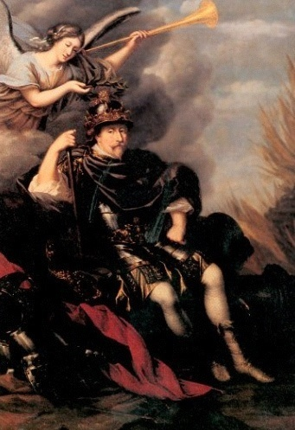
Gustavus Adolphus

Slide 30
The French Phase: 1635-1648
France & Sweden switched roles.
French under Cardinal Richelieu supported Protestant cause. WHY?
All countries in Europe now participated.
This phase was most destructive!
German towns decimated.
Agriculture collapsed → famine resulted.
8 million dead → 1/3 of the population [from 21 million in 1618 to 13.5 million in 1648]
Caused massive inflation.
Trade was crippled throughout Europe.

Slide 31
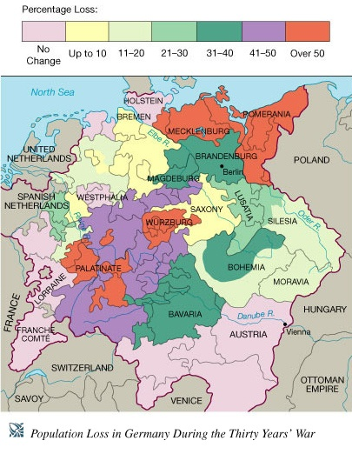
Loss of German Lives in 30 Years’ War

Slide 32
The Peace of Westphalia (1648)
Political Provisions:
Each Ger. prince became free from any kind of control by the HRE.
The United Provinces [Dutch Neths.] became officially independent. Southern part remained a Spanish possession. (Belgium and Luxemburg still RC)
France received. most of the German-speaking province of Alsace. (this region will go back and forth between them)
Sweden got lands in Northern Germany on the Baltic coast.
Switzerland became totally independent of the HR Emperor → Swiss Confederation.
Sweden won a voice in the Diet of the HRE.
Brandenburg got important territories. on North Sea & in central Germany.

Slide 33
The Peace of Westphalia (1648)
Religious Provisions:
Calvinists would have the same privileges as the Lutherans had in the Peace of Augsburg.
The ruler of each state could determine its official religion, BUT [except in the hereditary lands of the Habsburgs], he must permit freedom of private worship.
(It’s basically Augsburg with Calvinism!)

Slide 34
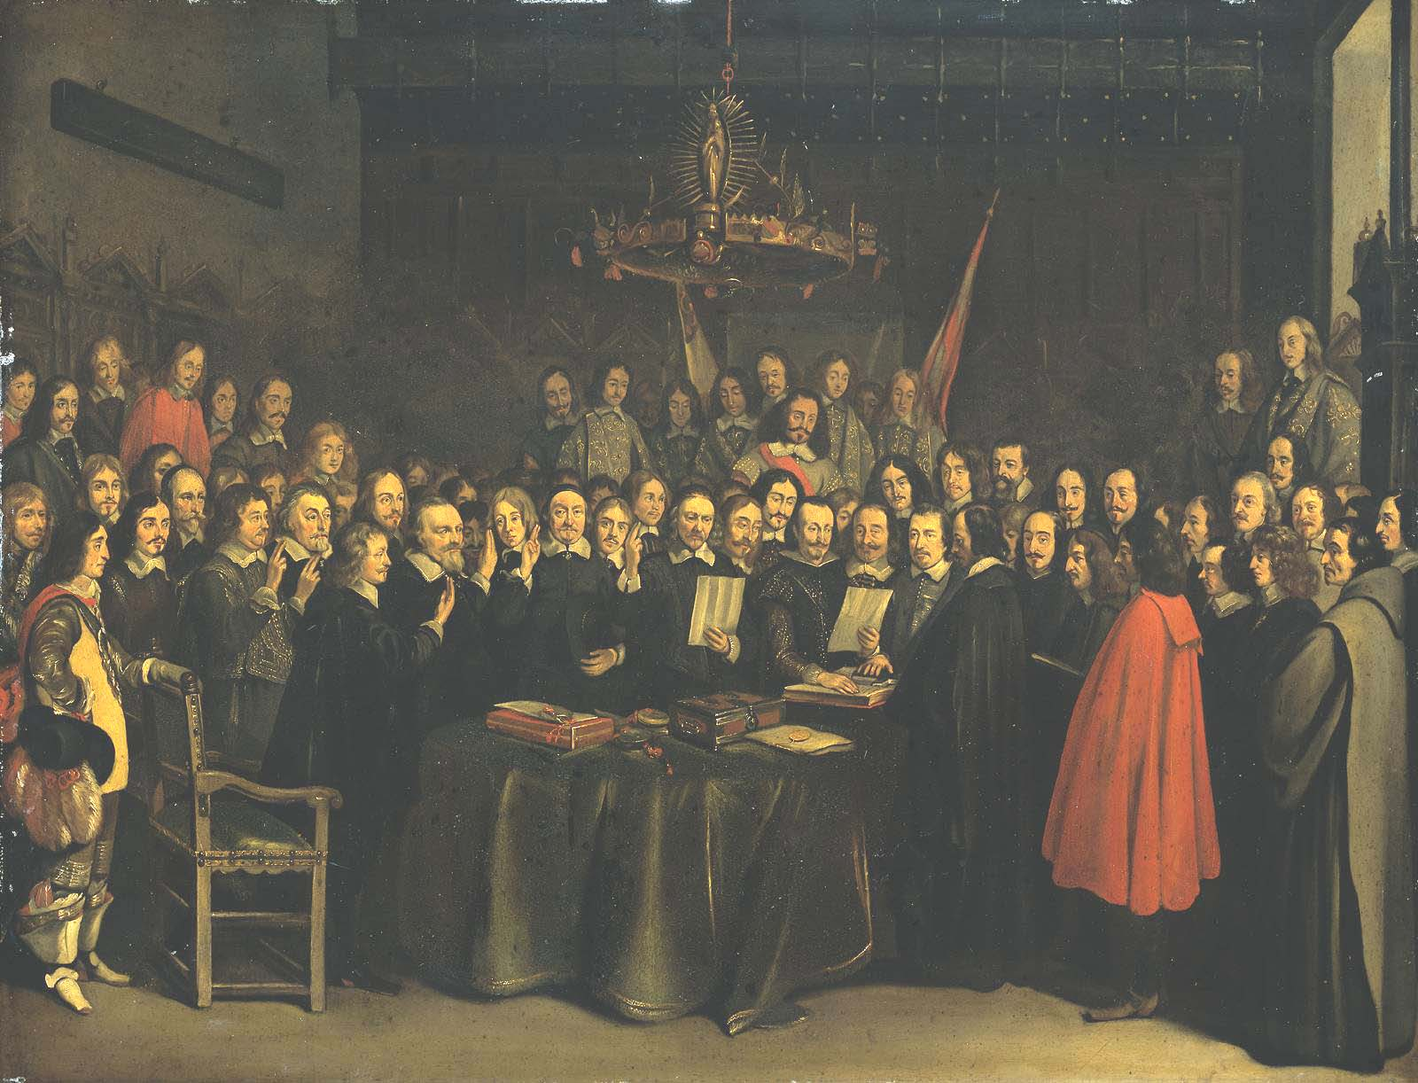
Treaty of Westphalia (1648)

Slide 35
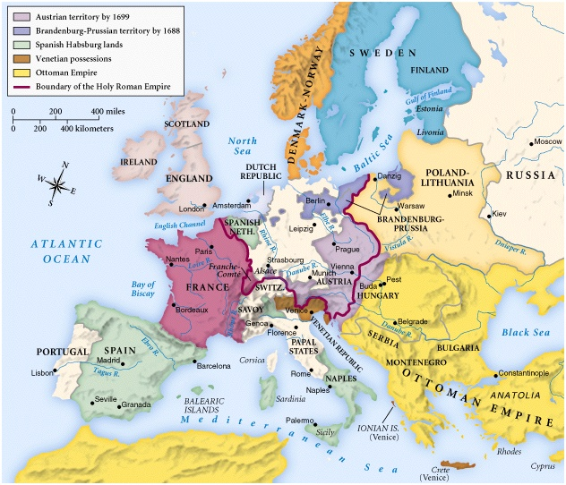
1688-1700

Slide 36
Nobody Was Happy!
Many Protestants felt betrayed.
The pope denounced it.
Only merit → it ended the fighting in a war that became intolerable!
For the next few centuries, this war was blamed for everything that went wrong in Central Europe.

Slide 37
Winners
German States: greater independence from HRE
Sweden: Military successes
England: Weakened the rest of Europe militarily, kept their stuff occupied
German Rulers: kept right to choose no increase in RC
Prussia: recognized military success/power
Richelieu: chose the winning side weakened Haps/strengthened France
Feudalism : Still there in most of eastern europe
Technology: showed the power of new weapons

Slide 38
And Losers
German States land, infrastructure, economy ruined
Hapsburgs lost power and prestige with failure to win
Peasants suffered the greatest losses (people, land, livelihood) nothing gained
RC Failed to make any gains despite huge effort lost power and prestige
Guilds system devastated by economic failure

Slide 39
What were the long-range effects of the Thirty Years’ War?

