Slide 1
Versailles Settlement
A series of treaties that ended WW I
Versailles Treaty dealt with Germany only!

Slide 2
Results of WW I
Entire continent crippled
fiscally (there was no money!)
socially (huge numbers of dead and maimed)
productively (economies had been dedicated to war, land and infrastructure destroyed or drastically altered)
Who was to pay for all this?
THE LOSERS!!!

Slide 3
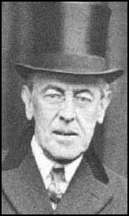
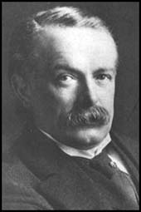
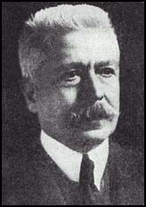
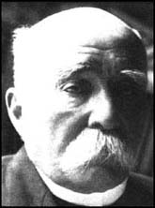
Woodrow Wilson USA
David Lloyd-George Great Britain
The Big Four?
Georges Clemenceau France
Vittorio Orlando Italy

Slide 4
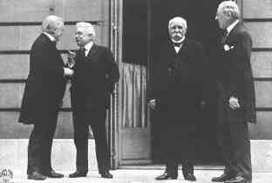
The Big Four at Versailles in 1919

Slide 5
What did France want?
1. Security
2. Revenge
3. Reparations
Essentially neuter Germany!
Clemenceau wanted to make sure that Germany could not invade France in the future.
He was determined that Germany should be made to pay for the damage that had been caused in northern France by the invading German armies.
Clemenceau : The Tiger

Slide 6
What did Britain Want?
In public Lloyd-George said he wanted to punish the Germans. The British public was very anti-German at the end of the war.
In private he realised that Britain needed Germany to recover because she was an important trading partner.
He was also worried about the “disease from the east”, communism. Lloyd-George believed that the spread of communism had to be stopped.
A strong Germany would be a barrier against it.
(US uses this idea in 1945!)
David Lloyd-George

Slide 7
What did America Want?
Woodrow Wilson wanted the treaty to be based on his Fourteen Points:
Solution to all of Europe’s problems!
Rearrange borders based on self determination
The right of people to decide who should rule them. (Except the losers!!)
He believed Germany should be punished but not severely. He wanted a just settlement that would not leave Germany feeling resentful
Wilson wanted to set up an international organization called The League of Nations which would settle disputes
Woodrow Wilson
New World Leader! NAIVE
The American public did not support him. They were fed up with involvement in European affairs. The USA became more isolationist.

Slide 8
What did Italy want?
Recognition as a European power
Territory – especially at the expense of Austria in the North and along the Dalmatia coast. (from 1815)
Italy had sided with the winners and expected reward.
Wilson was keen to establish self determination in the Balkans where the war began.
He refused to give Italy the areas they wanted and Orlando left the conference.
He returned to sign the agreements.
Italy was angry and looked for new and strong leadership. (Guess who?)
Orlando – the “loser”?

Slide 9
Terms of the Treaty of Versailles
Germany’s armed forces (French demands):
The German army was to be reduced to 100,000 men. It was not allowed to have tanks.
Germany was not allowed an airforce
The German navy was to have no submarines or large battle-ships (British demand)
The area known as the Rhineland was to be de-militarised
The Allies were to occupy the west bank of the Rhine for fifteen years

Slide 10
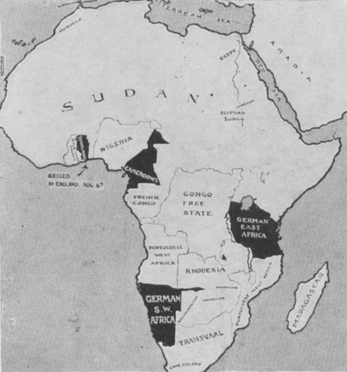
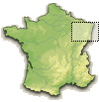
Territorial Losses
Germany lost ALL of her overseas colonies. They were assumed by the British and the French until they could become independent.
Alsace-Lorraine was given back to France.

Slide 11
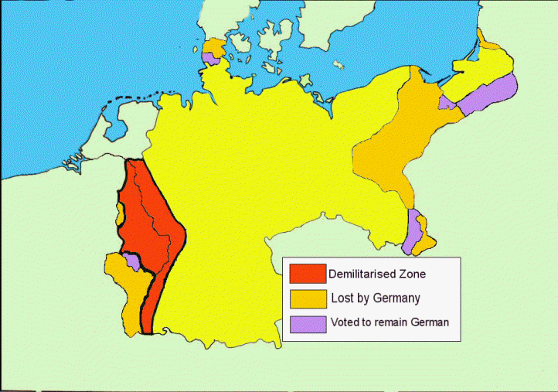
Posen was given to Poland so that she would have access to the Baltic Sea. This area became known as the Polish Corridor. It meant that East Prussia was cut off from the rest of Germany.

Slide 12
The Saar coalfields were given to France for fifteen years.
The port of Danzig in the new Polish corridor was made a Free City under the control of the League of Nations

Slide 13
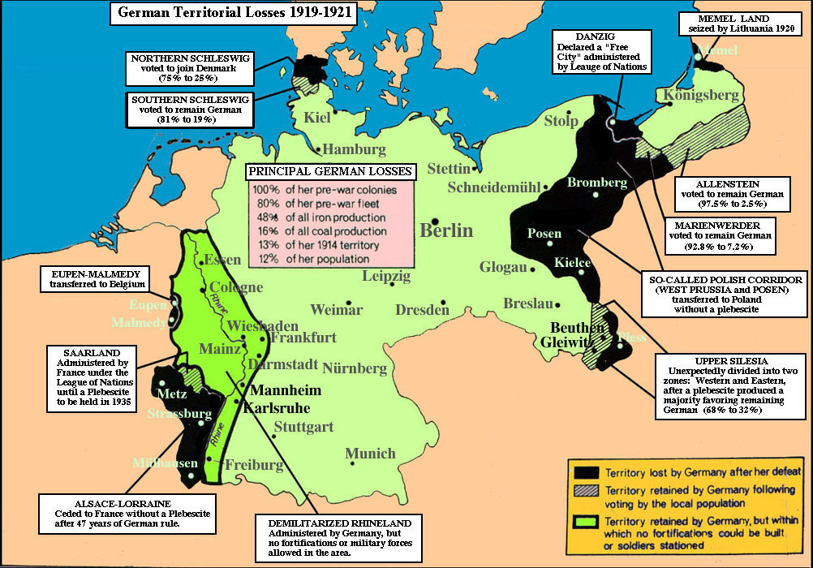

Slide 14
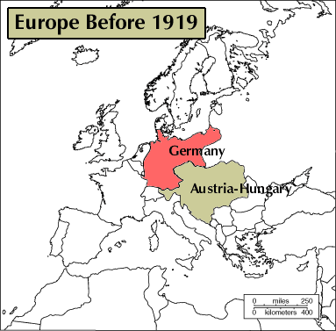
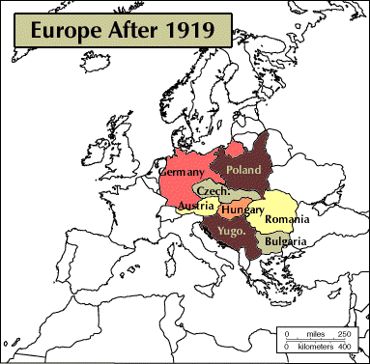

Slide 15
The War Guilt Clause
"The Allied and Associated Governments affirm, and Germany accepts, the responsibility of Germany and her Allies for causing all the loss and damage to which the Allied and Associate Governments and their nationals have been subjected as a consequence of a war imposed upon them by the aggression of Germany and her Allies."
Article 231

Slide 16
REPARATIONS
Germany agreed to pay for the damage caused by her armies during the war. In January 1921, the total sum due was decided and was set at 269 billion gold marks (the equivalent of around 100,000 tonnes of pure gold). This 100,000 tonnes of gold is equivalent to more than 50% of all the gold ever mined in history which was clearly not within the means of the Germans to pay. Consequently their only way of paying back the debt was in devalued Gold Marks which ultimately led to the hyperinflation.
Event | German gold marks (billions) | Gold Standard U.S. dollars (billions) | 2012 US$ (billions)
1921 | 269 | 64.0 | 834
Young Plan 1929 | 112 | 26.6 | 360
Lausanne Conference 1932 | 20 | 4.8 | 86

Slide 17
How did Germans React to the Treaty?
Germans thought the Treaty was a “diktat” : a dictated peace. They had not been invited to the peace conference at Versailles and when the Treaty was presented to them they were threatened with war if they did not sign it.
The Treaty was NOT based on Wilson’s Fourteen Points as the Germans had been promised it would.
Most Germans believed that the War Guilt Clause was unjustified. The French and British had done just as much to start the war
The loss of territory and population angered most Germans who believed that the losses were too severe.
Many Germans believed the German economy would be crippled by having to pay reparations.

Slide 18
The Treaty of Versailles was signed on 28th June 1919. It officially ended the 1st World War.
Many historians believe that it was a major cause of the 2nd World War.
Most Germans were horrified by the harshness of the Treaty. WHY?
Almost no war inside Germany. People thought they were doing well! Armistice was a shock!
There was anger amongst all groups in Germany aimed at the authors of the Treaty.
However anger was also directed against the government in Germany. (those who had signed the Peace agreement)
Already there was a myth growing in the country that the German army had been “stabbed in the back” by politicians…the so called “November Criminals”.
The new democracy of the Weimar Republic was closely linked with the humiliation of Versailles…

Slide 19
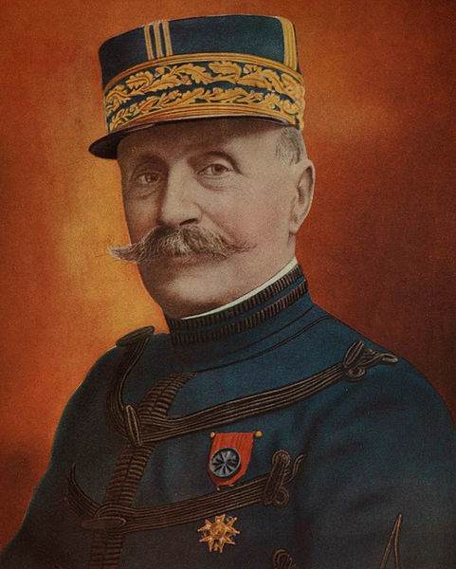
"This is not peace. It is an armistice for 20 years”
French General Foch
He believed the Treaty did not hurt Germany enough!

Slide 20
John Maynard Keynes Economist was also at the negotiations, but resigned when he realized the ridiculous financial expectations placed on Germany
“Carthaginian Peace”

Slide 21
League Of Nations
It wasn’t!
Several countries left out or opt out
US, USSR, Germany, Austria,(both the latter were admitted in the mid 1920s)
Italy, Japan were part, but both leave
It was the League of Some Nations
There were other issues too
Who would lead? GB? France?
No way to enforce decisions.
What could they do?
Sanctions were weak and depended on all members abiding by them
Non members often filled the void! (You bastards)

Slide 22
Mandate system
Colonies had fought and hoped this would give them respect of colonial rulers and their independence
Instead Mandate System was created with territories to be administered by the Western powers until they were ready for independence
Middle East and North Africa
Asia
Sub Saharan Africa and Island nations
The number represented how close to independence they were!
This was partly because of the distributions of former German and Ottoman territories.

Slide 23
USA
US one of two countries better off after WW I (Japan). It was #1
(that hurt to put in the slide!)
American people object to treaty as does Congress. (Wilson out of office)
US isolationist – stay out of world affairs
US focuses on itself (roaring 20s)
(more later)

