Slide 1
Versailles (only)

Slide 2
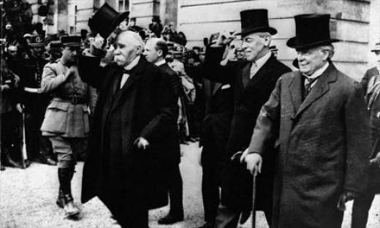
Peace?
Major countries met to figure out a peace agreement
USA – Wilson
14 points
New world leader
France – Clemenceau
Neuter Germany!
Revenge!
GB - Lloyd George
Hurt Germany
Get things back to the way they were
14 Points how to solve Europe’s problems.
Rearrange borders based on
self determination
The right of people to decide who should rule them. (Except the losers!!)

Slide 3
Results of WW I
Entire continent crippled
fiscally (there was no money!)
socially (huge numbers of dead and maimed)
productively (economies had been dedicated to war (TOTAL WAR), land and infrastructure destroyed or drastically altered)
Who was to pay for all this?
THE LOSERS!!!

Slide 4
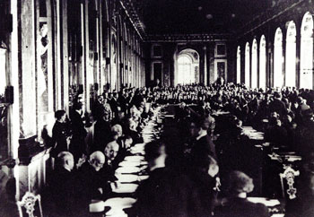
Treaty of Versailles
Italy wanted land but got none and left in a huff…FASCISM!
Brutal terms for Germans
Article 231 (“war guilt” clause)
$33 billion in reparations over 30 years
Germany loses land to France, Poland, Czechoslovakia and all its colonies.
Prohibited to have offensive military (worked for a short while, then they started making weapons 1930s)
“Stab in the Back Theory” – Military
Left Germany really angry!!!

Slide 5
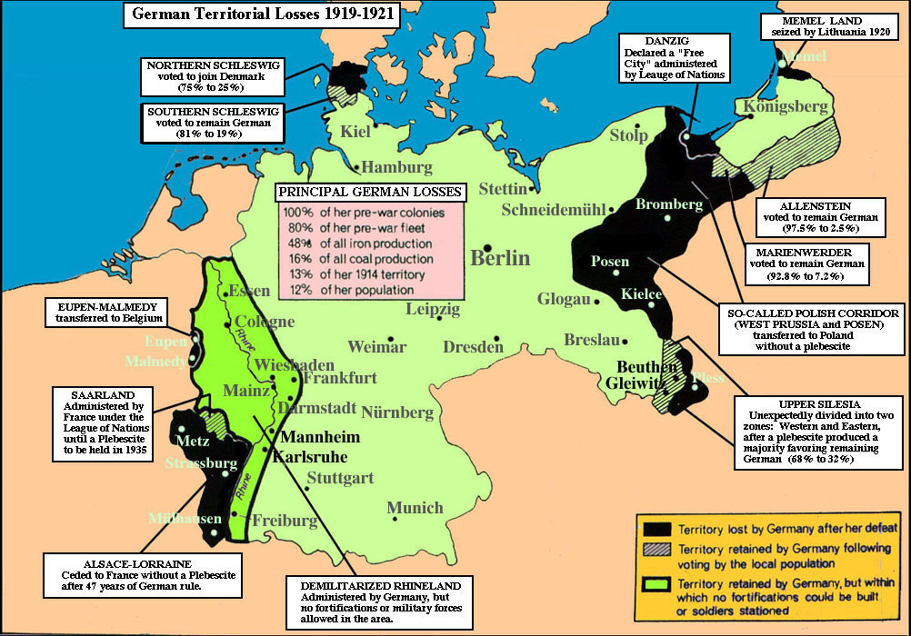
Self Determination was not applied in the areas in black! WHY?
Why is this important…

Slide 6
League Of Nations
It wasn’t! Several countries left out or opt out
US, USSR, Germany, Austria, Italy
(some are admitted in 1920s, others leave in 20s and 30s)
(it was the League of Some Nations)
There were other issues too
No way to enforce decisions. What could they do?
Sanctions were weak
No unity of purpose

Slide 7
Mandate system
Colonies had fought and hoped this would give them respect of colonial rulers and their independence
Instead Mandate System created territories to be administered by the Western powers until they were ready for independence
Middle East and North Africa
Asia
Sub Saharan Africa and Island nations
The number represented how close to independence they were!

Slide 8
USA
US one of two countries better off after WW I (Japan). It was #1
(that hurt to put in the slide!)
American people object to treaty as does Congress. (Wilson out of office)
US isolationist – stay out of world affairs
US focuses on itself (roaring 20s)
(more later)
How does this affect Versailles?

Slide 9
IF WW I WAS A BAR FIGHT…
Germany, Austria and Italy are standing together in the middle of a pub when Serbia bumps into Austria and spills Austria’s pint.
Austria demands Serbia buy it a whole new suit because of the new beer stains on its trouser leg.
Germany expresses its support for Austria’s point of view.
Britain recommends that everyone calm down a bit.
Serbia points out that it can’t afford a whole suit, but offers to pay for the cleaning of Austria’s trousers.
Russia and Serbia look at Austria.
Austria asks Serbia who it’s looking at.
Russia suggests that Austria should leave its little brother alone.

Slide 10
Austria inquires as to whose army will assist Russia in doing so.
Germany appeals to Britain that France has been looking at it, and that its sufficiently out of order that Britain not intervene.
Britain replies that France can look at who it wants to, that Britain is looking at Germany too, and what is Germany going to do about it?
Germany tells Russia to stop looking at Austria, or Germany will render Russia incapable of such action anymore.
Britain and France ask Germany whether it’s looking at Belgium.
Turkey and Germany go off into a corner and whisper. When they come back, Turkey makes a show of not looking at anyone.

Slide 11
Germany rolls up its sleeves, looks at France, and punches Belgium.
France and Britain punch Germany. Austria punches Russia. Germany punches Britain and France with one hand and Russia with the other.
Russia throws a punch at Germany, but misses and nearly falls over. Japan calls over from the other side of the room that it’s on Britain’s side, but stays there. Italy surprises everyone by punching Austria.
Australia punches Turkey, and gets punched back. There are no hard feelings because Britain made Australia do it.
France gets thrown through a plate glass window, but gets back up and carries on fighting. Russia gets thrown through another one, gets knocked out, suffers brain damage, and wakes up with a complete personality change.

Slide 12
Italy throws a punch at Austria and misses, but Austria falls over anyway. Italy raises both fists in the air and runs round the room chanting.
America waits till Germany is about to fall over from sustained punching from Britain and France, then walks over and smashes it with a barstool, then pretends it won the fight all by itself.
By now all the chairs are broken and the big mirror over the bar is shattered. Britain, France and America agree that Germany threw the first punch, so the whole thing is Germany’s fault . While Germany is still unconscious, they go through its pockets, steal its wallet, and buy drinks for all their friends.
Be sure you understand the analogy!

