Slide 1
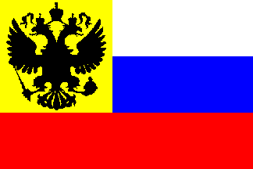
The Russian Revolution

Slide 2
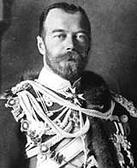
Pre-Revolutionary Russia
Only true absolute monarchy left in Europe
No type of representative political institutions
Nicholas II became tsar in 1884
Believed he was the absolute ruler
Married to Alexandra
Russo-Japanese War (1904) – defeat led to political instability

Slide 3
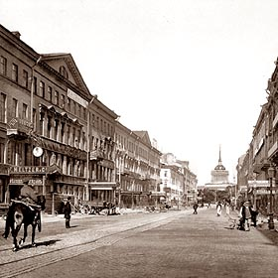
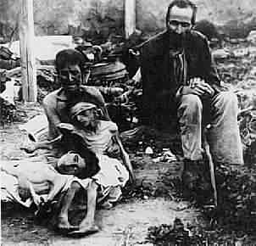
The Revolution of 1905
Russia is BAC.
Economy was agricultural.
Has to try and catch up with the rest of Europe – industrialize!
Rapid growth of working class is result
Two major industrial centers St. Petersburg and Moscow

Slide 4
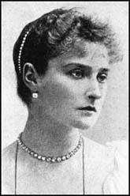
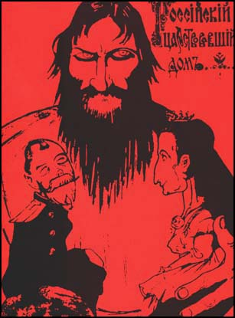
Alexandra Had Issues
She was a German Princess!
And Germany was a rival.
She was under the influence of Rasputin
Origins of Rasputin’s power - ?
She had married into her own family…
Hemophilia

Slide 5
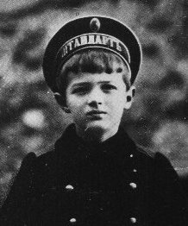
Alexis: Alexandra’s Son with Hemophilia

Slide 6
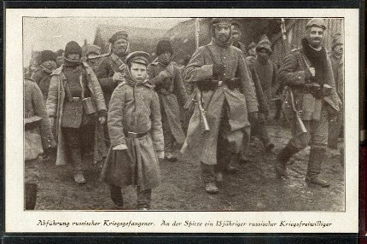
World War I: “The Last Straw”
War revealed the weakness of Russia again
Corrupt military leadership had contempt for ordinary Russian people – cannon fodder!
Average peasants had very little invested in the War

Slide 7
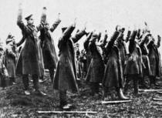
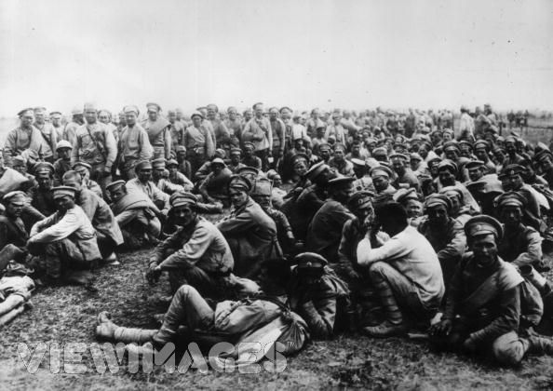
World War I (cont)
Russia was not ready for industrial war
Used up all their shells in the first 9 months of the war!
the result:
mass desertions
2 million casualties by 1915
Chaos and disintegration of the Russian Army

Slide 8
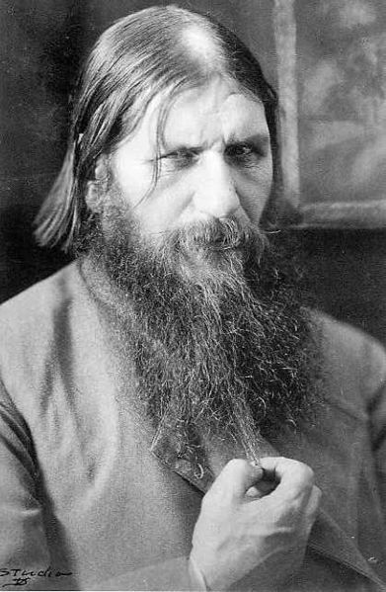
The Collapse of the Imperial Government
Nicholas left for the Front (King leads his military into battle?)
Alexandra and Rasputin accused of treason (and “other” things.
Rasputin assassinated in December of 1916
Took several attempts

Slide 9
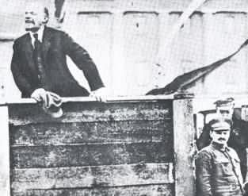
The Two Revolutions of 1917
The March Revolution (March 12) Menshevik (Less ‘revolutionary’)
The November Revolution (November 6) Bolshevik (more ‘revolutionary’)

Slide 10
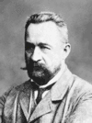
The March Revolution
Origins: Food riots/strikes
Tsar ordered soldiers to intervene; instead they joined the rebellion…the Tsar abdicated
New Provisional Government led by a Menshevik, Alexander Kerensky
Very Popular
Kerensky favored gradual socialist reform
However, saw the war effort as #1 priority

Slide 11
Lenin
Revolutionary from early on
Arrested and sent to Siberia
Fled to Switzerland
Adapted Marx
Not a revolution of the people, needed professional leadership.
A dictatorship of the proletariat

Slide 12
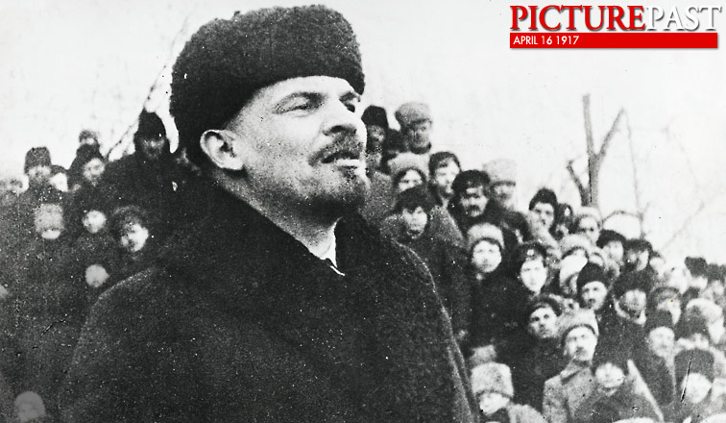
Lenin Returns
With Russia in a state of chaos and Germany struggling on the Western Front, Germany helps transport Lenin from exile into Russia to help lead a revolt. The idea was that Russia would make peace, and Germany could redeploy their army to the West.
(US had just
joined WW I )

Slide 13
The End
Karensky announces new summer offensive
Unpopular – mass desertion
Lenin pushes for reform
New slogan
“Peace, Land, Bread”
Takeover the Kremlin and “storm the Winter Palace” (Bastille / Boston Tea Party)
Bolsheviks in charge

Slide 14
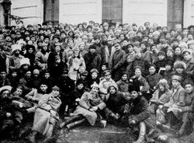
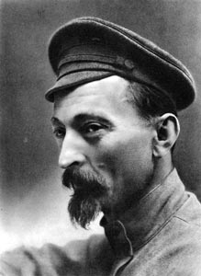
November Revolution (cont)
Revolutionary army created with Trotsky in charge = “Red Army”

Slide 15
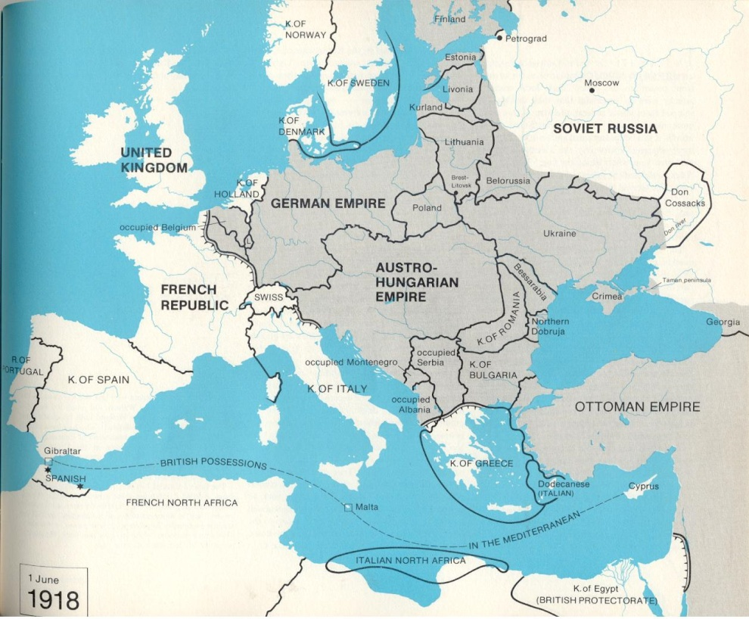
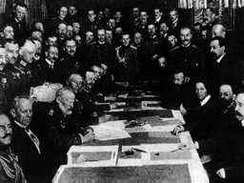
November Revolution (cont)
Lenin’s 1st task was to get Russia out of the war so he could concentrate on internal reform…
The Treaty of Brest-Litovsk
Mensheviks wanted to regain their power.
Civil War followed, 1918-1922
→“Reds” versus “Whites”
Complete breakdown of Russian economy and society

Slide 17
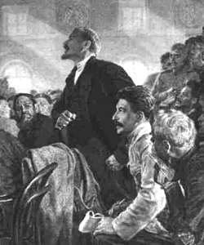
^{USSR / CCCP}
Civil war REDS V WHITES
Estimated 9 million die as a result
West supported WHITES. Why?
War communism allowed Bolsheviks to do whatever they deemed necessary to win. After war Lenin introduces
NEP - Limited capitalism
Opposed by pure Marxists – assassination attempt 1922
Lenin dies as a result 1924.
Who will succeed?

Slide 18
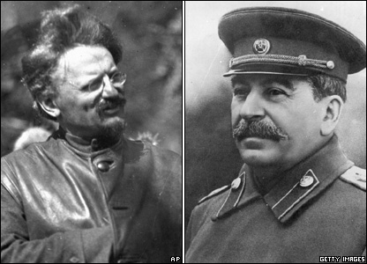
Leon Trotsky
Flamboyant leader of revolution, theorist and military hero
Josef Stalin quiet bureaucrat.

