Slide 1
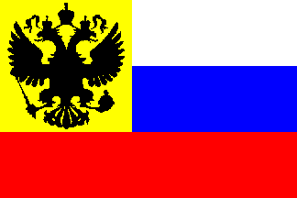
The Russian Revolution

Slide 2
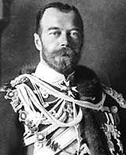
Pre-Revolutionary Russia
Only true autocracy left in Europe
No real representative political institutions
Nicholas II became Tsar in 1884
Believed he was the absolute ruler
Russo-Japanese War (1904) – defeat led to political instability

Slide 3
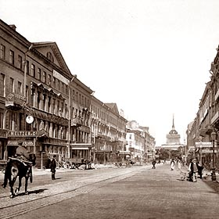
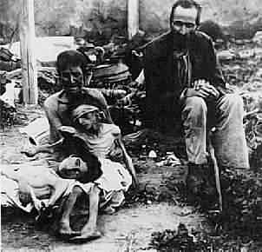
The Revolution of 1905
Rapid growth of (discontented) working class
Vast majority of workers concentrated in St. Petersburg and Moscow
Little help from the countryside. Impoverished peasants – Populist Movements of the 1870s and latter had done little to improve their lot
No individual land ownership
Rural Famine

Slide 4
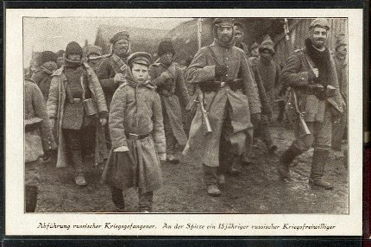
World War I: “The Last Straw”
War revealed the ineptitude and arrogance of the country’s aristocratic elite
Corrupt military leadership had contempt for ordinary Russian people
Average peasants had very little invested in the War

Slide 5
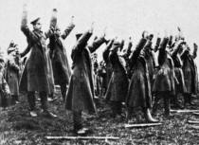
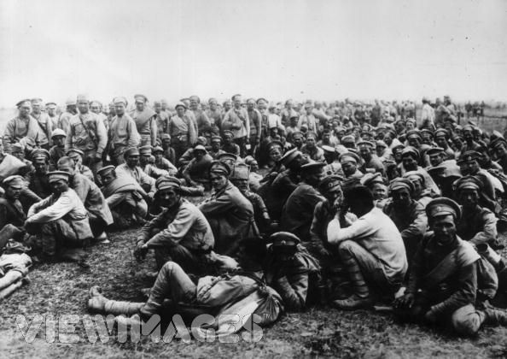
World War I (cont)
ill-trained, ineffective officers, poorly equipped (Russia was not ready for industrial war)
the result:
mass desertions
2 million casualties by 1915
Battle of Tannenberg August, 1914 - massive defeat at hands of Gen. Hindenburg who becomes a war hero as a result. (more later)
Chaos and disintegration of the Russian Army

Slide 6
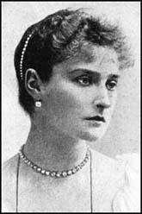
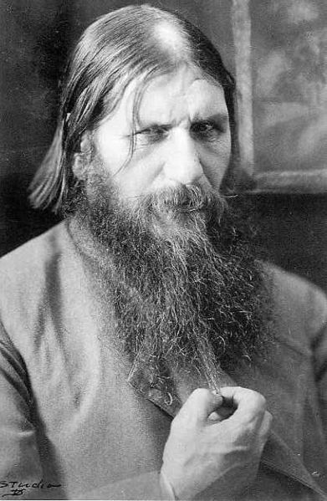
Alexandra: The Power Behind the Throne
Even more blindly committed to autocracy than her husband
She was under the influence of Rasputin
Origins of Rasputin’s power - ?
Hemophilia
Scandals surrounding Rasputin served to discredit the monarchy

Slide 7
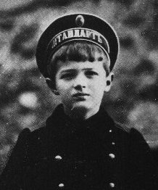
Alexis: Alexandra’s Son with Hemophilia

Slide 8
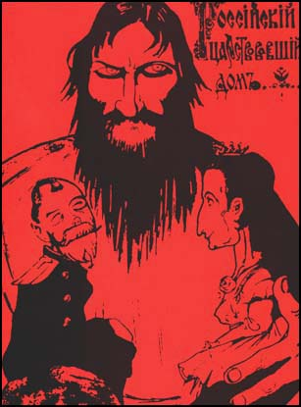
The Collapse of the Imperial Government
Nicholas left for the Front—September, 1915
Alexandra (and Rasputin) left in charge.
Country falls into chaos
Alexandra and other high government officials accused of treason

Slide 9
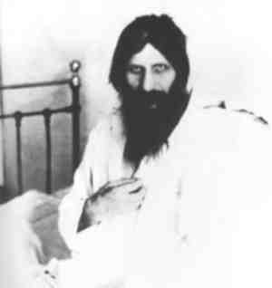
The Collapse of the Imperial Government
Rasputin assassinated in December of 1916
Complete mismanagement of the wartime economy
Industrial production plummeted, inflation and starvation were rampant, and the cities were overflowing with refugees
Cities then became a hotbed for political activism. By March 1917, strikes and food shortages showed Revolution was a real and serious threat, especially in St. Petersburg

Slide 10
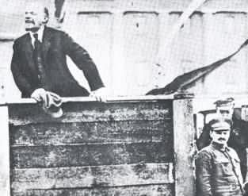
The Two Revolutions of 1917
The March Revolution (March 12)
The November Revolution (November 6)

Slide 11
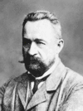
The March Revolution
Origins: Food riots/strikes
Remember France? Not just lending money apparently!
Duma declared itself a Provisional Government on March12
Tsar ordered soldiers to intervene; instead they joined the rebellion…the Tsar abdicated on March 17
The Menshevik, Alexander Kerensky headed the Provisional Government,
Very Popular Revolution
Kerensky favored gradual socialist reform
However, saw the war effort as #1 priority

Slide 12
Kornilov Affair
Karensky announces new summer offensive
Unpopular – mass desertion
Karensky clashed with new Commander (Kornilov) over use of death penalty for desertion
General Kornilov attempted to overthrow Provisional Government with military takeover
To prevent this takeover, Kerensky freed many Bolshevik leaders from prison and supplied arms to them.
They are the Red Guard to protect the government!

Slide 13
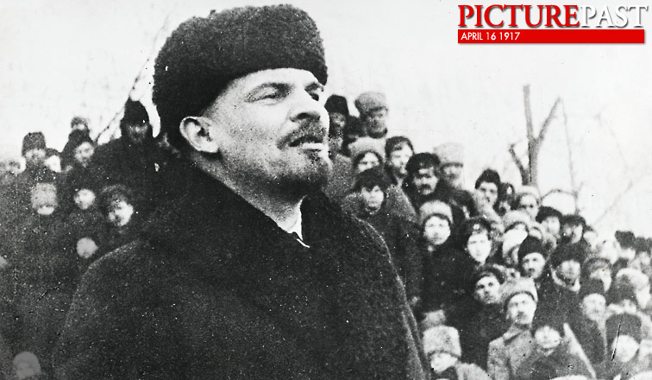
Lenin Returns
With Russia in a state of chaos and Germany struggling on the Western Front, Germany helps transport Lenin from exile into Russia to help lead a revolt. The idea was that Russia would make peace,
and Germany
could redeploy
their resources.

Slide 14
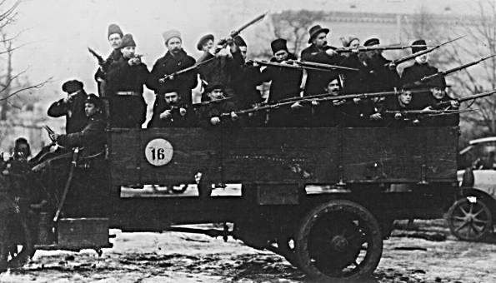
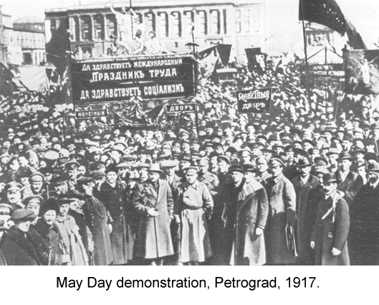
The Petrograd Soviet
leftists in St. Petersburg formed the Petrograd Soviet.
They claimed to be the new govt.
Lenin and Red Guard protect Petrograd
“We are fighting against Kornilov not for Karensky”

Slide 15
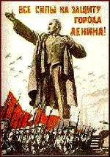
Lenin Steps into This Vacuum
Lenin’s arrival in Petrograd
A tremendously charismatic personality
“Peace, Land, Bread”
“All Power to the Soviets”
He preached that the war was a capitalist/imperialist war that offered no rewards for the peasants/workers; he also felt the war was over with the Tsar’s abdication.
Bolshevik party membership exploded; their power was consolidated

Slide 16
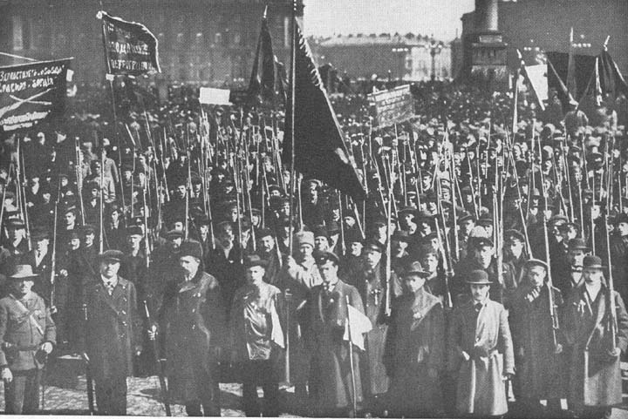
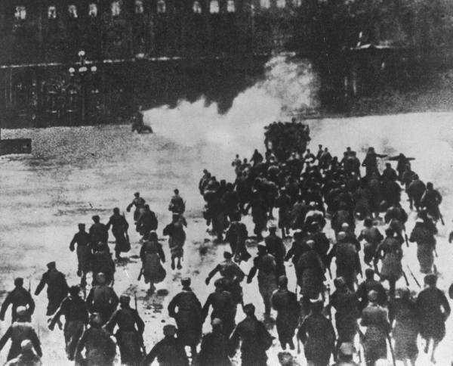
The November Revolution
Nov. 6, 1917…
Leon Trotsky, who had gained the confidence of the army led the coup
(= the “Red Miracle”)
Election set January 1918
Social revolutionaries win the majority
Lenin disbanded the Constituent Assembly using the Red Army.
Council of People’s Commissars was created
All private property was abolished and divided among the peasantry
Largest industrial enterprises - nationalized

Slide 17
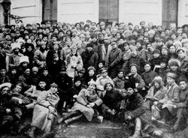
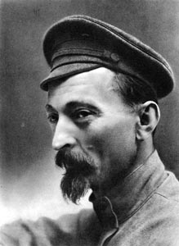
November Revolution (cont)
Political Police organized: CHEKA
Revolutionary army created with Trotsky in charge = “Red Army”
Bolshevik Party renamed Communist Party in March of 1918

Slide 18
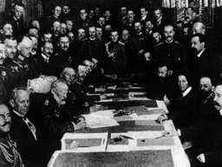
November Revolution (cont)
Lenin’s 1st task was to get Russia out of the war so he could concentrate on internal reform…
The Treaty of Brest-Litovsk negotiated with the Germans, giving them much Russian territory, population, and resources
Assassination attempt
Civil War followed, 1917-1920
→“Reds” versus “Whites”
Complete breakdown of Russian economy and society

