Slide 1
The Scientific Revolution Mid 1500s 0n

Slide 2
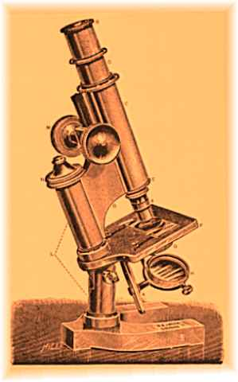
Causes of the Scientific Revolution (after Reformation starts)
The Italian Renaissance
Renewed emphasis on mathematics
Navigational problems of long sea voyages.
Why was this an issue?
MONEY!
Better scientific instruments were being made for the above reasons.
Everything feeds each other!

Slide 3
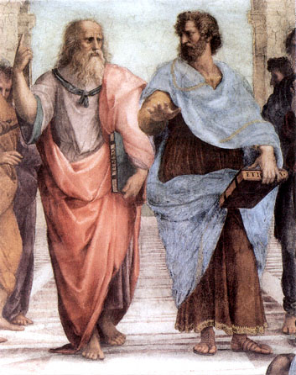
The Old Universe
View of the universe was derived from Ptolemy and Aristotle.
Heavens were perfect…. (Why? what does this mean?)
Relied on observation and conclusion – hence a Geocentric view.
“The world at the center with the heavens, planets etc pushed around perfect circular crystal spheres by angels.”
Idea of experience, experiment and empiricism
This was supported by the Church! WHY?

Slide 4
Scientific “Revolutionaries”

Slide 5
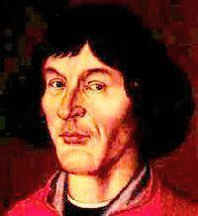
Copernicus (1473-1543)
Aims to correct errors in the calendar.
Result was a Sun centered universe - Heliocentric
Aristotle in all other ways.
Earth no different than any other planet
“On the Revolutions of the Heavenly Spheres”
(1543 the year he died -no coincidence)

Slide 6
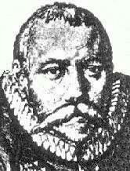
Tycho Brahe (1546-1601)
Most sophisticated observatory of his day
Tons of observations every night. Most earlier observers were not so dedicated.
Observes super nova!
Why is this important?
Discovered comet shooting right through crystal spheres (but no broken crystal?)

Slide 7
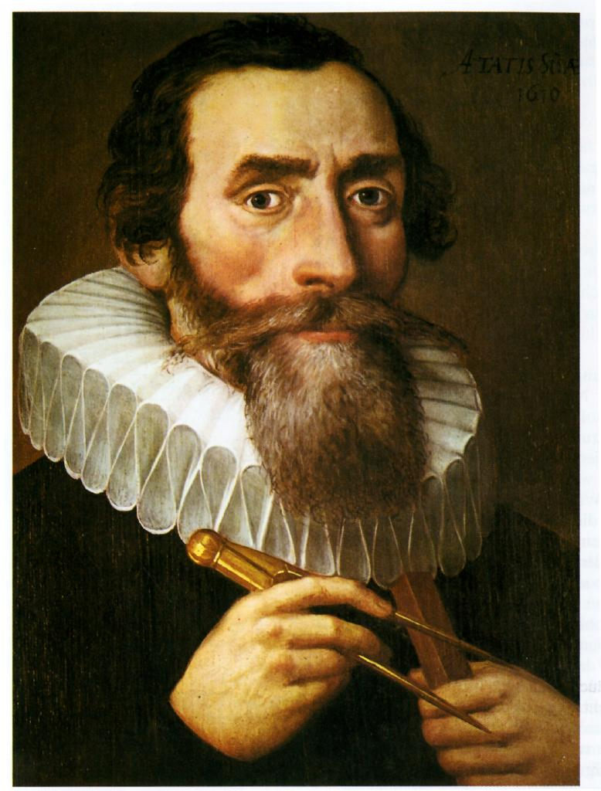
Johannes Kepler (1571-1630)
Student of Brahe
Planetary motion conforms to mathematical formulae
Elliptical orbits
Planets move at different speeds during their orbits
Speed and distance travelled along orbit proportional to distance from the sun
3 Laws of Planetary Motion

Slide 8
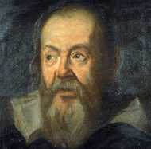
Galileo Galilei (1564-1642)
Early practitioner of the experimental method (rolling balls)
Mathematical formula for acceleration of falling objects
Has to accurately measure time – pendulum
Discoveries using the telescope
Moons, sun spots and craters
“The Starry Messenger”

Slide 9
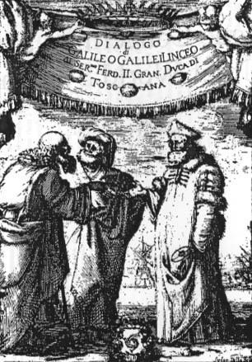
Galileo (contd)
Things were OK until Galileo started talking publically about his observations.
Church said STOP!
Publishes Dialogue Concerning the Two Chief World Systems
But…Galileo ordered to appear before the Inquisition

Slide 10
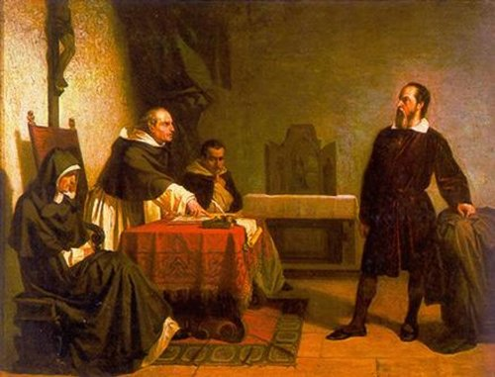
Trial of Galileo
Galileo ready to prove Copernican theory.
Issue was no longer Copernicus and whether he was right or not, but the authority of the Church.
Old, fearful and broken Galileo recants (takes back his ideas) and spends the rest of his life (8 years) under house arrest.

Slide 11
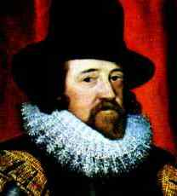
Francis Bacon (1561-1626)
Father of the Scientific Revolution
The Scientific Method
Question in a logical method
Argued against idea that there was no new knowledge
Emphasis on practical, useful knowledge not “Biblical nonsense”

Slide 12
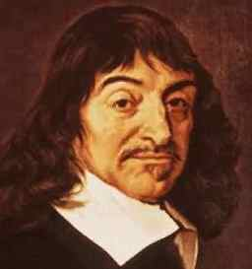
Rene Descartes (1596-1650)
Father of “analytical geometry”
Emphasized the significance of Doubt. Never blindly believe. (the church?)
Believed in Rationalism / deduction.
Come to conclusions based on logic.
Founder of modern philosophy
“I think therefore I am.”
Senses can be tricked therefore cannot be trusted. How can your senses be tricked???
IF you cannot trust your senses, what is real?
THE MATRIX…

Slide 13
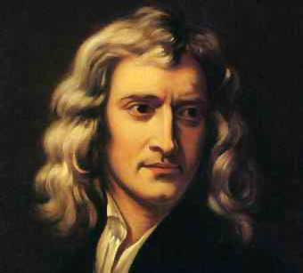
Isaac Newton (1642-1727)
“If I have seen farther, it is because I have stood on the shoulders of giants”
‘Responsible’ for Calculus
Blends inductive and deductive methods
Argues for a universe governed by natural laws
Idea that one force affects all objects and varies with mass and distance
Principia; Mathematical Principles of Natural Philosophy (1687)

Slide 14
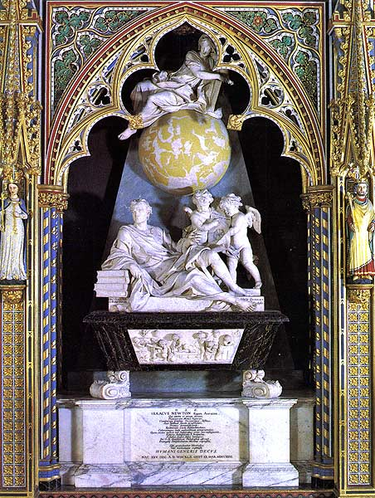
Newton’s Legacy
Proof that nature was based on order
Not just faith based, but predictable and reasonable
Science and Religion work together
Nature could be understood
Nature and Nature’s laws lay hid in night:
God said let Newton be:
And all was light.

Slide 15
Medical Advances
Medicine was based on superstition and the work of the Greeks. (Galen and Hippocrates)
4 humors. Imbalance caused sickness… to rebalance the excess was “removed”.
Black Death changed much. Inexplicable!
Killed 1/3 of Europe
Very contagious!
What was it caused by? How did they “know”?
God…, Devil, Foul smells, humors
These ideas will become part of thinking in the 1700s

Slide 16
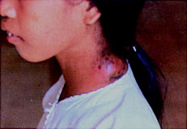
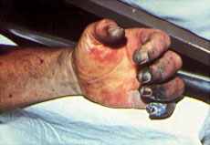
The Symptoms
Bulbous
Septicemia Form: almost 100% mortality rate.

Slide 17
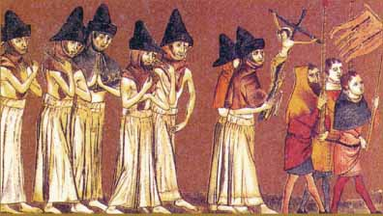
Attempts to Stop the Plague
Flagellanti: Self-inflicted “penance” for our sins!

Slide 18
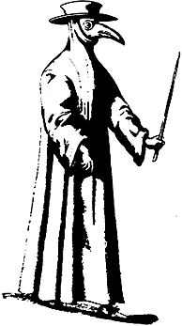
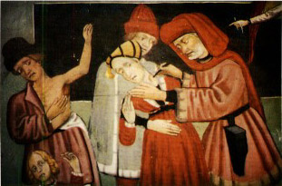
Attempts to Stop the Plague
“Leeching”
A Doctor’s Robe
Black death song

Slide 19
Medicine
Improved medical treatment. No idea about germs or hygiene.
Microscope - Leeuwenhoek uses it to look at blood and saliva – bacteria (doesn’t understand them)
Versalius corrects Galen’s ideas on anatomy. Knows where stuff is but not how it works
Harvey demonstrates the heart and circulation Still thinks there are 2 types of blood. WHY?
Vaccination – Jenner. “Cures” smallpox

