Slide 1
Early
Russian
History

Slide 2
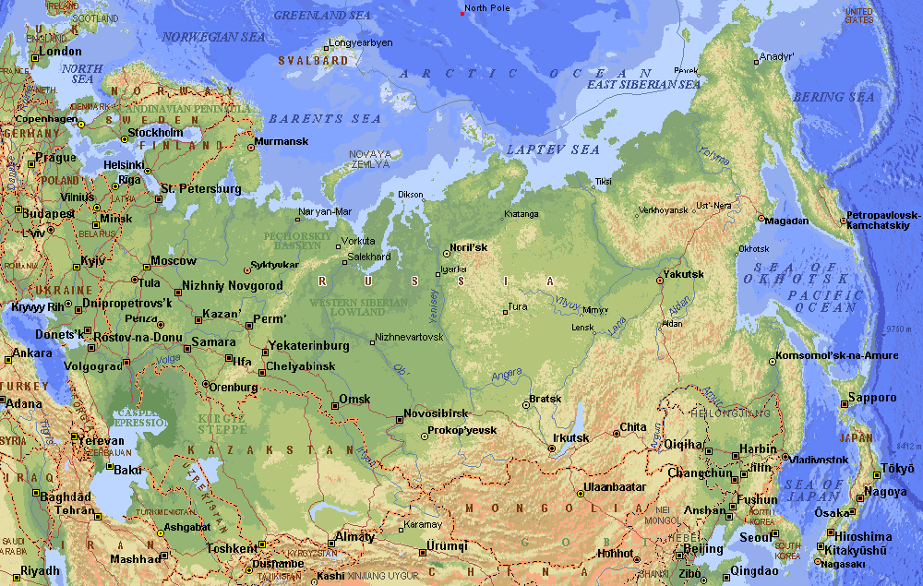
Russia Today

Slide 3
Former Soviet Region Compared in Latitude & Area with the United States

Slide 4
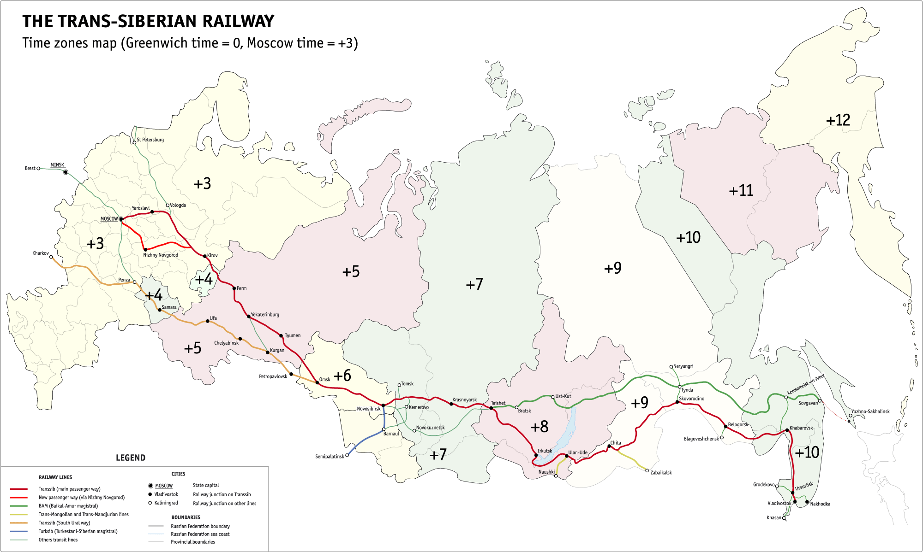
Russia’s Time Zones

Slide 5
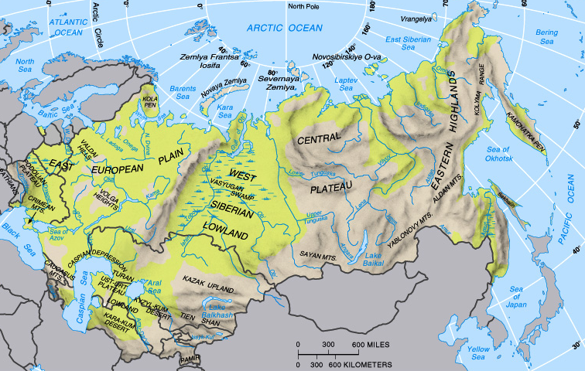
Topography of Russia

Slide 6
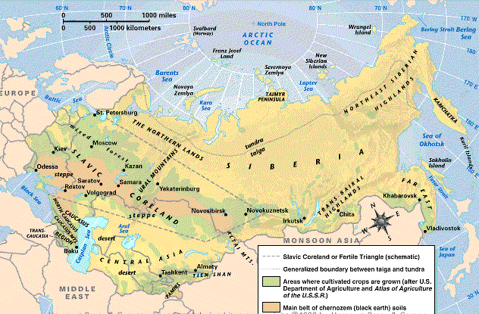
Rich Soil of the Steppes
Chernozen Soil

Slide 7
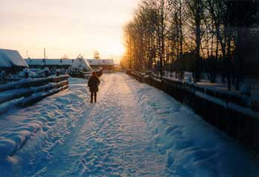
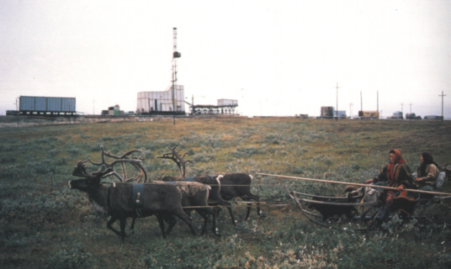
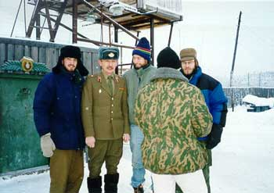
Siberia → “Permafrost”
Average temperatures of January vary from 0 to -50°C, and in July from 1 to 25°C
150,000,000 population.
A former “gulag” Soviet prison camp.

Slide 8
Themes in Russian History
Expansion by conquest.
Need for warm-water ports.
The necessity of a strong, central government.
Control of multiple ethnic, cultural and religious groups
Protection from neighboring countries

Slide 9
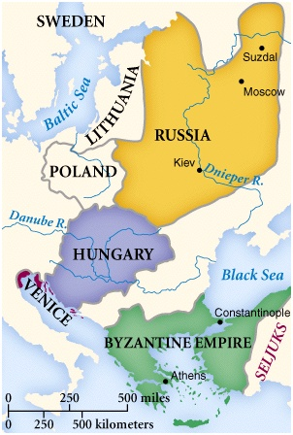
Early Russia

Slide 10
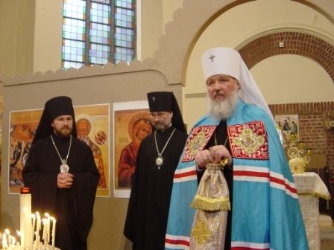
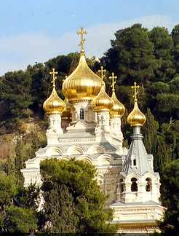
Early Byzantine Influences: Orthodox Christianity
Rus choose Orthodoxy over R.C. because of the beauty of the buildings (Hagia Sophia)

Slide 11
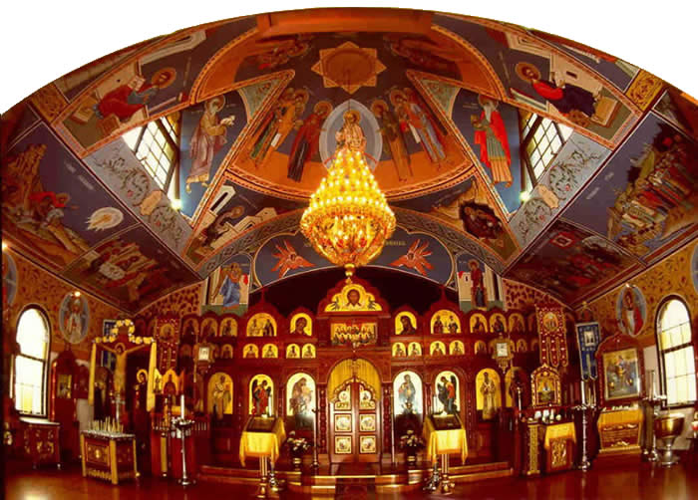
Early Byzantine Influences: Orthodox Christianity

Slide 12
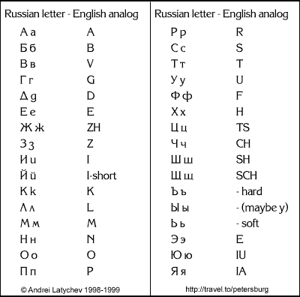
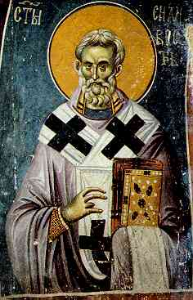
Early Byzantine Influences: Cyrillic Alphabet
Monk, Cyril goes to Rus to teach Orthodoxy helps develop alphabet for their language

Slide 13
Think about the impact of the choices made by the Rus. How do they affect Russia?
What other things have a huge effect on the development of Russia?

Slide 14
“Stuff” that made a difference
Mongol invasion WHY?
Geography HOW?
Written language HOW?
Religion WHY
Black death (lack thereof) WHY

Slide 15
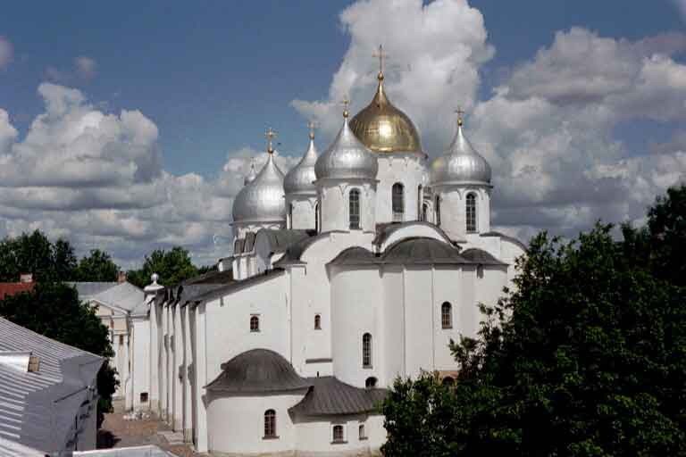
Novgorod
(Early Capital)

Slide 16
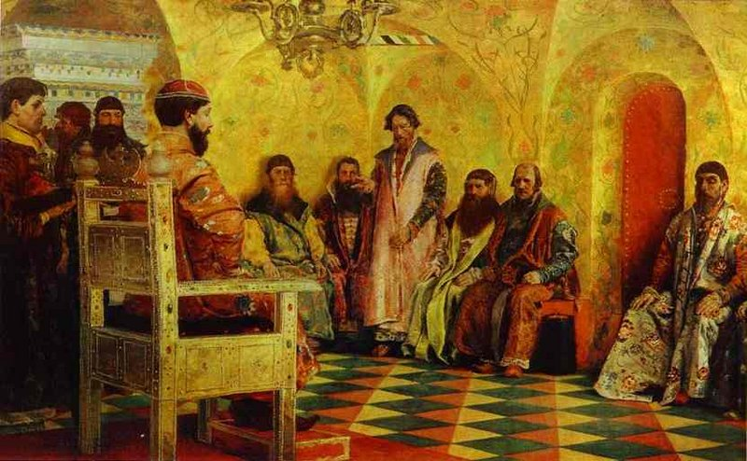
Russian Boyars

Slide 17
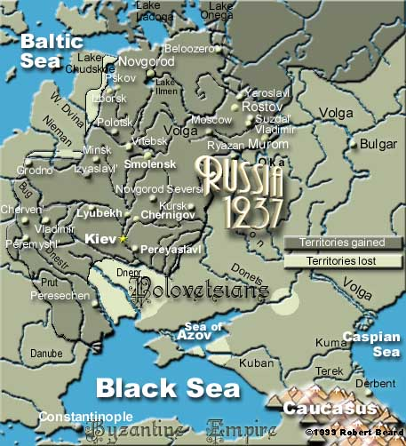
Russian Expansion

Slide 18
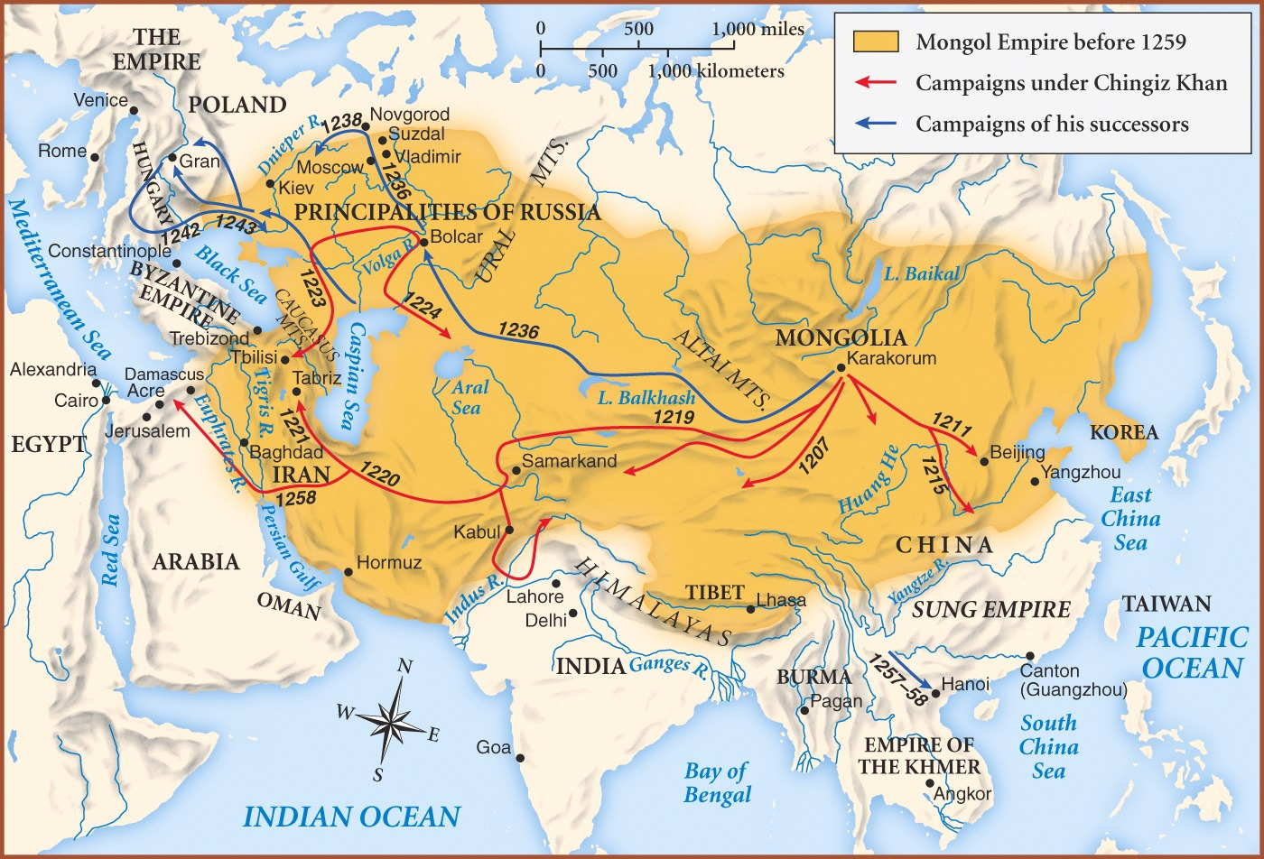
The Mongols Invade Russia
Known as Golden Horde/Tartars. Mongols wreaked havoc on Eastern Europe. They were the Borg of their day. Resistance was futile! Novgorod resisted and was destroyed. Moscow became the new capital

Slide 19
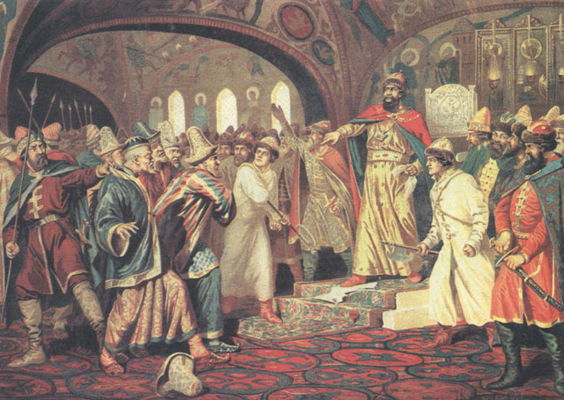
Ivan the Great (r. 1462-1505)
Ivan III Tearing the Great Khan’s Letter Requesting More Tribute in 1480.

Slide 20
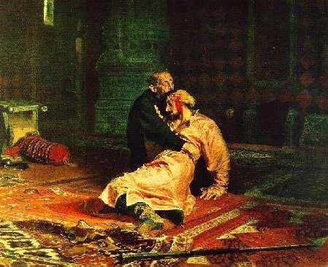
Ivan IV (TERRIBLE) it means awesome although he was mean too
Ivan inherited the throne age 3. Boyars ruled in his stead, led by Shulsky.
Ivan gains control age 13 and has Shulsky thrown to the dogs (they tore him apart)
What he wanted:
Respect for throne
Expand the kingdom
Reduce the power of the
Boyars.
Pushed the idea that he
was descended from
Caesar. Hence CZAR
(killed his son in a fit of rage)

Slide 21
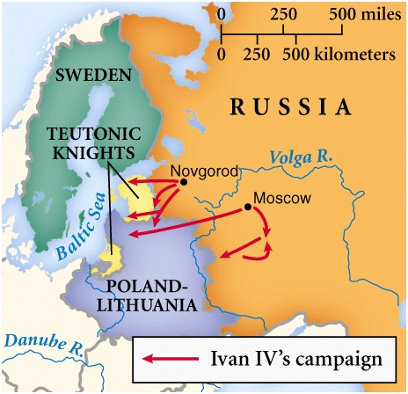
More Ivan IV
Conquered the Khanates of the Tartars
Sets sights on Poland and Lithuania, but fails, and abdicates
Returns but very paranoid (this is his reputation) Divides Russia in 2

Slide 22
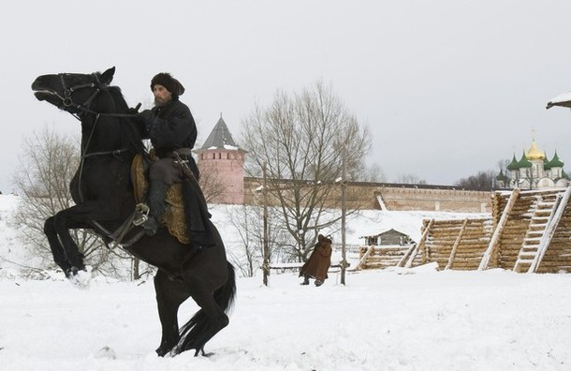
Russia in the Late 1500s
2 Part Russia:
One as it had always been
Ivan ruled the other with an iron fist!
Known as Oprichnina.
Ivan set up secret police (not for the last time) called Oprichniki.
They carried dogs heads and brooms to symbolize sweeping out the treacherous dogs.
And surprise, surprise,
they found thousands
of them!
(not for the last time)

Slide 23
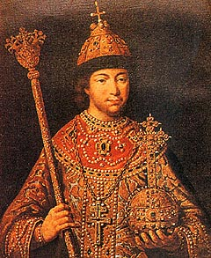
Michael Romanov (r. 1613-1645)

Slide 24
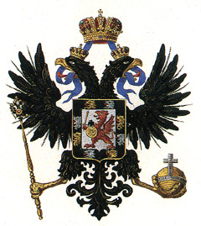
Romanov Dynasty (1613-1917)
Romanov Family Crest
What bird is part of the crest?

Slide 25
The Pendulum of Russian History
Pro-West For Progress & Change Encourage New Ideas, Technologies, etc.
Anti-West Isolationist Xenophobic Ultra-Conservative
A few Tsars
Intellectual elites
Merchants/businessmen
Young members of the middle class.
Most Tsars
Russian Orthodox Church
Military
Boyars
peasants
REFORM-MINDED LEADER
DEMAGOGUE

Slide 26
Peter the Great (r. 1682-1725)

Slide 27
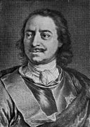
Modernize/Westernize Russia
Saw the advances made in the West
Willingly or not Peter was determined to force Russia into the modern era
Traveled to the West to learn
Carpentry
Mathematics
Military training and tactics
Including how to torture (must have visited Britain)
Started with Church, education, economy and military

Slide 28
Church
Why go after the Church?
Wealth
Power and influence
Patriarch died. Peter replaced him with group known as SYNOD
1721 Regulation abolished hierarchy making positions the responsibility of the Synod
Clergy now answered to Peter.
Their job:
Work for state causes
Make congregations submissive to will of state

Slide 29
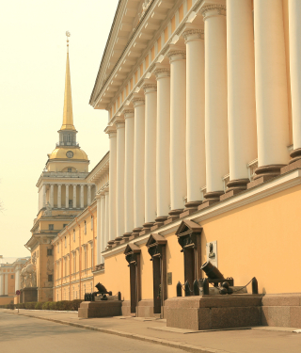
Education
Necessary part of ongoing changes to be made
Schools of navigation and math, artillery and languages 1701
State newspaper “Vedomosti”
School of medicine 1707
School of engineering 1712
Travel abroad to learn
new technology,
economics, political
thought

Slide 30
Military
Massive modernization in Navy and Army
ARMY
Limited professionals - Strelsky (abolished and soldiers spread through other regiments)
Russian army based on peasants going to battle for the Motherland led by village elders
All soldiers now trained in a uniform manner
Conscription meant large numbers (130,000 by 1725)

Slide 31
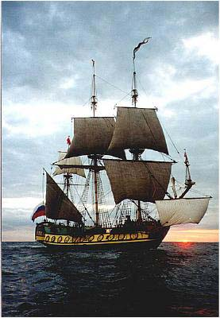
Military (contd)
Navy
Essentially Peter’s creation
Brought in foreign experts in sailing techniques
1725 48 ships
ready to expand the
Russian empire

Slide 32
Industry
Tried to copy mercantilist ideas
State dominated industrial output and purchased finished goods
Fixed prices
Profit only made on surplus production over the state’s demand
Agriculture remained medieval. Little technology. Remains this way until 1920s and 30s (Stalin 5 yr Plan)

Slide 33
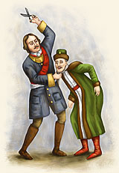
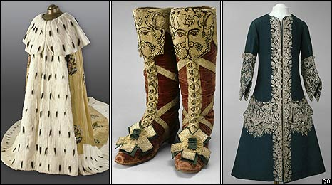
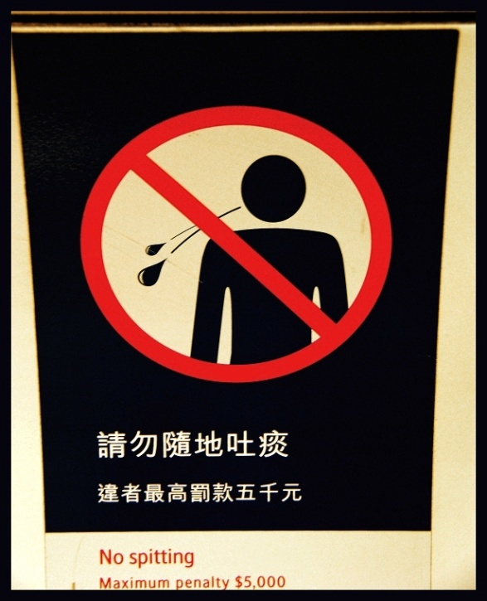
Westernization
Change to western lifestyle
no beard (tax)
unveil women
women allowed out in
society
no spitting
no scratching at dinner
clothing in French fashion

Slide 34
Cost for reforms
Peter did everything to raise capital for these reforms
TAXES
Social – beard etc.
Directly on households. To avoid paying families lived together in one house.
Soul tax on males. (every male owed a tax) If a man fled the community to avoid the tax, the village had to make up the difference.
Bee hives

Slide 35
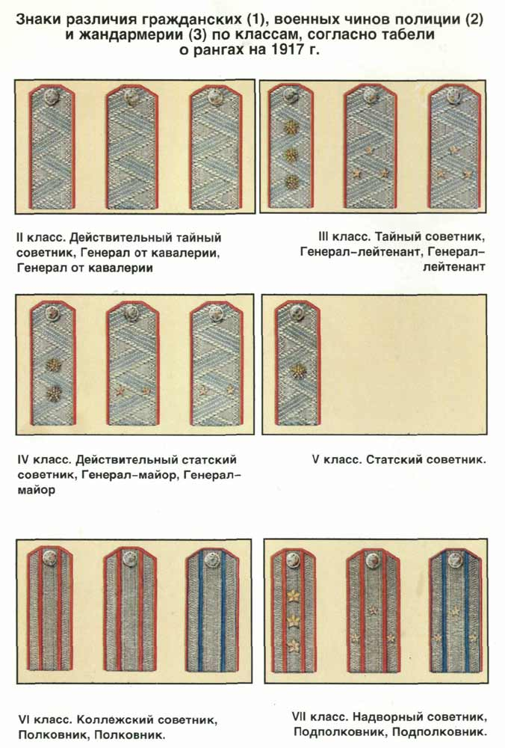
Table of Ranks 1722
Organized civilian and military position by service to emperor not seniority or birth.
Every civil, military
and court position
given a rank 1 – 14.
Gave Czar great
control
Continued until 1917.

Slide 36
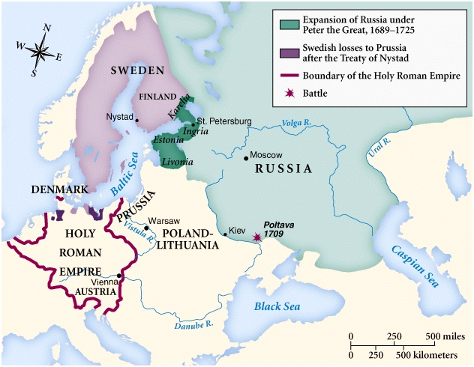
Russia & Sweden After the Great Northern War

