Slide 1
Early 18c Europe:
Proto-Industrialization

Slide 2
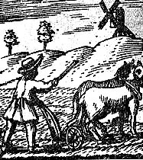
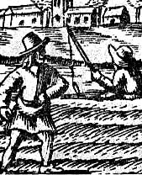
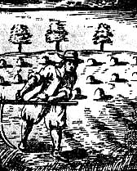
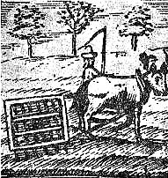
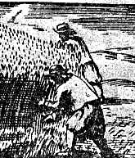
17c European Agrarianism

Slide 3
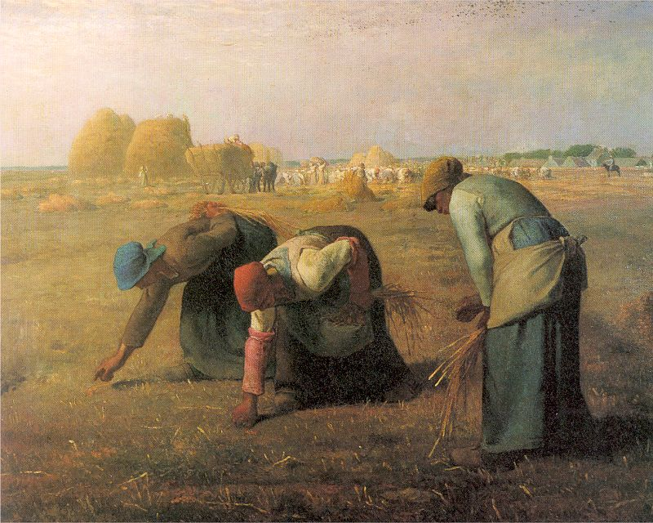
Feudal Common Field System

Slide 4
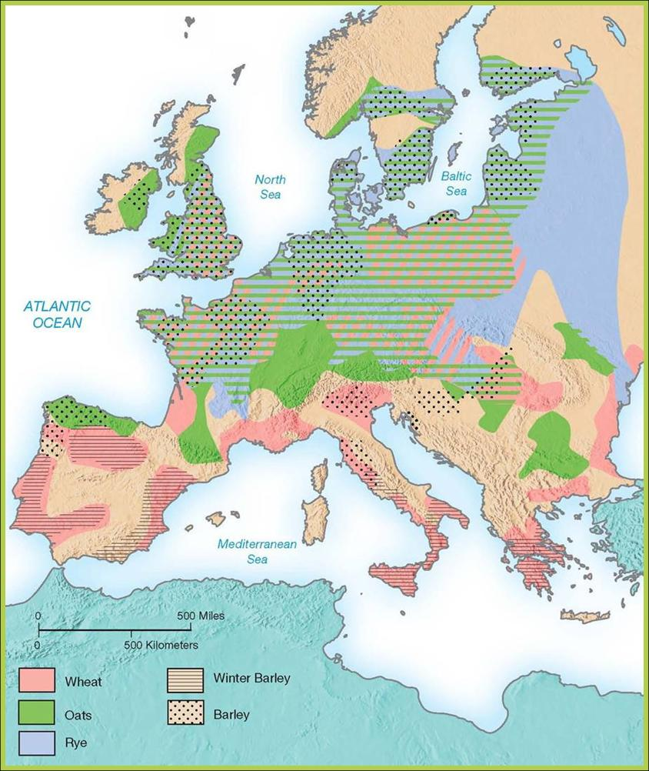
Cereal Crops in 18^{c} Europe

Slide 5
New Crops
Turnips – good for eating?
Helped development of crop rotation
New science - analysis of yields, dates etc.
Thomas Coke rudimentary fertilizers and field grasses.
Parishes controlled all planting in open areas
Landowners wanted change
ENCLOSE THE LAND

Slide 6
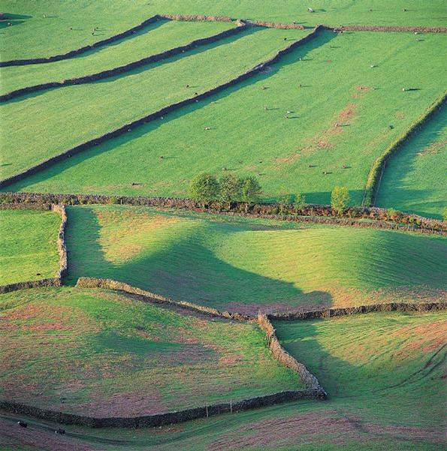
“Enclosed” Fields

Slide 7
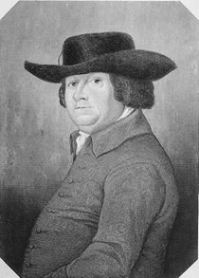
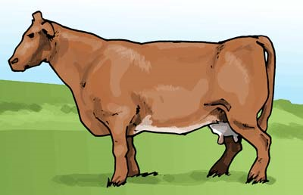
Bakewell and Selective Breeding
Again Science
By taking the biggest and best animals produced bigger and better offspring.
In 85 years the average cow for slaughter went from 370lbs to 840lbs

Slide 8
Population
Changes

Slide 9
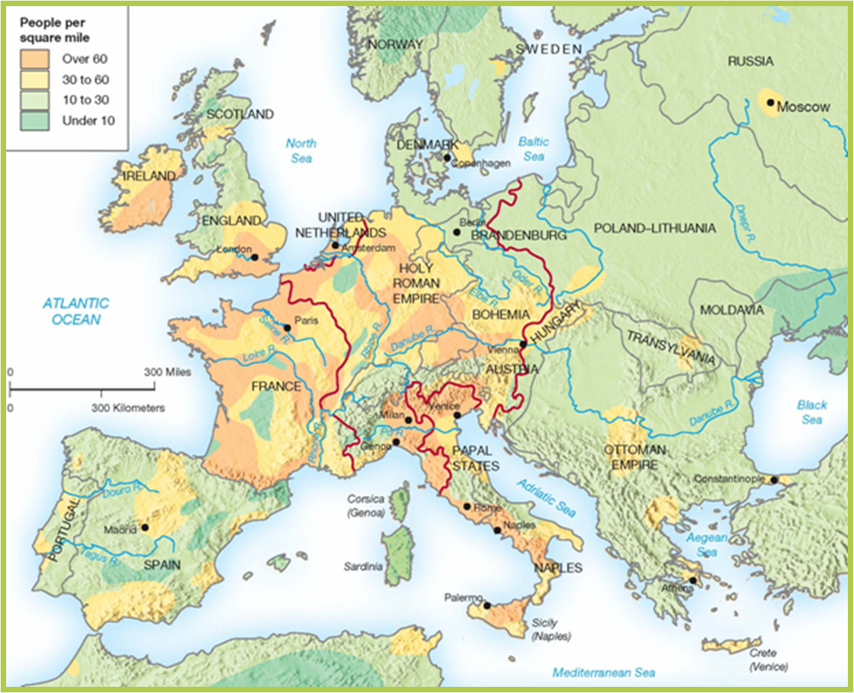
Population Density: 18c Europe

Slide 10
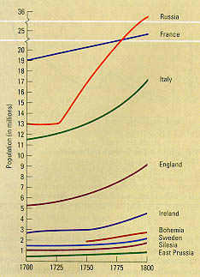
18c Population Growth Rate

Slide 11
Village and
Small Town
Life

Slide 12
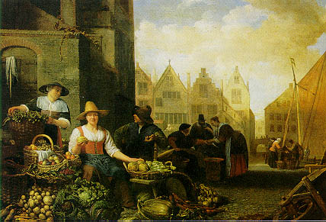
Small Town
“Farmer’s Markets”

Slide 13
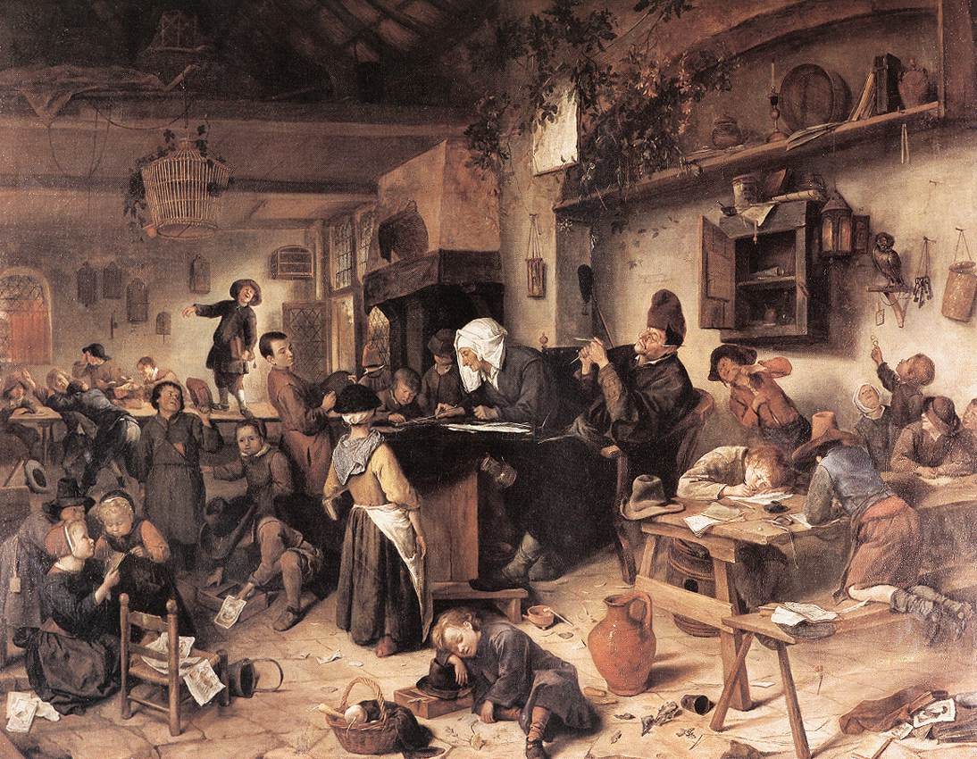
The Village School (17^{c})

Slide 14
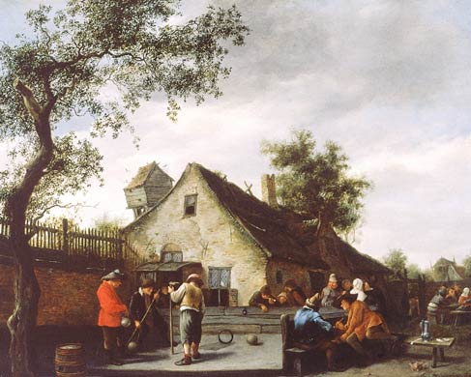
Country People Playing a Ball Game

Slide 15
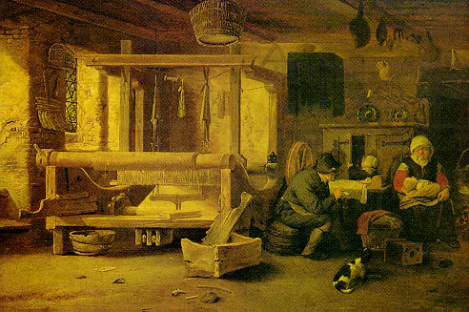
Supplemental Income → Cottage Industries: “Putting-Out” System”

Slide 16
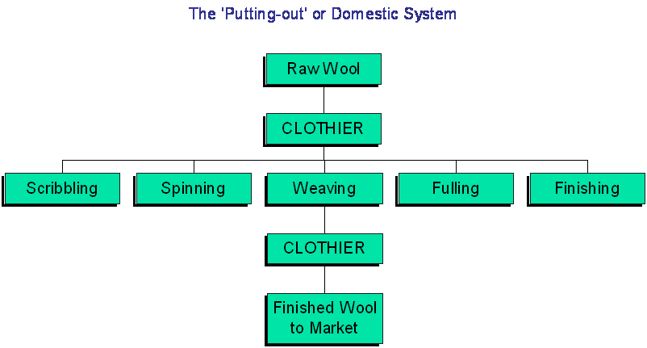
The “Putting-Out” System

Slide 17
Advantages of the Putting-Out System
Peasants could supplement their agricultural incomes.
Take advantage of winter months when farming was impossible.
Merchants could avoid the higher wages and often demanding regulations of urban labor.
Easier to reduce the number of workers when the economy was bad.
Merchants could acquire capital, which would later play a part in funding industrialization itself.
Peasants acquired future skills.
Young people could start separate households earlier, thus contributing to population growth.

Slide 18
Disadvantage of the Putting-Out System
When demand rose [which it did in the 18c] this system proved inefficient.
Merchant-capitalists found it difficult to induce peasant-workers to increase their output.
This dilemma eventually led to the factory system
All the workers were concentrated in one place under the supervision of a manager.
Water or steam power could easily be applied there.

Slide 19
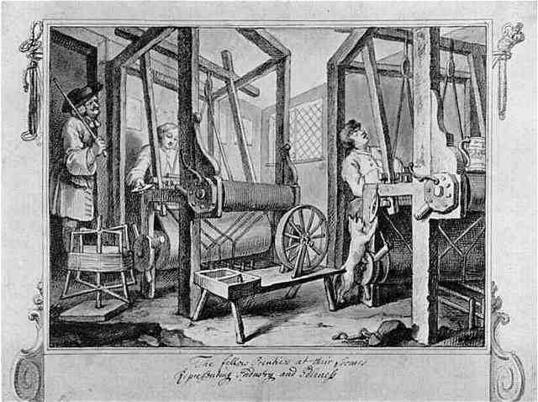
“Apprentices at Their Looms” William Hogarth, 1687

Slide 20
Why Was England
Different?

Slide 21
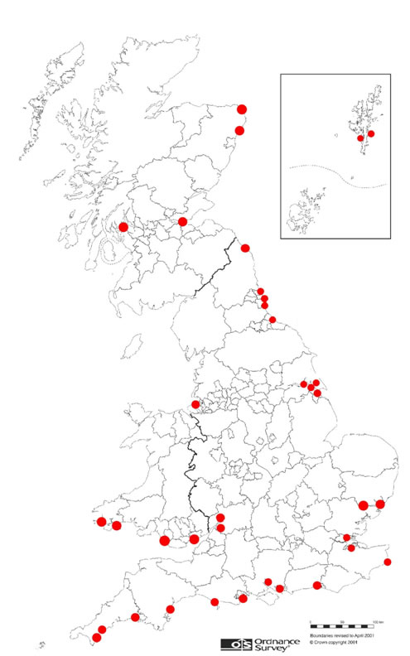
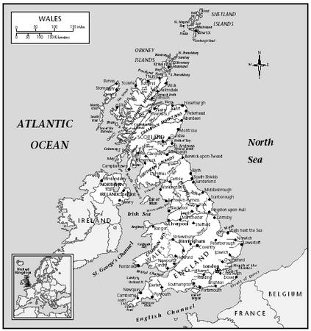
Ports
Lots of natural harbors
Established merchant navy

Slide 22
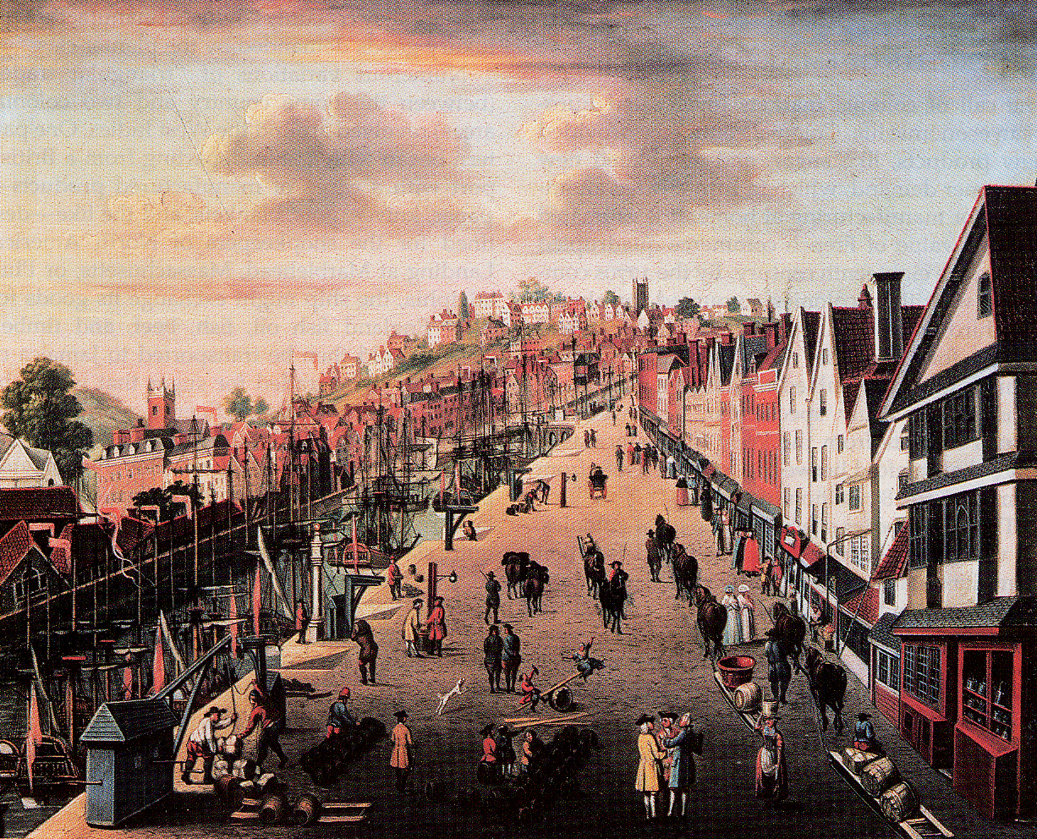
18c British Port

Slide 23
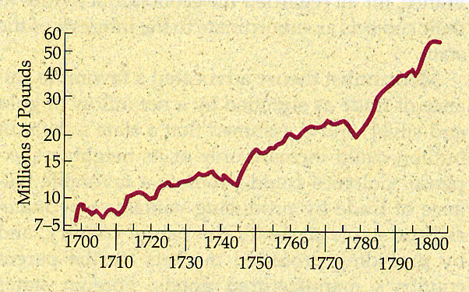
The Growth of England’s Foreign Trade in the 18c

Slide 24
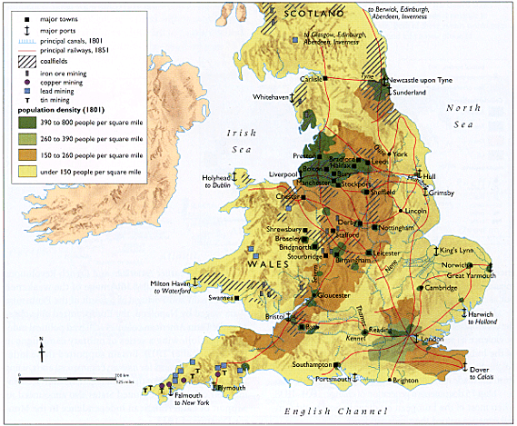
British Raw Materials

Slide 25
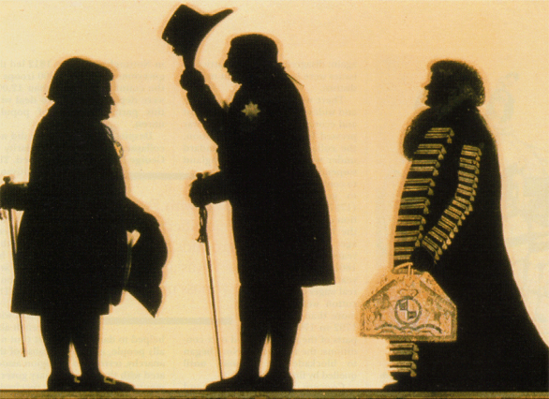
18c English “Nouveau Riche”: The Capitalist Entrepreneur

Slide 26
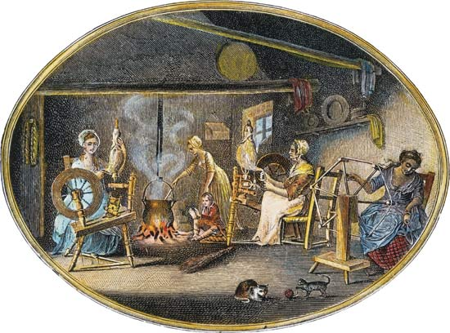
The First Factories
Growing demand for textiles leads to the creation of the first large factories
Putting out system can’t keep up with demand

Slide 27
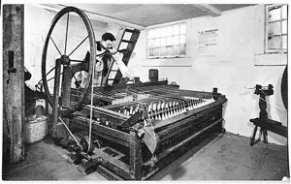
The First Factories
Flying Shuttle
Hargreaves’s Spinning Jenny and Arkwright’s water frame speed up spinning
Cotton spinning gradually moved to factories
Cotton goods cheaper and more available
Wages of weavers rise quick, workers move to become weavers

Slide 28
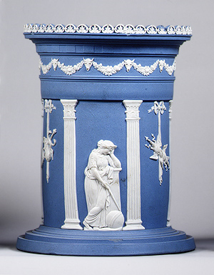
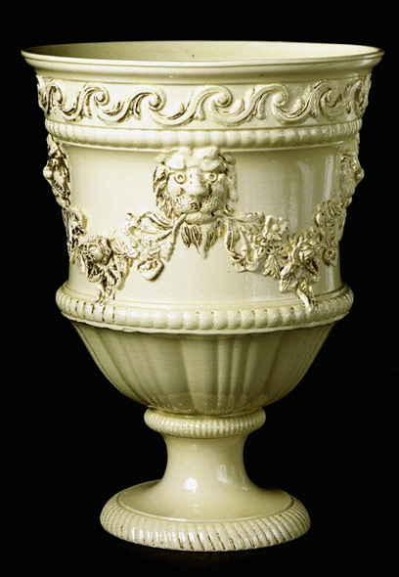
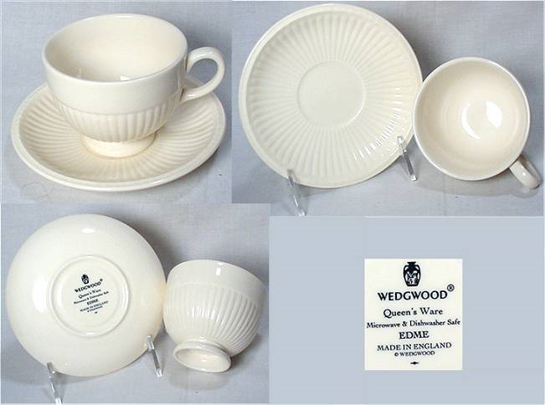
Wedgewood
Beginnings of factories for manufacture
Upgrade crockery more available
Social reformer (more later)
High end collectible pieces

Slide 29
For their 250th anniversary (2009), Wedgewood produced a series of collectibles including this 10.25” vase – Priced
$9500

