Slide 1
Mid-19c
European
Nationalism

Slide 2
The Ottoman Empire
Copied French model using French advisors – Tanzimat Reforms
Young Turks Movement for constitution rather than Sultan.
Increased secularization. (Still most secular Arab state)
France (Catholic) uses influence to gain “care” of Christian Holy places in Ottoman Empire. Had been domain of Russia (EO)
Russia declares war to “protect” EO Christians

Slide 3
The Crimean War
[1854-1856]
Russia
[claimed protectorship over the Orthodox Christians in the Ottoman Empire]
Ottoman Empire
Great Britain
France
Piedmont-Sardinia
Austrian support but no real participation (remember 1848 situation.)

Slide 4
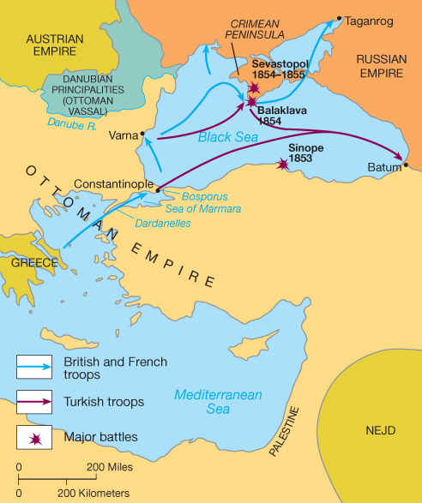
The Crimean War [1854-1856]

Slide 5
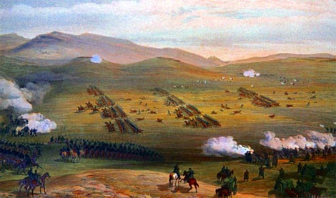
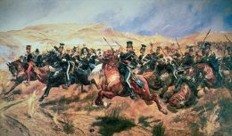
The Charge of the Light Brigade:
The Battle of Balaklava [1854]
Half a league, half a league,
Half a league onward,
All in the valley of Death
Rode the six hundred.
"Forward, the Light Brigade!
"Charge for the guns!" he said:
Into the valley of Death
Rode the six hundred…
"Forward, the Light Brigade!"
Was there a man dismay'd?
Not tho' the soldier knew
Someone had blunder'd:
Theirs not to make reply,
Theirs not to reason why,
Theirs but to do and die:
Into the valley of Death
Rode the six hundred.
A romanticized poem of the battle
by Alfred Lord Tennyson

Slide 6
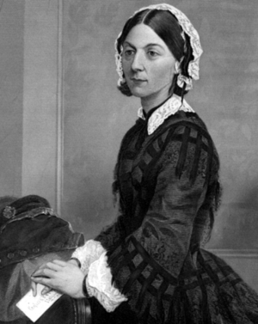
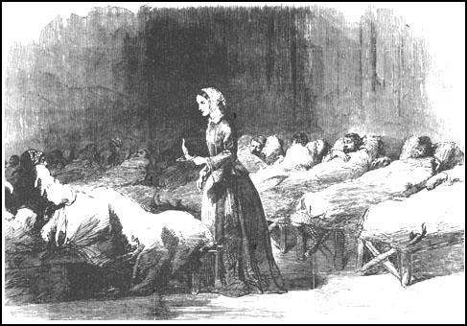
Florence Nightingale [1820-1910]
“The Lady with the Lamp”

Slide 7
Treaty of Paris [1856]
No Russian or Ottoman naval forces on the Black Sea.
All the major powers agreed to respect the political integrity of the Ottoman Empire.
Who benefitted?
Who lost big?

Slide 8
Results
Russian specter is destroyed.
  Austria plays this until WW I
Ottoman Empire propped up by GB and Fr.
  (plugged back in)
The Concert of Europe is gone. Major powers no longer working as a cohesive group to promote conservative ideology!
  Allows Italian and German unification.

Slide 9
Italian
Unification

Slide 10
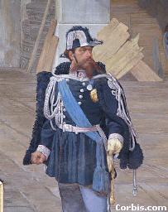
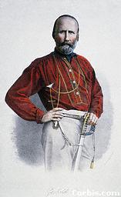
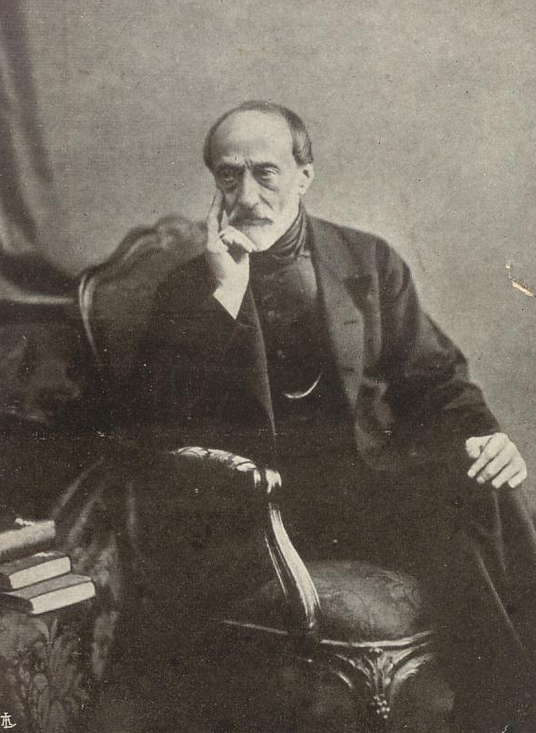
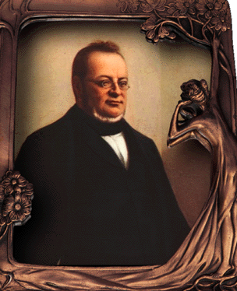
Italian Nationalist Leaders
King Victor
Emmanuel II
Giuseppi Garibaldi
[The “Sword”]
Count Cavour
[The “Head”]
Giuseppi Mazzini
[The “Heart”]

Slide 11
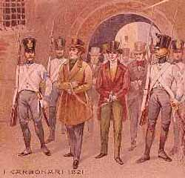
Step #1: Carbonari Insurrections:
Napoleon III was a member
“Carbonari”

Slide 12
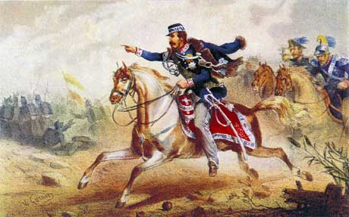
Step #2: Piedmont-Sardinia Sends Troops to the Crimea
Wanted to gain favor with France and Britain to help their independence movement (1848)

Slide 13
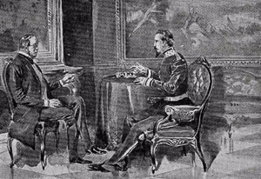
Step #3: Cavour & Napoleon III Meet at Plombières, 1858

Slide 14
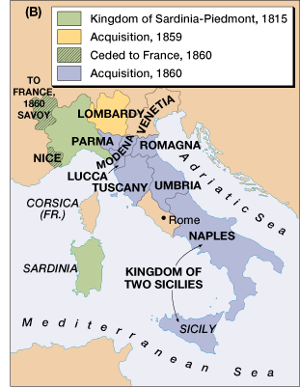


Step #4: Austro-Sardinian War, 1859
Swiss man Henri Dunant observed Battle of Solferino. So horrified by the carnage determines to create organization to care for the wounded. Result is…

Slide 15
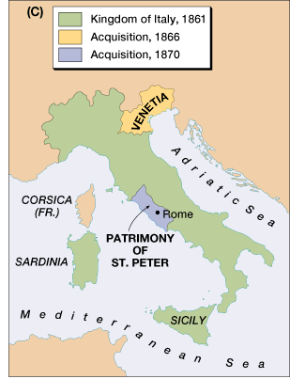
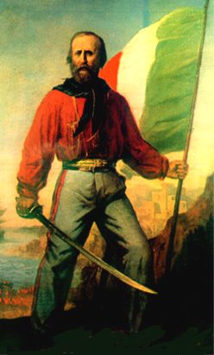
Step #5: Garibaldi & His “Red Shirts” Unite with Cavour

Slide 16
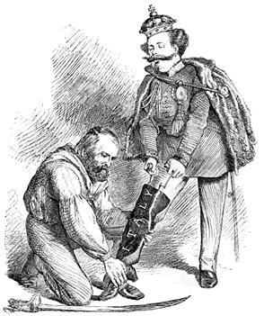
A Unified Peninsula!
A contemporary British cartoon, entitled "Right Leg in the Boot at Last," shows Garibaldi helping Victor Emmanuel put on the Italian boot.

Slide 17
The Kingdom of Italy: 1871
Not all a bed of Roses Problems within Italy:
Industrial North and agrarian south
Wanted Republic got Monarchy
Not fully united. Who was still independent?

Slide 18
German
Unification

Slide 19
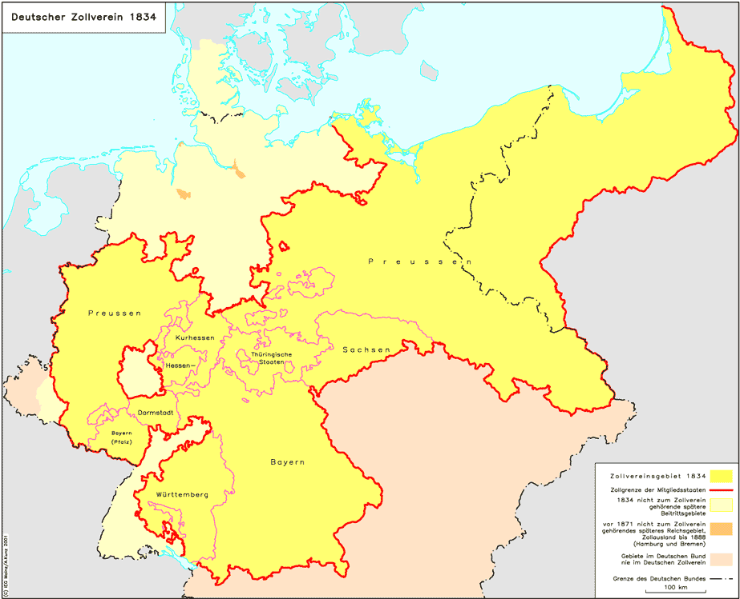
Zollverein, 1834

Slide 20
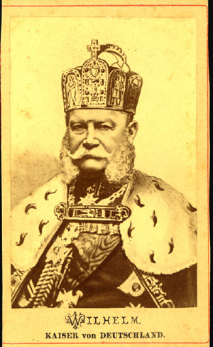
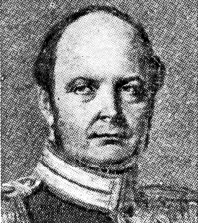
Is replaced by Kaiser Wilhelm I. Far more traditional Prussian. What does this mean?
Kaiser Frederick William IV is diagnosed with mental problems

Slide 21
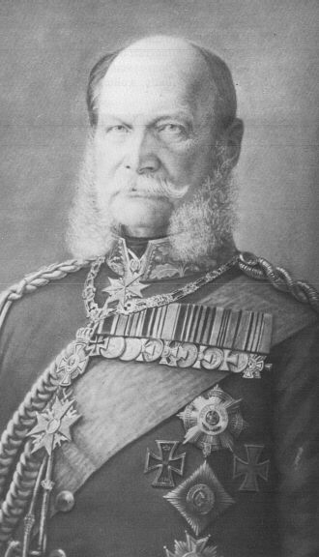
Kaiser Wilhelm I
NO!
It means you grow serious facial hair!

Slide 22
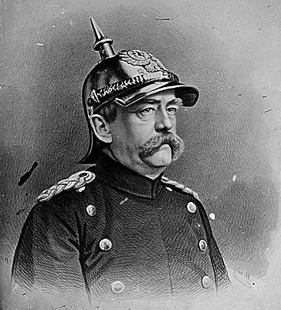
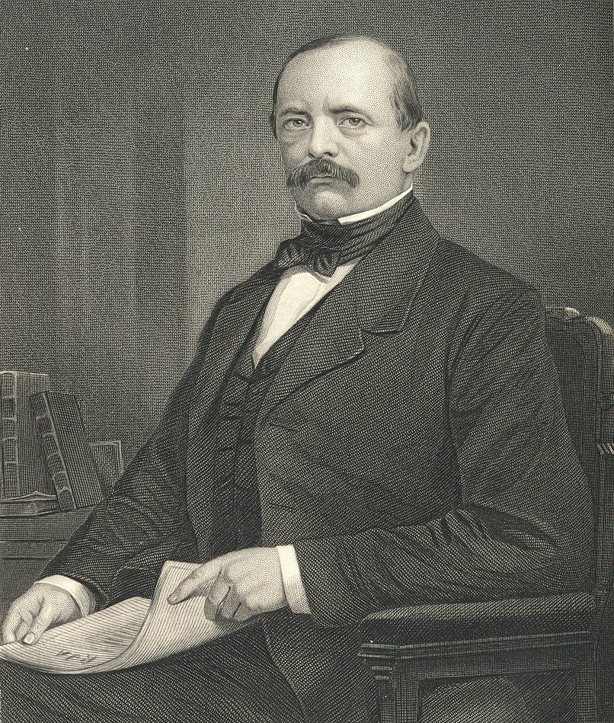
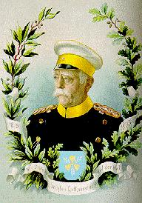
Chancellor Otto von Bismarck
The “Iron
Chancellor”
Realpolitik
“Blood
&
Iron”

Slide 23
Otto von Bismarck . . . .
The less people know about how sausages and laws are made, the better they’ll sleep at night.
Never believe in anything until it has been officially denied.
The great questions of the day will not be settled by speeches and majority decisions—that was the mistake of 1848-1849—but by BLOOD AND IRON.

Slide 24
Otto von Bismarck . . . .
I am bored. The great things are done. The German Reich is made.
A generation that has taken a beating is always followed by a generation that deals one.
Some damned foolish thing in the Balkans will provoke the next war.

Slide 25
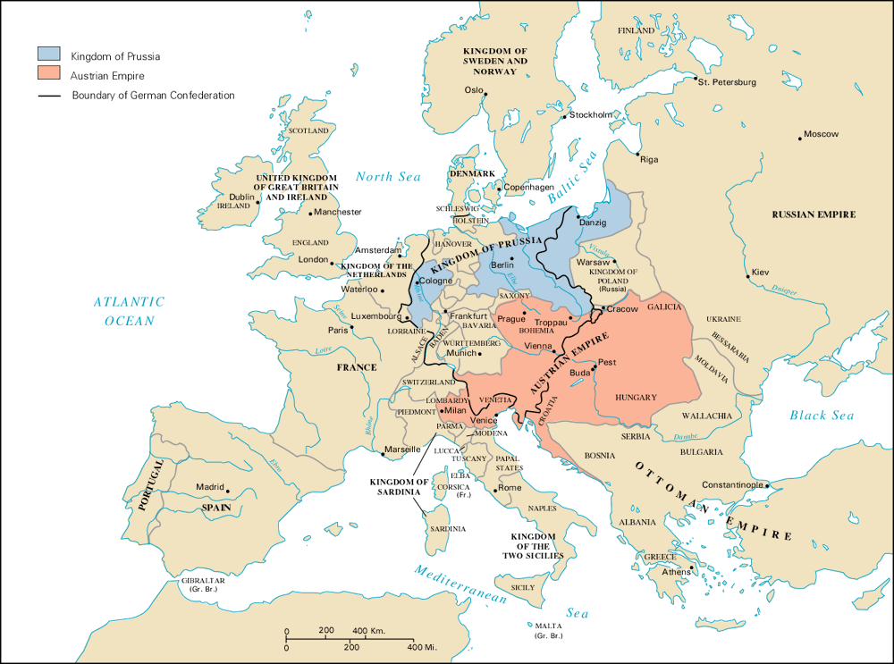
Prussia/Austria Rivalry
Grossdeutsch Vs Kliendeutsch

Slide 26
Why include Austria?
Why exclude Austria?
Opportunity for someone else to rule ‘Germany’
Owned vast non German areas that were traditionally problem regions. Don’t need the hassle when starting a new country
Who wants that much yodeling!
Austria traditionally part of “Germany”
Austria ruled ‘Germany’ under the old HRE
They have shown great musical aptitude and make really yummy strudel!

Slide 27
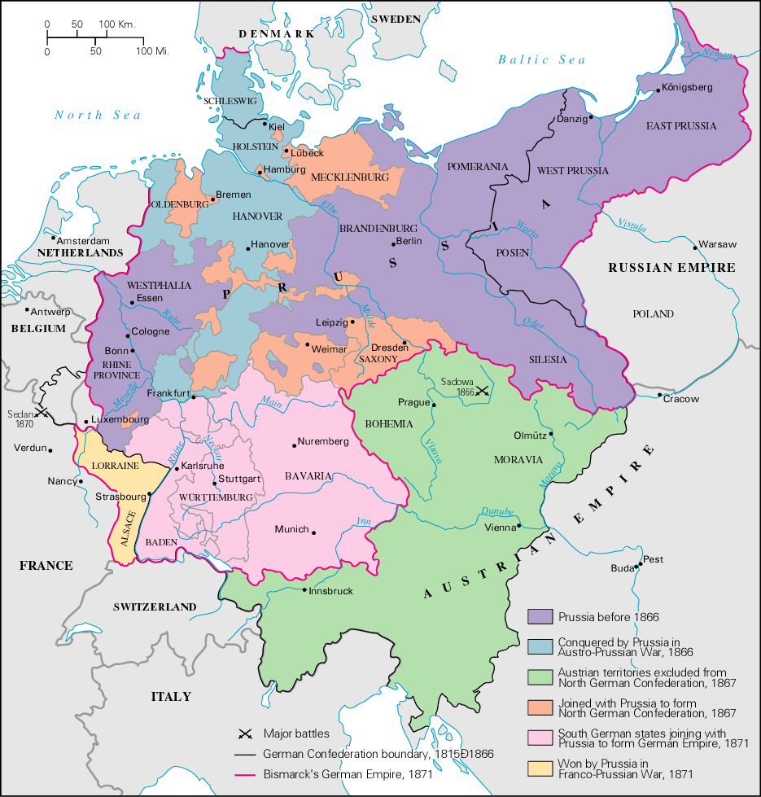
The German
Confederation

Slide 28
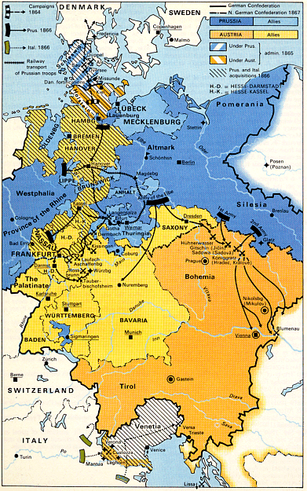
Step #1:
The Danish War
[1864]
The Peace of
Vienna

Slide 29
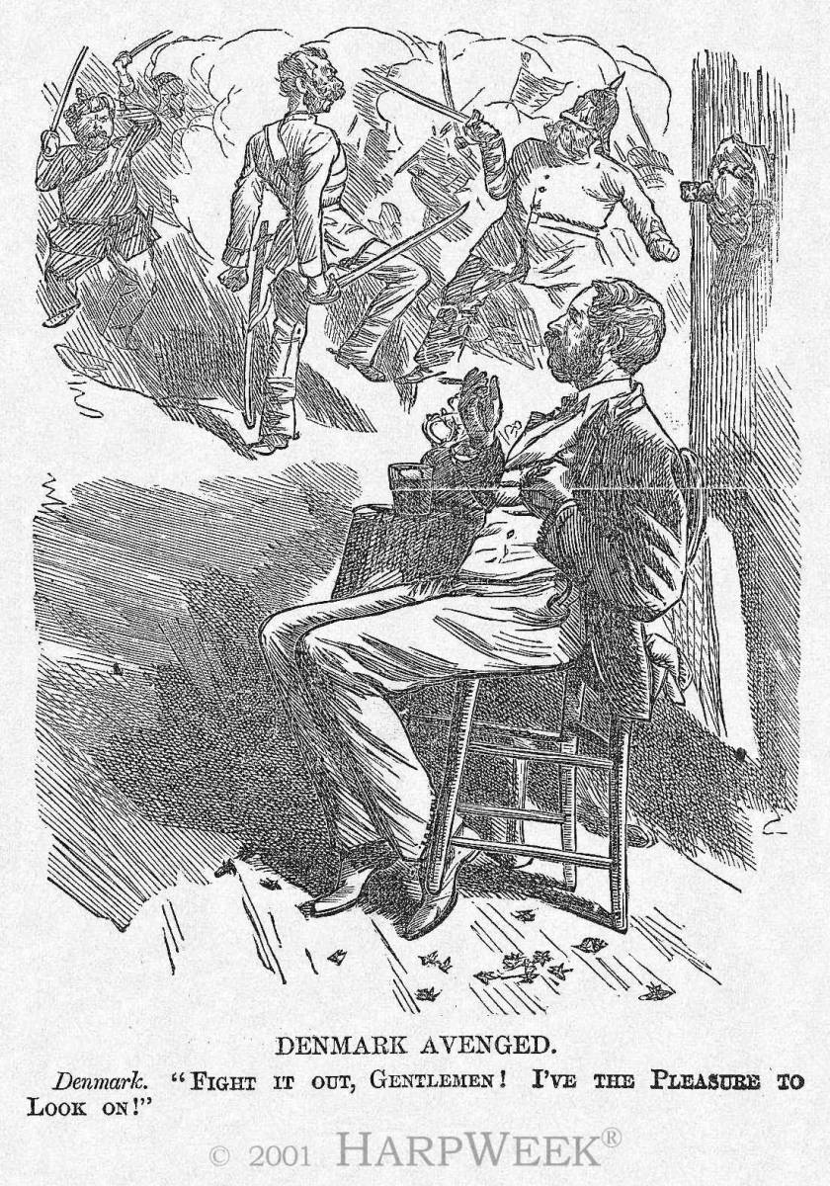
Step #2: Austro-Prussian War
[Seven Weeks’ War], 1866
Prussia
Austria

Slide 30
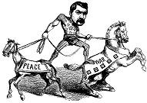
Step #3: Creation of the Northern German Confederation, 1867
Shortly following the victory of Prussia, Bismarck eliminated the Austrian led German Confederation.
He then established a new North German Confederation which Prussia could control → Peace of Prague

Slide 31
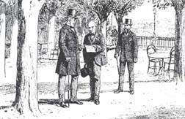
Step #4: Ems Dispatch [1870]:
Catalyst for War
1868 revolt in Spain.
Spanish leaders wanted
Prince Leopold von Hohenz.
[a cousin to the Kaiser & a
Catholic], as their new king.
France protested & his name was withdrawn.
The Fr. Ambassador asked the Kaiser at Ems to apologize to Nap. III for supporting Leopold.
Bismarck “doctored” the telegram from Wilhelm to the French Ambassador to make it seem as though the Kaiser had insulted Napoleon III.

Slide 32
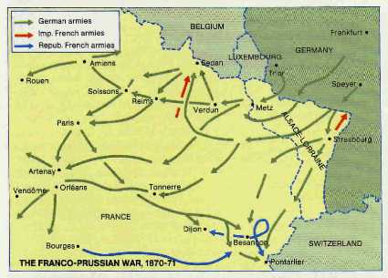
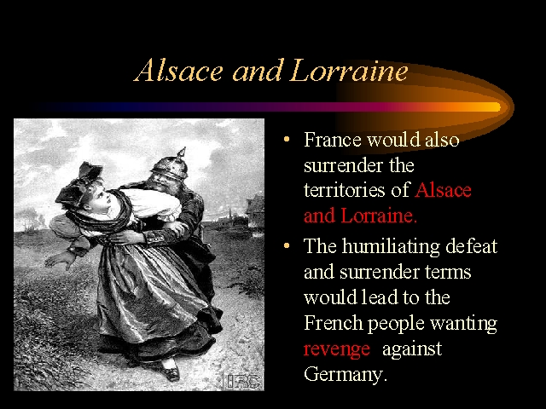
Step #5: Franco-Prussian War [1870-1871]
German soldiers “abusing”
the French.

Slide 33
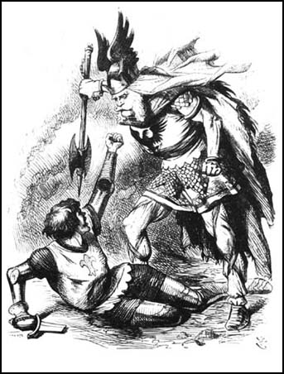
Franco-Prussian War
[1870-1871]

Slide 34
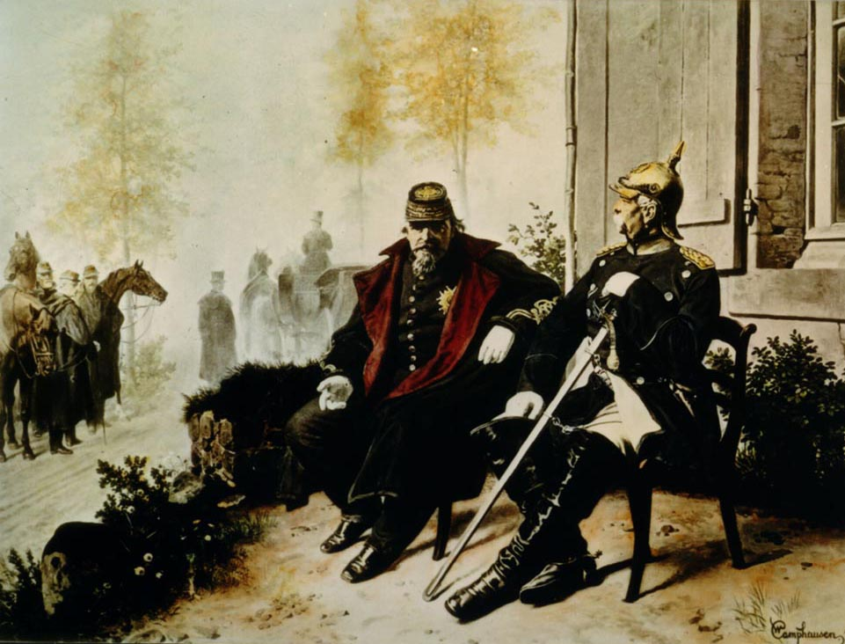
Bismarck & Napoleon III. Napoleon forced out in disgrace. Abdicates and flees to GB.

Slide 35
Treaty of Frankfurt [1871]
The Second French Empire collapsed and was replaced by the Third French Republic.
The Italians took Rome and made it their capital.
Russia put warships in the Black Sea [in defiance of the 1856 Treaty of Paris that ended the Crimean War].
-------------------
France paid a huge indemnity and was occupied by German troops until it was paid.
France ceded Alsace-Lorraine to Germany [a region rich in iron deposits with a flourishing textile industry]. (watch this region for further developments)

Slide 36
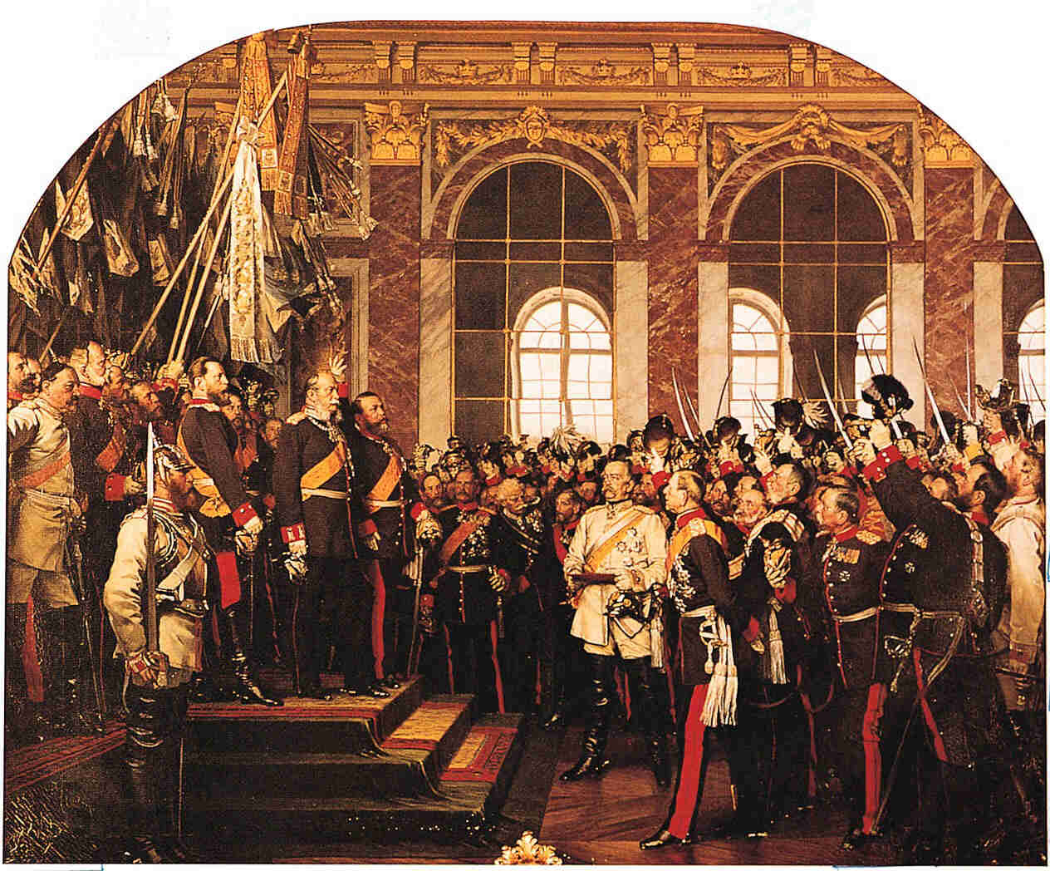
Coronation of Kaiser Wilhelm I (at Versailles 1871)
[r. 1871–1888]

Slide 37
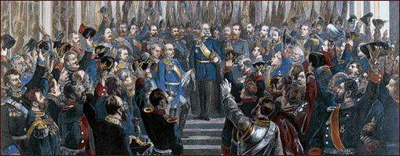
Prussian Junkers Swear Their Allegiance to the Kaiser

Slide 38

German
Imperial Flag
What was the First Reich?

Slide 39
Results of German Unification
Nationalist feelings of Germans revealed as very strong.
German idea of superiority enhanced
(Wagner, Nietzche)
From weakest in 1850 behind Rus, Aus, Fr, now the most powerful
New Power in Europe. Independence of Italy, and Germany
Weakened Austria and France
Economic power with resources. Far bigger and important than Prussia alone had been
Germany gains Alsace and part of Lorraine (rich in resources)
France to pay 5 billion francs

Slide 40
France
French feel betrayed by Treaty of Frankfurt (especially in Paris. They had fought Prussia almost alone with no help from the rest of the country)
Try to create independent state – Paris Commune
French Govt puts down commune (with help of Prussian advisors and new design of the city)
Repression killed 20K
(more than the war had)

Slide 41
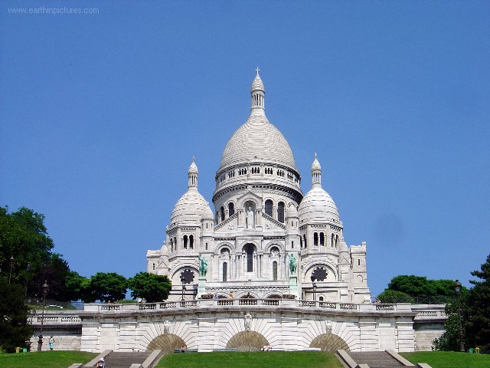
Sacre Coeur
Built to alleviate guilt of losing war and results of repression of Paris Commune

Slide 42
End of Republic (again!)
Constitutional monarchy (again)
2 claimants
  Heirs of Charles X – Henri Comte de Chambord supported by Legitimists
  Heirs of Louis Philippe – Louis Philippe (son) supported by Orleanists
  To prevent civil war two sides reach compromise
    Henri inherits (childless)
    Louis Philippe is the heir.

Slide 43
The End of the French Monarchy (finally)
1875 new constitution
  President
  Bicameral assembly.
President MacMahon (monarchist) tries to dismiss republican ministers.
Election returns Republicans
THIS IS THE 3RD REPUBLIC

Slide 44
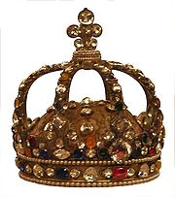
To prevent the return of the monarchy the French Crown jewels were sold!

Slide 45
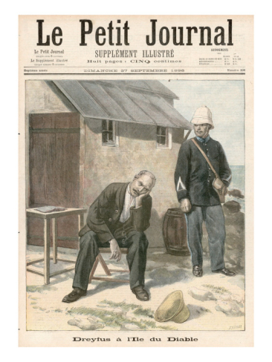
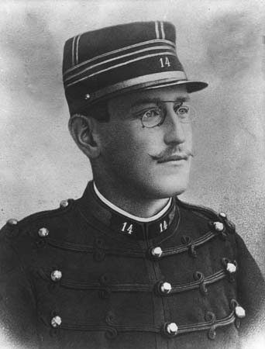
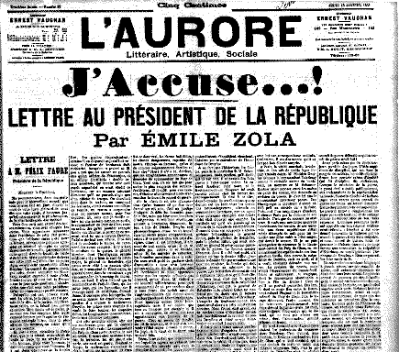
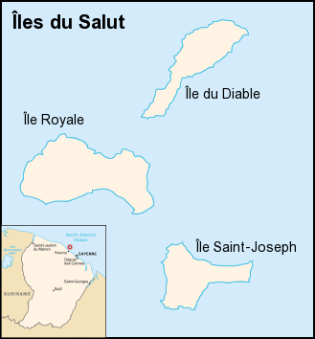
Dreyfus Affair
Results:
Right wing groups disgraced
  Monarchists
  Army
  And especially the Church, which had supported the army and both verdicts. Also opposed the Republic and openly “prayed” for the return of a Catholic King
Republic in revenge takes power of education away from Church.
1905 official separation of Church and State.
Blow to the conservatives of France
The new role of wives in society? Lucie works to have him cleared. Takes 12 years

Slide 46
Eastern
Europe
in the Last Half
of the 19c

Slide 47

Austrian Imperial Flag

Slide 48
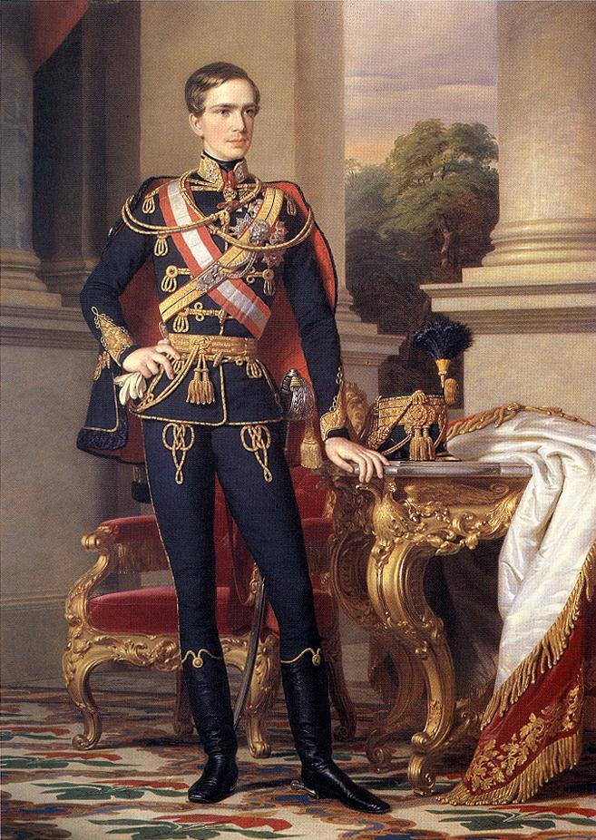
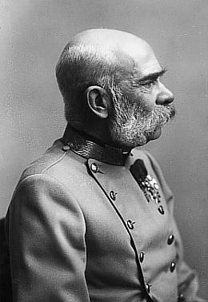
Emperor Franz Josef I
[r. 1848-1916]

Slide 49

The Compromise of 1867:
The Dual Monarchy → Austria-Hungary
The Hungarian Flag

Slide 50
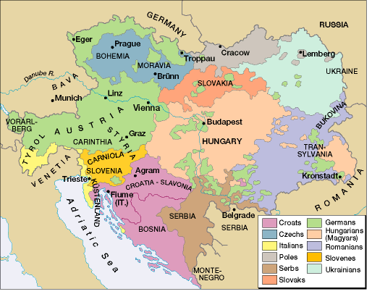
How to Rule 2 Kingdoms?!
Single head of State – King of Hungary and Emperor of Austria.
Austrian Reichsrat and Hungarian Diet
  And Delegations which comprised members of both!
Biggest issue?
  Especially SLAVS
  23 million out of 50 million
  never happy under either group.
Stabilize relationships in East
  3 emperor’s league then 3 emperor’s alliance

Slide 51
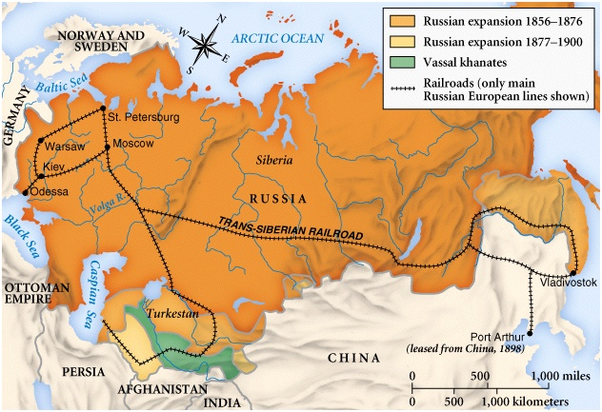
Russian Expansion
A heterogeneous empire

Slide 52
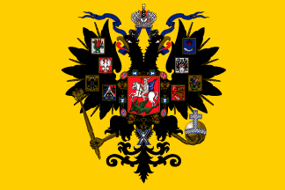
Russian Imperial Flag

Slide 53
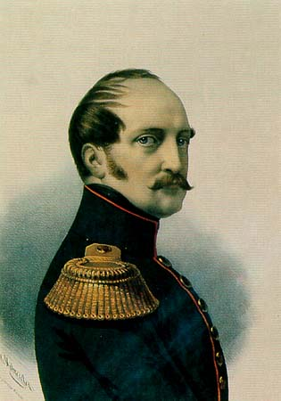

Nicholas I [r. 1825-1855]
Autocracy!
Orthodoxy!
Nationalism!
Dies during Crimean War

Slide 54
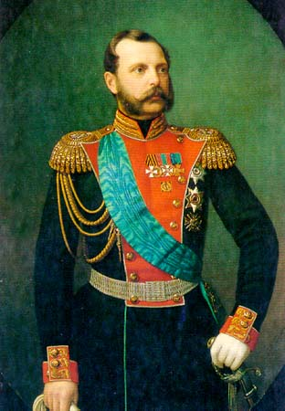
Alexander II [r. 1855-1881]
Defeat in the Crimean War.
  Not a good start!
Emancipation of the Russian serfs [1861-1863]. Not necessarily a great thing…not given land, had to buy it (much like sharecroppers in US)

Slide 55
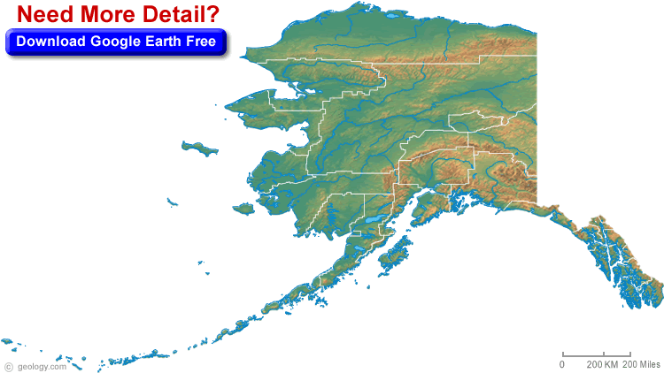
Alaska sold to US 1867

Slide 56
Russian Expansion

Slide 57
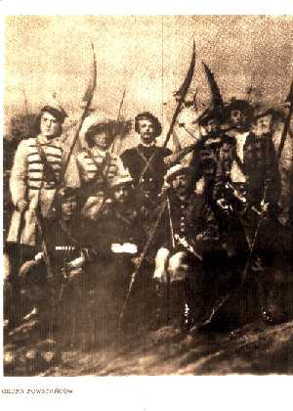
Russification of Poland
After rebellion of 1863 led by nobility, Alexander II moves to “Russify” Poland
Emancipates serfs there too (punish nobles)
Makes Poland a Russian province

Slide 58

Assassination of Alexander II
Despite reforms not very popular
Populist student movement
Opposition grows until turns violent.
Attempt on life caused Alex to become more repressive which made situation worse
Finally killed by bomb thrown into his carriage

Slide 59

Alexander III [r. 1881-1894]
Reactionary.
Slavophile.
“Russification” program.
Jews → forced migration to the Pale

Slide 60

Forced Migration of Russia’s Jews
The
Pale
Think about what this means in WW 2

Slide 61
Britain: 1850-1870s
The most prosperous period in British history.
  Unprecedented economic growth.
  Heyday of free trade.
  New fields of expansion → shipbuilding from wood to iron.
    By 1870, Britain’s carrying trade enjoyed a virtual monopoly.
  Br. engineers were building RRs all over the world.
  Br.’s foreign holdings nearly doubled.
BUT, Britain’s prosperity didn’t do away with political discontent!

Slide 62
The “Victorian Compromise”
Both Tories and Whigs had considered the 1832 Reform Bill as the FINAL political reform.
Therefore, the aims of the two political parties seemed indistinguishable.
But, by the 1860s, the middle class and working class had grown → they wanted the franchise expanded!
This era saw the realignment of political parties in the House of Commons:
  Tory Party → Conservative Party
  under Benjamin Disraeli.
  Whig Party → Liberal Party
    under William Gladstone.

Slide 63


The Two “Great Men”
Benjamin Disraeli, Conservative Prime Minister
  1868
  1874-1880
William Gladstone, Liberal Prime Minister
  1868-1874
  1880-1885
  1886
  1892-1894

Slide 64

William Gladstone (1809-1898)
An active legislator and reformer.
Known for his populist speeches.
Could be preachy.
Queen Victoria couldn’t stand him.
Tried to deal with the “Irish Question.”
Supported a “Little England” foreign policy.

Slide 65

Benjamin Disraeli (1804-1881)
A dandy and a romance novelist.
A brilliant debater.
Baptized by his father into the Anglican Church.
BUT, he was the first & only Prime Minister of Jewish parentage.
A strong imperialist.
  “Greater England” foreign policy.
Respected by Queen Victoria.

Slide 66

The 2nd Reform Bill - 1867
In 1866, Gladstone introduced a moderate reform bill that was defeated by the Conservatives.
A more radical reform bill was introduced by Disraeli in 1867, passed with Liberal support.
  His own party did not support it

Slide 67
The 2nd Reform Bill - 1867
Disraeli’s Goals:
  Give the Conservative Party control over the reform process.
  People would be grateful and vote Conservative.
Components of the Bill:
  Extended the franchise by 938,427 → an increase of 88%.
  Eliminated rotten boroughs with fewer than 10,000 inhabitants.
  Extra representation in Parliament to larger cities like Liverpool & Manchester.

Slide 68
Gladstone’s 1st Ministry
Goals: [“Gladstonianism”]
  Decrease public spending.
  Reform laws that prevented people from acting freely to improve themselves.
    He’s against privilege & supports a meritocracy.
    Protect democracy through education.
  Promote peace abroad to help reduce spending and taxation, and to help enhance trade.
    Low tariffs.
    All political questions are moral questions!

Slide 69
Gladstone’s 1st Ministry
Accomplishments:
  1868: Army reform → peacetime flogging was illegal.
  1869: Disestablishment Act → Irish Catholics did not have to pay taxes to support the Anglican Church in Ireland.
  1870: Education Act → free government sponsored elementary education for children between 5-13 years old.
  1870: Irish Land Act → curtailed absentee Protestant landowners from evicting their Irish Catholic tenants without compensation.
  1871: University Test Act → non-Anglicans could attend Br. universities.
  1872 Ballot Act → secret ballot (Chartist)

Slide 70
Disraeli’s 2nd Ministry
Accomplishments:
  Domestic Policy
    1875: Artisans Dwelling Act → govt. would define minimum housing standards.
    1875: Public Health Act → govt. to create a modern sewer system in the big cities & establish a sanitary code.
    1875: Climbing Boys Act → licenses only given to adult chimney sweeps.
    1875: Conspiracy & Protection of Property Act → allowed peaceful picketing.

Slide 71
Gladstone’s 2nd Ministry
Accomplishments:
  Domestic Policy
    1884 Reform Bill
      Extended the franchise to agricultural laborers.
      Gave the counties the same franchise as the boroughs.
      Added 6,000,000 to the total number who could vote in parliamentary elections.
    1885: Redistribution of Seats Act → changes M.P. seats in Commons to reflect new demographic changes.

Slide 72
Home Rule for Ireland
Home Rule movement begins 1870s.
  seeks partial independence to run domestic affairs.
  Westminster to run foreign affairs
Land League to help evicted tenants
Irish MPs in London form voting block to gain power.
Gladstone commits Liberal party to Home Rule for Ireland
DECISION SPLITS PARTY!

Slide 73

Home Rule for Ireland??
Gladstone debates Home Rule in Commons.

Slide 74

Home Rule Movement
Protestants in North
Catholics in South
Charles Parnell tries to unite but Irish divided over what they want
1893: Gladstone Reintroduced a Home Rule Bill.
  Provided for an Irish Parliament.
  Did NOT offer Ireland independence!
  Passed by the Commons, but rejected in the House of Lords.

Slide 75
The Foreign Policy Debate
“Big England” Policy
“Little England” Policy
Disraeli
Conservative Party
England must be the greatest colonial power.
Spend £ on supporting the empire.
Gladstone.
Liberal Party.
England must invest in her own people at home.
Try negotiations, rather than costly military solutions.

Slide 76

“Scramble for Africa”
1869: Disraeli pushed for the completion of the Suez Canal.

Slide 77

“Scramble for Africa”
Gladstone opposed the “Mad Scramble.”
1880-1881: First Boer War in South Africa Gladstone basically forced into involvement in South Africa.

Slide 78



“Scramble for Africa”
1884-1885: Mahdi uprising in the Sudan [Gladstone].
Muhammad Ahmad “al-Mahdi”
Charles Gordon “Pasha”

