Slide 1
Italian Fascism

Slide 2
A Definition of Fascism
Fascism is the totalitarian philosophy of government that glorifies the state and nation and assigns to the state control over every aspect of national life.
The State not only is authority which governs and molds individual will with laws and values of spiritual life, but it is also power which makes its will prevail abroad….For the Fascist, everything is within the State and…neither individuals nor groups are outside the State...For Fascism, the State is an absolute, before which individuals or groups are only relative….Liberalism denied the State in the name of the individual; Fascism reasserts the rights of the State as expressing the real essence of the individual. -- Enciclopedia Italiana, 1932

Slide 3
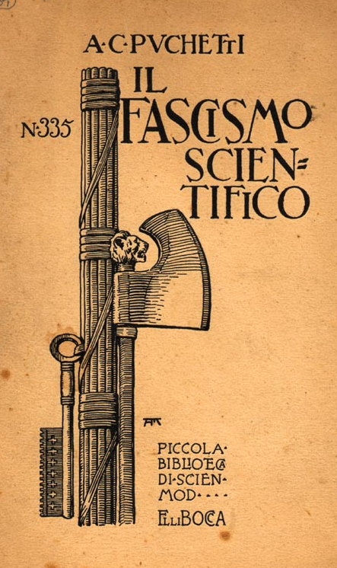
The Fasces Symbol
Comes from the Latin word fasces.
In ancient Rome, the fasces were cylindrical bundles of wooden rods, tied tightly together around an axe.
They symbolize unity and power.

Slide 4
The Characteristics of Fascism

Slide 5
Ideology
A form of extreme right-wing ideology.
It celebrates the nation or the race as an organic community transcending all other loyalties.
Powerful and continuing nationalism.
Constant use of patriotic mottos, slogans, symbols, songs, etc.
Flags are seen everywhere.

Slide 6
Subordination to the State
Fascism seeks forcibly to subordinate ALL aspects of society to its vision of organic community [usually through a totalitarian state].
It uses organized violence to suppress opposition.
Glorification of force.
Accepts the tenets of Social Darwinism.
Is anti-democratic.

Slide 7
Cult of State Worship
The individual had no significance except as a member of the state.
The fascists were taught:
Credere! [to believe]
Obbedire! [to obey]
Combattere! [to fight]

Slide 8
The Myth of Rebirth
The “phoenix rising up from the ashes .”
Think about this with what Mussolini promises
Emphasis on a national or racial rebirth after a period of decline or destruction.
Calls for a “spiritual revolution” against signs of moral decay [such as individualism and materialism].
Seeks to purge “alien” forces and groups that threaten the organic community.

Slide 9
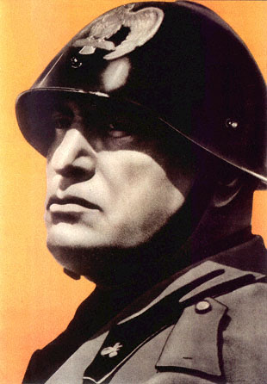
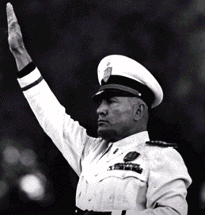
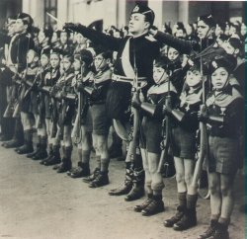
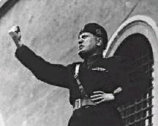
Militarism

Slide 10
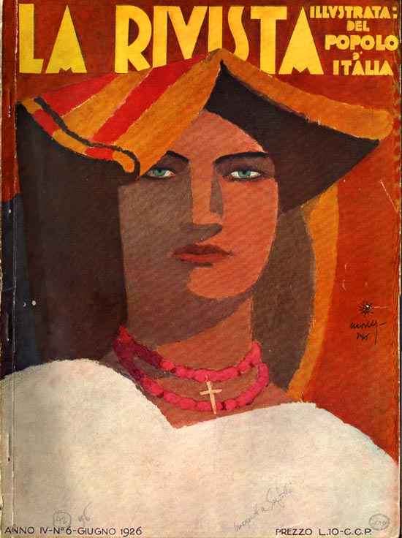
Rampant Sexism
Almost exclusively male-dominated.
Traditional gender roles are made more rigid.
Divorce, abortion & homosexuality are suppressed.
The state is represented as the ultimate guardian of the family institution.

Slide 11
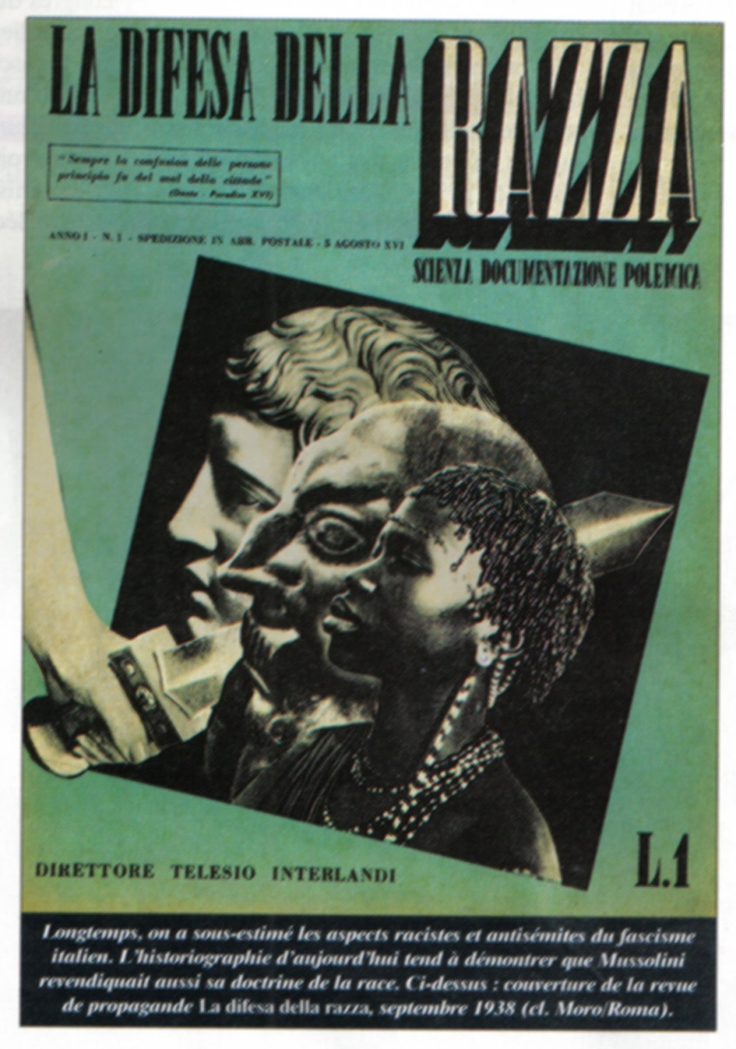
Identification of Enemies or Scapegoats as a Unifying Cause
The people are rallied into a unifying patriotic frenzy over the need to eliminate a perceived common threat or foe.
This foe could be racial, ethnic, a religious minority, or political ‘enemies’.

Slide 12
Disdain for the Recognition of Human Rights
Because of the fear of enemies and the need for security, the people are persuaded that human rights can be ignored out of “need.”
People look the other way or even approve of torture, summary executions, long incarcerations of prisoners, assassinations, etc.

Slide 13
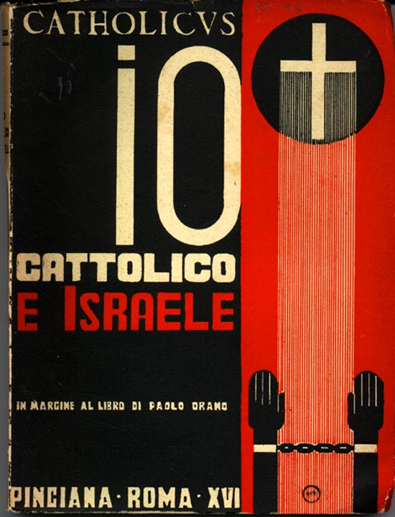
Jews Are the Enemy!

Slide 14
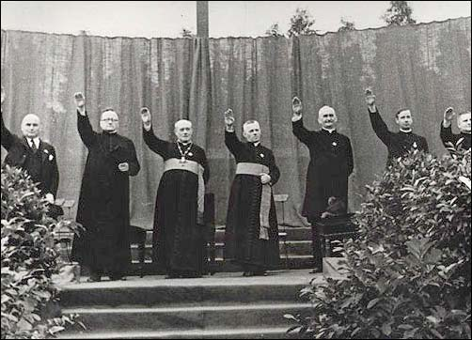
Religion & Government Are Intertwined
Fascist governments tend to use the most common religion in the nation as a tool to manipulate public opinion.
They meld religious rhetoric, symbolism, mythology, etc., into their policies [appears to give a religious imprimatur to government policies!]

Slide 15
Disdain for Intellectuals & for the Arts
Open hostility to higher education and academia is promoted.
Professors and other academics are censored or arrested.
Free expression in the arts and letters is openly attacked.

Slide 16
Rampant Nepotism & Corruption
Fascist regimes are almost always governed by groups of friends and associates who appoint each to government positions.
This group uses governmental power and authority to protect their friends from accountability.
National resources and even treasures can be appropriated or even outright stolen by government leaders.

Slide 17
Fraudulent Elections
Elections can be a complete sham.
Other times, elections are manipulated by smear campaigns against or even assassination of opposition candidates.
The use of legislation to control who can vote.

Slide 18
Controlled Mass Media

Slide 19
Labor Power is Suppressed; Corporate Power is Protected
Because the organizing power of labor is the only real threat to a fascist government, labor unions are suppressed or independent unions are eliminated.
The industrial and business aristocracy of a fascist state often are the ones who put the government leaders into power.
This creates a mutually beneficial business/government relationship and power elite!

Slide 20
The Rise of Mussolini

Slide 21
Immediate Post-WWI Italy
Fascism, to some extent, was a product of a general feeling of anxiety and fear among the middle class of post-war Italy:
Fears regarding the survival of capitalism.
Economic depression.
The rise of a militant left.
A feeling of national shame and humiliation at Italy’s poor treatment by the other Entente leaders after World War I [especially at Versailles].
(many of these characteristics are shared by Germany)

Slide 22
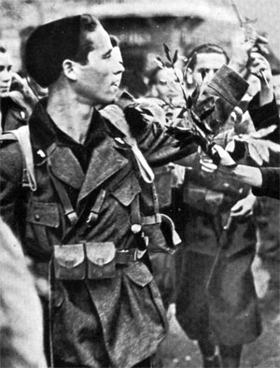
Immediate Post-WWI Italy
In 1920 the Italian Socialist Party organized militant strikes in Turin and other northern Italian industrial cities.
Economic chaos in the north could spread to the rest of Italy!
Hundreds of new fascist groups developed throughout Italy in response → “Black Shirts” [paramilitary squadriste] violently attacked the Socialists.
Motto: “Me ne fergo!”
I don’t give a damn!

Slide 23
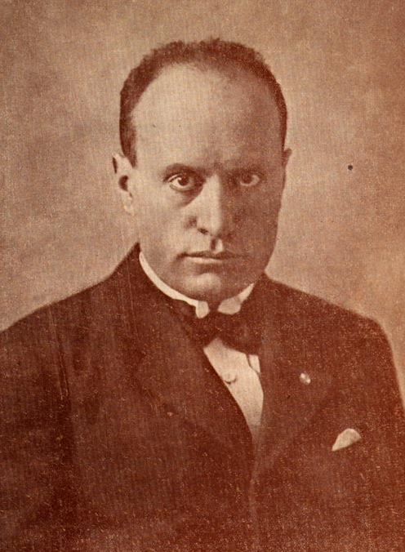
Benito Mussolini (1883-1945)
Started as a schoolteacher
Originally a Marxist, published Edited the Italian Socialist Party newspaper. Avanti! [Forward!].
Went to war became corporal
Wounded returned a nationalist due to Italy’s failures

Slide 24
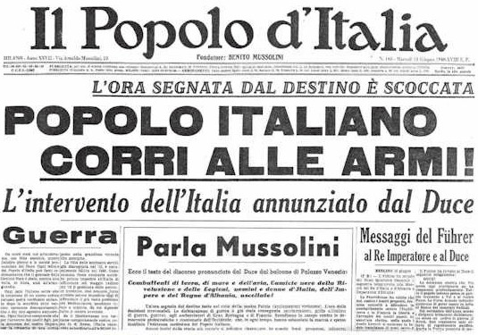
Benito Mussolini (1883-1945)
Founded the newspaper Il Popolo d’Italia [The People of Italy] to encourage Italy to join the war.

Slide 25
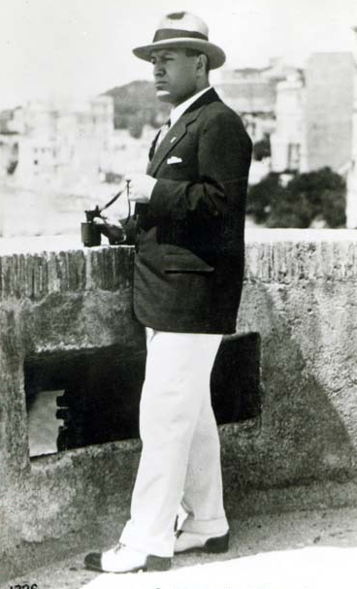
Benito Mussolini (1883-1945)
His editorial positions:
The war was a turning point for Italy.
The returning combat soldiers would form a new elite and bring about a new type of state.
This new elite would transform Italian politics and society!
Disappointment in the Versailles outcome. Support for D’Annunzio

Slide 26
Gabriele D’Annunzio
D’Annunzio wanted more from Versailles
Demanded Italy be given port of Fiume and Dalmatia coast.
When not granted, he used his private army of Blackshirts to attack 1919. Embarrassment to Italian government.
Welcomed by the people. Held the town until 1921 when Italian navy forces him out

Slide 27
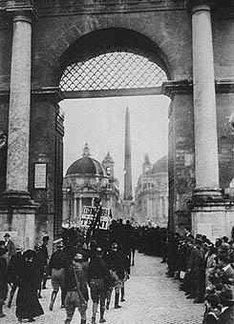
Mussolini Comes to Power
1921 election → Fascists included in the political coalition bloc of P. M. Giovanni Giolitti’s government [they win 35 seats].
October, 1922 → Mussolini threatened a coup d’etat.
“March on Rome” → 25,000 Black Shirts staged demonstrations throughout the capital.
“Either the government will be given to us or we shall seize it by marching on Rome”

Slide 28
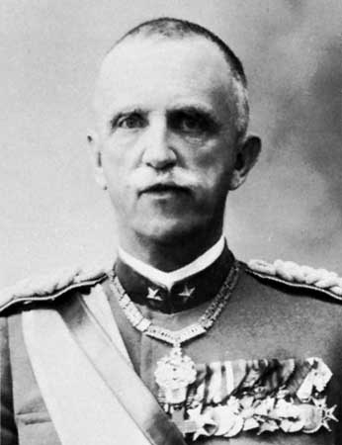
Mussolini Forms a Government
King Victor Emmanuel III refused to sign a law giving the Italian military the ability to quell the chaos and arrest the Fascists. Why?
Mussolini sets about garnering support from all sides.
Workers granted 8 hour day
Industrialists had inquiry into WWI profiteering dropped
Religious education made compulsory

Slide 29
Acerbo Law
1923 changed election laws.
25% of vote = 66% of seats
Why would non fascists support this?
“a good beating never hurt anyone”
1925 → Mussolini seized dictatorial powers during a political crisis [Black Shirts murdered one of Mussolini’s chief Socialist critics, Giacomo Matteotti].
Massive political and public protest, but the King refused to dismiss Mussolini.
1925 “I alone assume the political, moral and historic responsibility for everything that has happened. Italy wants peace and quiet, work and calm. I will give these things with love if possible and with force if necessary.”

Slide 30
The Fascists Consolidate Power (1925-1931)
New laws passed to create the legal basis for Italy’s official transformation into a single-party state:
Independent political parties & trade unions were abolished.
Freedom of the press was curbed.
Special courts created to persecute any political opposition.
National police force created [with a secret police (OVRA) component (of course)]

Slide 31
The Lateran Accords (1929)
This settled a long-running dispute over the Catholic Church’s role in Italian politics → this was the 1st time in Italian history that the Church and the government agreed on their respective roles!
1870 Italy seized papal lands in unification
1871 offered Pope use of Vatican and annual salary. Pope declined.
Church claimed need for independence from politics in religion. Declared themselves prisoners in the Vatican.

Slide 32
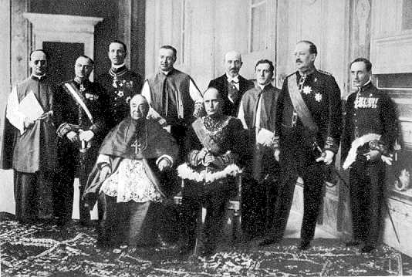
The Lateran Treaty
Agreement created the independent state of Vatican City
Perpetual neutrality in international affairs
Mediation only if requested by both parties
RC the state religion of Italy (1984 this was changed so that there is no longer a State sponsored religion)
Financial compensation for the lands taken in 1870 during unification

Slide 33
Italian Fascist Propaganda

Slide 34
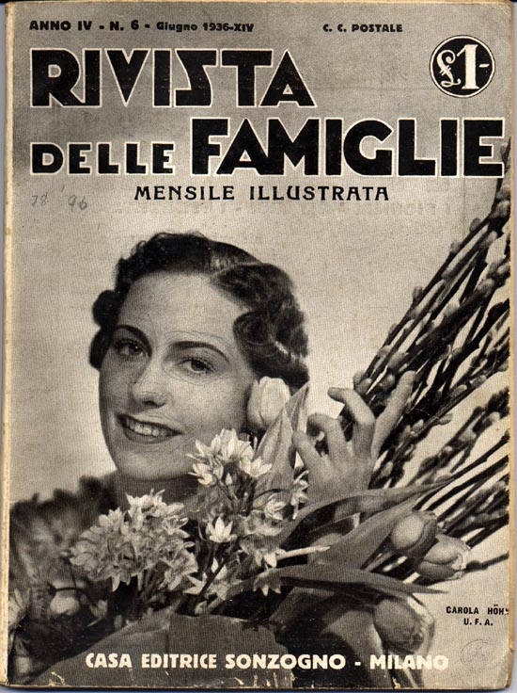
The Fascist Family
The Fascists encouraged the development of large families.
Need the large population to make Italy powerful.
Battle for Births 1927
Families were given a target of 5 children.
Mothers who produced more were recognized by the state.
1933 Mussolini met 93 mothers who had produced
1300 children between them!

Slide 35
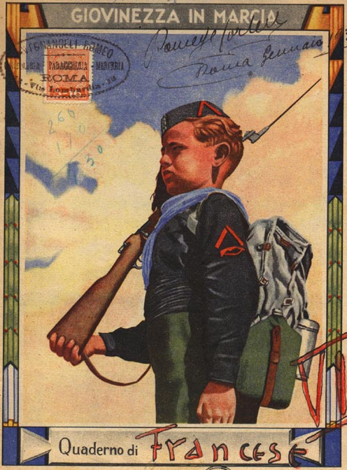
Education
The first sentence pronounced by children at school was Let us salute the flag in the Roman fashion; hail to Italy; hail to Mussolini.
Textbooks emphasized:
The glorious past of the ancient Romans.
The limitations imposed upon the present inhabitants by geography and the West.
The imperial destiny that awaited Italy’s future development.

Slide 36
Emphasis on Physical Fitness

Slide 37
Anti-Semitism
50,000 Jews lived in Italy in the 1930s.
Mussolini did NOT implement an extermination program in Italy.
75% of Italian Jews survived World War II.
8,000 died in German extermination camps.
1938 →anti-Semitic laws passed
Manifesto degli Scienziati Razzisti [The Manifesto of the Racist Scientists].
Excluded foreign Jews [most of them were sent to German death camps].
Forbade all Jews from teaching.
Excluded Jews from serving in the government or in the military.

Slide 38
Mussolini Was Hitler’s Role Model

