Slide 1
Europe
in the
1920s

Slide 2
Issues After World War I
Threat of Communism
Economies of Europe in ruins
What to do with losers – how to implement Versailles
Societal failure – loss of men
End of empires
Who will lead the world? US?

Slide 3
Economic problems
GB less empire to use to rebound
Moves from creditor to debtor
Trade based economy hit by protectionism
Need to import less and export more. HOW?
Be more efficient (expensive to change)
Reduce pay/increase workload (socially unpopular)
Importing less hard because food was imported - inflationary

Slide 4
Economic problems
France
Major battlefield and suffered greatly
Lost revenue from battle sites
Lost male population
Agricultural self sufficiency helped
Reliance on reparations to pay back debt and finance recovery (needed a strong Germany but wanted a weak Germany)

Slide 5
Economic problems
USSR / CCCP
Able to avoid many of the pitfalls of the 1920s. WHY?
Isolation (self and imposed)
Industry was not consumer oriented – shortages of “stuff”
Govt was not answerable to anyone
Govt control of the economy (wages, output, prices)
Slave labor, mass execution, starvation

Slide 6
Economic problems
Weimar Republic
Financial collapse from birth.
No colonies
Reparations
Lost equipment as a result of Versailles
Lost resource rich terrritory
Anti German feelings hurt exports

Slide 7
^{USSR / CCCP}
Civil war REDS V WHITES
War communism allowed Bolsheviks to do whatever they deemed necessary to win. After war Lenin introduces
NEP - Limited capitalism
Opposed by pure Marxists – assassination attempt 1922
Lenin dies as a result 1924.
Who will succeed?

Slide 8
Leon Trotsky
Flamboyant leader of revolution, theorist and military hero
Josef Stalin quiet bureaucrat.

Slide 9
Triumverate
Bukharin
Kamenev
Stalin
Zinoviev

Slide 10
Commintern
Communist Party in Russia becomes the Communist International / Commintern.
“…by all available means , including armed force, the overthrow of the international bourgeoisie and the creation of an international Soviet republic as a transition stage to the complete abolition of the State”

Slide 11
Zinoviev Letter
1924 just before the general election, MI5 intercepted a letter from Zinoviev urging British workers to revolt. Labour PM Ramsay Macdonald lost the election as a result of the publicity. This resulted in Zinoviev’s dismissal too.
In 1999 It was proved that the letter was a fake.

Slide 12
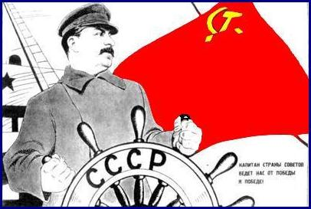
USSR
Stalin takes control of the economy Called for a command economy – system which the government makes all economic decisions
Creates a Five Year Plan (several of them in fact)
Five year plans designed to bring the USSR into the industrial age as fast as possible.

Slide 13
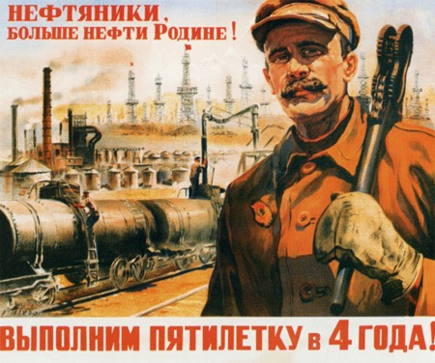
5 Year Plans
set unrealistically high production goals
consumer production was limited to try to reach these goals, causing widespread shortages of food, housing, clothes, etc
Government controlled all aspects of people’s lives – chose jobs, assigned hours
Those who did not cooperate could be executed or sent to the gulags (work on Baltic Canal or Siberian railway.

Slide 14
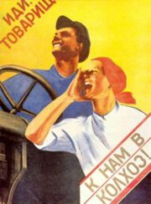
Collectivization
In order to allow the majority of workers to work in industry, farmers had to overproduce to feed them
Private farms combined into government owned collectives
Were told what to plant, when, etc
Strong resistance from peasants – especially kulaks – class of wealthy peasants
Kulaks resisted and were killed or sent to gulags in Siberia.
(Approx 5 million die)

Slide 15
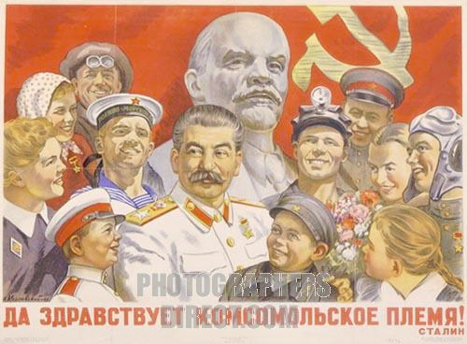
Government Control
As well as the economy, the Communist government controlled everything else.
Religion – NONE
Human rights – NONE
However there were benefits
Goods were cheaper
Free medical care
Equality for women

Slide 16
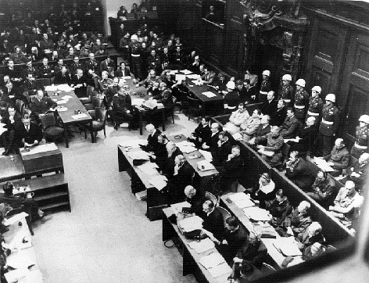
1934 Great Purge
1932 calls for Trotsky. 5 Yr plans were costing a lot
Stalin afraid of anyone taking control, so he stopped them – ALL OF THEM!
Police terror – destroyed enemies of Stalin
Monitored telephone lines, read mail, planted informants
Many children told on parents for “disloyal” comments
Led to Show trials.
Accused were forced to confess
then put on trial for the public

Slide 17
How Many Were Killed by Stalin?
famines, prison and labor camp mortality, and state terrorism (deportations and political purges) are taken into account, Stalin and his colleagues were directly or indirectly responsible for the deaths of millions.
How many millions died under Stalin is greatly disputed. Although no official figures have been released by the Soviet or Russian governments, most estimates put the figure between 8 and 20 million
“The death of one man is a tragedy. The death of millions is a statistic.”

