Slide 1
The
Industrial
Revolution

Slide 2
What was the Industrial Revolution?
Mass production of goods by machine
Meant the end of the guild system which had run “industry for 800 years
What is the guild system?
“Hand made” took too long and was expensive
Was it a good thing?

Slide 3
Changing Life
Population numbers increased <more later>
New agricultural tools and techniques
<more later>
Improved medical treatment. Doctors actually cured people
Vaccination – Jenner
Anesthsia <ether> and antisceptic- Crawford Long and Lister.
Transportation – canals and roads, iron and steam <more later>
Population moved from rural to urban
<more later>

Slide 4
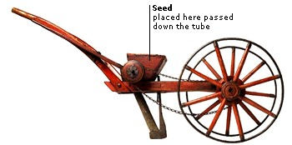
Science in Farming
Keep accurate records of
Planting dates
Seed used
Crop yield
Crop rotation: cereal, legumes and fallow
Heavy plough to get through the soil
Planting innovation. Seed drill

Slide 5
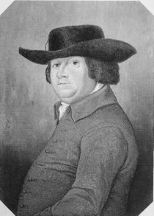
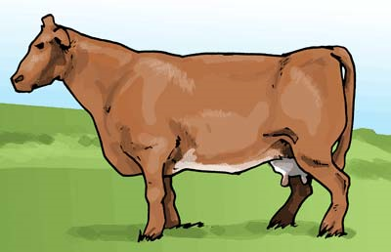
Bakewell and Selective Breeding
Again Science
By taking the biggest and best animals produced bigger and better offspring.
In 85 years the average cow for slaughter went from 370lbs to 840lbs
Turnips and clover to feed them during winter months

Slide 6
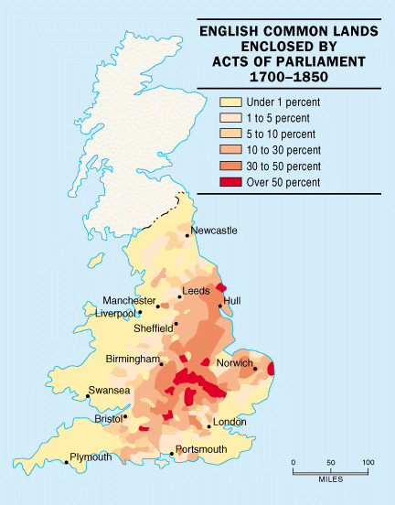
The Enclosure Movement

Slide 7
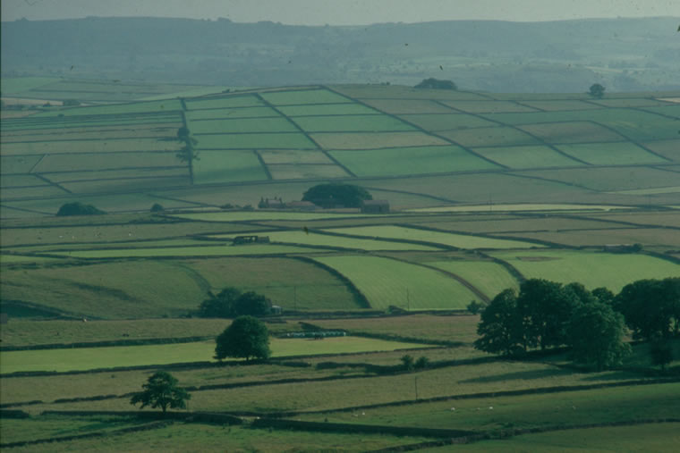
“Enclosed” Lands Today
Small tenant farmers evicted!! Where do they go?

Slide 8
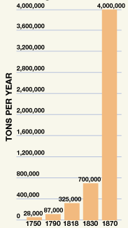
British Pig Iron Production
Abraham Darby uses coal to smelt iron. Improves the quality of iron. Makes it stronger by burning out impurities.

Slide 9
Why Did
Industrialization
Begin in
England First?

Slide 10
Food production increased
Population rose dramatically
1350 – 1750 Pop. doubled
1750 – 1850 Pop. doubled
New larger population needs work MIGRATION
Natural Resources
Fast flowing rivers, canals, ports, iron and coal deposits
No wars to destroy “stuff”
Entrepreneurs
Navy to protect imports and exports

Slide 11
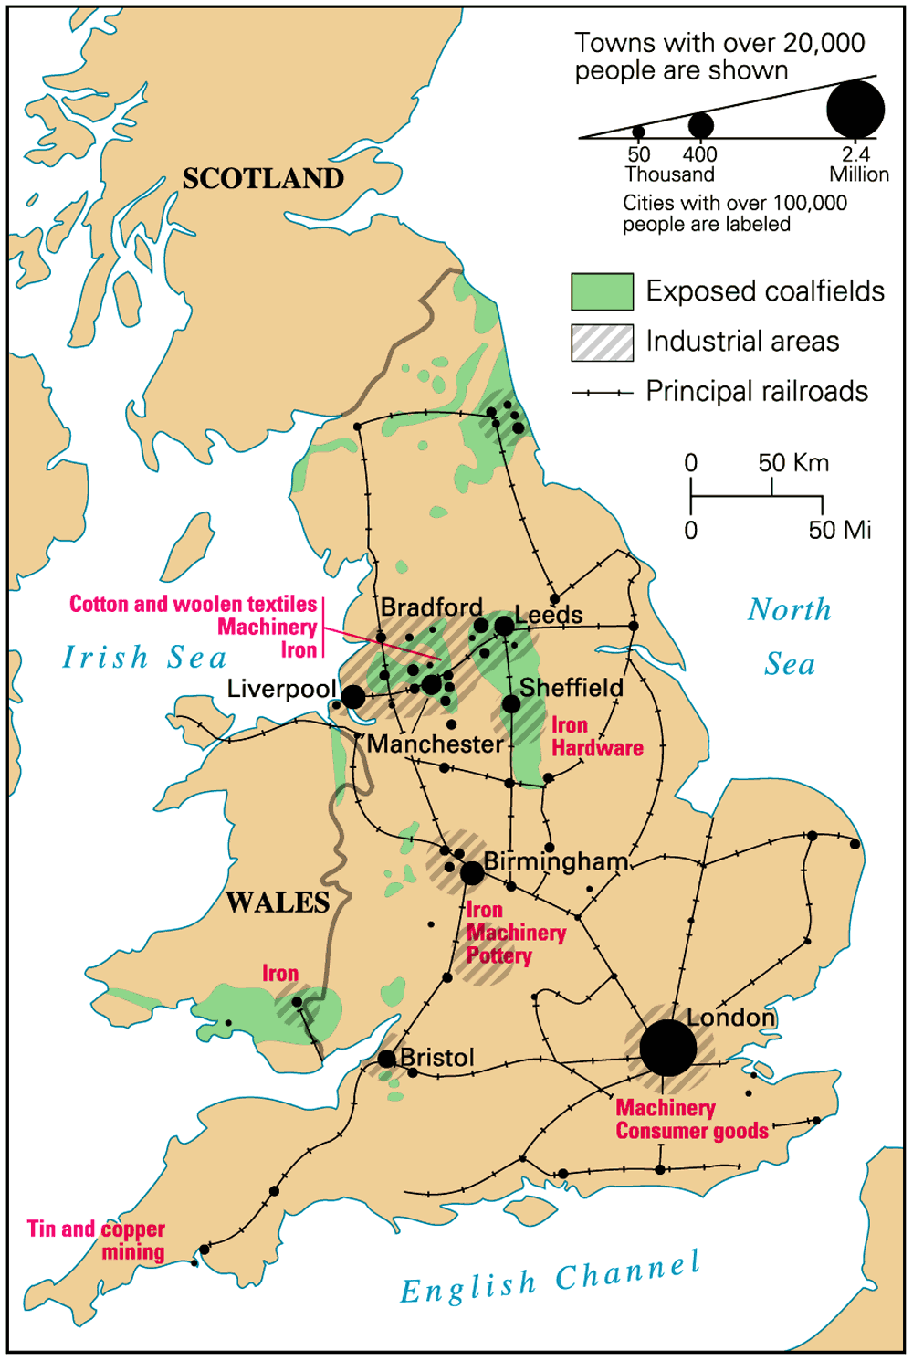
Coalfields & Industrial Areas

Slide 12
Coal Mining in Britain: 1800-1914
1800 | 1 ton of coal | 50, 000 miners
1850 | 30 tons | 200, 000 miners
1880 | 300 million tons | 500, 000 miners
1914 | 250 million tons | 1, 200, 000 miners

Slide 13
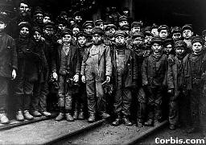
Young Coal Miners

Slide 14
New Inventions
of the
Industrial Revolution

Slide 15
Cottage Industry
With the growing population, need for goods, particularly cloth rose.
Result was cottage industry.
Each part of production - spinning, weaving, finishing – was done by a different family. The merchant moved the cloth from one place to the next after it was “PUT OUT”
Called PUTTING OUT SYSTEM
Demand grew too much so…

Slide 16
Factory Production
Concentrates production in one place [materials, labor].
Located near sources of power. At first in the hills (Why? Then on coalfields
Who were the first entrepreneurs?
Those who could increase production could make a lot of money.
Any inventions that sped up one part of production encouraged new inventions in another part…

Slide 17
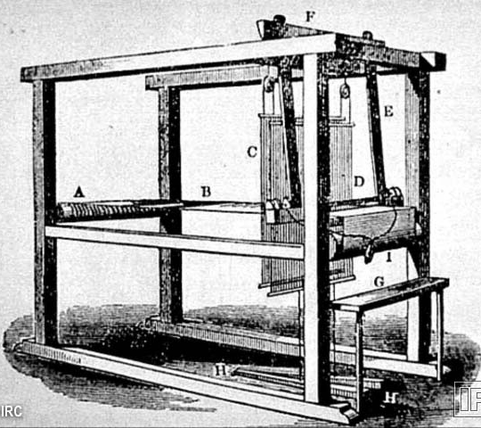
John Kay’s “Flying Shuttle”

Slide 18
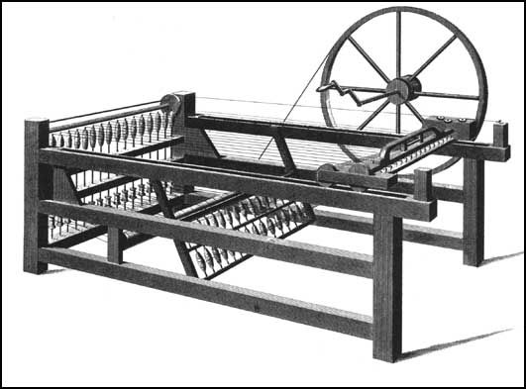
James Hargreaves Spinning Jenny

Slide 19
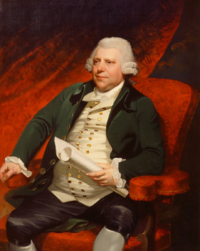
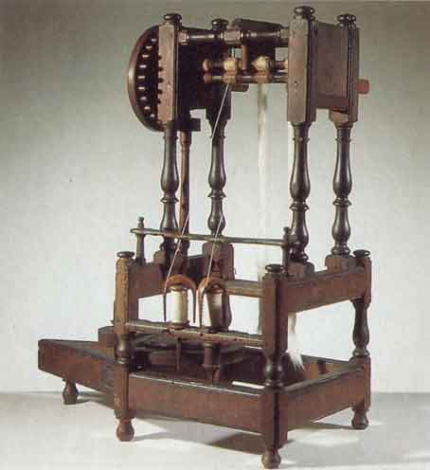
Richard Arkwright:
The “Water Frame”

Slide 20
The Power Loom

Slide 21
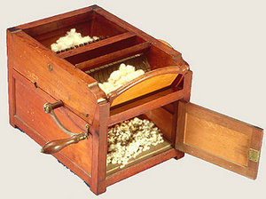
Eli Whitney
Cotton Gin

Slide 22
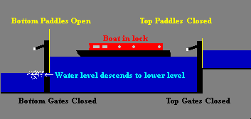
Early Canals
Britain’s Earliest Transportation Infrastructure

Slide 23
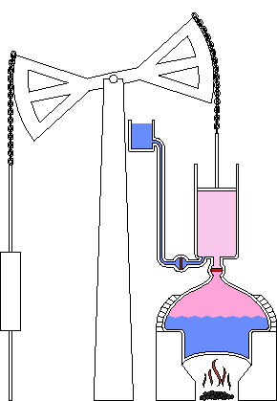
Newcommen Steam Engine

Slide 24
James Watt’s Steam Engine

Slide 25
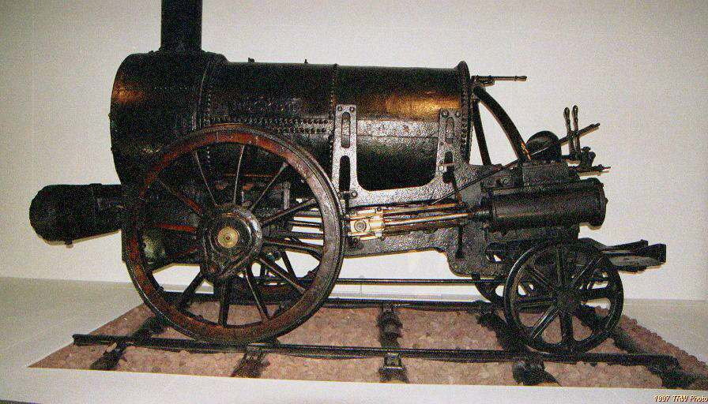
Stephenson’s Rocket 1829
1830 first railway line opens – Manchester to Liverpool

Slide 26
Growth of Railways
Why did it take so long to develop a rail system?
Who opposed railways? Why?
This was the driving force of the industrial revolution.

Slide 27
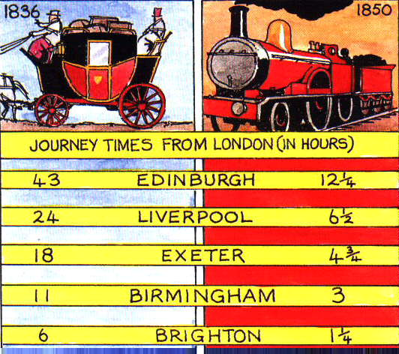
The Impact of the Railroad

Slide 28
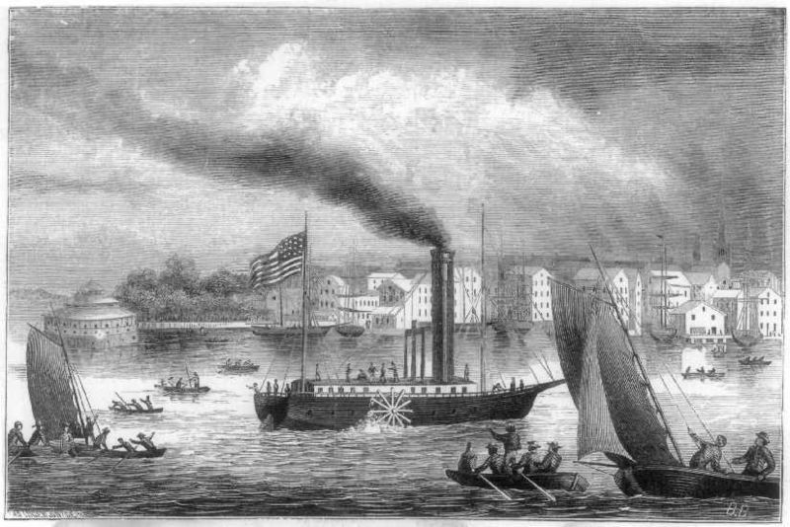
Steam Ship
developed by Robert Fulton

Slide 29
The "Haves":
Bourgeois Life
Thrived on the
Luxuries of the
Industrial Revolution

Slide 30
19^{c} Bourgeoisie: The Industrial Nouveau Riche

Slide 31
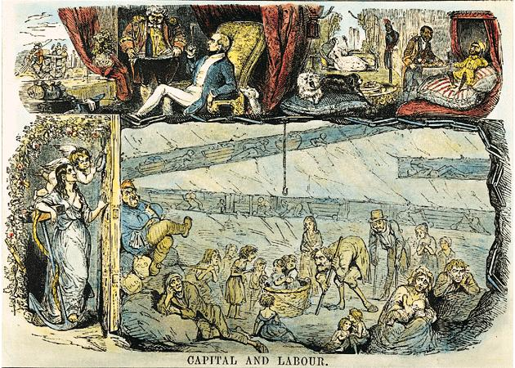
“Upstairs”/“Downstairs” Life

Slide 32
The "Have-Nots":
The Poor,
The Over-Worked,
& the Destitute

Slide 33
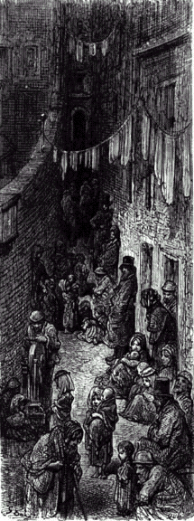
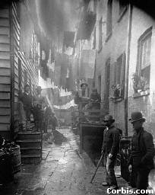
The New Industrial City

Slide 34
Industrial Staffordshire

Slide 35
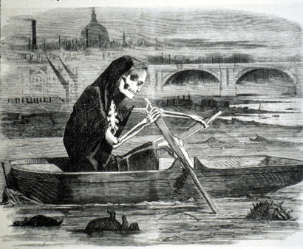
Problems of Pollution
The Silent Highwayman - 1858

Slide 36
Early-19c London

Slide 37
Worker Housing in Manchester

Slide 38
Factory Workers at Home

Slide 39
Workers Housing in Newcastle Today

Slide 40
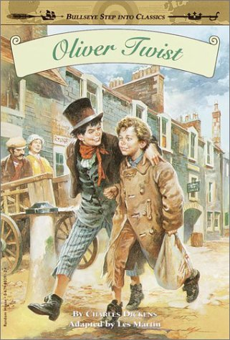
The Life of the New Urban Poor: A Dickensian Nightmare!

Slide 41
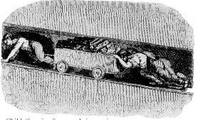
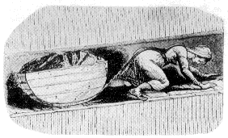
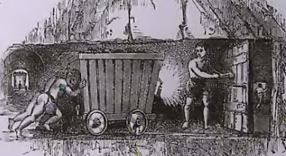
Child Labor in the Mines
Collier – miner working at the pit face.
Corves – little mine cars to carry coal
Hurriers/drawers / bearers/carriers / thrusters hired by colliers to pull the mined coal from the pit face to the shaft bottom usually in corves, but sometimes just manually.
Trapper Someone who sat in a confined area to open and close the door when a cart of coal came, this allowed ventilation

Slide 42
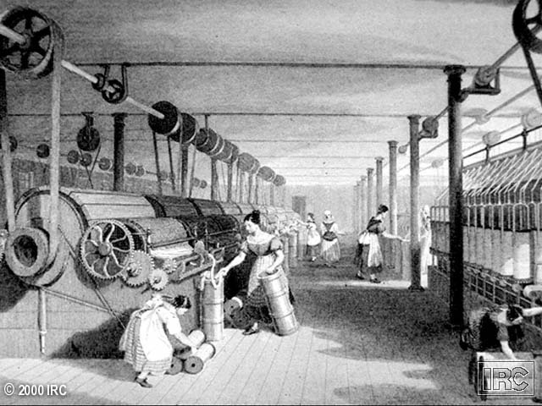
Young “Bobbin-Doffers”

Slide 43
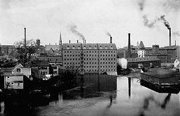
The Factory System
Rigid schedule.
12-14 hour day.
Dangerous conditions.
Mind-numbing monotony.

Slide 44
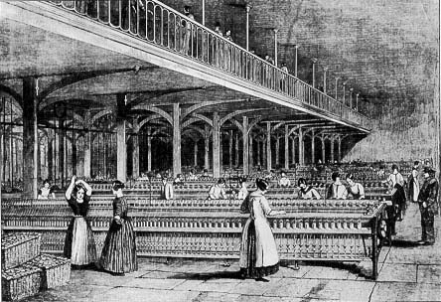
Textile Factory Workers in England

Slide 45
Factory Wages in Lancashire, 1830
Age of Worker | Male Wages | Female Wages
under 11 | 2s 3d. | 2s. 4d.
11 - 16 | 4s. 1d. | 4s. 3d.
17 - 21 | 10s. 2d. | 7s. 3d.
22 - 26 | 17s. 2d. | 8s. 5d.
27 - 31 | 20s. 4d. | 8s. 7d.
32 - 36 | 22s. 8d. | 8s. 9d.
37 - 41 | 21s. 7d. | 9s. 8d.
42 - 46 | 20s. 3d. | 9s. 3d.
47 - 51 | 16s. 7d. | 8s. 10d.
52 - 56 | 16s. 4d. | 8s. 4d.
57 - 61 | 13s. 6d. | 6s. 4d.
It cost about £5 per week to keep a family of 4.

Slide 46
Protests / Reformers

Slide 47
Labour<British spelling> Movement
What was the purpose of Unions?
Improve conditions, wages safety of workers
Did the factory owners allow unions to be formed?
Why not?
Employed strike breakers!
Who formed the first unions?
Skilled workers who could not easily be replaced

Slide 48
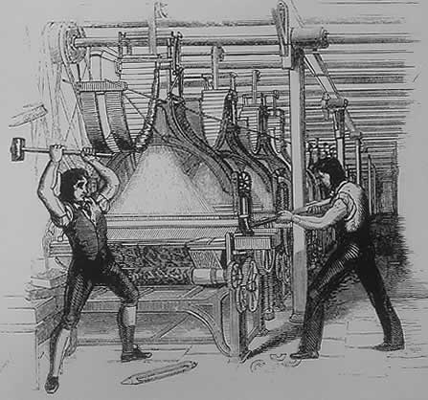
The Luddites: 1811-1816
Attacks on the “frames” [power looms].
Ned Ludd [a mythical figure supposed to live in Sherwood Forest]

Slide 49
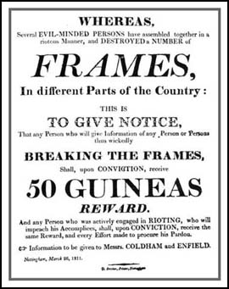
The Luddites

Slide 50
Government Response
Abolition of slavery in the colonies in 1832 [to raise wages in Britain].
Factory Act [1833] – child labor. Children under 9 not allowed to work in factories. Limited hours for older kids.
New Poor Law [1834] – indoor relief.
Poor houses. Made so awful that people would rather work than go to them!

Slide 51
New Ways
of
Thinking

Slide 52
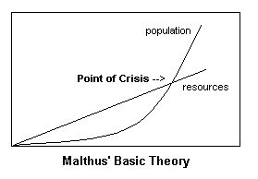
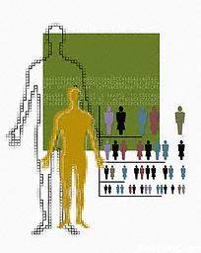
Thomas Malthus
Population growth will outpace the food supply.
War, disease, or famine control population.
The poor should have fewer children.
Food supply will then keep up with population.

Slide 53
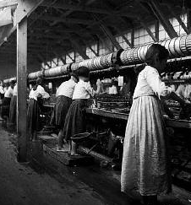
David Ricardo
“Iron Law of Wages.”
When wages are high, workers have more children.
More children create a large labor surplus that lower wages again.
Why increase wages in the first place?
Who supported Ricardo?

Slide 54
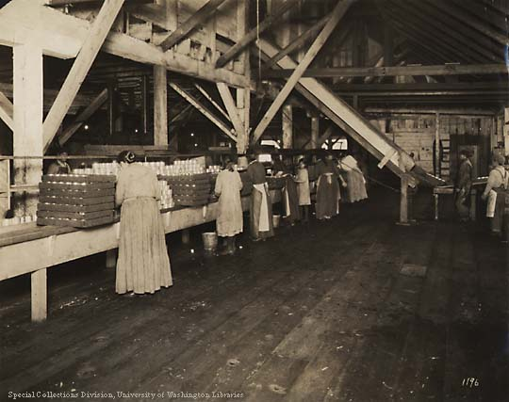
The Utilitarians: Jeremy Bentham & John Stuart Mill
The goal of society is the greatest good for the greatest number.
There is a role to play for government intervention to provide a social safety net. What do we call it?
Welfare

Slide 55
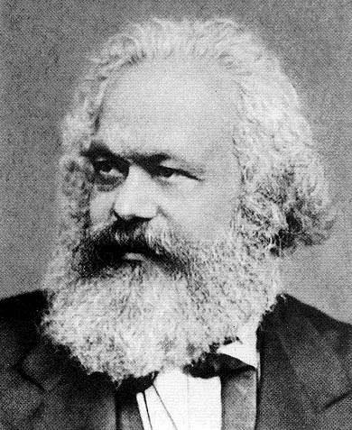
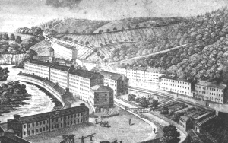
The Socialists: Utopians & Marxists
People as a society would operate and own the means of production, not individuals.
Their goal was a society that benefited everyone, not just a rich, well-connected few.
Tried to build perfect communities [utopias].

Slide 56
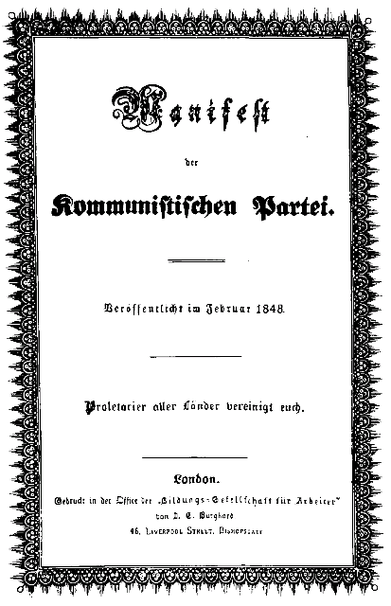
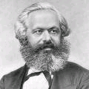
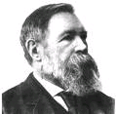
Communist Manifesto
Karl Marx
Fredreich Engels
2 group Haves and have nots - Bourgeoisie and proletariat)
Bourgeoisie control the means of production. Proletariat work
Gap between two grows until ‘P’ rise up and overthrow ‘B’. Results in a new classless society.
Marx did not account for:
Religion unions wage concession nationalism racial/ethnicity bwelfare reform

