Slide 1
The
Second
Industrial
Revolution

Slide 2
Symbolized by:
Increased European Population
Growth of Cities & Urban Life
Migration from Europe
1850-1940 → 60 million left Europe
Went to → US, Argentina, Brazil, Canada, Australia/N.Z., Africa, SE Asia
2nd arrival of European culture on the world thanks to new transportation

Slide 3
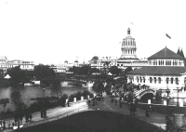
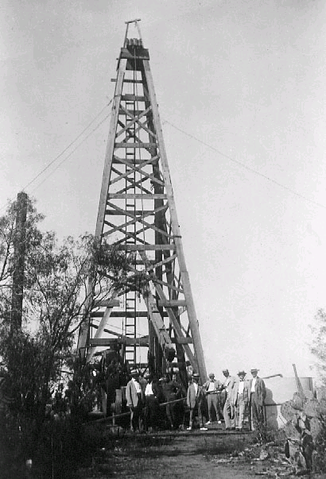
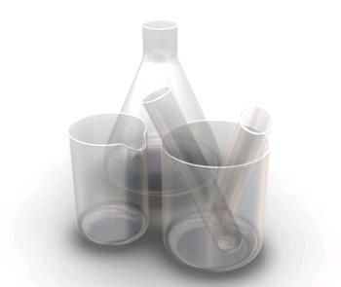
New industries of the late 1800s:
Electricity
Oil
Chemical

Slide 4
New industries of the late 1800s:
Chemical Industry
Leblanc process developed in France for producing soda
Solway process produced sodium bicarbonate (cheap soap.)
Why is this important?
Germany takes the lead late 1800s
Synthetic dyes led by BASF and Bayer
First research facility/teaching lab
Students from all over world enter
German domination stays until WW I
(chemical warfare)

Slide 5
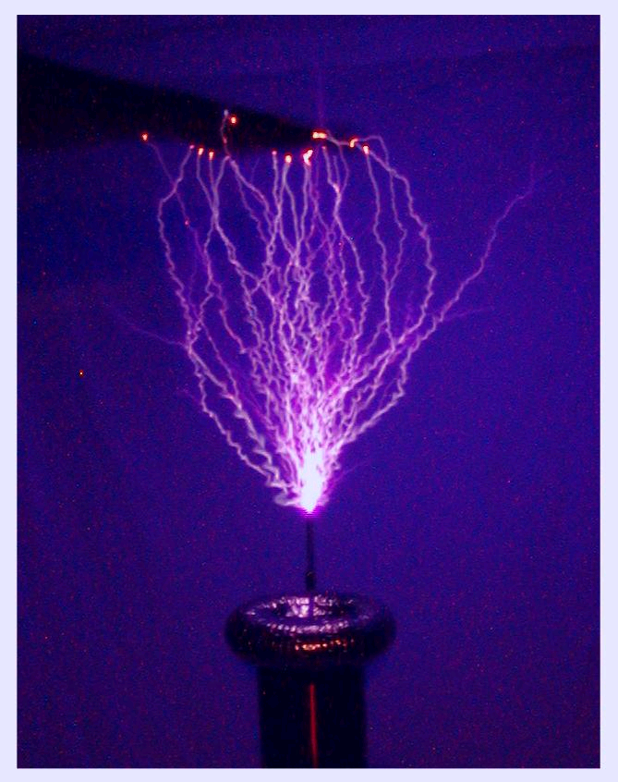
Electricity
Maybe the single greatest change for society in history.
Developed throughout 1800s:
Volta, Faraday, Edison
Affected every aspect of life.
Such as…?
How?
Not just light bulb
New cheaper more efficient power source with multiple applications

Slide 6
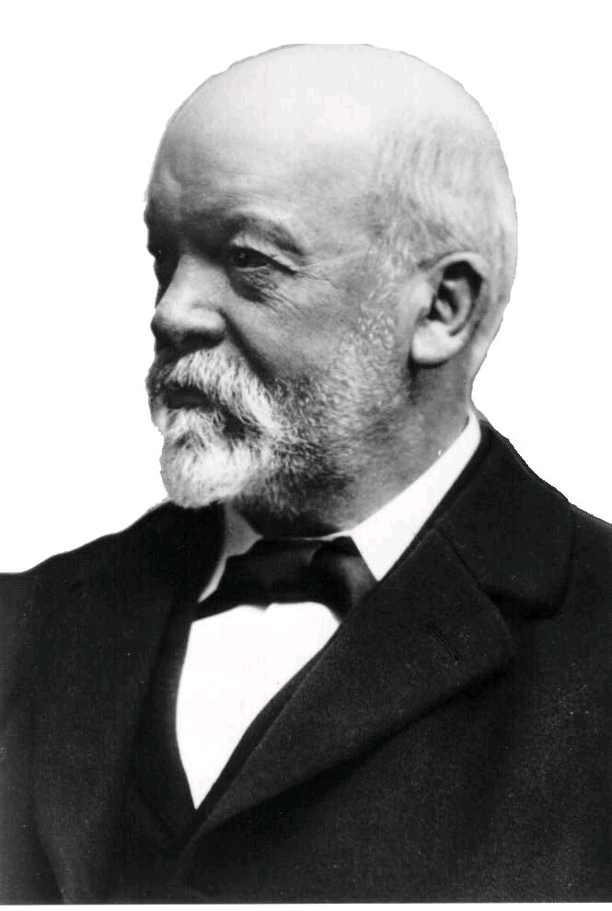
Oil
Invention of internal combustion engine creates new demand for oil
New oil companies Shell and Royal Dutch among the first
Oil industry spawns plastics
Daimler

Slide 7
New Middle Class
With the industrial movement in full swing there was a new group of consumers! MIDDLE CLASS
New industries and corporate structure brought new white collar jobs
Book keeping, accountancy, sales execs, middle management
This group no longer supported change. Had a vested interest in the system.
Now the new and primary consumers of whatever was produced

Slide 8
Urbanization
Haussmann redesigns Paris
Slums knocked down
Parks, Boulevards, monuments built
Paris is the show piece of Europe
Urban planning!
Other cities in France and Europe emulate the model

Slide 9
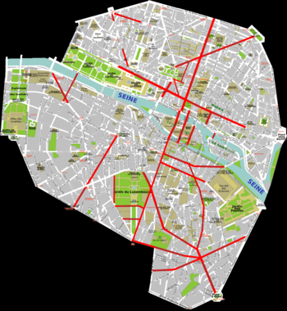
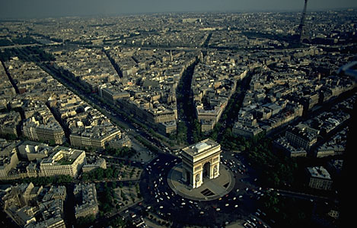
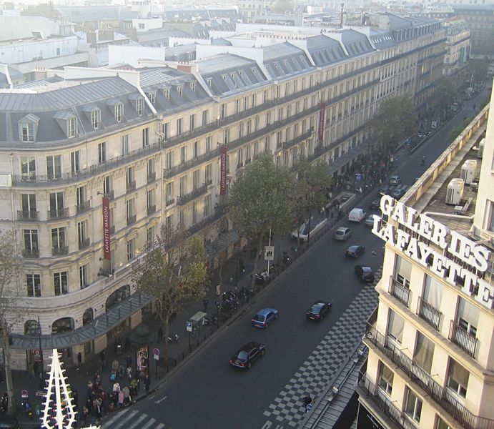

Slide 10
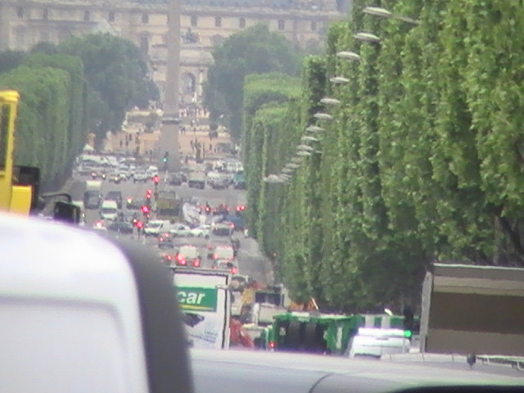
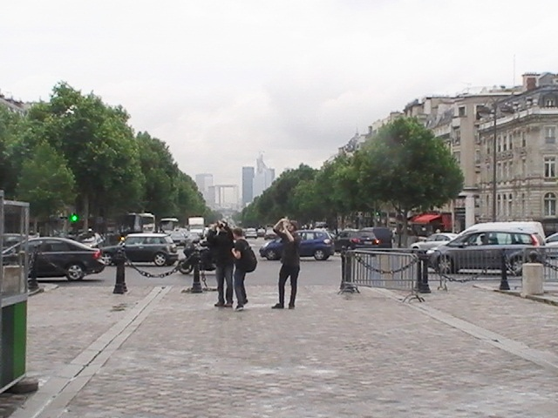

Slide 11
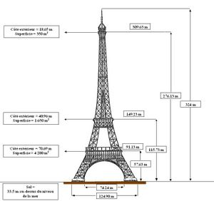
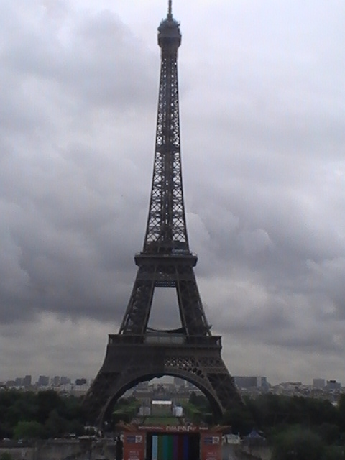
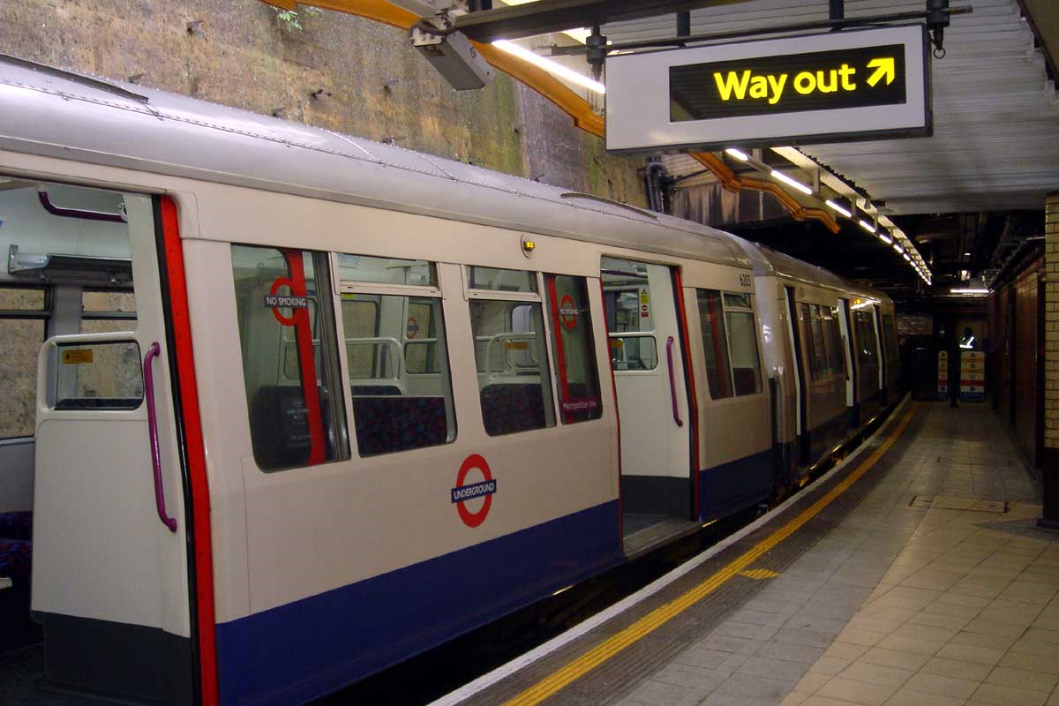
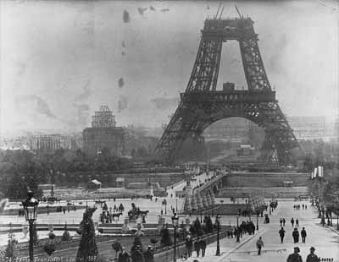
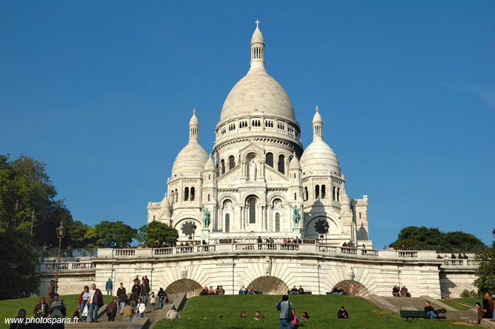

Slide 12
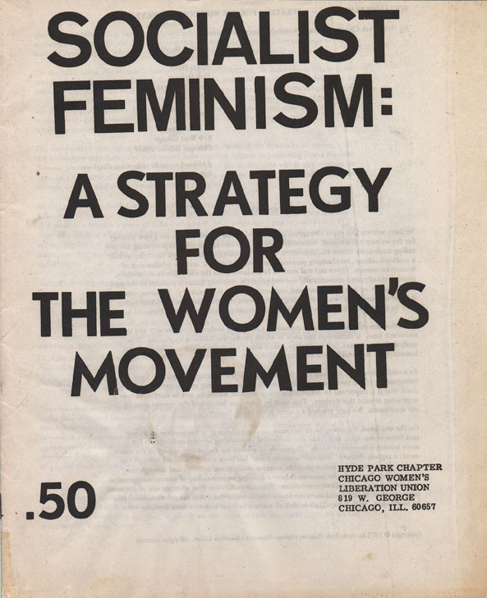

Slide 13
Women’s Movement
New Liberalism meant changes in thought about people
1800s saw the beginning of the “rights” movements,
Anti slavery – in Britain and colonies, later around the globe
Children – factory and mines acts
Labour – limited hours, unions, conditions

Slide 14
Women’s Status
They had none!
No legal rights
No vote
(Had to obey laws that they had no say in)
Wasn’t that was the basis for “some” Revolution 1776?
Few occupational choices and earned fraction of man’s wage for the same job
Few educational rights
(no higher education)

Slide 15
Women’s place was in the home (cult of domesticity alive and well)
Employers paid women less! Why?
Were not wage earners
Unions did not allow women
Could not work as long or as hard as men
Did not account for
women as wage earners (Widows, sick/disabled husbands)
Laws to protect women made them less available to hire

Slide 16
Where Did Women Work? 4 main fields
Depended on class
Teaching – limited work for children meant they needed looking after. Cause of citizenship-educated people voted smarter(?)
Nursing – Florence Nightingale
Domestic servant – cook, maid
Garment industry
Most powerful person on Earth?
Queen Victoria (could not vote!)

Slide 17
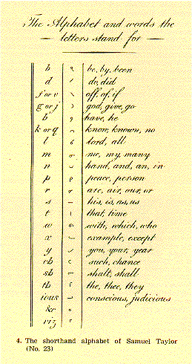
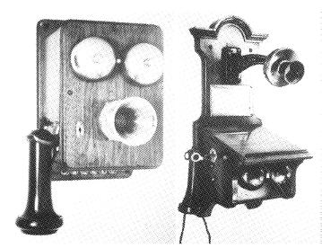
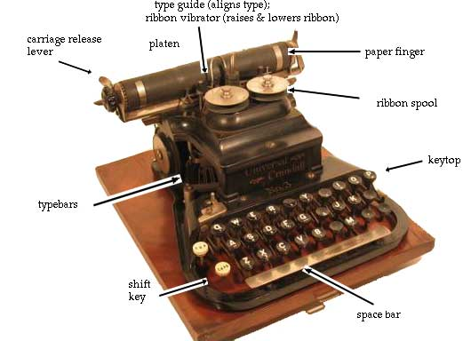
Things Begin to Change
Entrance to Universities – Zurich and London
New jobs created by change in business model. Aided by new inventions such as…

Slide 18
Some Things Did Not Change
Societal expectations helped control women.
Once married stop working (Teachers)
If pregnant stop working
Concept of “women’s work”. Middle classes wanted women at home. WHY?
Cult of Domesticity alive and well
Women had power of the purse at home!
Target for the new advertizing industry.
To be replayed in the 50s

Slide 19
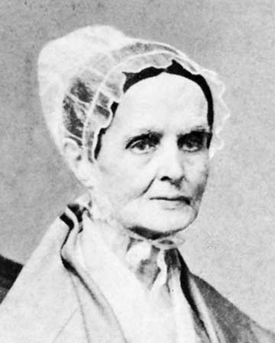
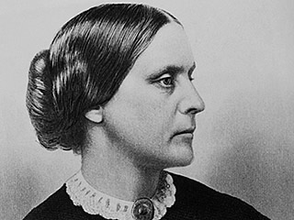
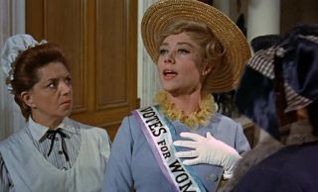
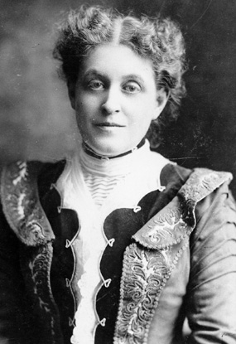
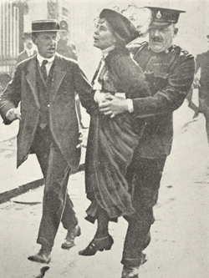
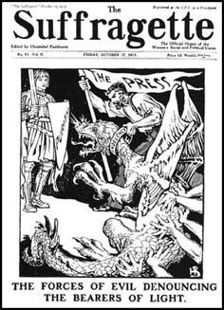
Suffrage Movement

