Slide 1
Imperialism
Old & New Imperialism

Slide 2
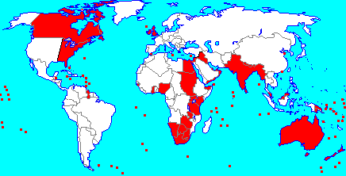
Europe’s influence continued to expand in the 19th c.
Original reasons 3Gs. What are the new reasons?
Resources to feed the industrial hunger
White Man’s Burden (from the poem)
Nationalism prove your country is better.
So it’s really for all the same old reasons…

Slide 3
“Old Imperialism”, European powers did not usually acquire territory (except for Spain in Americas and Portugal in Brazil) but rather built a series of trading stations
Respected and frequently cooperated with local rulers in India, China, Japan, Indonesia, and other areas where trade flourished between locals and European coastal trading centers.
the “new imperialism” tended to favor direct conquest and formal empire
Africa and Asia had seen limited Euro. intrusion and most contacts had been coastal in nature…entire continents now came under Euro. influence

Slide 4
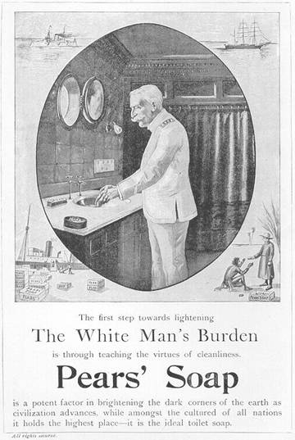
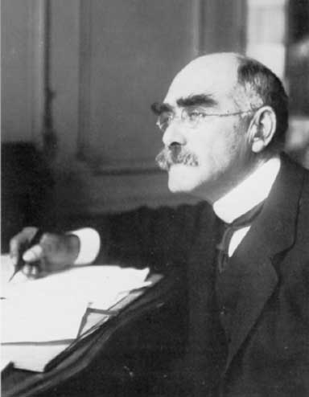
Ideology: Nationalism and Social Darwinism
Russia especially used imperialistic drives to divert popular attention from the class struggle at home and to create a ‘false’ sense of national unity. Other countries used it to promote their nationalistic sentiments. Look at the map…
(listen to me)
"White Man's Burden": racist and patronizing. It preached that the “superior” Westerners had an obligation to bring their culture to “uncivilized” peoples in other parts of the world - Poem by Rudyard Kipling

Slide 5
Take up the White Man's burden--No tawdry rule of kings, But toil of serf and sweeper-- The tale of common things. The ports ye shall not enter, The roads ye shall not tread, Go mark them with your living, And mark them with your dead. Take up the White Man's burden--And reap his old reward: The blame of those ye better, The hate of those ye guard-- The cry of hosts ye humour (Ah, slowly!) toward the light:-- "Why brought he us from bondage, Our loved Egyptian night?" Take up the White Man's burden--Ye dare not stoop to less-- Nor call too loud on Freedom To cloak your weariness; By all ye cry or whisper, By all ye leave or do, The silent, sullen peoples Shall weigh your gods and you.
Take up the White Man's burden-- Send forth the best ye breed-- Go bind your sons to exile To serve your captives' need; To wait in heavy harness, On fluttered folk and wild-- Your new-caught, sullen peoples, Half-devil and half-child. Take up the White Man's burden-- In patience to abide, To veil the threat of terror And check the show of pride; By open speech and simple, A hundred times made plain To seek another's profit, And work another's gain. Take up the White Man's burden-- The savage wars of peace-- Fill full the mouth of Famine And bid the sickness cease; And when your goal is nearest The end for others sought, Watch sloth and heathen Folly Bring all your hopes to nought.

Slide 6
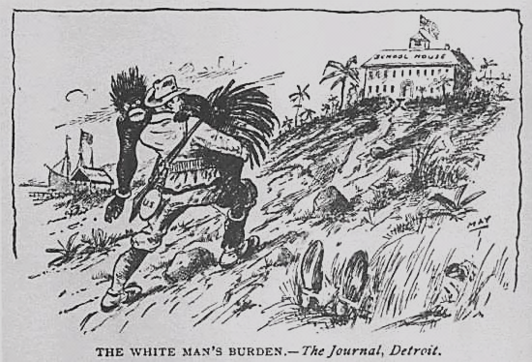
The Poem was read in Congress as US debated the Spanish American War!

Slide 7
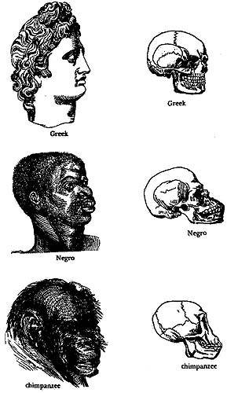
Social Darwinism

Slide 8
What was new was the extent!
For the 1st time, Euro. imperialism was truly global in nature.
Britain was the world leader. Naval Supremacy
(“The sun never sets on the Br. Empire”)
It was also contradictory:
Euro. nations explored the ideals of liberalism, nationalism, and socialism for their own people…
Imperialism meant none of these ideas were offered to the occupied nations. The Europeans remained as exploitative as ever!

Slide 9
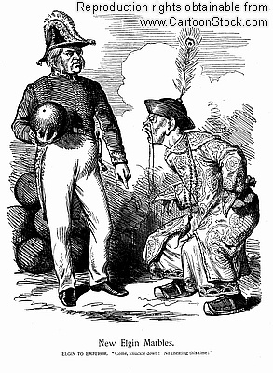
Other remnants of the “Old Imperialism”
Why was there an Opium War?
First Opium War (1839-1841) Britain occupied several coastal cities and forced China to surrender- GB used military force in defence of “free trade”
Treaty of Nanking (1842)
Forced China to cede Hong Kong to Britain thru 1997…2020 issues
pay large indemnity
open up several large ports to foreign trade.

Slide 10
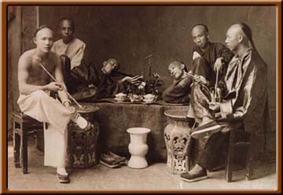
Second Opium War (1856-1860)
China forced to accept trade and investment on unfavorable terms for the foreseeable future.
Extraterritoriality subjected Westerners to their home country’s laws rather than China’s.

Slide 11
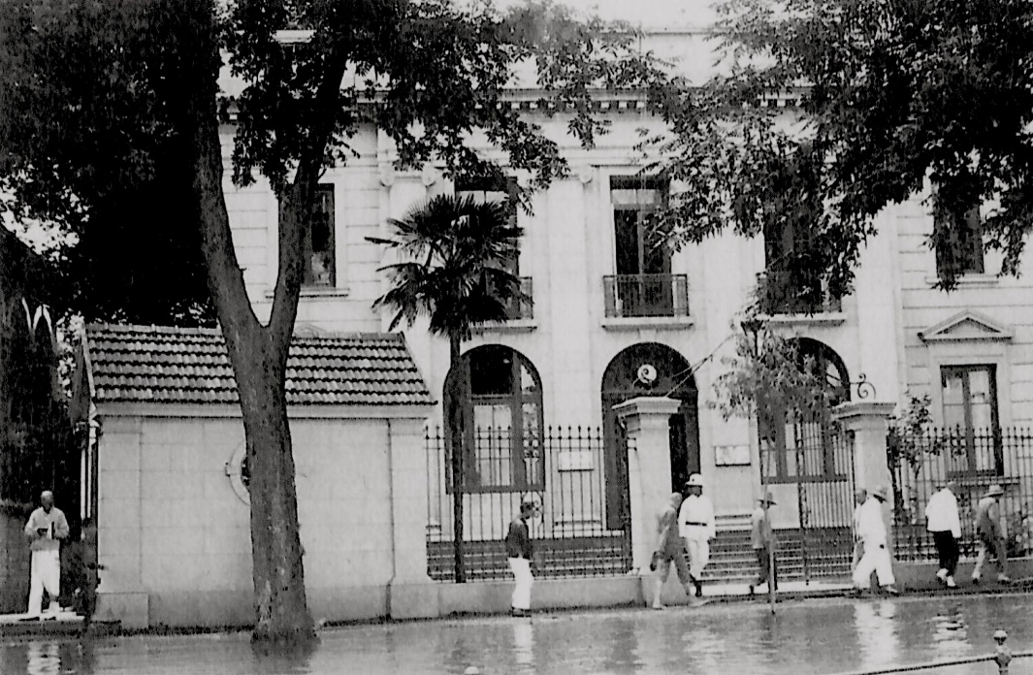
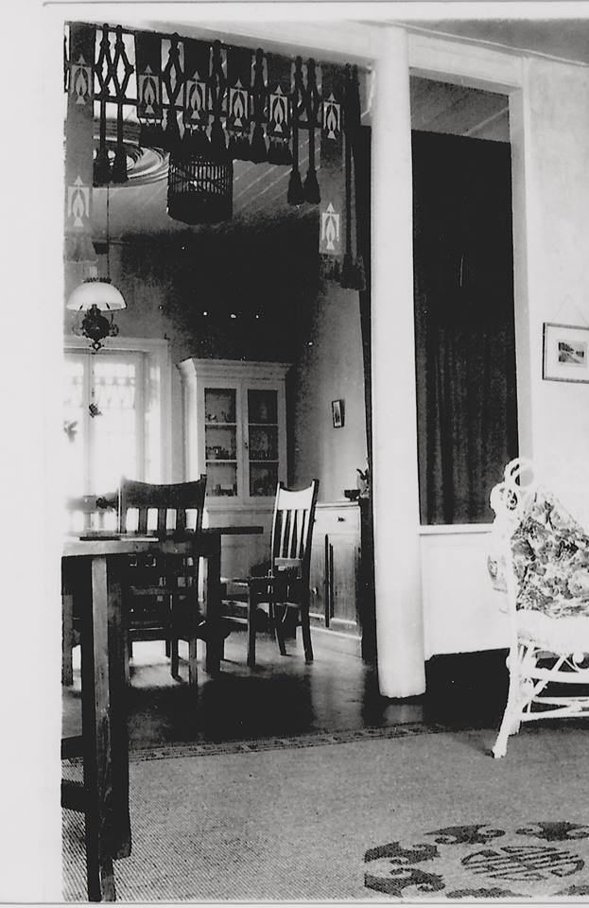
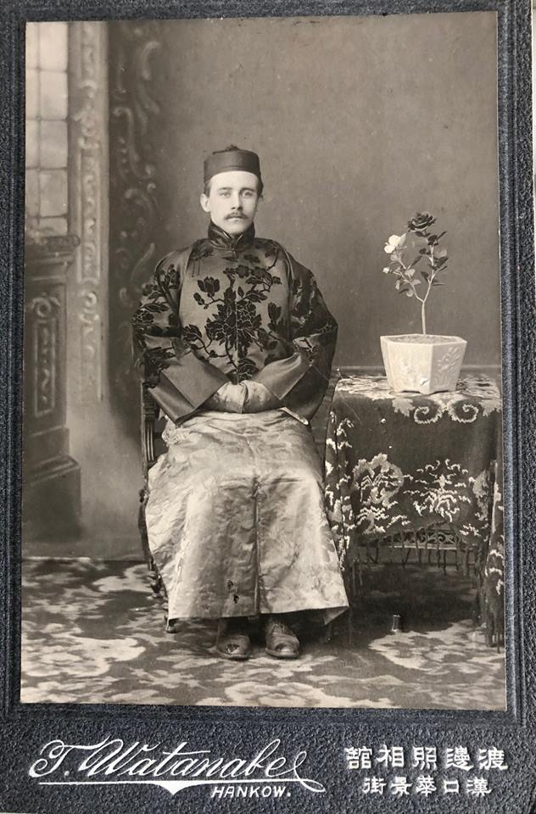
One of my great uncles lived and worked in China in the early 1900s
(pics are from 1915) in Hankou. This is his house. I have a MahJong set he brought back made of bamboo and ivory. This is him in traditional Chinese clothing. It was common for Europeans to “dress up” for special occasions. Ironically the Chinese did the same to try and impress/secure opportunities by appearing as European as possible.

Slide 12
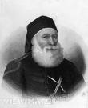
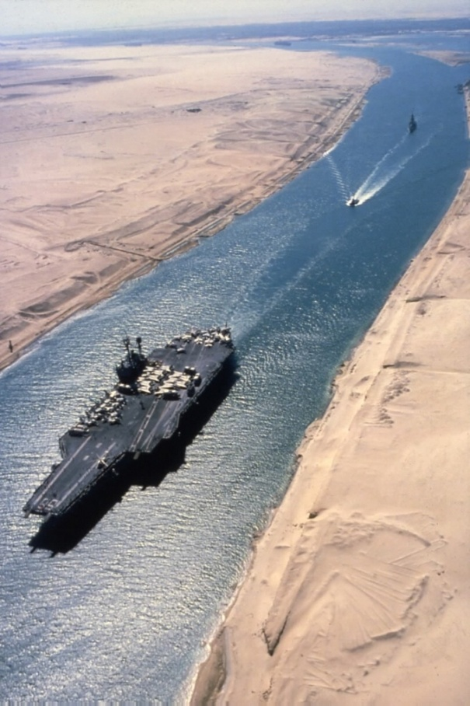
Egypt And Into Africa
Became a protectorate of Great Britain from 1883 until 1956
British domination of Egypt became the model for the "new imperialism"
Turkish general Muhammad Ali had made Egypt into a strong and virtually independent state by 1849
Used foreign investment to build Suez Canal…
Egypt's inability to satisfy foreign loans led to it selling its shares in the Suez Canal to Britain
Safeguarding the Suez Canal (completed in 1869) played a key role in the British occupation of Egypt and its bloody conquest of the Sudan.

Slide 13
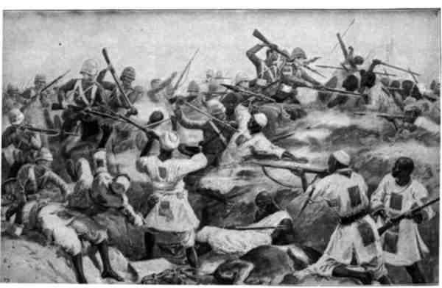
Britain: perhaps the most enlightened of the imperialist powers (though still oppressive)
Uprising in Egypt threatened Suez - Took control of Egypt in 1883, then pushed southward and took control of Sudan
Battle of Omdurman (1898): General Horatio H. Kitchener defeated Sudanese tribesman (revenge for General Gordon) and killed 11,000 (use of machine gun) while only 28 Britons died

Slide 14
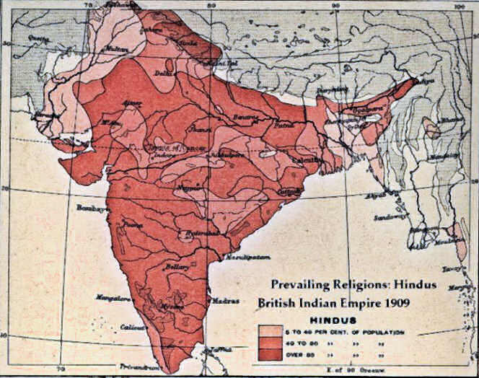
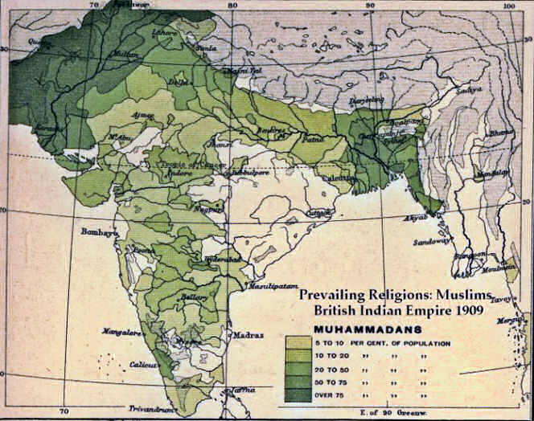
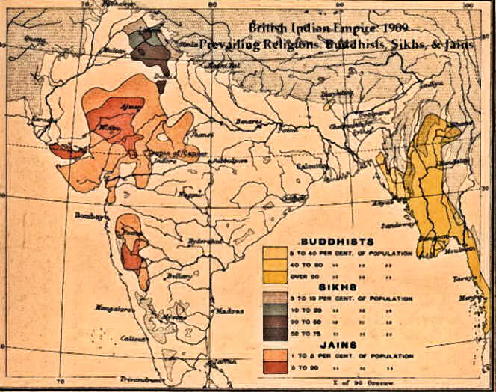
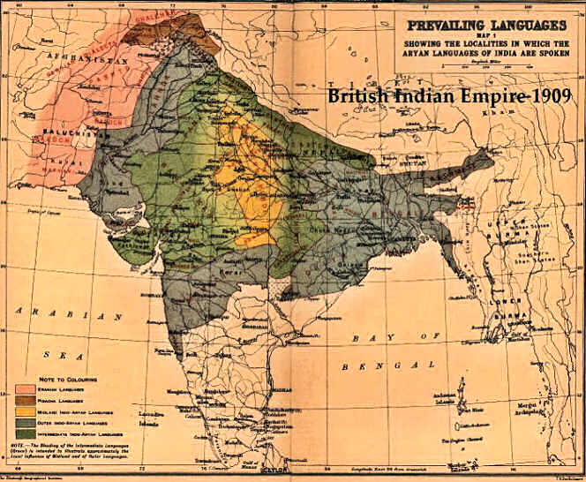
India
GB-Already owned India from French 7 Years War.
Run by BEIC
Very diverse population especially religion
Which Religions?
Hindu
Muslim
Buddhist
Also languages / culture
This allowed Brits to control by encouraging groups to compete rather than unite.

Slide 15
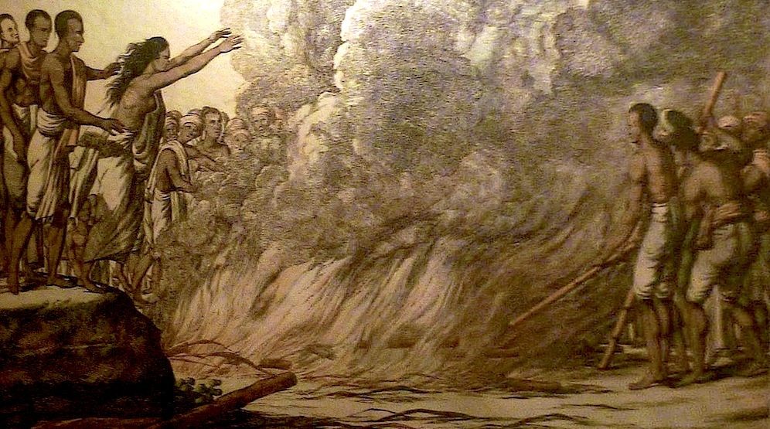
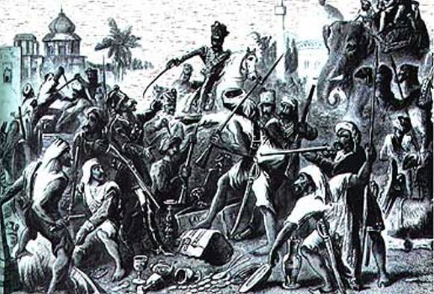
India
Sepoy Mutiny
Muslim and Hindu soldiers in British Army
Bullet grease issue
Sepoys went on violent rampage
Put down harshly by the British.
WHY?
Result was the British Government took control of India – too valuable to risk!
(where would we get our tea?)
BEIC exploited resources.
Built stuff but for their benefit. Little attention paid to Indian culture. Unless it was un-Christian - SUTTEE!

Slide 16
Other Reasons to “put a flag in it”
www.youtube.com/watch?v=hYeFcSq7Mxg
New military and naval bases to protect one's interests against other European powers. (Br in Sudan and Burma)
Br. concerned by Fr. & Ger. land grabs in 1880s; might seal off their empire’s future, economic opportunities might be lost
Increased tensions between the “haves” (e.g. British Empire) and the “have nots" (e.g. Germany & Italy) who came in late to the imperialistic competition.

Slide 17
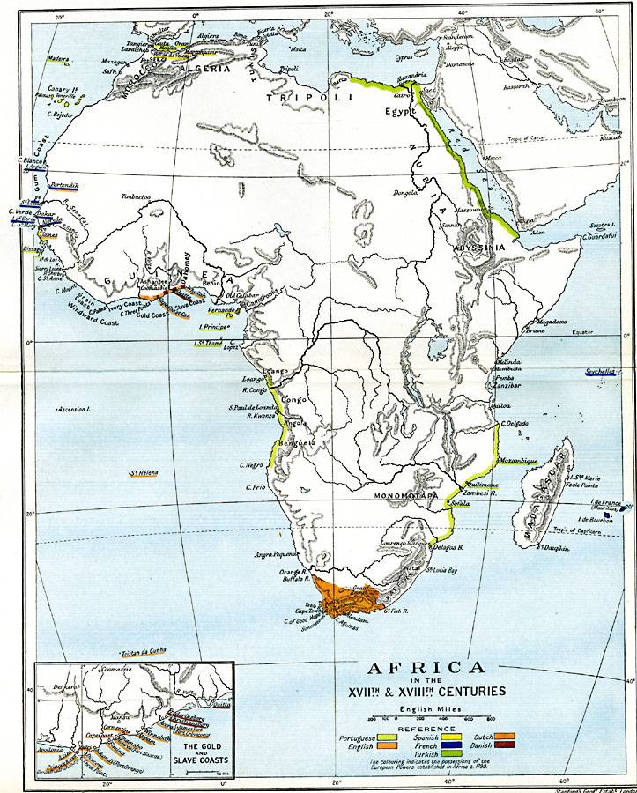
Africa
1830, Europeans controlled 10% of Africa
New Scramble for Africa...
by 1914 controlled all except Liberia & Ethiopia

Slide 18
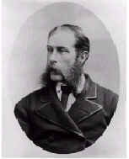
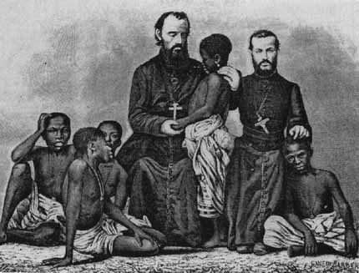
Missionary work: far more successful in Africa than in Asia and Islamic world.
Dr. David Livingston:
first white man to do humanitarian and religious work in central Africa
Sent back “reports” to newspapers. Stories about Africa printed for mass consumption
led to fascination with “Dark Continent”
When the reports stopped….

Slide 19
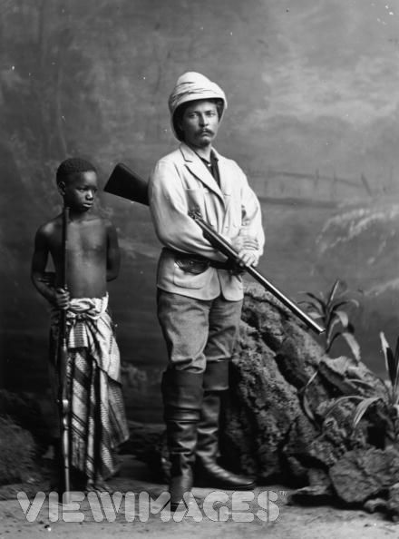
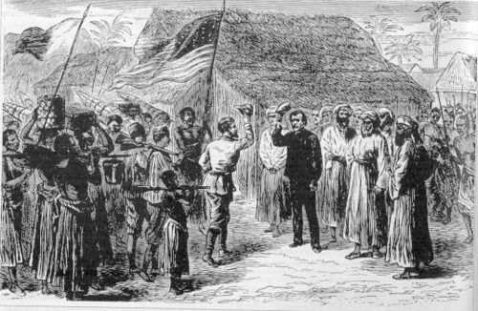
H. M. Stanley newspaper reporter sent to Africa to “find” Livingstone… (whom westerners thought to be dead)
Mission accomplished, Stanley sought the aid/sponsorship of the king of Belgium to dominate the Congo region.

Slide 20
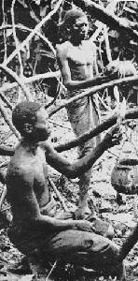
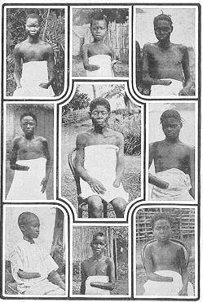
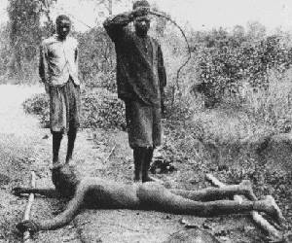
5-8 Million Victims! (50% of Popul.)
Harvesting Rubber
It is blood-curdling to see them (the soldiers) returning with the hands of the slain, and to find the hands of young children amongst the bigger ones evidencing their bravery...The rubber from this district has cost hundreds of lives, and the scenes I have witnessed, while unable to help the oppressed, have been almost enough to make me wish I were dead... This rubber traffic is steeped in blood, and if the natives were to rise and sweep every white person on the Upper Congo into eternity, there would still be left a fearful balance to their credit. -- Belgian Official

Slide 21
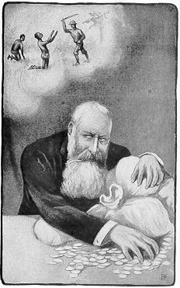
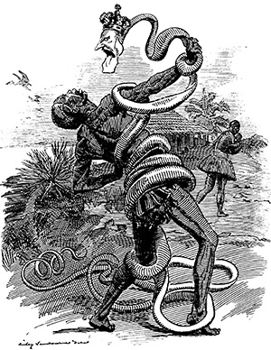

Slide 22
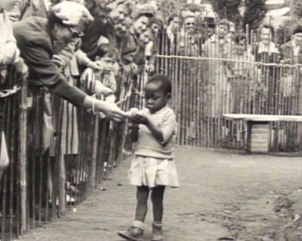
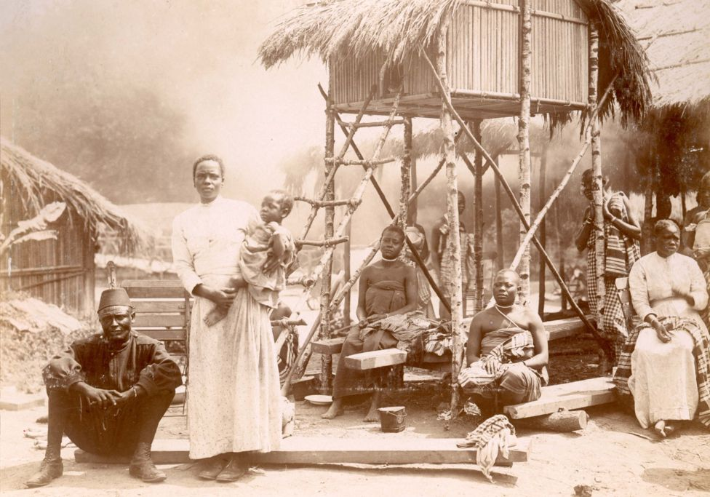
Throughout the late 19th century, and well into the 1950′s, Africans and in some cases Native Americans, were kept as exhibits in zoos. Far from a relic from an unenlightened past, remnants of such exhibits have continued in Europe. Above photograph is from Brussels, Belgium in 1958.
1897, 267 Congolese people were taken to Belgium as part of an “exhibit” in Brussels.
In 1906, Madison Grant—socialite, eugenicist, amateur anthropologist, and head of the New York Zoological Society—had Congolese pygmy Ota Benga put on display at the Bronx Zoo in New York City alongside apes and other animals. At the behest of Grant, the zoo director William Hornaday placed Benga displayed in a cage with the chimpanzees, then with an orangutan named Dohong, and a parrot, and labeled him The Missing Link, suggesting that in evolutionary terms Africans like Benga were closer to apes than were Europeans. It triggered protests from the city's clergymen, but the public reportedly flocked to see it.

Slide 23
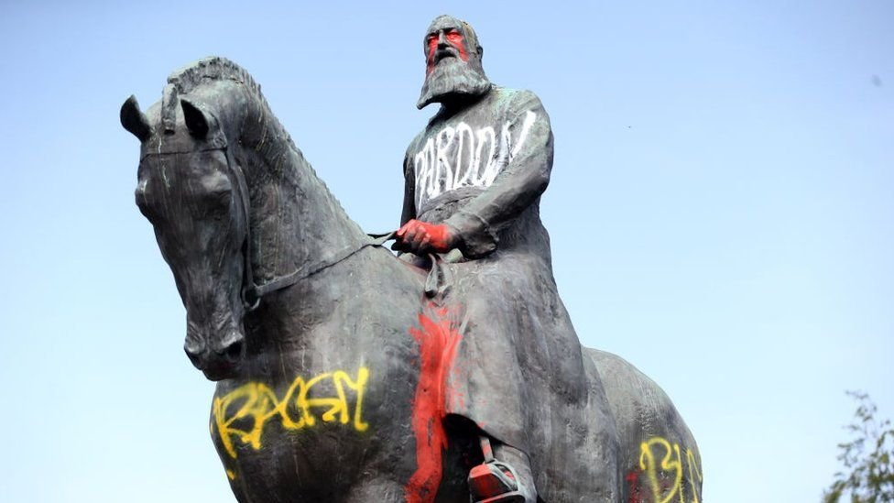
Statue of Leopold in Brussels in the wake of the BLM movement. Should history be sacrificed by changing morality?

Slide 24
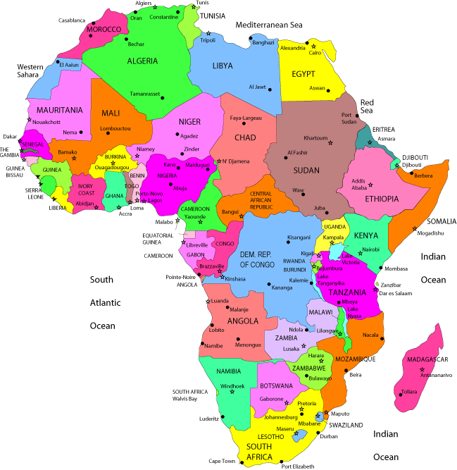
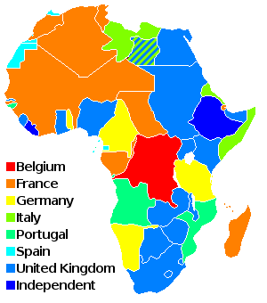
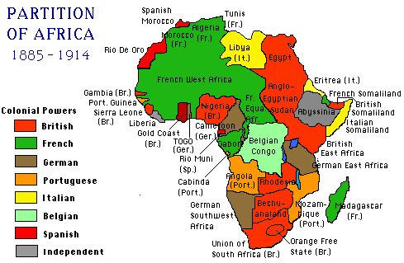
Africa: Berlin Congress 1884-85
Established the "rules" for conquest of Africa
“Paper Partition”
Sponsored by Bismarck; sought to
prevent conflict over
imperialism
Congress coincided
w/ Ger.'s rise as an imperial power
Everyone agreed to stop slavery & slave trade in Africa
How does this arrangement affect Africa today?

Slide 25
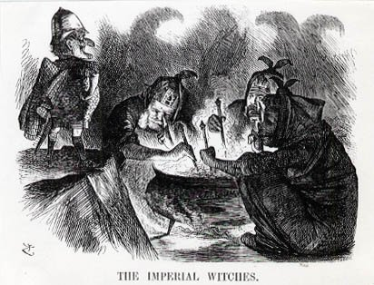

Slide 26
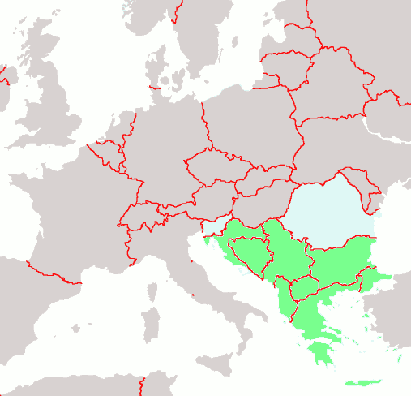
The “Eastern Question”
1870s--constant crisis in the Balkans (who would control region?)
Russia's dream since reign of Catherine the Great was to retake the Balkans and ultimately Constantinople (the old capital of Byzantine Empire and the cradle of Orthodox Christianity)
Pan-Slavism: Idea of uniting all Slavs in Europe under one gov't (Russia?)
Russia defeated the Ottoman Empire by 1878 and seemed poised to dominate the Balkans
Treaty of San Stefano

Slide 27
Treaty of Berlin(1878)
Rewrote the Treaty of San Stefano, taking away the gains made by Russia.
Though Disraeli was most responsible for the agreements, Russia blamed Bismarck
Russian hostility toward Germany led Bismarck to embark upon a new system of alliances which transformed European diplomacy and effectively killed remnants of Concert of Europe

Slide 28
Bismarck’s Foreign Policy
Isolate France – Dual Alliance with Austria. Believed Tsarist Russia would never ally with Republican France.
WHAT IS THE PROBLEM WITH THIS SET UP?
Britain was in “splendid isolation”
Russia would be driven to Germany.
Reinsurance Treaty – Germany and Russia
All this is fine until…

Slide 29
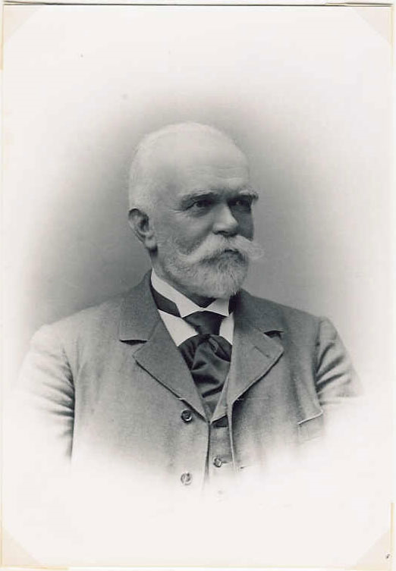
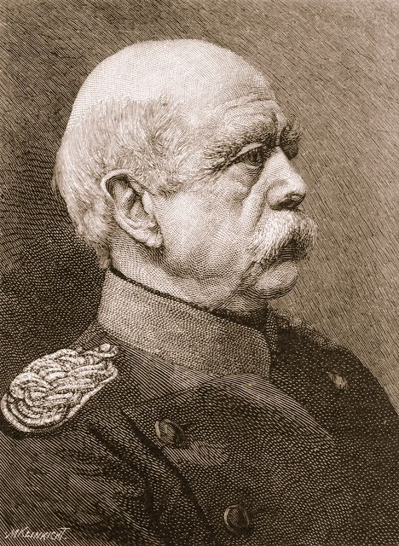
The Beginning of the End
Bismarck out
and Caprivi in!
Willhelm II

Slide 30
The New Rivalry
Germany under Wilhelm II and Caprivi let the Reinsurance treaty lapse. (Who needs Russia???)
France jumps to buy a friend (had invested in Russian industrialization)
New alliance between France and Russia.
issue for Germany… who now looks to join with GB.
“Imitation is the sincerest form of flattery”, and Germany was flattering GB.
Unfortunately it was more like a 6th grade flattery
Tried to get GB attention by antagonizing and imitating them…
Africa
Boers
Navy

Slide 31
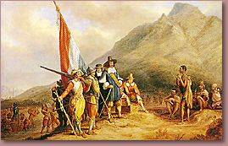
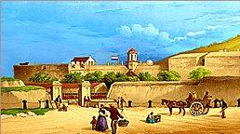
Dutch Landing in 1652

Slide 32
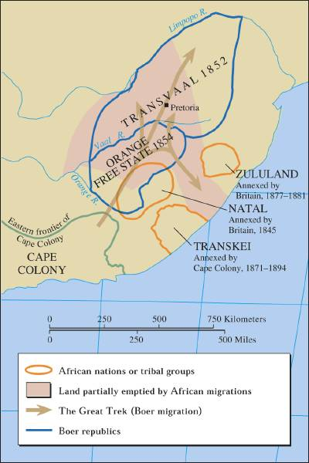
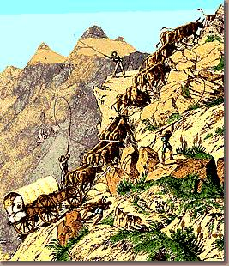
The Great Trek, 1836-38
Afrikaners “chose” to leave because of British policy

Slide 33
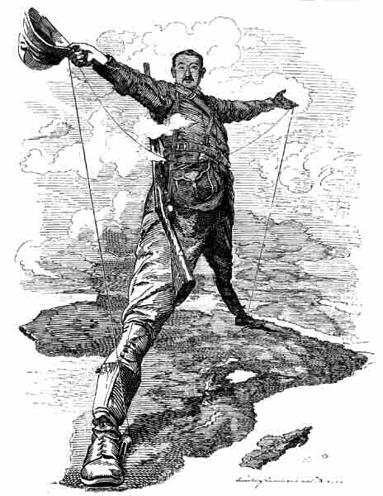
Rhodes’ Railway Dream
Cecil Rhodes had become Prime Minister of Cape Colony; principal sponsor of the Cape-to-Cairo dream where Britain would dominate the continent.

Slide 34
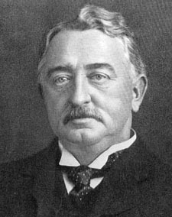
South Africa and the Boer War (1899-1902)
Diamonds and gold were discovered in the Transvaal and Rhodes wanted to extend his influence there but region controlled by Boers (descendents of Dutch settlers) Led to -
Boer War
Bad PR from the war…
Kruger Telegram (1902): Kaiser Wilhelm II, dispatched telegram to Boers congratulating them on defeating British invaders without need of German assistance (GB actually won, but…)
Anger swept through Britain aimed at Germany.

Slide 35
South Africa and the Boer War (1899-1902)
Massive British force eventually defeated Boers.
World Reaction bad for GB
1910 the Transvaal, Orange Free State, Cape Colony, & Natal combined to form the Union of South Africa.
ABC's for Patriots

Slide 36
Naval Build Up
GB anxious to keep naval supremacy
Britain designs HMS Dreadnought 1904
People’s Budget – 1909 - arms race drained tax payer money. Resentment in GB!
Germany (Admiral von Turpitz) build navy to be a threat, but also be a potential ally…
Germany copies the boat

Slide 37
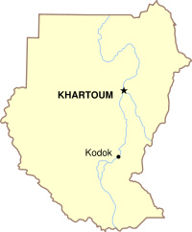
Fashoda Incident (1898): France & Britain nearly went to war over Sudan; France backed down in the face of the Dreyfus Affair
It did establish mutual cooperation and later Entente.

Slide 38
Moroccan Crises 1 + 2
1904 Entente Cordial – GB + France as a result of the Fashoda incident. What’s an Entente?
(FR and Russia already allied… does not ally GB and Russia)
France looking to control Morocco makes a deal with GB – you do it in Egypt and Sudan, we do it in Morocco.
Germany tries to undermine French control of Morocco. Kaiser visits to offer German support to ruler of Morocco in their rejection of French “rules”
Germany agrees to “open door policy” in Morocco as a compromise…
#2 France sends troops to put down uprising
Germany sends gunboats as “support”
GB sees this as an attempt to take Morocco and create Atlantic Base (more irritation)
FR and Ger agree to limited German involvement in Morocco
GB creates Expeditionary Force to go where Germany is a threat
GB and France + Russia now on the same page

Slide 39
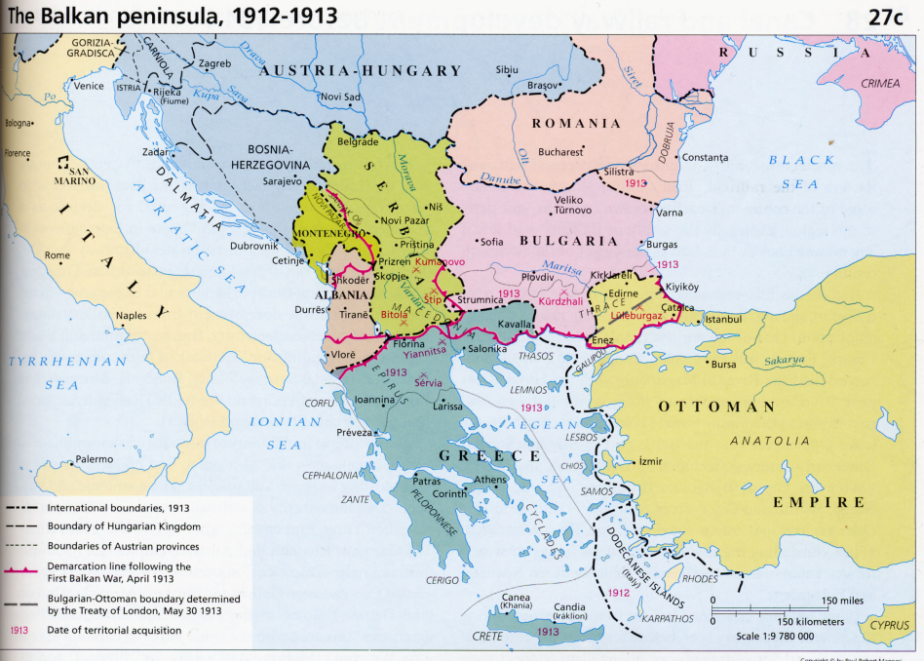
More Balkan Crises
Young Turks - Kamal Attaturk
Modernize Turkey, which meant the Slavs under Ottoman rule were less likely to gain independence
Russia was the Slavic older brother and tries to stop the “bullying”
1912 1st Balkan war – several countries rise. Russia and Austria support. Austria gains Bosnia Herzegovina, Serbia gains independence.

Slide 40
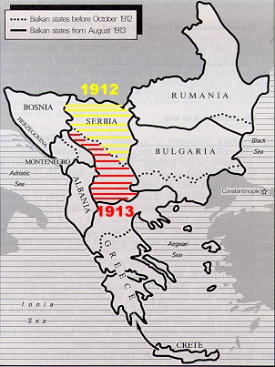
Balkans Contd. “The death of the Sick man of Europe”
2nd Balkan war (because 2 is better than 1)
Fought over who got what from the 1st war
Bulgaria unhappy attacks Greece and Serbia. The two of them are able to defeat Bulgars.
Russia now has an ally in Balkans – Serbia!!!
Serbia believes it will have Russian support in any action

