Slide 1
The French Revolution
Phase1: "Liberal"
1789-1791

Slide 2
The Setup
3 Estates:
First – Church
Second – Nobility
Third – everybody else
A) Bourgeoisie educated and wealthy. Followers of the enlightenment
B) Sans Culottes poor artisans , traders. Poor.
C) Peasants subsistence farmers

Slide 3
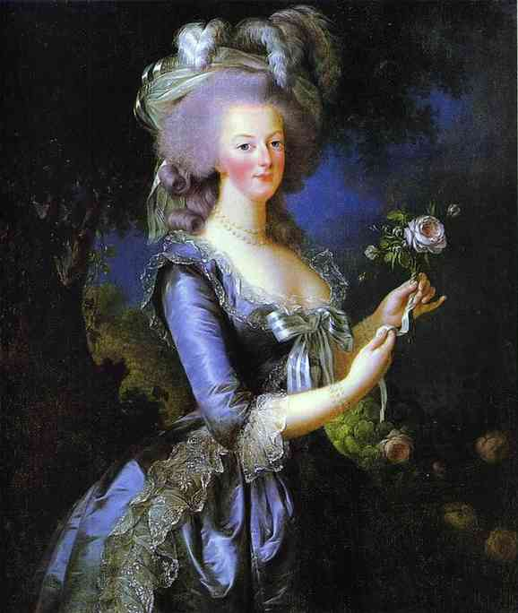
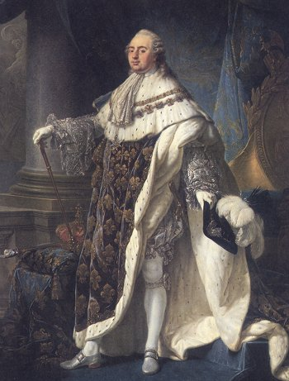
The French Monarchy: 1775 - 1793
Marie Antoinette & Louis XVI

Slide 4
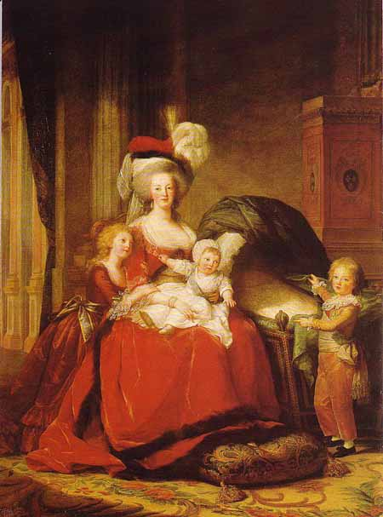
Marie Antoinette and the Royal Children

Slide 5
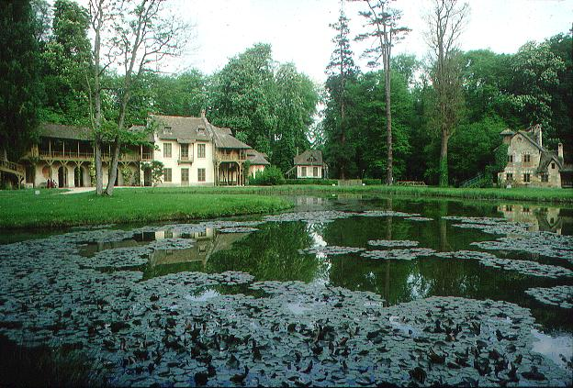
Marie Antoinette’s “Peasant Cottage”

Slide 6
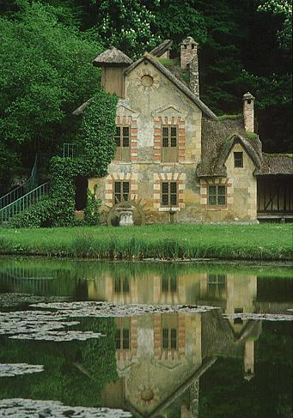
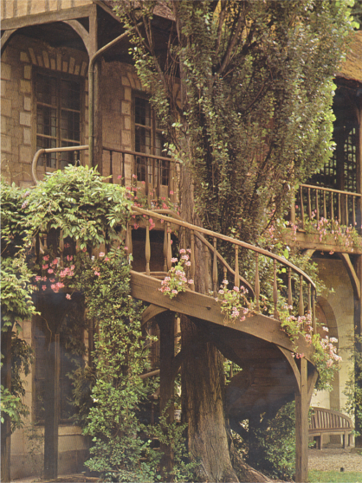
Marie Antoinette’s “Peasant Cottage”

Slide 7
Tensions Between and Among the Estates
First Estate – Cardinals, bishops were members of aristocracy. Parish priests were third estate.
Second estate – Nobles of the sword V Nobles of the Robe
Third Estate – taxation issues, bourgeoisie aware of enlightenment ideas, no influence despite wealth

Slide 8
The Voting Pattern: Voting by Estates
Clergy
1st Estate
1
Aristocracy
2nd Estate
1
1
Commoners
3rd Estate

Slide 9
Financial Problems in France, 1789
Urban Commoner’s Budget:
Food 80%
Rent 25%
Tithe 10%
Taxes 35%
Clothing 20%
TOTAL 170%
King’s Budget:
Interest 50%
Army 25%
Versailles 25%
Coronation 10%
Loans 25%
Admin. 25%
TOTAL 160%

Slide 10
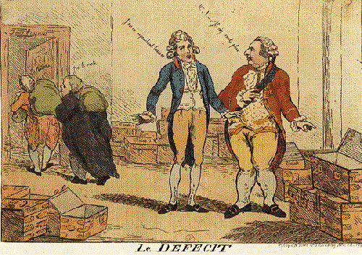
Where is the tax money?
The first and second estates paid no taxes, but were responsible for their collection

Slide 11
The French Urban Poor

Slide 12
Convening the Estates General May, 1789
Last time it was called into session was 1614!

Slide 13
The Number of Representatives in the Estates General: Vote by Head!
Clergy
1st Estate
300
Aristocracy
2nd Estate
300
648
Commoners
3rd Estate

Slide 14
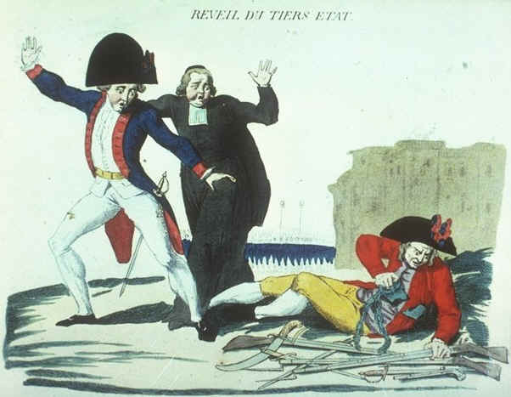
“The Third Estate Awakens”

Slide 15
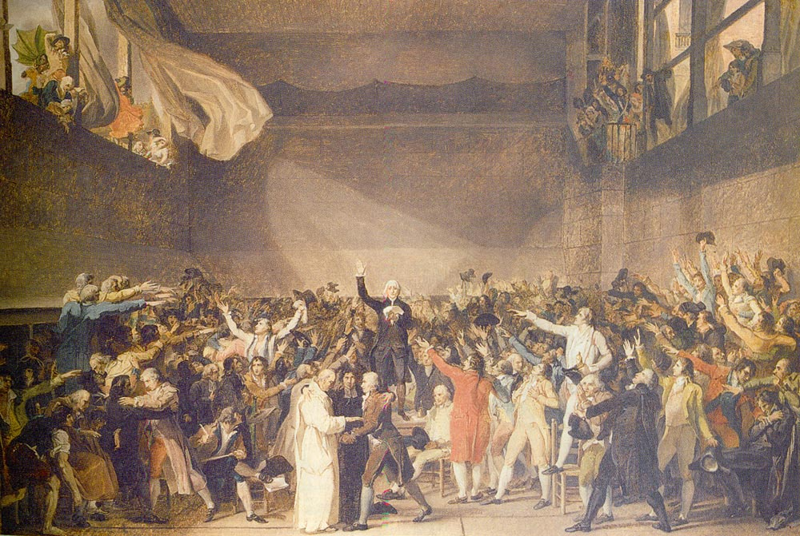
“The Tennis Court Oath” by Jacques Louis David
June 20, 1789

Slide 16
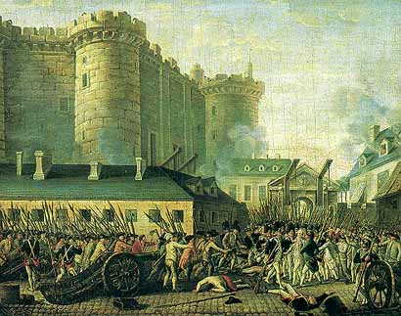
Storming the Bastille, July 14, 1789

Slide 17
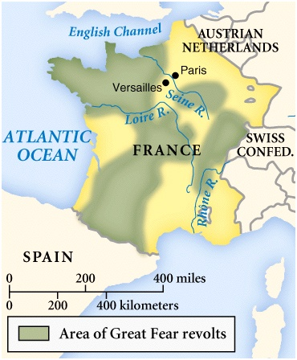
The Great Fear: Peasant Revolt
July 20, 1789

Slide 18
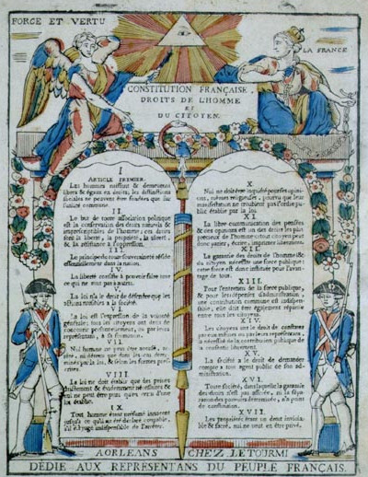
The Declaration of the Rights of Man and of the Citizen
August 26, 1789

Slide 19
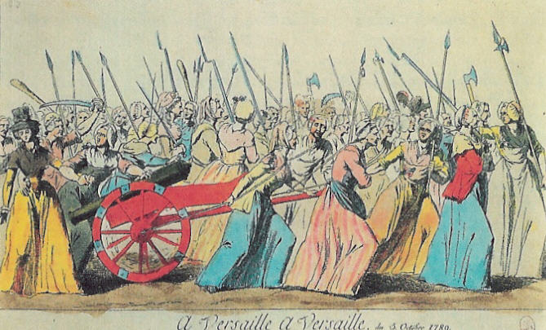
March of the Women, October 5-6, 1789
We want the baker, the baker’s wife and the baker’s boy!

Slide 20
The Tricolor (1789)
The WHITE of the Bourbons + the RED & BLUE of Paris.
Citizen!

Slide 21
The Tricolor is the Fashion!

Slide 22
The “Liberty Cap”: Bonne Rouge

Slide 23
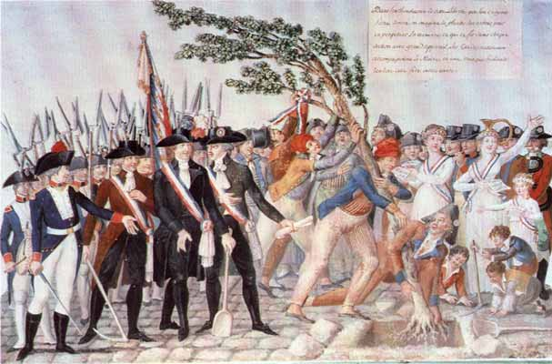
Planting the Tree of Liberty
1790

Slide 24
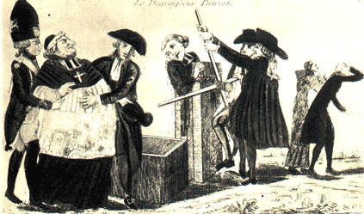
The Confiscation of Church Lands
1790

Slide 25
“Must” Reads: Important Books & Pamphlets of the French Revolution

