Slide 1
FRANCE

Slide 2
Blue Horizon Chamber
So called because of the uniforms of the numerous veterans in the legislature.
Wanted to protect France from Germany
Versailles not enough
Joined Little Entente with Yugoslavia, Romania and Czechoslovakia
This created insecurity in Germany and the two outcasts (Russia) joined in the Treaty of Rapallo
Gave Germany exclusive trade rights
Also allowed Germany to produce and perfect weapons forbidden by Versailles

Slide 3
Rhur Crisis
Reparations part of Versailles
US did not ratify Treaty and waived claims to reparations.
German government made difficult to collect payments
Allies then claimed they were unable to pay US war debts
1923 occupation of the Rhur to collect what was owed
Germans went on strike.
French PM Poincare sent in French workers
Not supported by Brits who did not like the use of force

Slide 4
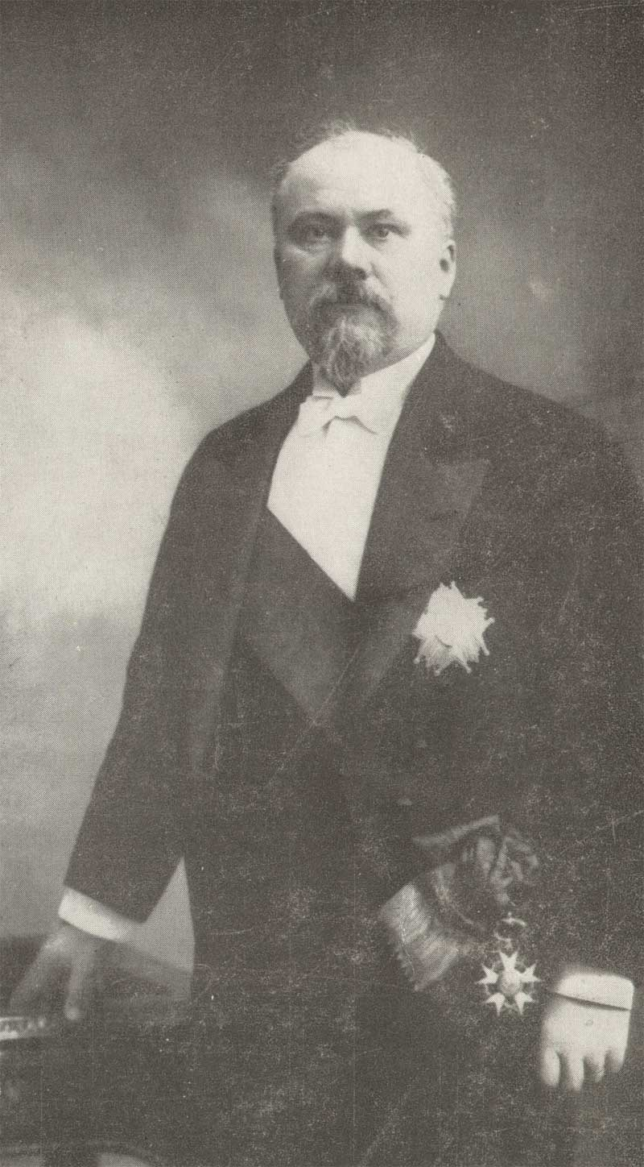
Raymond Poincaré & the Conservative Right
Pushed for large-scale infrastructure reconstruction programs [counting on German reparations to pay for them].
After 1926-29:
New taxes & tightened tax collections.
Drastic decline in govt. spending that stabilized the franc [the threat of runaway inflation was avoided!]

