Slide 1
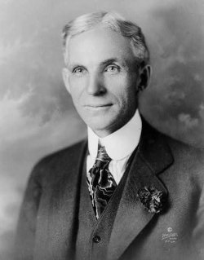
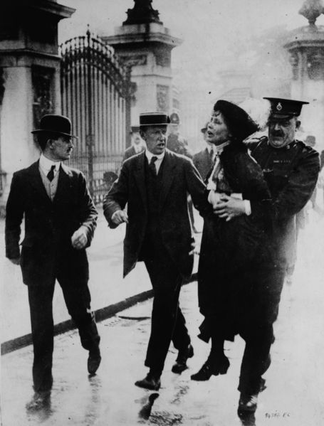
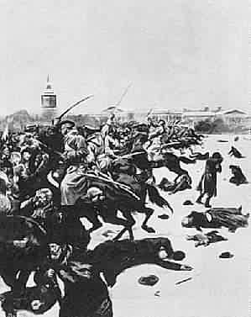
A.P. European History Building European Supremacy

Slide 2
The Building of European Supremacy
New Industrial
Revolution
100
200
300
400
500
Urbanization
100
200
300
400
500
Women in the
Modern Era
100
200
300
400
500
The Labor
Movement
100
200
300
400
500
Russia
100
200
300
400
500

Slide 3
What was the Solway Process?
MAIN
This was the process that refined the production of alkali and the recovery of chemical by-products.
400
500
SUBJECT:The New Industrial Revolution
200
300
100

Slide 4
What were Standard Oil in the U.S., British Shell Oil, and Royal Dutch Petroleum?
MAIN
These were the three major Petroleum Companies that monopolized oil production and supplies throughout the world.
400
500
SUBJECT:The New Industrial Revolution
200
300
100

Slide 5
Who was Gottlieb Daimler?
MAIN
He was the German engineer who put a an internal combustion engine on four wheels and developed the first automobile.
400
500
SUBJECT:The New Industrial Revolution
200
300
100

Slide 6
What were Joint Stock Companies?
MAIN
These were types of companies that were allowed to prosper in Britain in 1856, France in 1863 and Prussia in 1870.
400
500
SUBJECT:The New Industrial Revolution
200
300
100

Slide 7
Who was Henry Ford?
MAIN
He was the inventor and businessman who developed the assembly line and made affordable, reliable automobiles possible for American families.
400
500
SUBJECT:The New Industrial Revolution
200
300
100

Slide 8
Who was Napoleon III?
MAIN
He was the monarch that instigated the redesign of Paris and the widening of the streets to prevent barricading and riots, such as the Paris Commune.
400
500
SUBJECT: Urbanization
200
300
100

Slide 9
What were the Eiffel Tower and the Basilica of the Sacred Heart?
MAIN
These were the two French landmarks that symbolized the social and political divisions in the Third French Republic.
400
500
SUBJECT: Urbanization
200
300
100

Slide 10
What was cholera?
MAIN
This was the disease that swept through the major urban areas of Europe in the 1830s and 1840s.
400
500
SUBJECT: Urbanization
200
300
100

Slide 11
What was the Bois de Boulogne?
MAIN
This was the large park that was built in Paris that was two and half times the size of Central Park and three times the size of Hyde Park and at night turns into a notorious Red Light District.
400
500
SUBJECT: Urbanization
200
300
100

Slide 12
What was the Albert Embankment started in 1866?
MAIN
This was the major construction project along the Thames River in London that included large sewers, gas and water mains all encased in concrete and lowered the mortality rate in the city.
400
500
SUBJECT: Urbanization
200
300
100

Slide 13
What was the University of Zurich in Switzerland ( founded by Zwingli in 1525)?
MAIN
This was the first European University to open its doors to women in the 1860s.
400
500
200
300
SUBJECT: Women in the Modern Era
100

Slide 14
Who were Emmeline Pankhurst and her daughters Sylvia and Christabel?
MAIN
These were the leaders of the Women’s Suffrage Movement in Great Britain a mother and her two daughters that at times used violence to gain the right to vote for women.
400
500
200
300
SUBJECT: Women in the Modern Era
100

Slide 15
What was Prostitution?
MAIN
This was the profession that was usually reserved for poor, desperate women and on the European Continent was legalized and subject to municipal regulations, where as in Great Britain there were very few regulations or restrictions.
400
500
200
300
SUBJECT: Women in the Modern Era
100

Slide 16
What was the Weimar Constitution and Republic?
MAIN
This was the German government and constitution that finally allowed German women the right to vote in 1919.
400
500
200
300
SUBJECT: Women in the Modern Era
100

Slide 17
Who was Marie Mauguet ?
MAIN
She was the French Roman catholic Feminist who supported Women’s Right to vote but rejected the idea of protest or violence.
400
500
200
300
SUBJECT: Women in the Modern Era
100

Slide 18
What was the International Working Men’s Association or the First International?
MAIN
This was the Association established by British and French trade unionists.
400
500
200
300
SUBJECT: The Labor Movement
100

Slide 19
What was the Paris Commune?
MAIN
This was the government of Paris that Marx called a genuine proletarian uprising and made most Europeans to question socialism.
400
500
200
300
SUBJECT: The Labor Movement
100

Slide 20
Who were the Fabians, who help form the nucleus of the new Labour Party?
MAIN
This was Great Britain’s most powerful socialist group.
400
500
200
300
SUBJECT: The Labor Movement
100

Slide 21
What was the general strike, where all businesses shut down in support of a common cause?
MAIN
This was the action described by Georges Sorel in his Reflections on Violence that was often used by the French labor movement.
400
500
200
300
SUBJECT: The Labor Movement
100

Slide 22
What was Revisionism ? ( He ended up being correct)
MAIN
This was the response of Eduard Bernstein to Marx’s prediction for an inevitable social clash between workers and owners.
400
500
200
300
SUBJECT: The Labor Movement
100

Slide 23
Who was P.A. Stolypin ?
MAIN
He was the Prime Minister appointed by Nicholas II who suspended the Duma and hung numerous suspected enemies of the state, but also implemented agricultural reforms and educated farmers on better practices.
400
500
200
300
SUBJECT: Russia
100

Slide 24
Who were the radical Bolsheviks led by Lenin and the moderate Mensheviks led by Kerensky?
MAIN
These were the two Socialist parties who fought for control of Russia after 1905 and especially after 1917.
400
500
SUBJECT: Russia
200
300
100

Slide 25
What was the October Manifesto?
MAIN
This was the document that Nicholas II was forced to sign to stop the Revolution of 1905.
400
500
SUBJECT: Russia
200
300
100

Slide 26
What was the Treaty of Portsmouth and Theodore Roosevelt?
MAIN
This was the Treaty that settled the Russo-Japanese War and the person that won a Nobel Peace Prize negotiating it.
400
500
SUBJECT: Russia
200
300
100

Slide 27
What were Soviets?
MAIN
These were the groups of workers and soldiers who were the nucleus of the Bolshevik party and helped Lenin take control of Russia in 1917.
400
500
SUBJECT: Russia
200
300
100

