Slide 2
European
Imperialism

Slide 3
Summary of the Motives
Old Imperialism
New Imperialism
3 Gs
GOLD
GOD
GLORY
LED TO Europeans creating colonies throughout the New World
Resources for industrial revolution
Nationalism- Take Areas
to look good on the map
for military /strategic purposes
“White Man’s Burden” (more later)
Civilize the savage
Christianize
Social Darwin
3Gs again but in Africa and Asia

Slide 4
European Nationalism
Glory
Source for
Raw
Materials
Industrial
Revolution
Gold
Missionary Activity
God
European
Motives
For Colonization
Markets for Finished Goods
Military & Naval Bases
Glory
Social Darwinism
European Racism
God
Places to Dump Unwanted/ Excess Popul.
Humanitarian Reasons
God
Soc. & Eco. Opportunities
Gold
“White Man’s Burden”

Slide 5
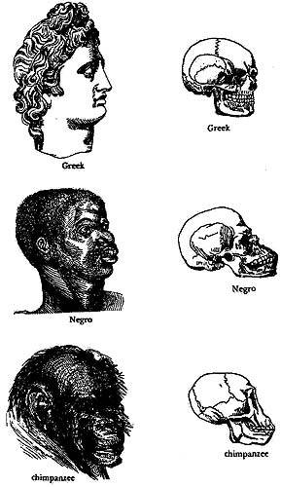
Social Darwinism

Slide 6
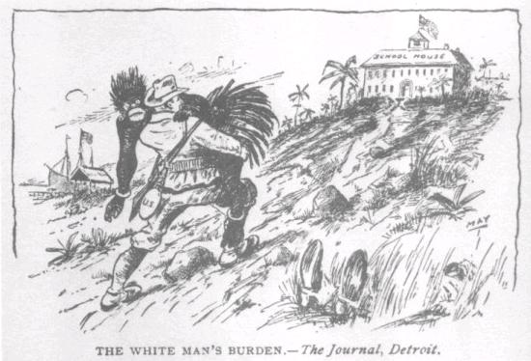
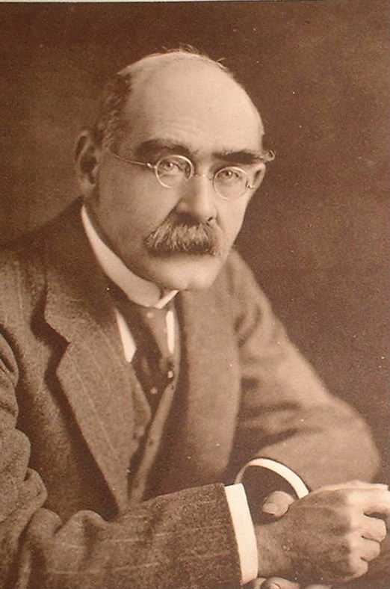
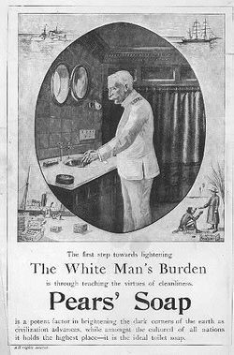
The “White Man’s Burden”
Take up the White Man's burden-- Send forth the best ye breed-- Go bind your sons to exile To serve your captives' need; To wait in heavy harness, On fluttered folk and wild-- Your new-caught, sullen peoples, Half-devil and half-child.
Rudyard Kipling

Slide 7
Types of Colony
Direct
Officials from mother country run things
Benefits –
More could be taken
Increased opportunity for expansion
Indirect / Protectorate
Local leaders allowed to maintain control
Benefits -
cheaper for colonial power
Local culture maintained
Tended to result in more cooperation
Sphere of Influence
Exclusive area claimed by a power for their benefit
e.g. China and South America

Slide 8
African Trade [15c-17c]

Slide 9
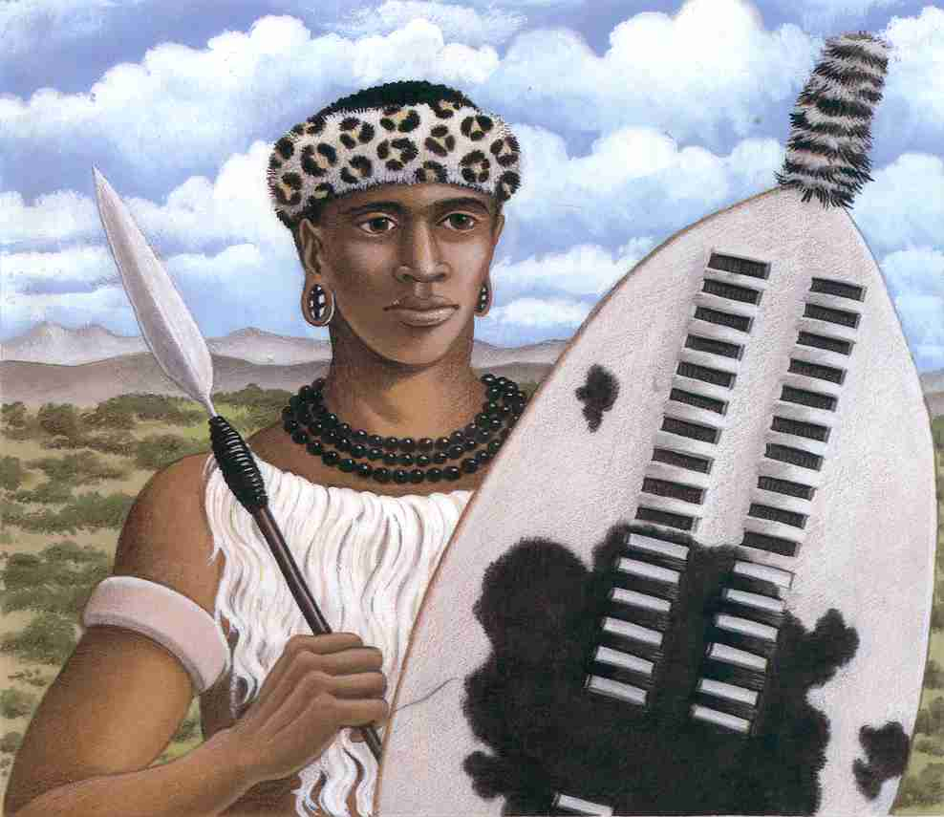
Shaka Zulu (1785 – 1828)

Slide 10
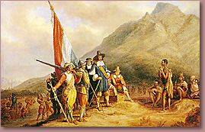
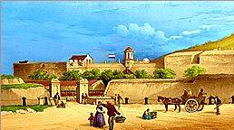
Dutch Landing in 1652

Slide 11
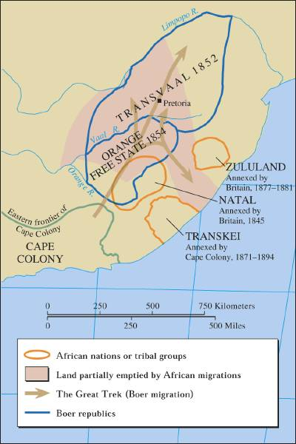
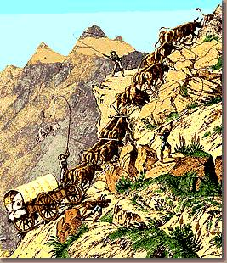
The Great Trek, 1836-38
Afrikaners
Remember this… (more to come)

Slide 12
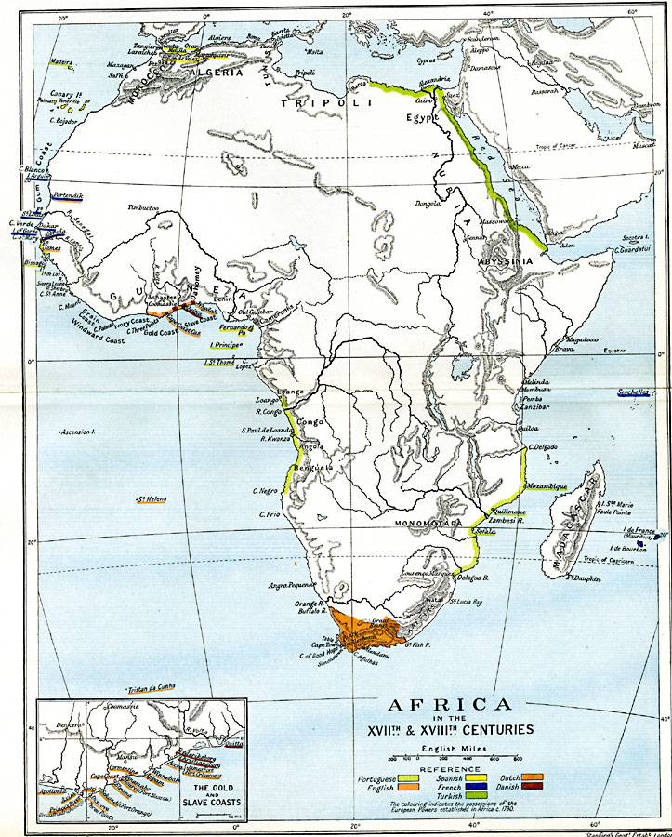
“The Scramble for Africa”
Early ColonialAfrica 1830

Slide 13
Livingstone + Stanley
Countries set out to explore Africa
Dr. David Livingstone – missionary and explorer.
Search for source of the Nile.
Sent back “reports” that were published in newspapers. When they stop, papers sponsor search.
Henry Stanley (US Reporter) goes in search…
“Dr. Livingstone I presume.”
Stanley went to work for King of Belgium

Slide 14
The Belgian Congo:
"King Leopold's
Ghost"

Slide 15
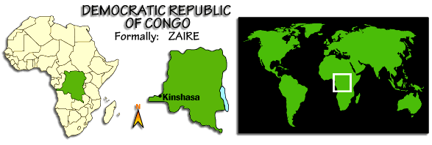
The Congo Free State or The Belgian Congo

Slide 16
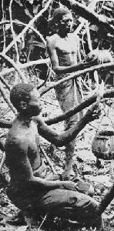
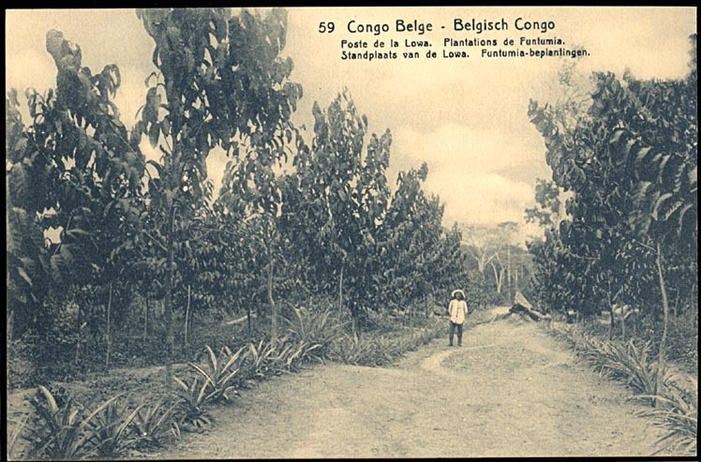
Harvesting Rubber

Slide 17
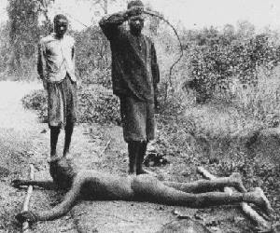
Punishing “Lazy” Workers

Slide 18
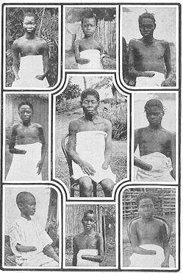
5-8 Million Victims! (50% of Popul.)
It is blood-curdling to see them (the soldiers) returning with the hands of the slain, and to find the hands of young children amongst the bigger ones evidencing their bravery...The rubber from this district has cost hundreds of lives, and the scenes I have witnessed, while unable to help the oppressed, have been almost enough to make me wish I were dead... This rubber traffic is steeped in blood, and if the natives were to rise and sweep every white person on the Upper Congo into eternity, there would still be left a fearful balance to their credit. -- Belgian Official

Slide 20
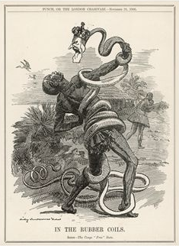
Belgium’s Stranglehold on the Congo

Slide 21
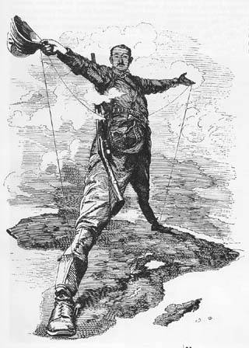
Cecil Rhodes (1853-1902)
Governor of South Africa
and Rhodesia
“The Colossus of Rhodes”
His dream was to build a British railway from Capetown in the South to Alexandria in the North. Never came true – Germany got in the way…this will cause problems down the road (or rail)

Slide 22
Berlin Conference
As more countries “scramble” for a piece of Africa, they come into conflict over who should get what!
Germany (last into the race and with little to lose) sets up conference to divide Africa to avoid a European war!

Slide 23
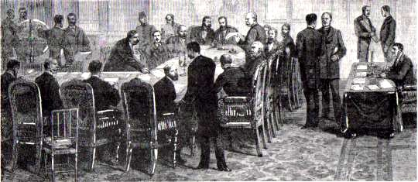
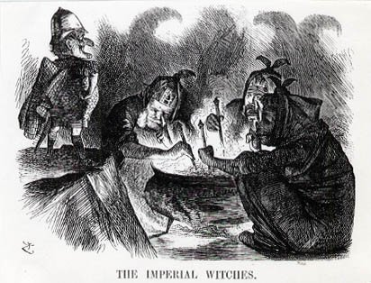
Berlin Conference of 1884-1885
Another point of view? →

Slide 24
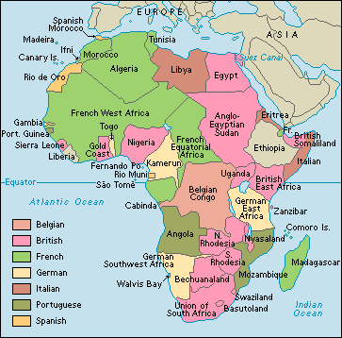
“The Scramble for Africa”
Africa
1890

Slide 25
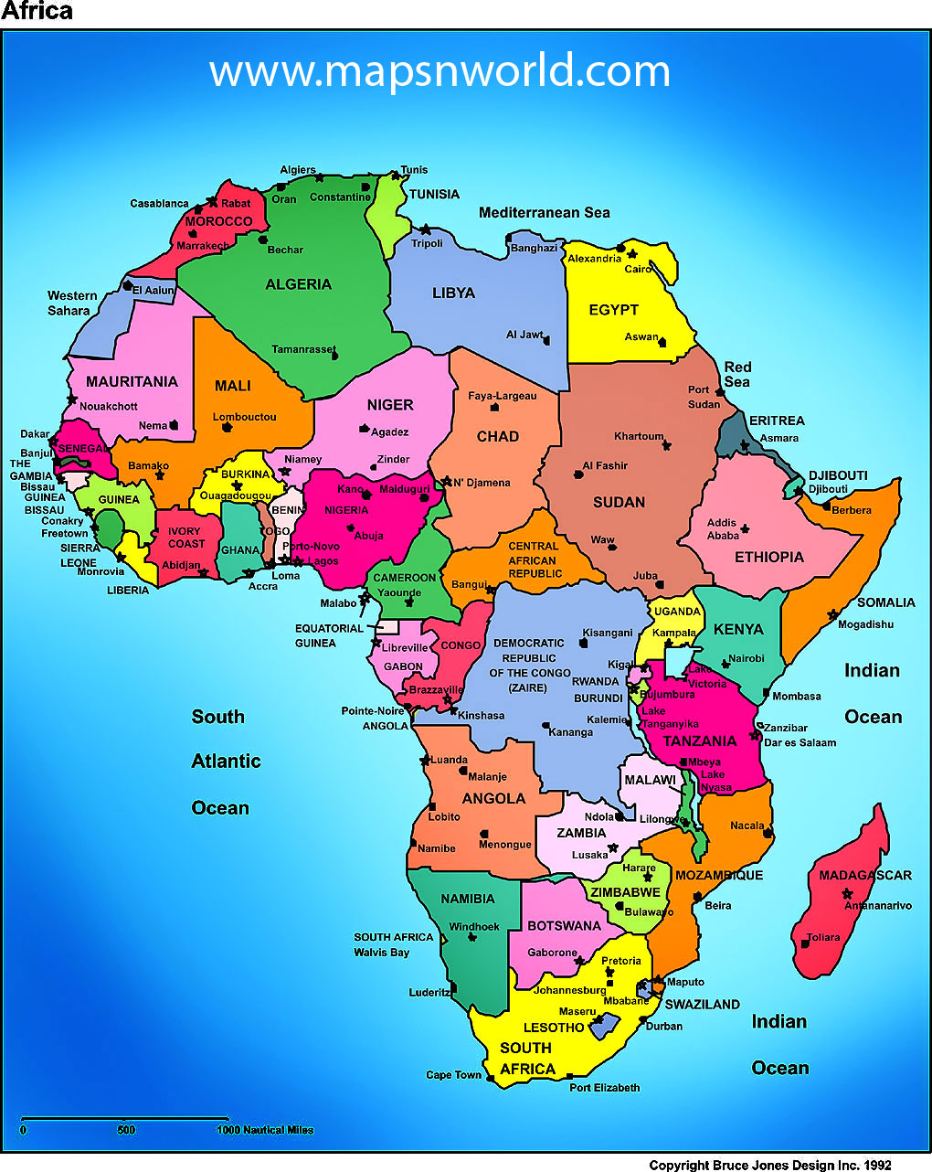

Slide 26
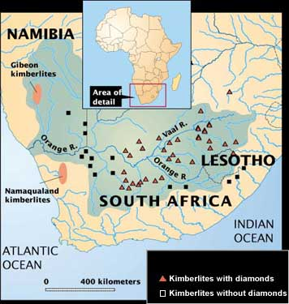
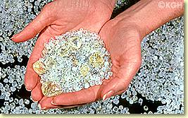
Diamond Mines
Raw Diamonds

Slide 27
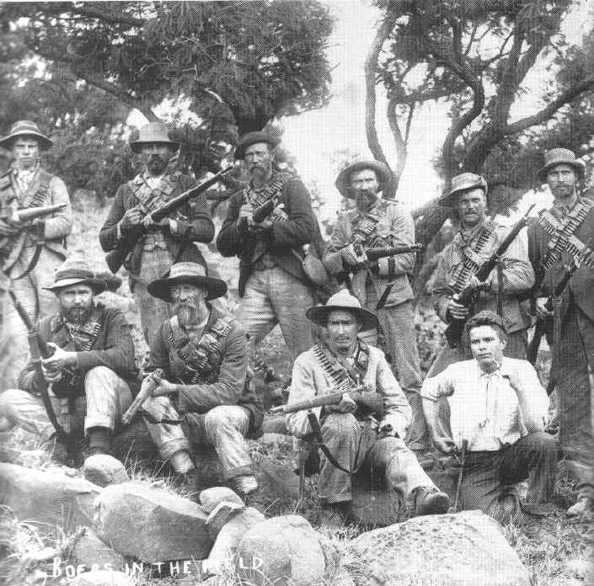
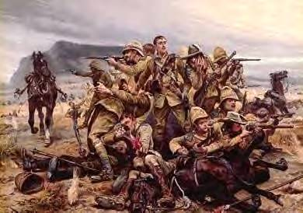
The Boer War: 1899 – 1901
The British
The Boers

Slide 28
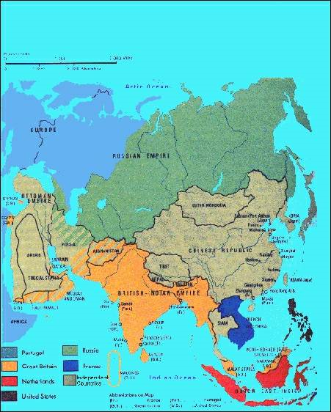
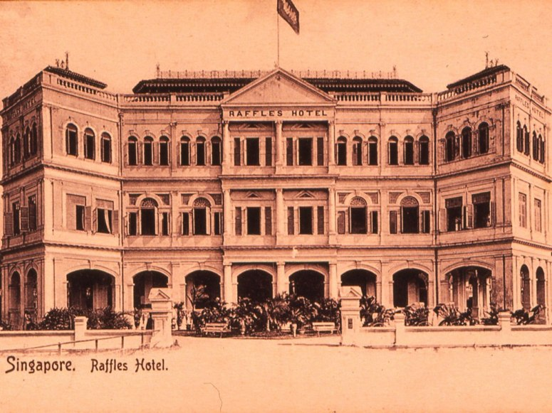
Asia
GB-Already owned India from French 7 Years War
Stamford Raffles takes Singapore. Why?
Strategic port for trade
Burma –
prevent French advance into India from ?

Slide 29
France out of India, now occupied ?
Vietnam - known as
French Indochina
The only independent country in region was ?
Siam
“The King and I”
US enters late and opens Japan and Philippines
Matthew Perry
Japan divided fight the West or adopt Western “stuff” – “LAST SAMURAI”
Spanish American War gives US an “empire”
Asia

Slide 30
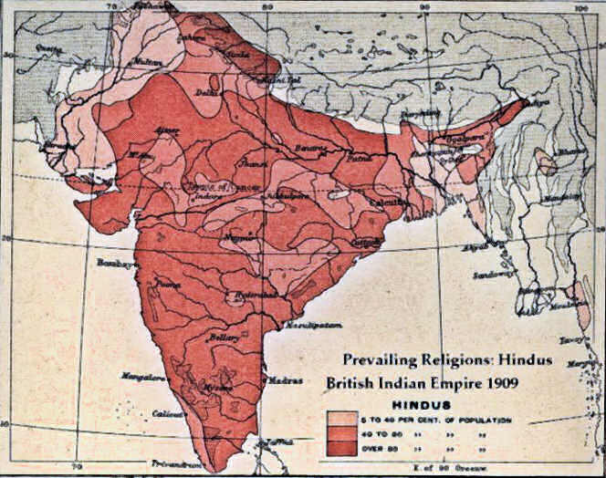
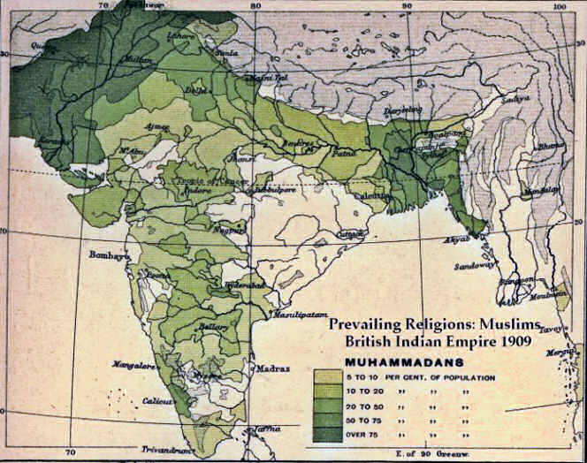
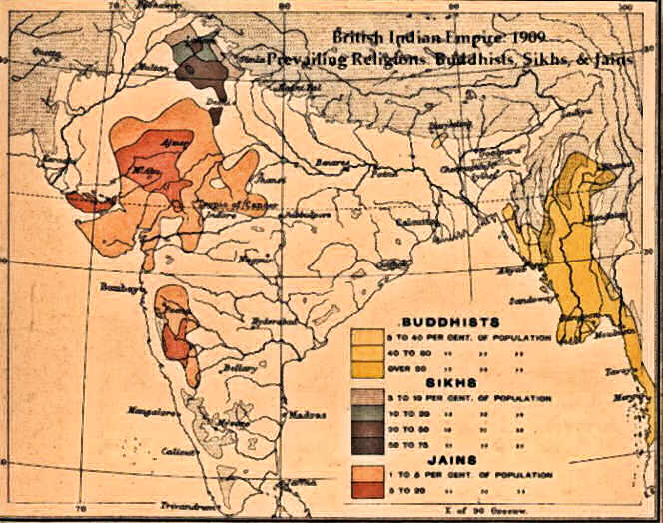
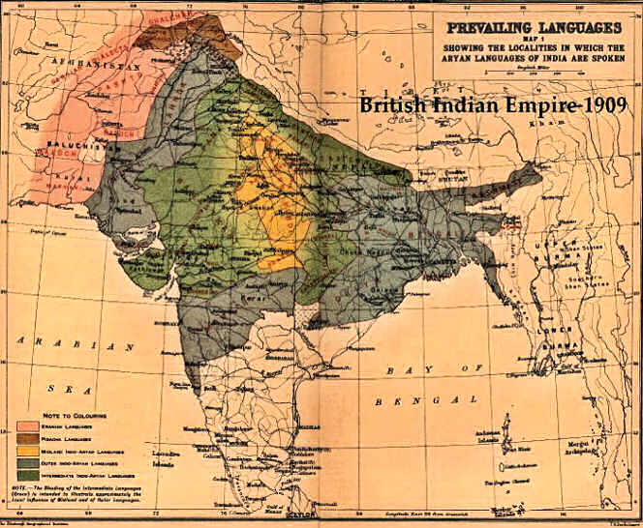
India
GB-Already owned India from French 7 Years War.
Run by BEIC
Very diverse population especially religion
Which Religions?
Hindu
Muslim
Buddhist
Also languages / culture
This allowed Brits to control by encouraging groups to compete rather than unite.

Slide 31
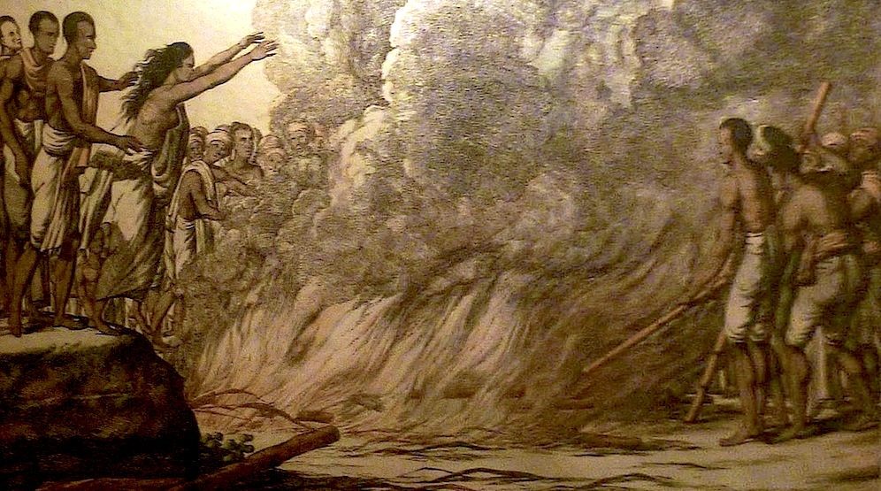
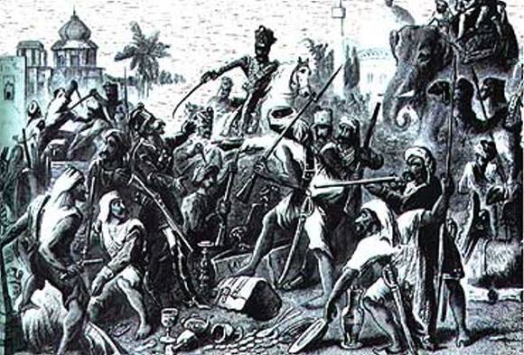
India
Sepoy Mutiny
Muslim and Hindu soldiers in British Army
Bullet grease issue
Sepoys went on violent rampage
Put down harshly by the British.
WHY?
BEIC exploited resources.
Built stuff but for their benefit. Little attention paid to Indian culture. Unless it was un Christian
SATI / SUTTEE!

Slide 32
India
Benefits of British Rule
Costs of British Rule
United Indian society (gave them someone to hate)
Educated population Lord Macaulay (taught them about the freedoms they did not have) Trained to serve in the army and government. Only higher castes
Introduced the newest technologies
Native population exploited economically
Locals heavily taxed to maintain occupation
Grew what Brits wanted not what was best (cash crops)
Technology was to benefit Brits
Brits tried to erase Indian culture
THESE LED TO…

Slide 33
Indian Nationalism
Resentment led to creation of INC
Indian National Congress
Hindu freedom movement
Led by Gandhi
Muslims create their own version AIML
All India Muslim League

Slide 34
2 Opium Wars
Mid 1800s Britain fought two wars with China over Opium! China would not buy enough
Britain had nothing to trade with China. (Trade Deficit)
Decided to get the Chinese hooked on opium (GB monopolized the market)
When China resisted Britain did it by force!
Results:
Britain acquires port cities (Shanghai and Hong Kong)
China forced to open up to foreign trade
extraterritoriality

Slide 35
Taiping Rebellion 1850 - 1864
Poor of China miserable
Tax burden, corruption and famine
Peasants rebel led by Hung Hsiu-ch’uan
Believed he was brother of Jesus
Wanted to destroy Chinese idol worship – Qing dynasty
Qing had to rely on foreign help to put down the revolt
Estimated 20 – 30 million dead
Led to Self Strengthening
Adopt western technologies
Return to Confucian government
the “Open Door Policy”

Slide 36
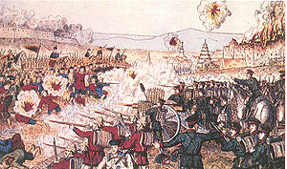
Boxer Uprising 1890s
Society of Harmonious
Fists
Opposed foreign influence (“open door”) from Christianity to opium
Centered in Beijing
Attacked churches and Europeans reacted.
Harsh treaty forced on China.
Military occupation
Fines paid by China to Europeans for their (European) losses

Slide 37
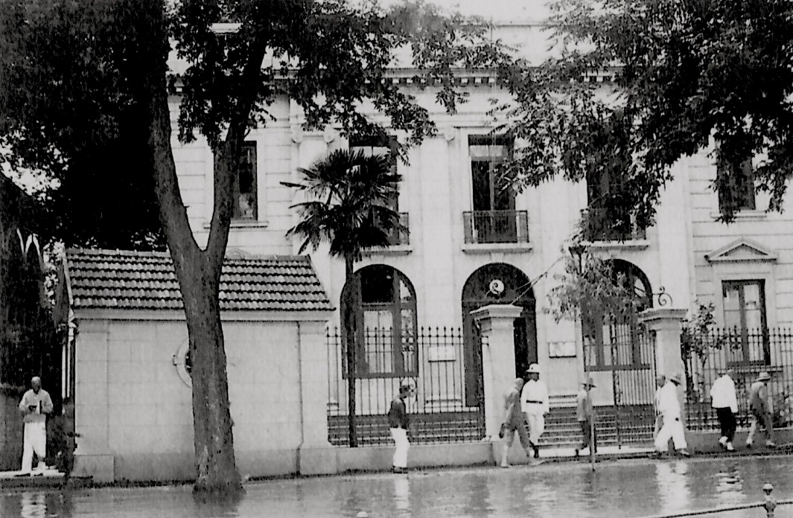
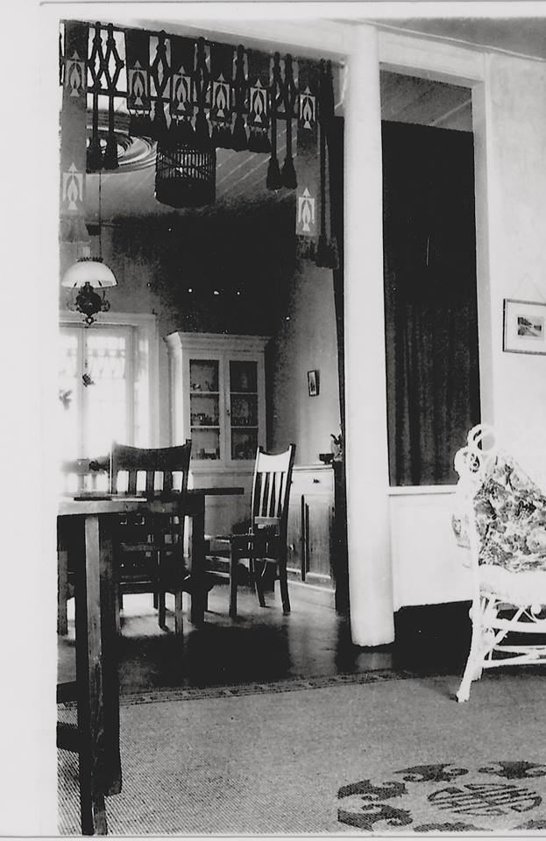
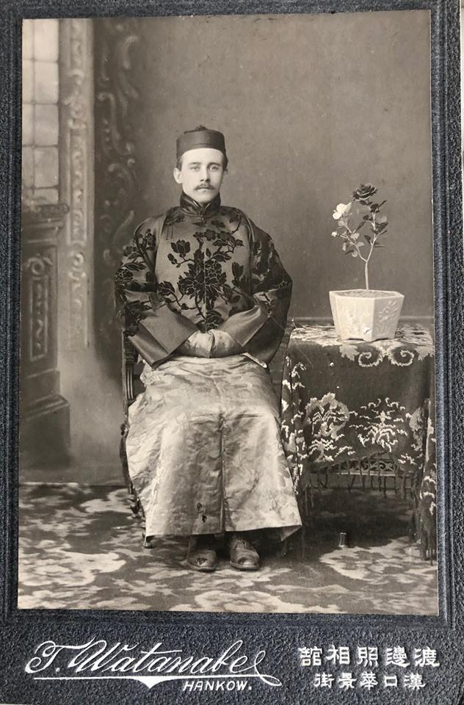
One of my great uncles lived and worked in China in the early 1900s
(pics are from 1915) in Hankou. This is his house. I have a MahJong set he brought back made of bamboo and ivory. This is him in traditional Chinese clothing. It was common for Europeans to “dress up” for special occasions. Ironically the Chinese did the same to try and impress/secure opportunities by appearing as European as possible.

