Slide 1
Changing European Society

Slide 2
Ancien Regime
All about tradition and keeping those “at the top” – at the top!
Nobility usually a tiny proportion of the population.
Nobility had rights and privileges that those who weren’t sought to end.
Biggest concern for all was food. Nobles owned land – food production
Game laws forbade lower classes from hunting
Each country’s nobles had different advantages but they were essentially the same ideas

Slide 3
The Family
Important in that it formed the backbone of 17th century society. Changes in 18th.
Localism – newly married couples left their parents. Extended families lived together if parents moved in with their children

Slide 4
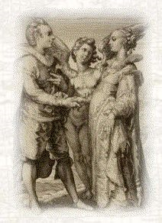
Marriage
Unlike earlier times, marriage tended to be later (27 or so)
WHY?
Economic – had to wait to acquire land (after parents died)
Societal laws to prevent “impetuous love” / LUST
Official restrictions – landowner approval.

Slide 5
Work
Rural - began at home and was gender based
Boys: plowed, wove
Girls: spun (hence the term for unmarried women!), tended animals
Urban – more likely to start away from home
Boys: apprenticeships (no marriage), drifters
Girls: domestic service. (often mistreated by the families – no protective laws)

Slide 6
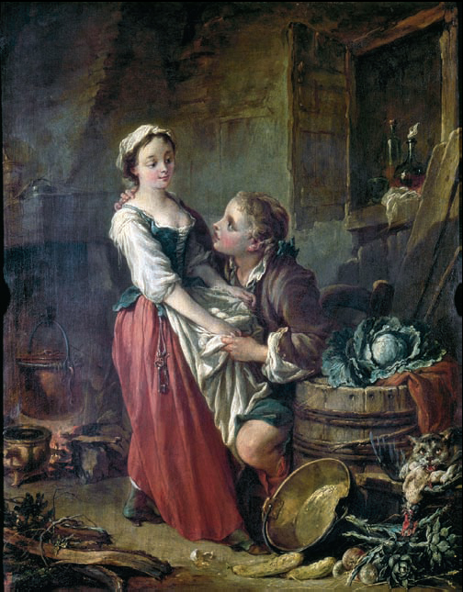
The Pretty Cook
Increased migration to urban areas in the eighteenth century contributed to a loosening of traditional morals and soaring illegitimacy rates. Young women who worked as servants or shop girls could not be supervised as closely as those who lived at home. The themes of seduction, fallen virtue, and familial conflict were popular in eighteenth-century art, such as this painting by François Boucher (1703–1770), master of the Rococo.

Slide 7
Premarital Sex
Contrary to popular belief it happened and more than you might think.
Few illegitimate children, so how do we know?
Births occurred within a few months of marriage.
This also shows the community expectation/control. The community policed itself.
Birth control was not unknown – coitus interuptus – but it was not very reliable!

Slide 8
More Sex
By the late 18th century trends were changing – European illegitimacy soared.
In some areas as high as 30 – 40%
WHY?
Industrialization
Increased food production
Economics
Marriage starts to trend earlier
Why?
Earning ability started earlier - “cottage industry”
In urban areas less control of “standards”
“Promises” of marriage led to seduction
(somethings never change!)

Slide 9
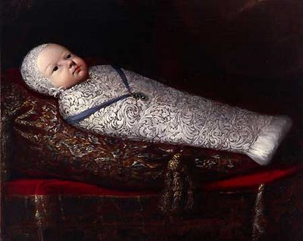
Children
Late marriage meant fewer child bearing years, so had them thick and fast.
This was not the only reason – infant mortality!
1:5
1:3 in poor areas
1:2 in Russia in first year
Diseases

Slide 10
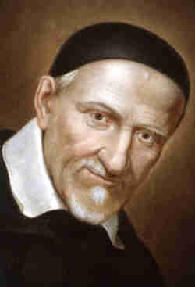
Children contd.
Extended nursing in lower classes helped survival and limited pregnancy.
Wet nursing
Infanticide – overlaying. Led to Austria passing law 1784
Restrictions led to abandoning
Saint Vincent de Paul – first home for foundlings in Paris

Slide 11
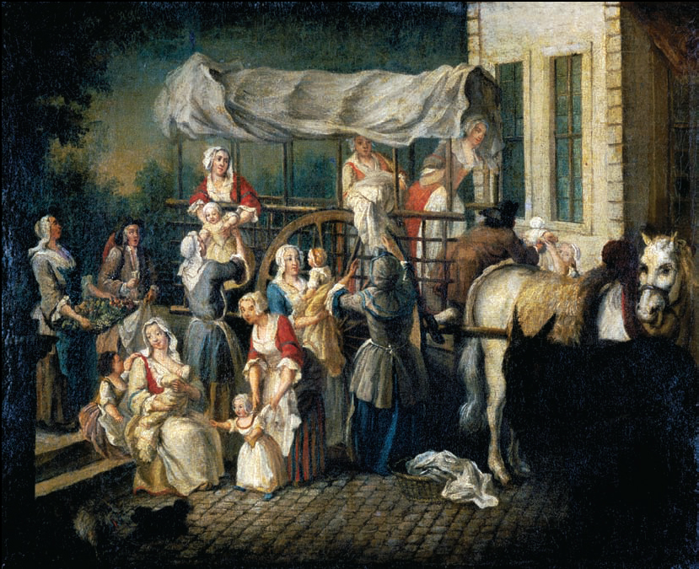
Arrival of the Wet Nurses
Wet-nursing was big business in eighteenth-century France, particularly in Paris and the north. Here, rural wet nurses bring their charges back to the city to be reunited with their families after around two years of care. These children were the lucky survivors of a system that produced high mortality rates. WHY?

Slide 12
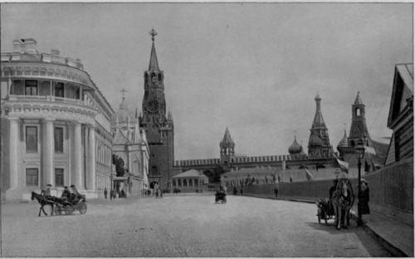
Children contd.
Foundling hospitals become a favored charity throughout Europe.
However they soon became a dumping ground.
1770s, 30% of all babies born in Paris ended up there.
Many entered few left.
at best 50%
at worst 10%
St Petersburg Foundling Hospital
So much death that they were labeled “legalized infanticide”

Slide 13
Attitudes toward Children
INDIFFERENCE! True of all classes
“One blushes to think of loving one’s child”
One English gentleman “had more interest in the disease of his horses than of his children”
Parents urged not to become attached as children were likely to die before age 9
Edward Gibbon (Historian more later) eldest of 7 four brothers all named Edward died, as did two sisters
Doctors could not treat the young. WHY?

Slide 14
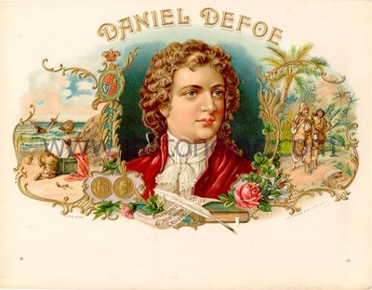
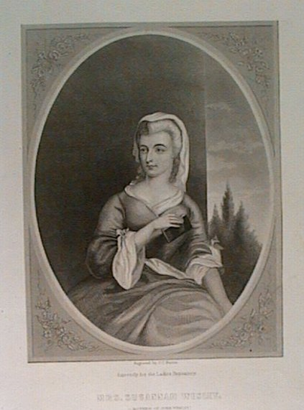
Attitudes toward Children
Indifference often led to abuse
Daniel Defoe coined the term
“spare the rod and spoil the child”
Susannah Wesley
“the task of the parent is to conquer the will and bring them to obedient temper”
Her babies were taught to
“fear the rod and to cry softly”
“the most odious noise is that of a crying child”
(mother of John Wesley: Methodism)

Slide 15
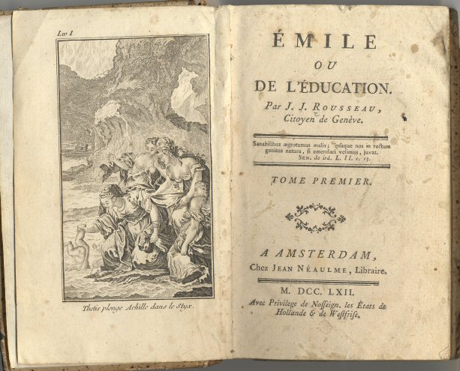
Attitudes toward Children
Mid 1700s publication of …
Called for greater love and compassion for children.
End to swaddling

Slide 16
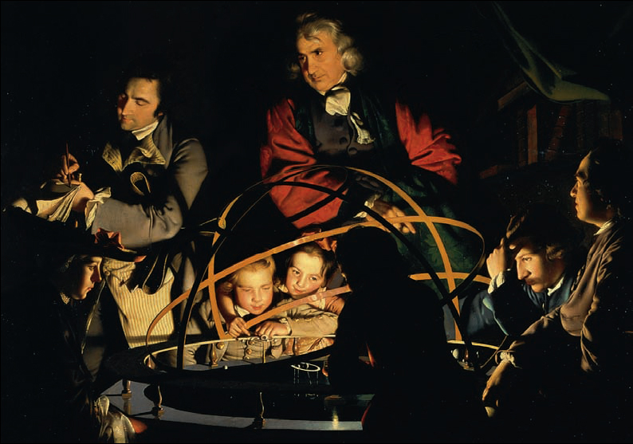
Cultivating the Joy of Discovery
This English painting by Joseph Wright of Derby (1734–1797) reflects new attitudes toward child development and education, which advocated greater freedom and direct experience. The children rapturously watch a planetarium, which illustrates the movements and positions of the planets in the solar system.

Slide 17
Education
Was the realm of the aristocracy and rich.
Religious control (Jesuits). Used a method of indoctrination.
Prussia leads effort for more universal education. WHY?
Lutheran - Everyone should be able to read the Bible
1717 compulsory elementary education
(I got a job as a result!)
Scotland follows
C of E and dissenters
1774 Austria under Maria Theresa
Huge growth in literacy between 1600 and 1800.
Scotland 1:6 to 9:10, France the same, England 1:4 to 3:4
Women also more literate but still behind men

Slide 18
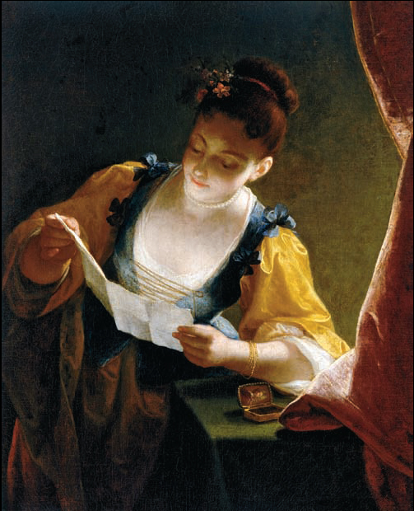
Young Woman Reading a Letter
As literacy rates rose, the novel also emerged as a new literary genre in this period. With its focus on emotions, love, and family melodrama, the novel was seen as a particularly feminine genre, and it allowed female writers more access to publish.
Writing and reading letters were also associated with women. Some worried that women’s growing access to reading and writing would excite their imagination and desires, leading to moral decay!
Chap-books were published on cheap paper for the poorer
Writing became entertainment with the development of Fairy Tales, Adventures and Historical fiction.

Slide 19
Diet
Grains were the staple.
Bread for most (as much as 2lbs per day)
Scots ate porridge (half cooked)
Grain prices were of vital importance to many – ‘fair price’ for all controlled by guilds (Bible) then governments. (Remember the Dutch)
Adam Smith and free market clashes with this
riots and uprisings (more later)
Vegetables were the food of the poor. Fruit very limited and dependent on season and location.
Meat was the primary food for the rich – 3 courses plus three fish courses were common.
Gaming laws made hunting legal for aristocracy only

Slide 20
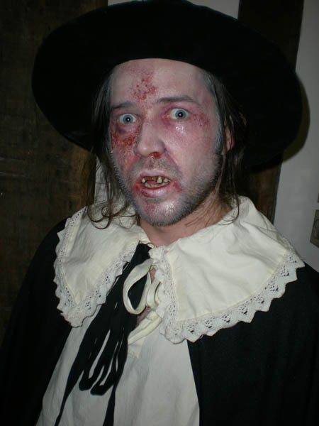
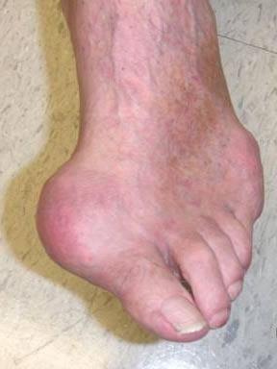
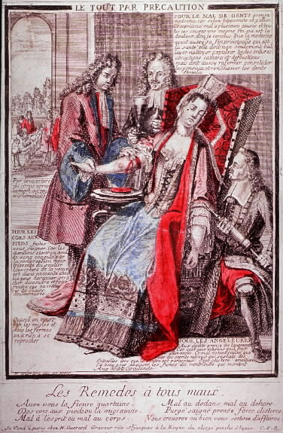
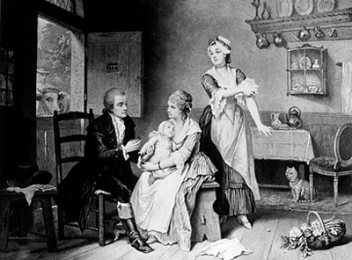
Health
Vitamin C deficient scurvy
Rich suffered from gout
Diseases were rampant
Jenner and smallpox
Apothecaries
Physicians
blood letting
Surgery in battle zones and all that entailed… at least there were plenty of subjects to practice on!
Midwives
Hospitals (not for getting better!)

Slide 21
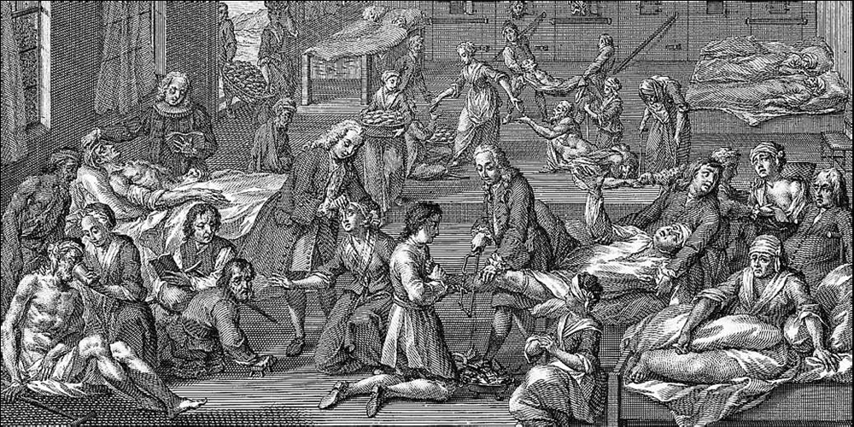
Hospital Life
Patients crowded into hospitals like this one in Hamburg in 1746 had little chance of recovery. A priest by the window administers last rites, while in the center a surgeon coolly saws off the leg of a man who has received no anesthesia.

Slide 22
William Hogarth

Slide 23
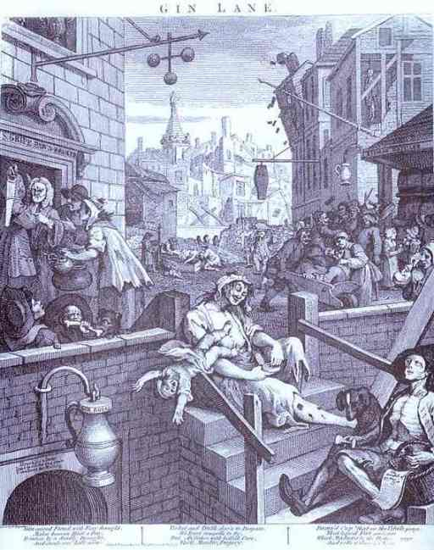
Gin Lane 1751
Part of a pair of works.
What does this picture tell about mid 18th century society in London?

Slide 24
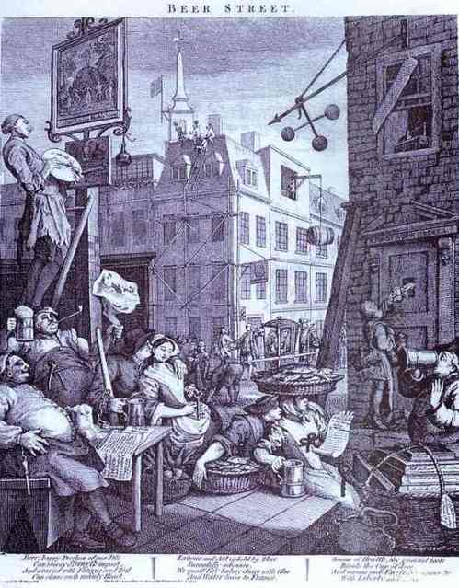
Beer Street 1751
The other picture
What does this picture tell about mid 18th century society in London?

Slide 25
Look at the two together

