Slide 1
The Early Cold War: 1947-1970

Slide 2
The Ideological Struggle
Soviet & Eastern Bloc Nations [“Iron Curtain”]
US & the Western Democracies
GOAL → spread world-wide Communism did not give up eastern Europe after WW II satellite states
GOAL → “Containment” of Communism & the eventual collapse of the Communist world. [George Kennan]
How did they fight?:
Espionage [KGB vs. CIA]
Arms Race [nuclear escalation]
Ideological Competition:
Communist govt. & command economy vs. democratic govt. & capitalist economy] → “proxy wars” used third countries
Alliances: NATO vs. Warsaw Pact

Slide 3
What’s In A Name?
The USSR- The Union of Soviet Socialist Republics- a union of communist states with Russia as the dominant state
The Soviet Union- same thing as the USSR
Russia- the dominant state of the USSR, it is often used in place of the terms USSR or Soviet Union
The Communists- the USSR; it could also include communist states such as China, Cuba and Yugoslavia

Slide 4
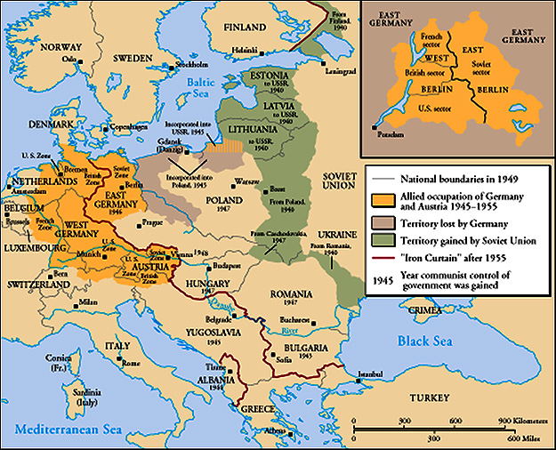
The “Iron Curtain”
From Stettin in the Balkans, to Trieste in the Adriatic, an iron curtain has descended across the Continent. Behind that line lies the ancient capitals of Central and Eastern Europe. -- Sir Winston Churchill, 1946

Slide 6
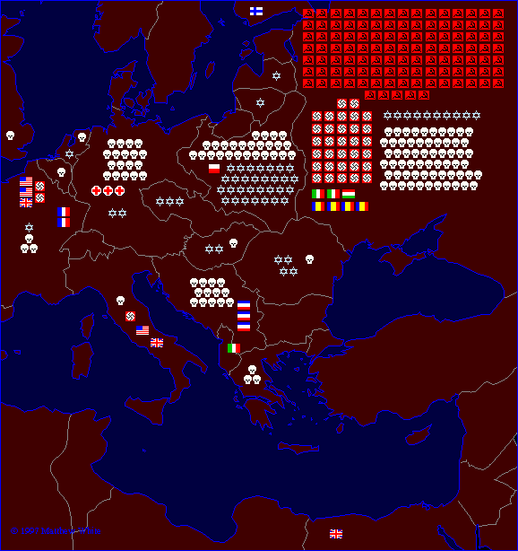
Why did the Iron Curtain exist?
Each symbol indicates 100,000 dead in the appropriate theater of operations

Slide 7
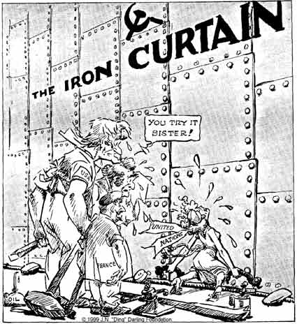

Slide 8
Truman Doctrine [1947]
Civil War in Greece.
The U. S. should support free peoples throughout the world who were resisting takeovers by armed minorities or outside pressures…We must assist free peoples to work out their own destinies in their own way.
The U.S. gave Greece & Turkey $400 million in aid.

Slide 9
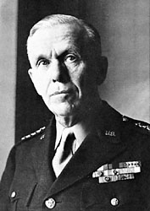
Marshall Plan [1948]
“European Recovery Program.” proposed by
of Secretary of State,
George Marshall
The U. S. should provide aid to all European nations that need it. This move is not against any country or doctrine, but against hunger, poverty, desperation, and chaos.
$12.5 billion of US aid to Western Europe extended to Eastern Europe & USSR, [but this was rejected].

Slide 10
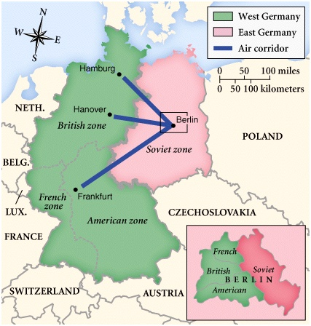
Post-War Germany

Slide 11
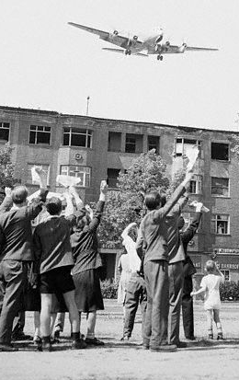
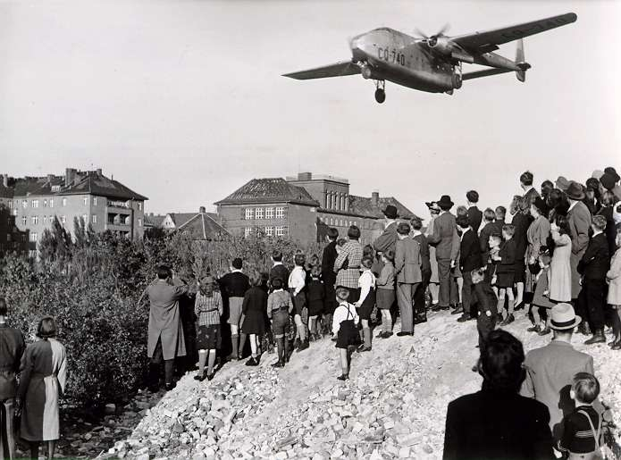
Berlin Blockade & Airlift (1948-49)

Slide 12
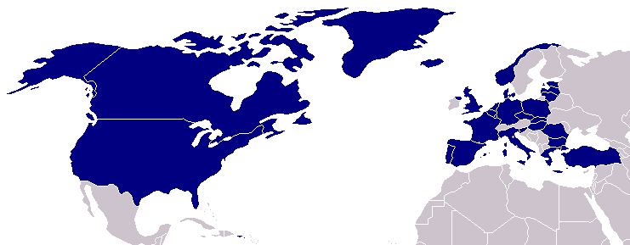
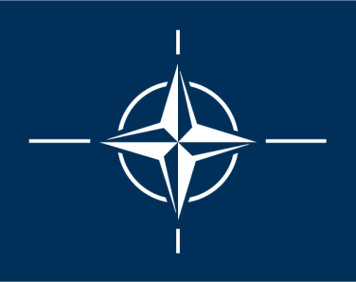
North Atlantic Treaty Organization (1949)
United States
Belgium
Britain
Canada
Denmark
France
Iceland
Italy
Luxemburg
Netherlands
Norway
Portugal
1952: Greece & Turkey
1955: West Germany
1983: Spain

Slide 13
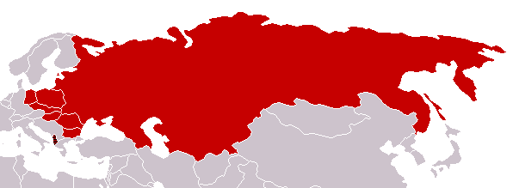
Warsaw Pact (1955)
U. S. S. R.
Albania
Bulgaria
Czechoslovakia
East Germany
Hungary
Poland
Rumania

Slide 14
Germany Divides
In May 1949, the US, British, and French zones in western Germany were combined to produce the Federal Republic of Germany / FRG (West Germany)
In the east, the Russian zone became the German Democratic Republic (East Germany / GDR)
THIS IS NOT THE BERLIN WALL!!!
East Germans worked in West Germany and saw the success and standard of living rise. Many defected! –
Brain Drain (3.5 million)

Slide 15
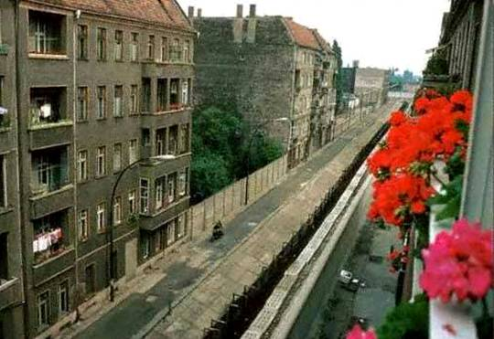
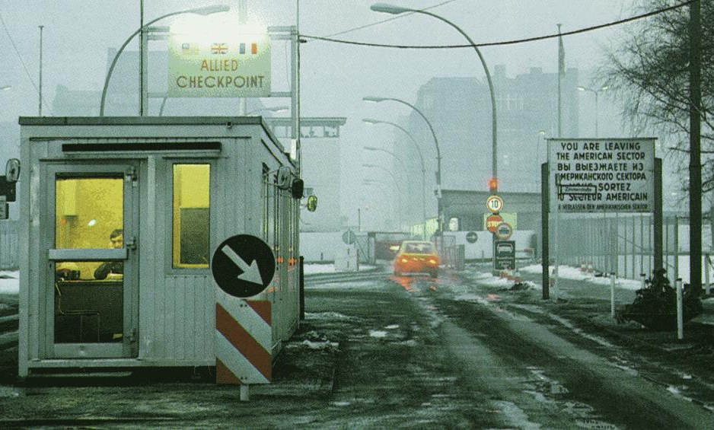
The Berlin Wall Goes Up (1961)
Checkpoint Charlie

Slide 16
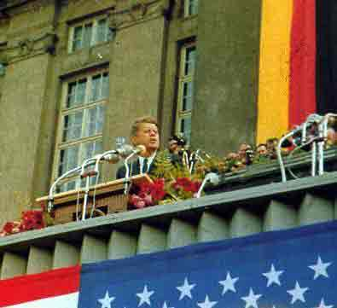
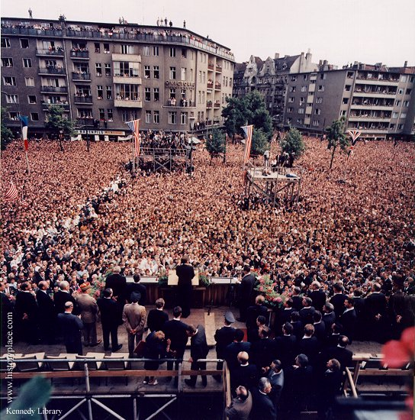
Ich bin ein Berliner! (1963)
(I am a jelly donut!)
President Kennedy tells Berliners that the West is with them!

Slide 17
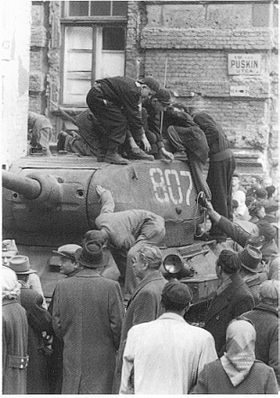
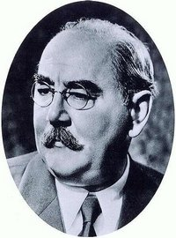
The Hungarian Uprising: 1956
Imre Nagy, Hungarian Prime Minister
Promised free elections.
This could lead to the end of communist rule in Hungary.

Slide 18
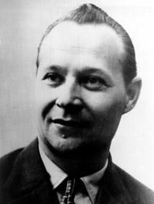
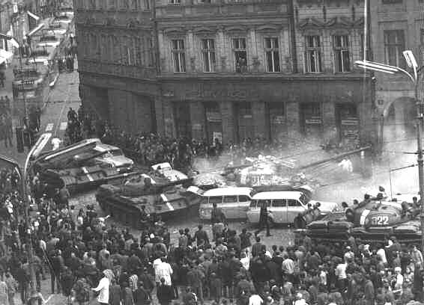
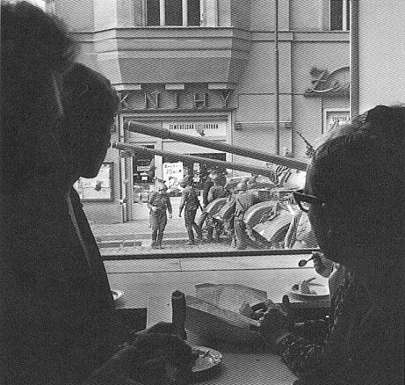
“Prague Spring” (1968)
Former Czech President, Alexander Dubček
Communism with a human face!

Slide 19
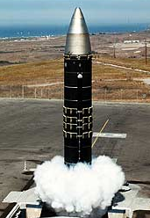
The Arms Race: A “Missile Gap?”
The Soviet Union exploded its first A-bomb in 1949.
Now there were two nuclear superpowers! And they began to build their arsenals!

Slide 20
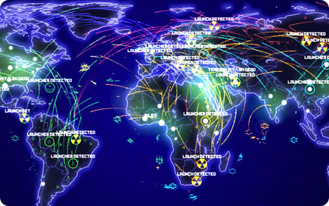
Mutually Assured Destruction
The concept that due to the massive number of nuclear weapons controlled by the USSR and USA, any launch would result in the destruction of both.
How to get
around this?
ABMs

Slide 21
Strategic Arms Limitation Talks
To reduce the number of weapons (and cost of continued building) USSR and US agreed to reduce their arsenals. Strategic Arms Limitation Talks = Détente
Ronald Reagan 1980s started “Star Wars” program to defend against attack. USSR now had to make better weapons.

Slide 22
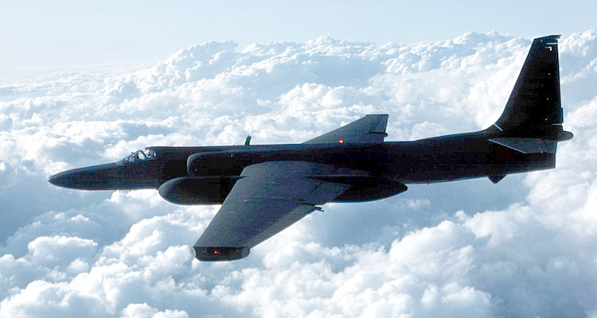
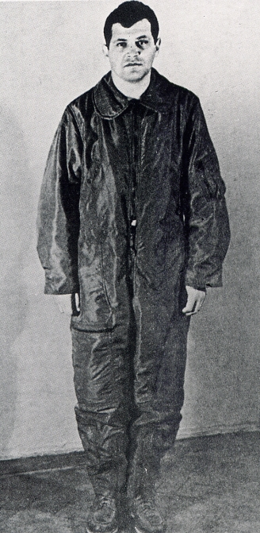
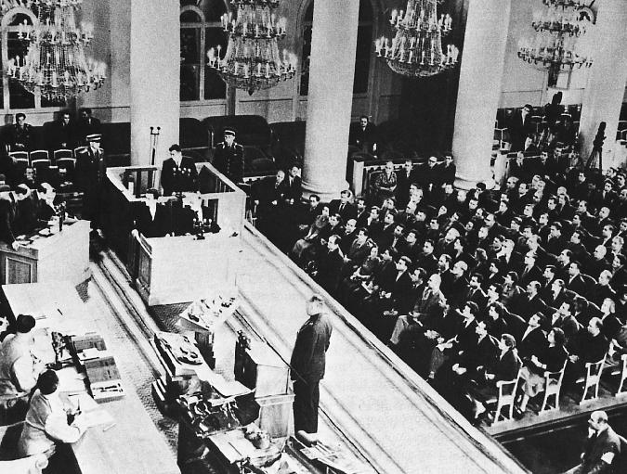
U-2 Spy Incident (1960)
Col. Francis Gary Powers’ plane was shot down over Soviet airspace.

Slide 23
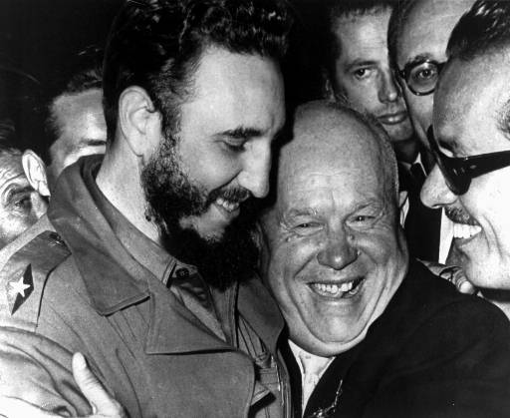
Communism on the Doorstep
1959 Communist revolution in Cuba
Fidel Castro overthrows Batista.
Several US companies had factories in Cuba. Those were taken by the new government.
Khruschev Embraces Castro, 1961

Slide 24
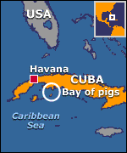
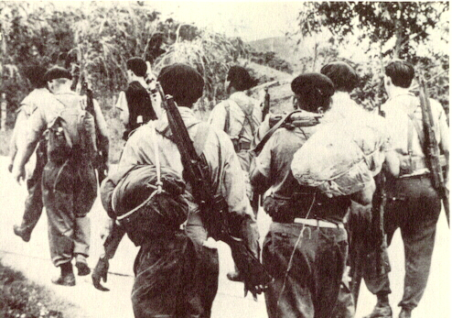
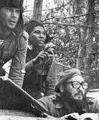
Bay of Pigs Debacle (1961)
USSR and Cuba now comrades

Slide 25
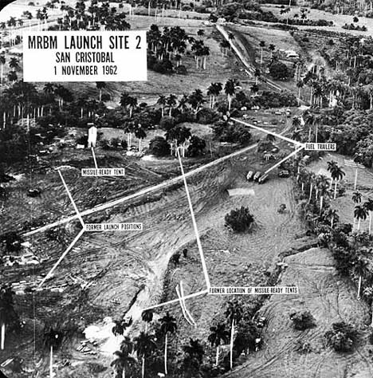
Cuban Missile Crisis (1962)

Slide 26
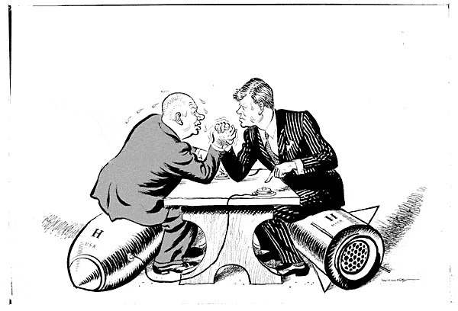
Cuban Missile Crisis (1962)
We went eyeball-to-eyeball with the Russians, and the other man blinked!

Slide 27
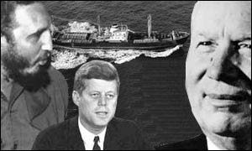
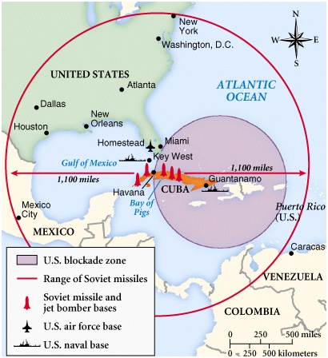
Cuban Missile Crisis (1962)

Slide 28
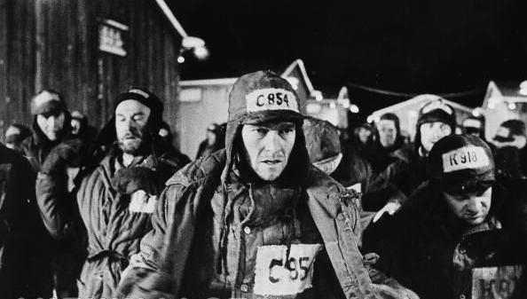
Khrushchev
After Stalin’s death 1953, Nikita Khrushchev new Soviet Leader.
De-Stalinization –undo Stalin’s repressive and terror ideas
“A Day in the Life of Ivan Denisovich” published
“A Day in the Life of Ivan Denisovich”
Alexander Solzhenitsyn

Slide 29
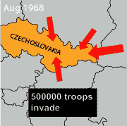
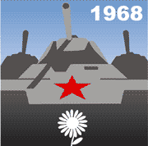
Brezhnev Doctrine
Brezhnev Doctrine - the USSR would not allow any Eastern European country to reject Communism.
On 20 August 1968, 500,000 Warsaw Pact troops invaded Czechoslovakia. “Prague Spring”
The Czechoslovakians did not fight the Russians. Instead, they stood in front of the tanks, and put flowers in the soldiers' hair.

Slide 30
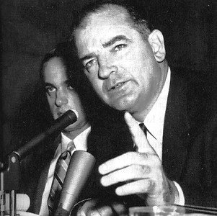
The Red Scare
Fear spread in both countries and was encouraged by the government
It gave them support for spending
McCarthyism and black ball
Reds were everywhere!!
House Un-American Activities Commission
Public officials and celebrities were called to testify before the commission about their real or supposed involvement in communist activities

Slide 31
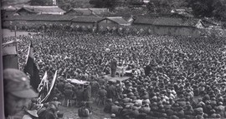
China Revolts
After the provisional government failed, the NATIONALISTS led by Chiang Kai-shek, the COMMUNISTS led by Mao Zedong, and various WARLORDS began a CIVIL WAR for control of China
1925-1937

Slide 32
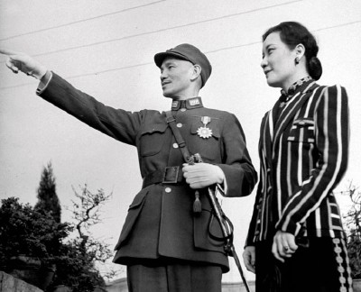
Chiang Kai-shek
Encouraged continued Western investment in China.
Nationalist and Militarist
He failed to consolidate power, improve the
economy (especially
the peasants), or modernize China

Slide 33
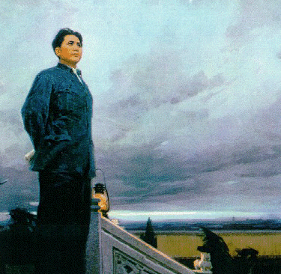
Mao Zedong
Concerned with the plight of the Chinese rural worker
Anti-Western
Nationalist and militarist
Led the army in developing guerilla warfare tactics to fight the Nationalists and later the Japanese

Slide 34
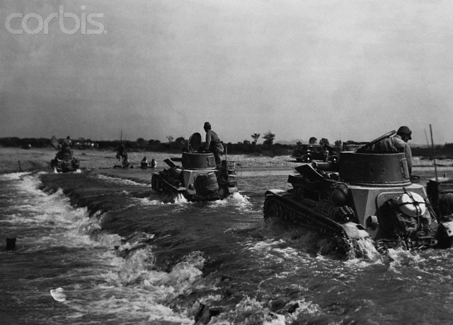
1937 – Japan invaded China
Communists & Nationalists fought the Japanese “separately together”.
Communists were more effective in their guerilla war against the Japanese.

Slide 35
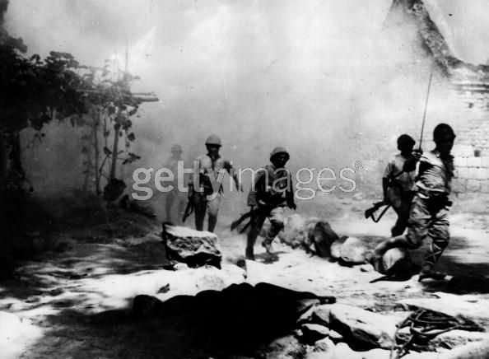
Civil War Continued 1945-1949
After WW II the Chinese picked up where they had left off
The West supported Chiang’s Nationalist Army and the USSR sent some support to Mao.

Slide 36
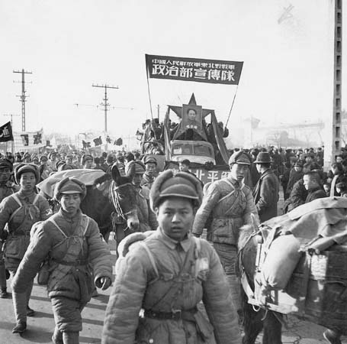
Communist Victory
1949
Chiang Kai-shek & the Nationalist Army were driven out of mainland China to Taiwan, the Communists founded the People’s Republic of China.

Slide 37
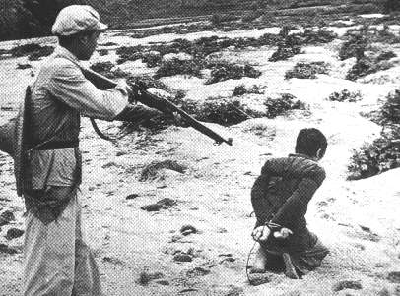
Communist China
PEASANT support grew with redistribution of land by the government.
Collectivization eventually forced on the peasants.
Where else did this happen?
OTHERS supported the government because of propaganda and education.
Many who were nationalists, upperclass, or dissidents were imprisoned in forced labor camps or killed.

Slide 38
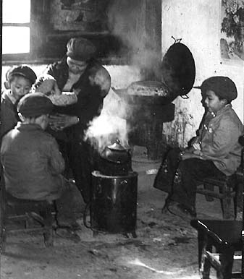
Women’s Status Improved?
Foot-binding ended and arranged marriages were limited
Women could hold professions, join the army, and serve in the government.
“Legal equality” with men.
Women were working outside of the home AND still responsible for the home and childcare.
Traditional emphasis on men as “superior” continued.

Slide 39
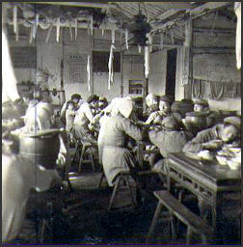
Great Leap Forward 1950s
State-controlled commune farms were created to improve efficiency.
“Backyard” industries.
idea was to have small businesses run industry.

Slide 40
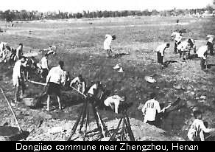
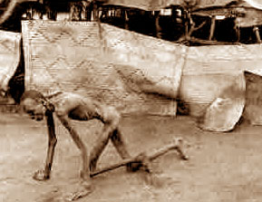
Great Leap Forward = Great Leap Backwards
The plan failed miserably – famine caused over 20 million deaths, steel production dropped drastically, the program ended early, and Mao’s power was reduced

Slide 41
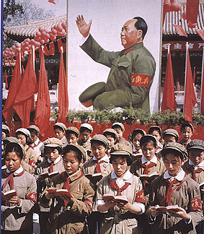
Cultural Revolution
1960s
Mao tried to regain power he lost in the Great Leap Forward and create another revolutionary movement.
Created The Red Guard from the Chinese youth – students, peasants, & soldiers

Slide 42
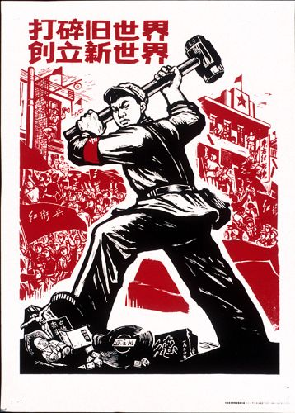
Cultural Revolution
Red Guard attacked people in positions of power or privilege who publicly disagreed with Mao.
Any “suspects” were imprisoned or forced into labor in rural areas.
Traditional culture and education were destroyed.
Cult of personality formed around Mao

Slide 43
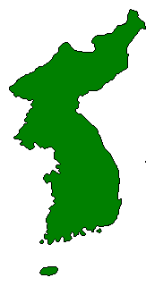
The Korean War: A “Police Action” (1950-1953)
Kim Il-Sung
Syngman Rhee
“Domino Theory”
(China was now communist too!)

Slide 44
What led to the war
N. Koreans wanted Communism
USSR Support
1st Korean President (Seungman Lee) was not a Communist

Slide 45
Beginning of the war
1950-June 25 4 a.m.
70,000 N. Korean troops invaded S. Korea
3 Days, took over Seoul (S. Korean capital)
1.5-2 Months
→

Slide 46
Inchon Landing Operation
American military intervention
Led by General MacArthur
Inchon Landing September 15
Turned the tide of battle
← Wonson

Slide 47
Enter China
US drives North to
Yalu river
China afraid of US
takeover
Warned the UN
December retook Seoul
War stalls and the
front line remains close
to 38th parallel
|
|
V

Slide 48
Divided Korea
War ends in 1953
Korea remains divided at 38th parallel
separated by a DMZ

Slide 49
Vietnam War
Vietnamese supported the allies in WW II. They hoped to gain independence from France as a reward.
France choose to keep its colony and the Vietnamese revolted led by Ho Chi Minh

Slide 50
Vietnam War
France was defeated in 1954 at Dienbienphu.
Vietnam divided with Minh controlling the North and elections to be held in the South.
US supported non communist named Diem
When it looked like Minh was going to win, Diem voided the elections.
US supported this.

Slide 51
Vietnam War
The US supplies advice and weapons until the Gulf of Tonkin Incident.
US ship clains it has been fired upon and the President (LBJ) is given power to take action…send in troops

Slide 53
Afghanistan 1979
PM Amin communist (rejected religion) leader tried to sweep aside Muslim tradition This outraged the majority who were traditionalists.
Mujahadeen declared a jihad on the supporters of Amin (including USSR) Russians claimed they had been invited and that they were not invading the country.

Slide 54
The United Nations condemned the invasion
Security Council called for the withdrawal of Russian forces.
vetoed......by Russia. HOW?
Becomes Russia’s “Vietnam”
US supports Mujahadeen with weapons, money and training.
Late 1980s Russia withdraws. US pulls its resources too. Afghans left to fight it out.

Slide 55
Gorbachev
The collapse of the Soviet Union happens for major reasons:
Inefficient economy being bled by space race, military etc.
Lack of productivity
New reform movement led by Mikhail Gorbachev 1985

Slide 56
Glasnost and Peristroika
Glasnost was a new era of openness. No more secret police taking people in the middle of the night. USSR admitted to the atrocities committed by Stalin.
New foreign policies
Reduction in nuclear arms
No more interference in Eastern Europe
Soviets out of Afghanistan
Persitroika restructuring of economy, politics and society. Tries to introduce a market economy, but it struggles to work. Shortages and complaints led to violence

Slide 57
Glasnost and Peristroika
With the relaxation of control, Soviet republics strove for independence Baltic States, ‘Stans etc.
Fear of break up led hard core communists to try and overthrow Gorbachev 1991
Prevented by
New leader Boris
Yeltsin who
becomes President

Slide 58
Poland
Economic reforms 1980 led to food shortages
Anti Communist trade union movement formed by Lech Walesa – SOLIDARITY
Gadansk shipyard strike
Catholic Church support
1981 new communist leader imposes martial law (in effect until 1983) and arrests leaders
Gorbachev 1986 announces Perestroika (restructuring) and USSR will no longer control domestic policies in Eastern Bloc countries

Slide 59
Czechoslovakia
Prague Spring led to USSR occupation of Czechoslovakia
With collapse the leaders of that movement re emerge.
Vaclav Havel new President, but like many countries internal ethnic problems result in the division of the country into Czech Republic and Slovakia

Slide 60
Romania

