Slide 1
British Politics

Slide 2
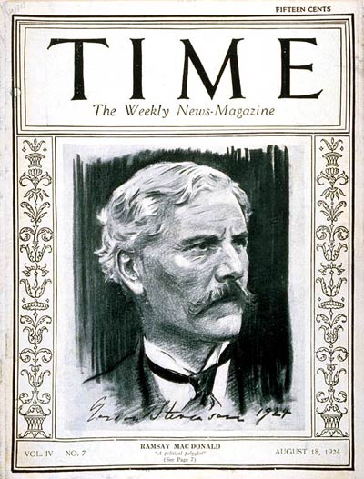
Ramsay MacDonald: 1924, 1929
Labour Party

Slide 3
Labour Party
Steadily increasing seats in the early 20s led by Ramsay MacDonald
1923 election Labour earned 191 seats making it second to Conservatives 258. MacDonald agreed to lead coalition government.
Labour had no experienced members to run cabinet and relied on Liberals
Little socialist legislation passed
Zinoviev letter results in conservative victory in 1924 election

Slide 4
General Strike
1925 mine owners announced reduction in pay for miners. TUC pledged support for miners
Baldwin’s government intervenes – victory for workers!
Royal commission investigates Mining Industry
Commission finds miners pay should be reduced and subsidies withdrawn
Owners publish terms of employment
increasing work hours
decreasing wages by as much as 25%.
If not accepted pits would be locked May 1
May 1 TUC met and came out in support of miners

Slide 5
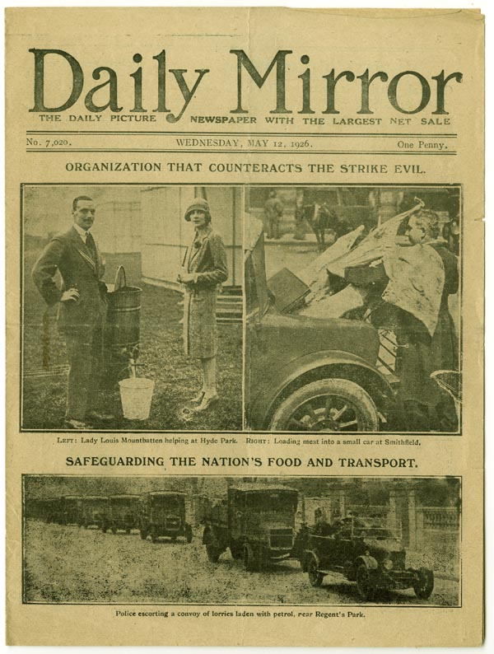
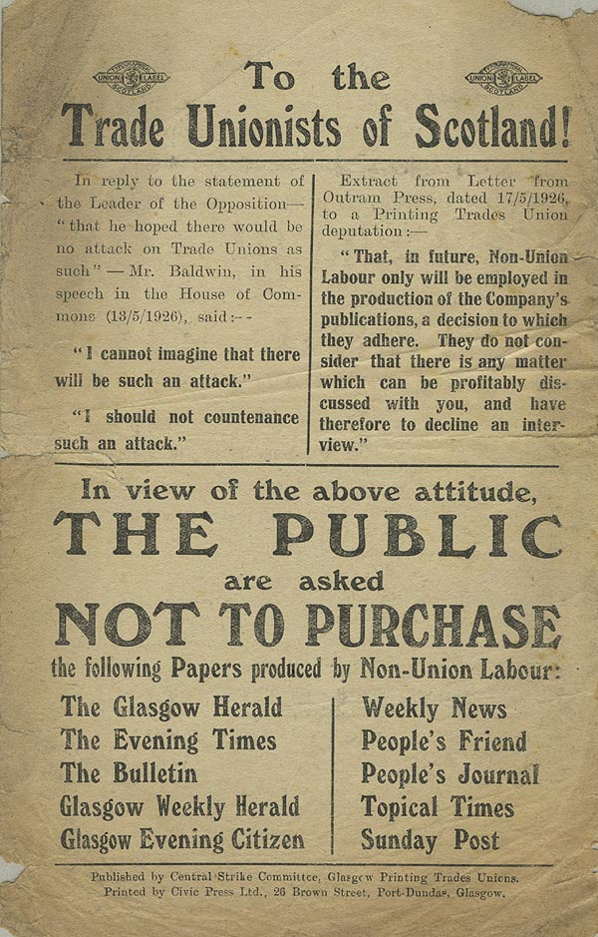

Slide 6
General Strike contd
May 3 1926 action begins
3 million men from key industries (transport, printers, dockers, iron and steel)
Others to join later
Lasted a week before negotiated settlement brought defeat for unions.
Miners hold out longer than the rest but settled
1927 Trade Disputes Act
Sympathetic strikes illegal
No mass picketing

Slide 7
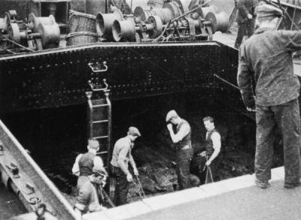
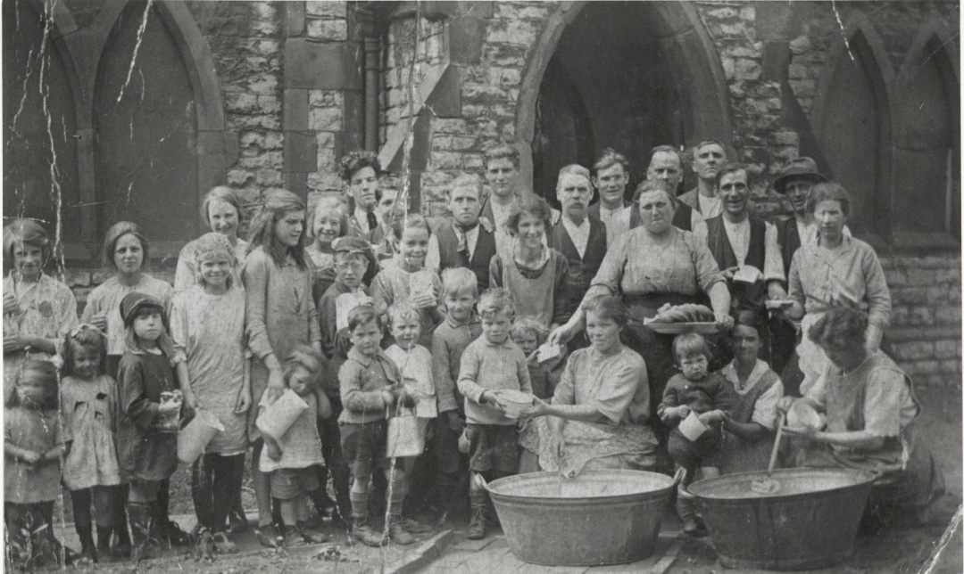
1926 General Strike

Slide 8
Labour Policy
MacDonald refused to support Strike.
Party was a moderate force
Strikes were not a political weapon
Get change through elections and the system
Moderate image kept MacDonald popular, but never enough to win free and clear majority.

Slide 9
Ireland
Easter Rebellion April 1916
Led by James Connolly, Patrick Pearse, and Eamon de Vallera (US) Michael Collins took part but was not a leader
Wanted an independent Ireland.
Take control of major public buildings in Dublin
Connolly and Pearse were sure the mission would fail
So why go ahead?
If rebellion started maybe others would join
British might abandon Ireland if there was such action (WW I)
Germans might come to the Irish aide (WW I)
Rebels hoped English would not use artillery on strategic targets

Slide 10
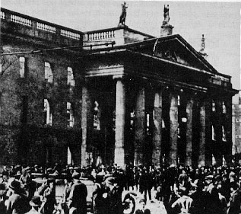
Easter Rebellion April 24 1916
Pearse took control of the General Post Office and declared Irish independence

Slide 11
Easter Rebellion contd
Boland’s Flour Mill at the dock was held by De Vallera.
Important to prevent British reinforcements arriving.
Failed!
Brits declare martial law and they will shoot looters (not rebels)
By 26th Rebels outnumbered 20:1
Brits start artillery attacks with no regard for targets.
General Maxwell ordered to quash rebellion quickly by any means
Did not distinguish between Rebel and civilian
Last Stand made at Post office and King’s Street.
29th Connolly seriously wounded, Pearse surrendered.
500 soldiers and 1,000 Irish died

Slide 12
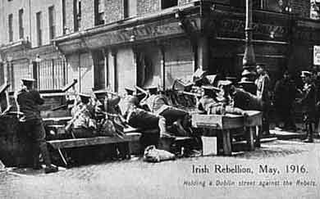

Slide 13
Leaders were tried in secret and executed
De Vallera escaped death as US citizen.
Connolly was tied to a chair and shot. Too injured to stand.
Ironically now was when public support for rebels came. After they were martyrs.
After the War efforts made to reconcile with Sinn Fein but were rejected.
New Irish leader Michael Collins
2 parties in Ireland 1918
Moderate Irish nationalist 6 seats want limited British involvement
Radical Sinn Fein 71 seats want Britain out of Ireland
Polarized North and South

Slide 14
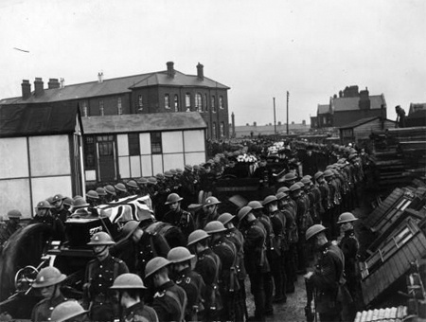
Brits decide to revive the 1914 Home Rule Bill, but revised it
Ireland would be 2 autonomous states with representation in Westminster
North accepts, South rejects
1919 South sets up one government in Dublin, known as Dail
IRA formed and targeted British in Ireland
Westminster responds by declaring Dail illegal, sending Auxilliaries to Ireland (black and tans - WW I veterans.) (NIKE)

Slide 15
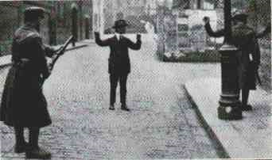
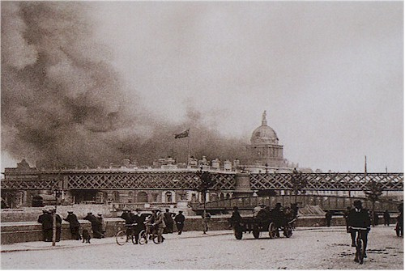
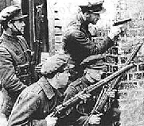
Brutality in Ireland

Slide 16
Anglo Irish Treaty
Divided Republic leadership
De Vallera opposed the provisions
Collins signed it and was assassinated as a result
Ireland never accepted the peace and we know what the results have been.
“Not accepting the Treaty was the single greatest mistake of my life” Eamon De Vallera

