Slide 1
What Do We Know About British Parliament?
Religion and the crown’s absolutism were major causes to the Glorious Revolution
The Revolution prevented any non C of E Monarch in England.
The Revolution also demonstrated a major shift in power from the Crown to Parliament. Remember the century had begun with James I and DRK and ends with Parliament choosing its King!

Slide 2
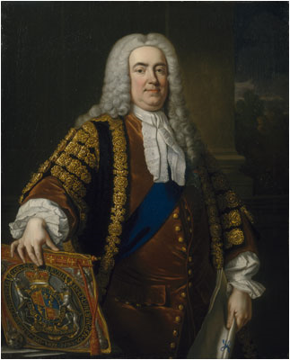
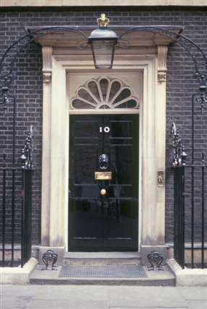
Role of Prime Minister.
1714 last of Stuart family dies.
Hanover dynasty begins:
George I - IV
George I could not speak English.
Was unfamiliar with traditions.
Why select him?
Protestant
Prepared to work with Parliament…
Sir Robert Walpole acted as leader of England for 20 years.
Given house in London in appreciation
10 Downing Street
Under Walpole leader of Majority party became Prime Minister.

Slide 3
Development of the Cabinet.
Executive committee develops to improve communication between parliament and Crown.
Originally it was the Monarch’s closest friends.
Gradually became majority party’s officials.
Think about the make up of the US cabinet…Is it the most qualified or the friends?

Slide 4
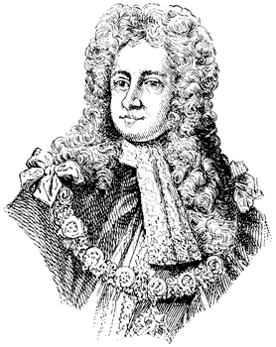
Walpole’s policies
National strength depends on national wealth
Do whatever you can to promote mercantilism
Removed export tax
Viewed war as a drain on the national economy
Would that the US thought that way!!
Therefore his policies avoided war at all costs

Slide 5
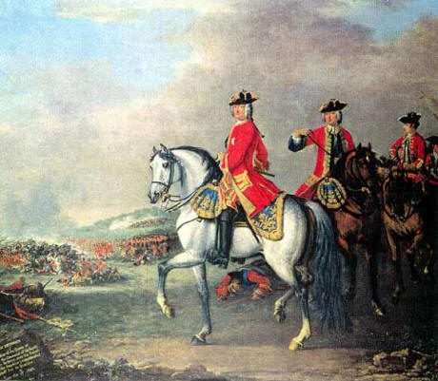
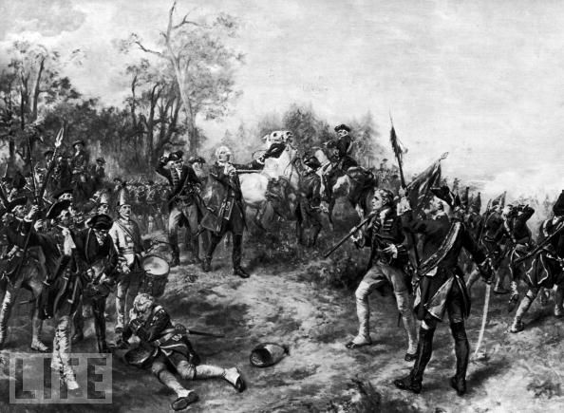
New King George II (1727) was a war monger.
Led to war with Spain and France 1739
George becomes the last King of England to lead his troops in battle.
Walpole did not support the actions and was accused of not supplying enough funding for the army.
Forced to resign 1742
Had set stage for future majority party leaders

Slide 6
Elections
Despite being the most advanced democracy in Europe, Britain’s system was not exactly “democratic”.
Issues included
Suffrage
Who was in Parliament
Who could stand
Rotten boroughs

Slide 7
Parliamentary Division
Two Parties
Whigs
Those who had opposed succession of James II
In favor of more “progressive” (this is a relative term) policies.
Pushed for the Hanovers to become monarchs
Tories
Supporters of the establishment, especially the church and traditional political set up.
Once elected there was little loyalty to the party. It was about personal interest!

Slide 8
Elections (contd.)
Suffrage was restricted to property owners.
Only property owners could stand for election.
It was open ballot
Electoral districts were out of date.
Did not reflect changing population patterns
ROTTEN BOROUGHS!

Slide 9
Elections (more)
Borough | Patron | MPs | Houses in Borough | Voters in 1831
Bramber | Duke of Rutland | 2 | 35 | 20
Callington | Lord Clinton | 2 | 225 | 42
Dunwich | Lord Huntingfield | 2 | 44 | 32
East Looe | John Buller | 2 | 167 | 38
Gatton | Sir Mark Wood | 2 | 23 | 7
Old Sarum | Earl of Caledon | 2 | 3 | 11
Newtown | Sir Fitzwilliam Barrington | 2 | 14 | 23
Plympton Earle | Earl of Mount Edgcumbe | 2 | 182 | 40
Rotten boroughs were called that because of the corruption and the decline of the area. Usually areas that had once thrived, but with population migration (more later), were no longer important.
Often had 2 MPs and few voters.
At one point of the 405 MPs, 293 were chosen by fewer than 500 voters each.
Peers often left their seats in Commons to their sons and took a place in Lords. Sometimes wealthy peers controlled multiple boroughs through their land holdings and influence.

