Slide 1
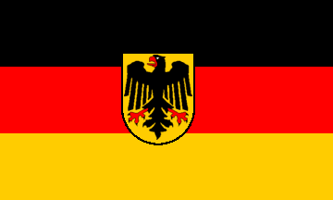
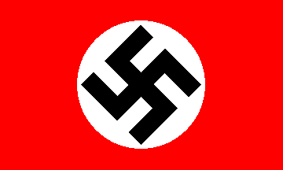
Europe Between the Wars

Slide 2
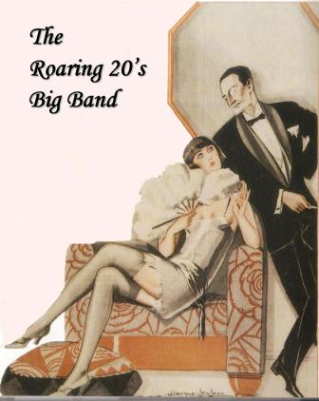
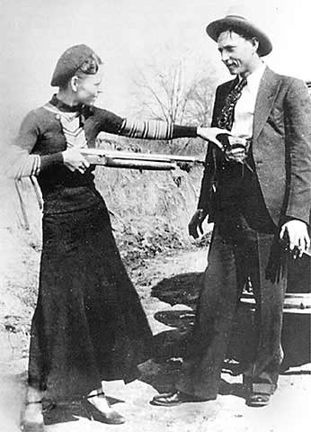
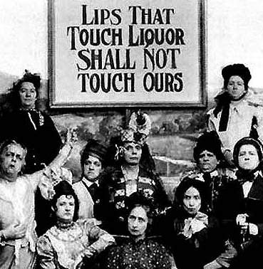
Roaring 20s
US growing rapidly
Era of:
Flappers and jazz
Prohibition
The mob
Dillinger, Bonnie and Clyde, Al Capone

Slide 3
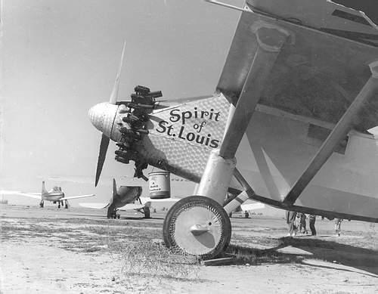
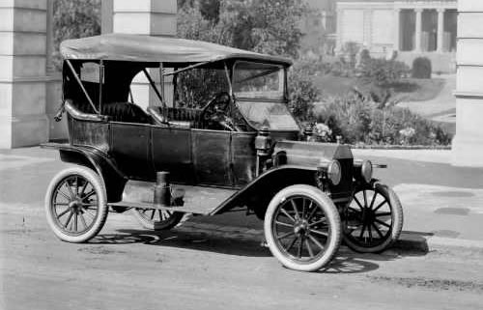
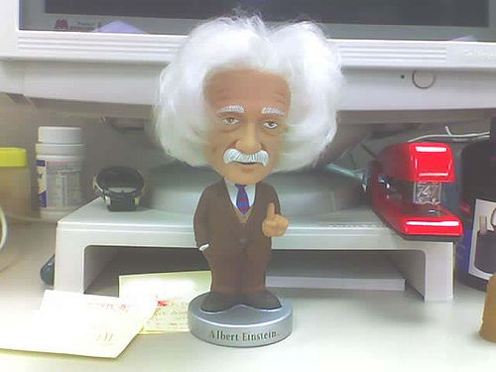
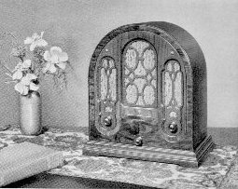
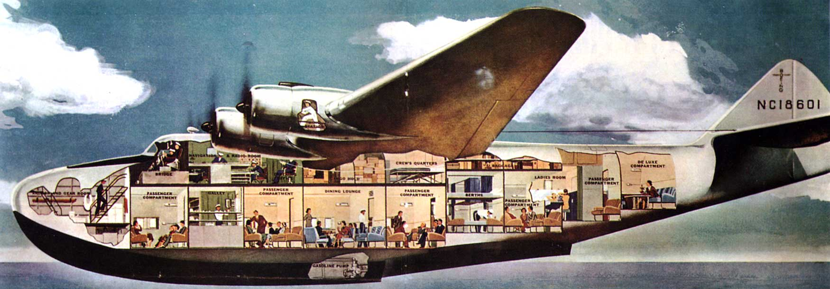
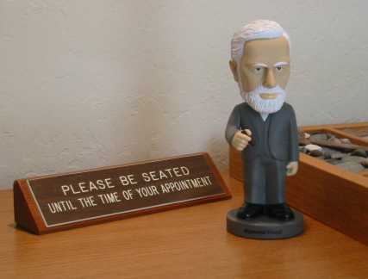
Roaring 20s
New ideas and technology
Cars
Air travel
Radio
Einstein
Theory of relativity
Freud
Subconscious mind
Psychoanalysis
Repression
Id, Ego, Superego

Slide 4
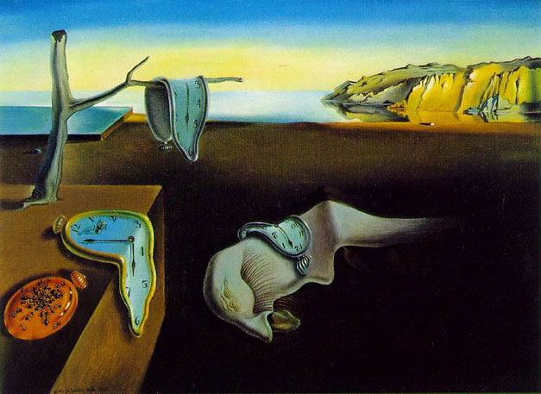
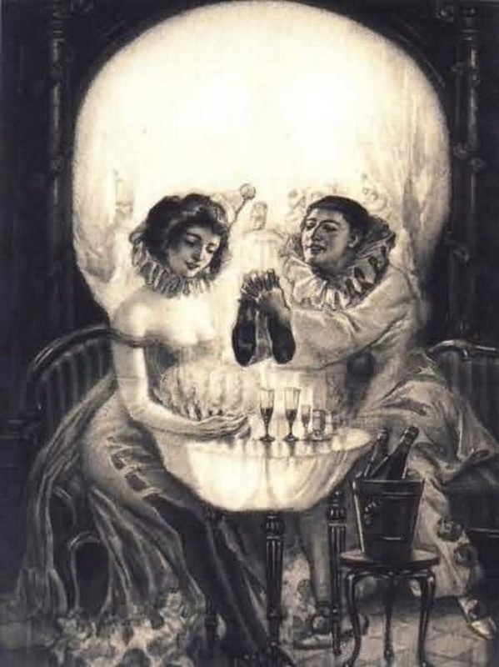
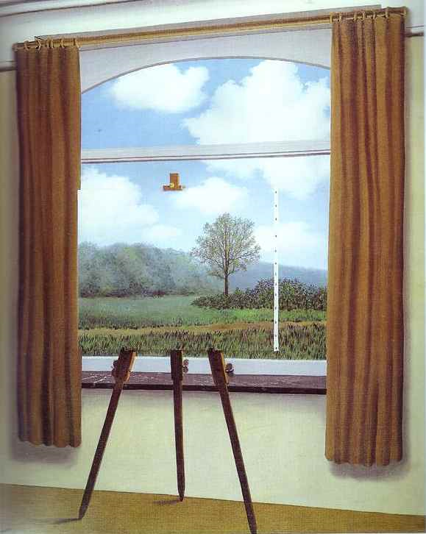
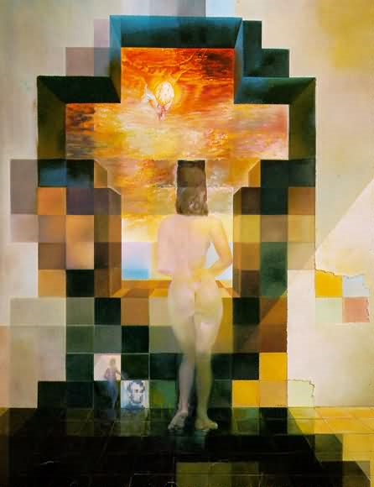
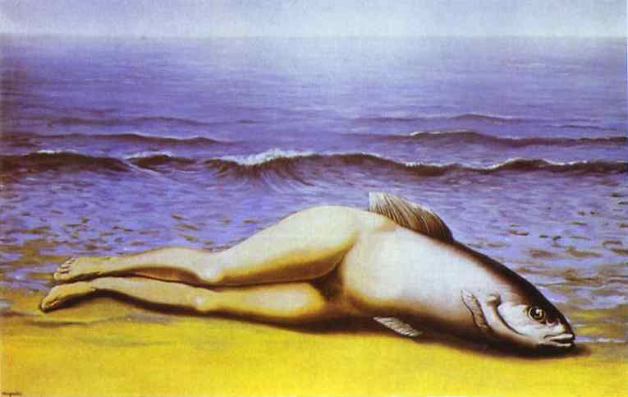
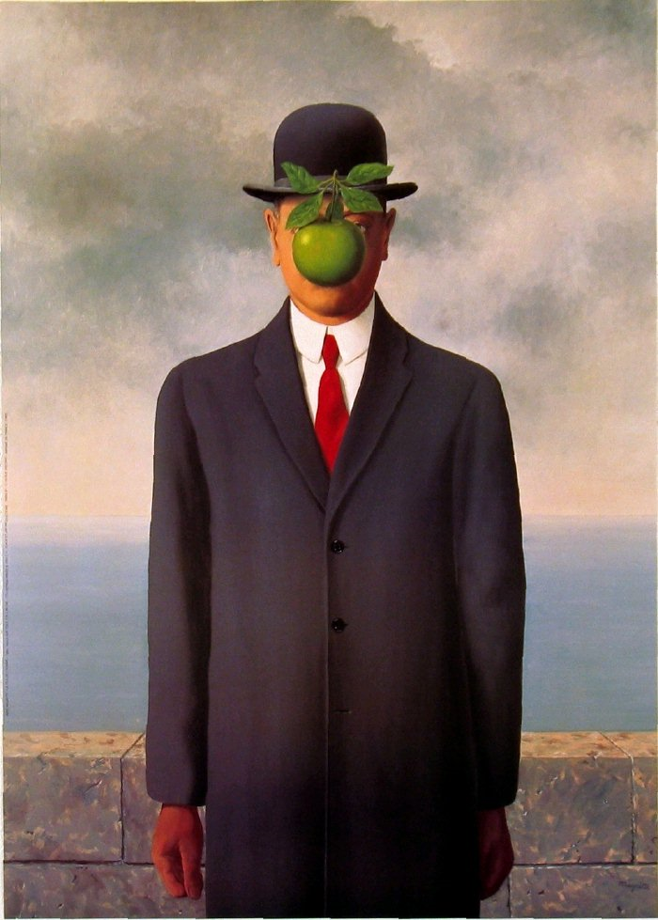
Surrealism
Put ordinary objects into unusual situations. Create a feeling of WOE

Slide 5
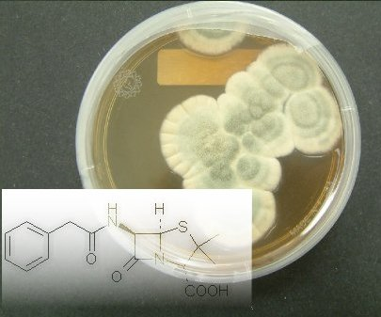
Science
Curie and radio activity
Won Nobel prize for chemistry and physics
Fleming and penicillin

Slide 6
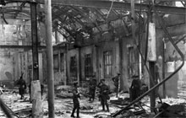
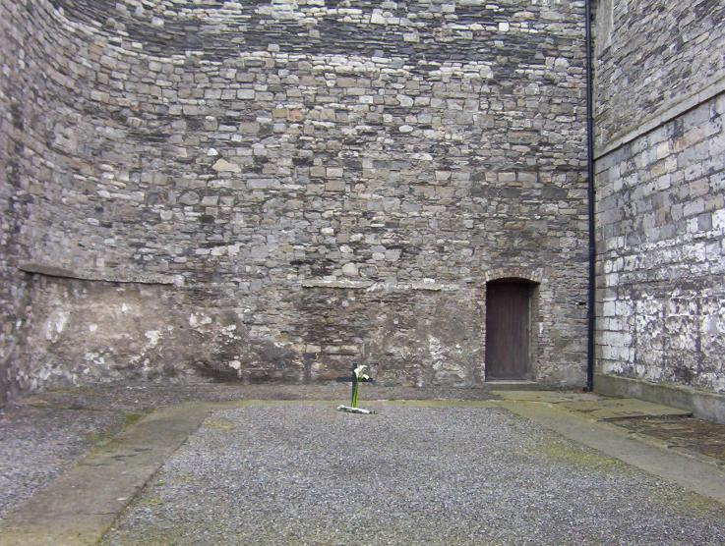
Post WW I Ireland
Ireland fights for independence.
Irish wanted nothing to do with Britain.
Easter Rebellion 1916.
Put down harshly and leaders executed. Leads to support (martyrs)
Home rule rejected and IRA formed to wage war on Brits in Ireland.

Slide 7
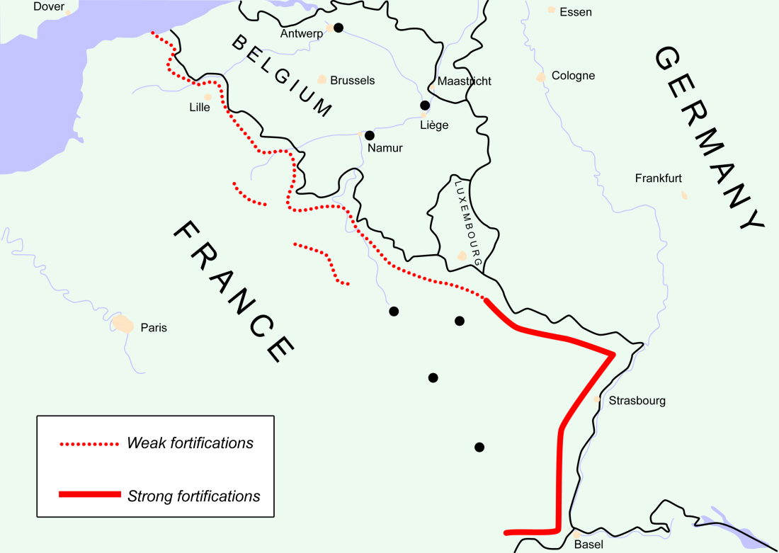
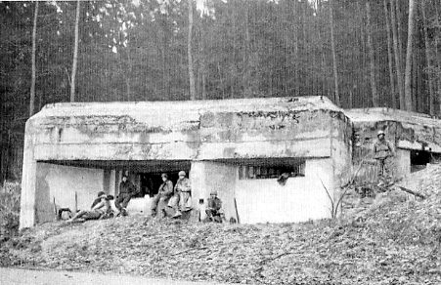
France
3rd Republic
Security was their priority
To that end they built a defensive barrier to protect the border with Germany
THE MAGINOT LINE
A series of bunkers and trenches (WW I)
(I will refer to it as the “imaginary line”)

Slide 8
Era Of Peace
Locarno
Undo worst parts of Versailles
Resolves some of the territorial disputes
Germany into League of Nations
Kellogg Briand Pact
‘renounce war as an instrument of national policy’

Slide 9
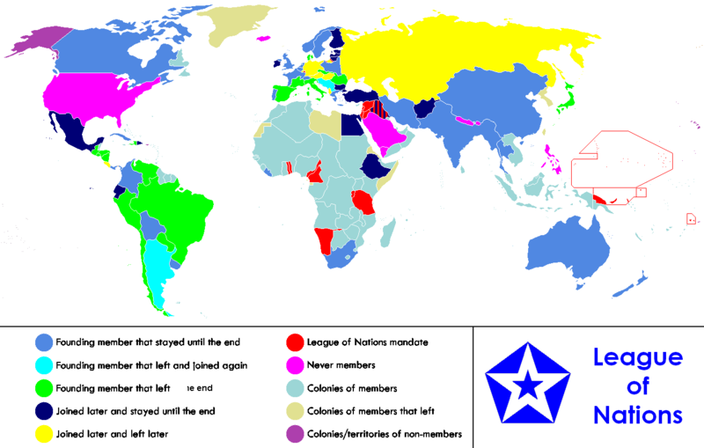
League Of Nations
Lots of weaknesses
“some nations”
No enforcement
Lacked leadership

Slide 10
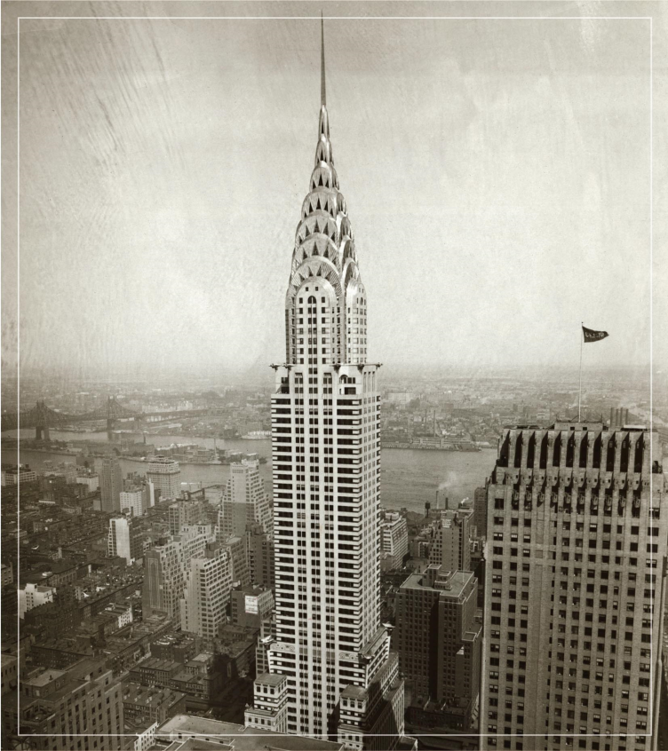
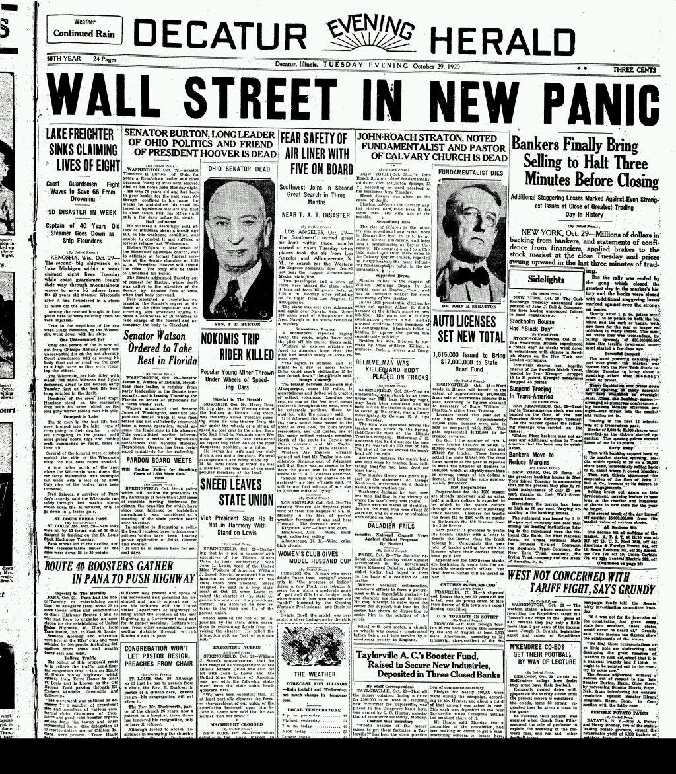
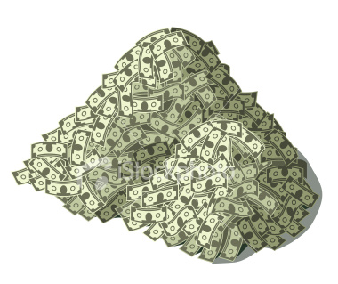
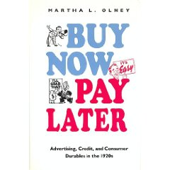
1929 Great Depression
Stock Market Crash
America was booming.
Companies producing lots of “stuff”
Issue – large amount of $ in the hands of few.
Everyone wanted to make money – invest in stocks! They will always rise in value
leverage everything (house etc.)
Demand drops
– create artificial demand
When that disappears….
Stocks plummet Oct 29 1929
Black Tuesday

Slide 11
FDR New Deal
British economist John Maynard Keynes proposed a radical way of ending depressions – increase demand.
How can demand be increased enough to end a depression?
Government spending!!!
FDR New Deal was to create Government sponsored jobs for workers. The Government spent money it did not have!
Workers would earn money, spend it and increase demand. Which would lead to more jobs…
Created all sorts of new government agencies
TVA built dams and bridges
CCC built Red Rocks
WPA built LMS

Slide 12
Italian Fascism

Slide 13
A Definition of Fascism
Fascism is the idea of a government that glorifies the state and nation. The government then controls over every aspect of national life.

Slide 14
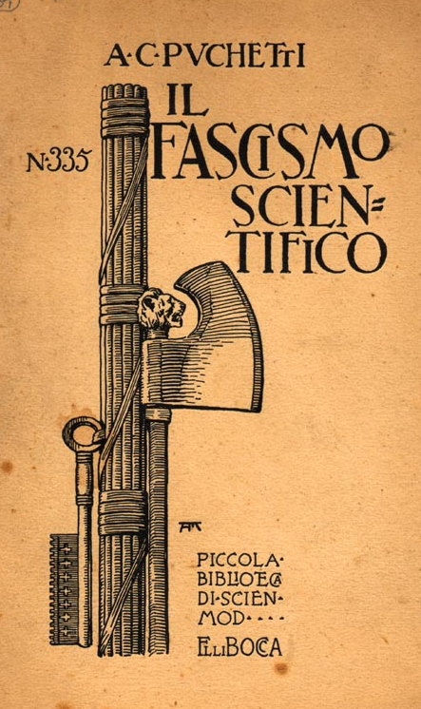
The Fasces Symbol
Comes from the Latin word fasces.
In ancient Rome, the fasces were cylindrical bundles of wooden rods, tied tightly together around an axe.
They symbolize the idea that the individual is not as powerful as the group.

Slide 15
The Characteristics of Fascism

Slide 16
Ideology
A form of extreme right-wing ideology.
Powerful nationalism.
Constant use of patriotic mottos, slogans, symbols, songs, etc.
Flags are seen everywhere.
Fascism seeks to make ALL aspects of society fall under its will.
It uses organized violence to suppress opposition.
Glorification of force.
Accepts the tenets of Social Darwinism.
Is anti-democratic.

Slide 17
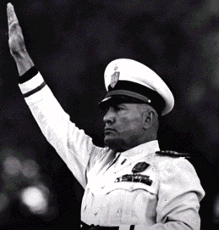
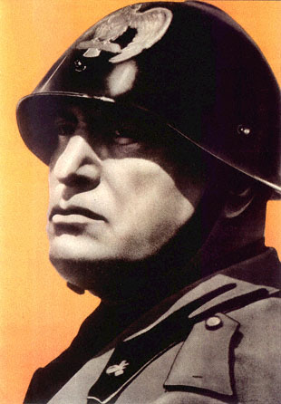
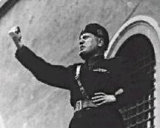
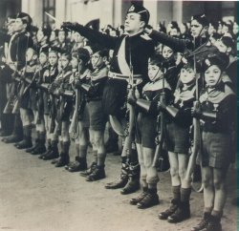
Militarism
The fascists were taught:
Credere! [to believe]
Obbedire! [to obey]
Combattere! [to fight]

Slide 18
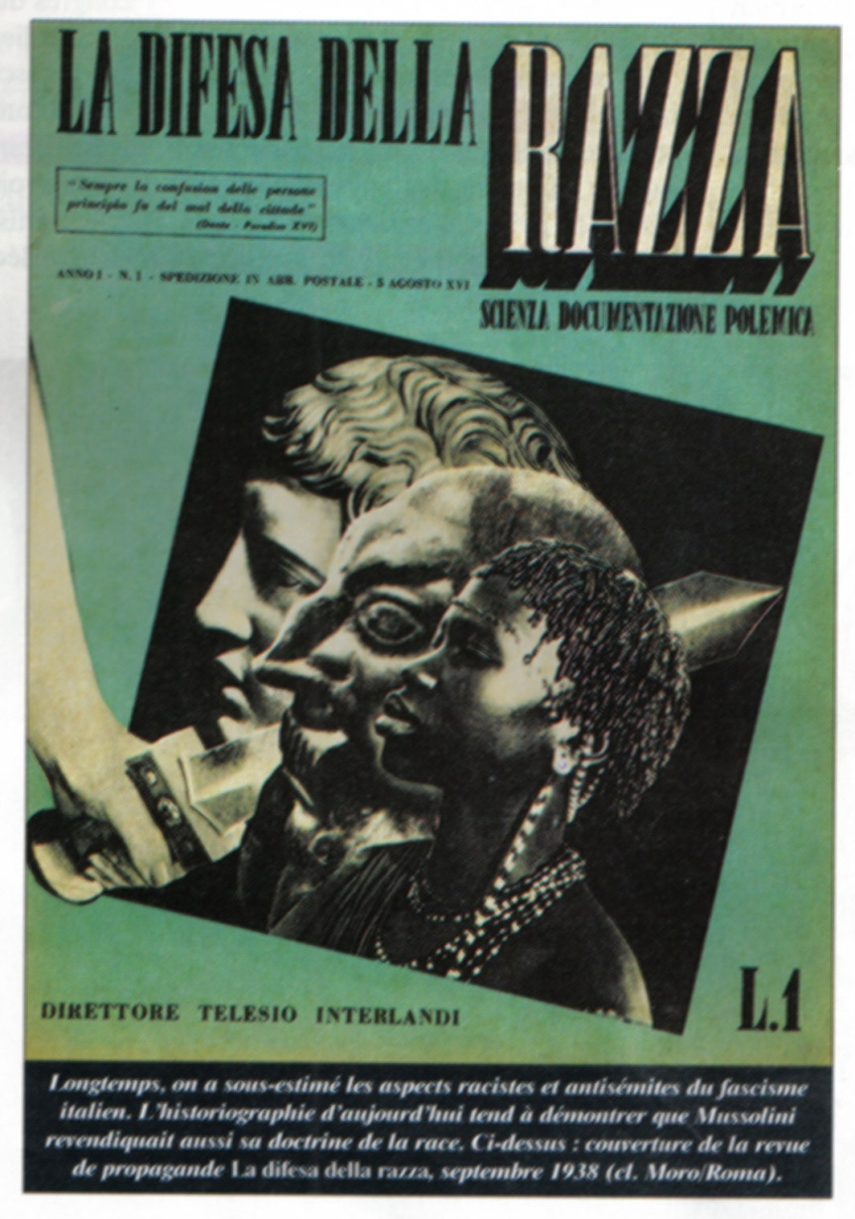
Identification of Enemies or Scapegoats as a Unifying Cause
The people are rallied to eliminate a perceived common threat or foe.
This foe could be:
Racial
Ethnic
a religious minority

Slide 19
The Rise of Mussolini

Slide 20
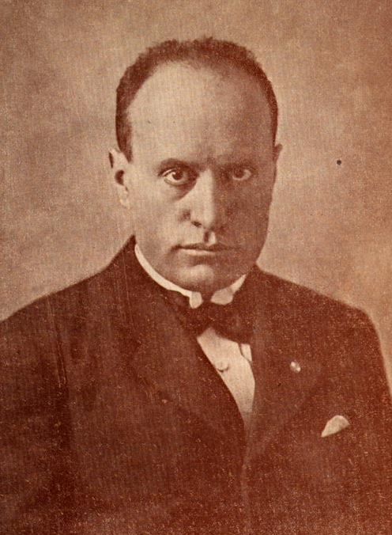
Benito Mussolini (1883-1945)
Started as a schoolteacher
Went to war became corporal
Wounded returned a nationalist due to Italy’s failures

Slide 21
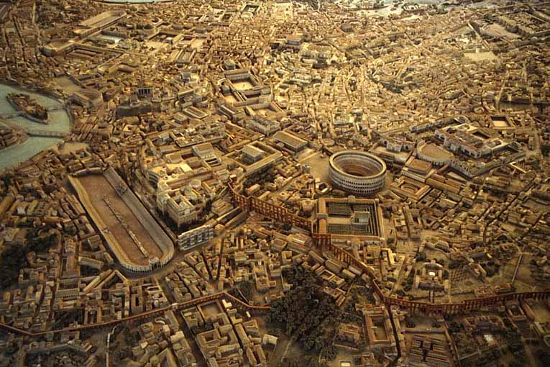
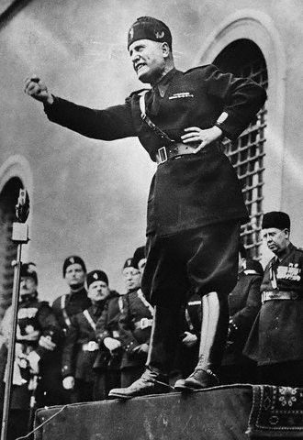
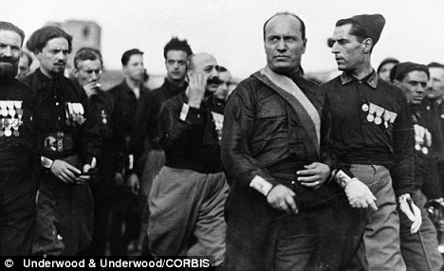
Italy
1919 disappointed with Versailles
Internal issues led to desire for strong leader.
Benito Mussolini – great orator
Calls party Fasci (bundle of sticks)
Blackshirts
Middle class support
March on Rome 1922
Given power by the King, and accepted by the Pope
Creates “dictatorship”
State control of: wages, prices, working hours
Propaganda “I will restore the glory of Rome!”
Il Duce

Slide 22
Italian Fascist Propaganda

Slide 23
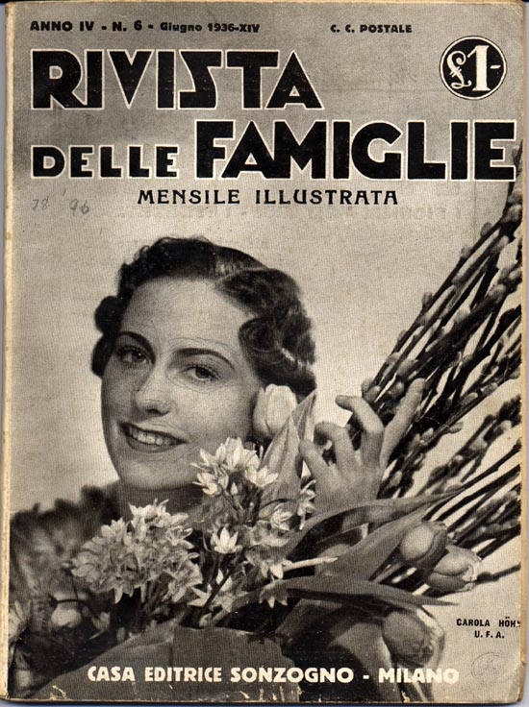
The Fascist Family
The Fascists encouraged the development of large families.
Need the large population to make Italy powerful.
Battle for Births 1927
Families were given a target of 5 children.
Mothers who produced more were recognized by the state.
1933 Mussolini met 93 mothers who had produced
1300 children between them!

Slide 24
Emphasis on Physical Fitness

Slide 25
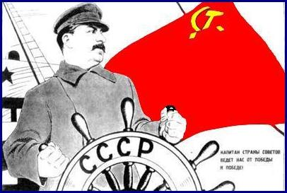
USSR
Stalin takes control of the economy Called for a command economy – system which the government makes all economic decisions
Creates a Five Year Plan (several of them in fact)
Five year plans designed to bring the USSR into the industrial age as fast as possible.

Slide 26
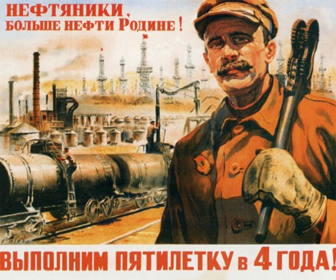
5 Year Plans
set unrealistically high production goals
consumer production was limited to try to reach these goals, causing widespread shortages of foot, housing, clothes, etc
Government controlled all aspects of people’s lives – chose jobs, assigned hours
Those who did not cooperate could be executed or sent to the gulags

Slide 27
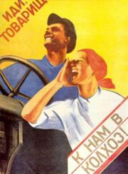
Collectivization
In order to allow the majority of workers to work in industry, farmers had to overproduce to feed them
Private farms combined into government owned collectives
Were told what to plant, when, etc
Strong resistance from peasants – especially kulaks – class of wealthy peasants
Kulaks resisted and were killed or sent to gulags in Siberia.
(Approx 5 million die)

Slide 28
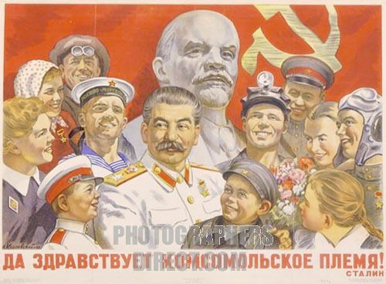
Government Control
As well as the economy, the Communist government controlled everything else.
Religion – NONE
Human rights – NONE
However there were benefits
Goods were cheaper
Free medical care
Equality for women

Slide 29
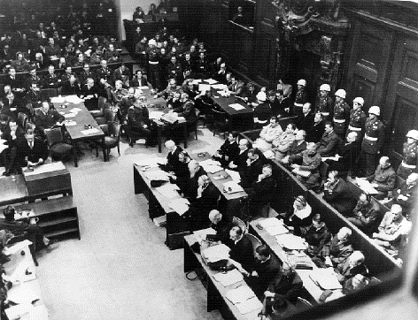
1934 Great Purge
Stalin afraid of anyone taking control, so he stopped them – ALL OF THEM!
Police terror – destroyed enemies of Stalin
Monitored telephone lines, read mail, planted informants
Many children told on parents for “disloyal” comments
Led to Show trials.
Accused were forced to confess
then put on trial for the public

Slide 30
How Many Were Killed by Stalin?
famines, prison and labor camp mortality, and state terrorism (deportations and political purges) are taken into account, Stalin and his colleagues were directly or indirectly responsible for the deaths of millions.
How many millions died under Stalin is greatly disputed. Although no official figures have been released by the Soviet or Russian governments, most estimates put the figure between 8 and 20 million
“The death of one man is a tragedy. The death of millions is a statistic.”

Slide 31
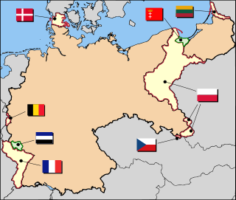
The Weimar Republic
Founded as WW I ended.
Associated with Versailles
Land loss
War Guilt
“Stab in the back”

Slide 32
Weimar Constitution
Newest and best of democratic ideals:
President elected popularly
Chancellor appointed by President
Legislators elected through proportional representation to Reichstag
Issues:
Too many parties
A country that did not understand democracy

Slide 33
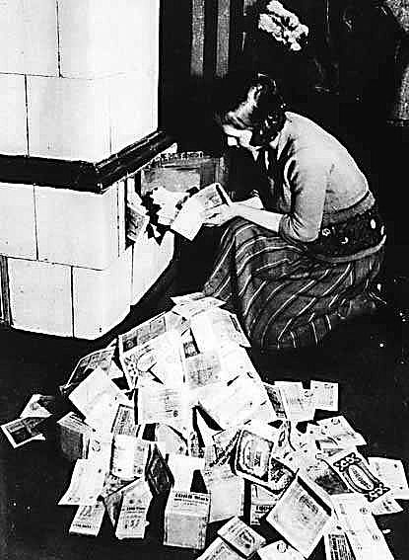
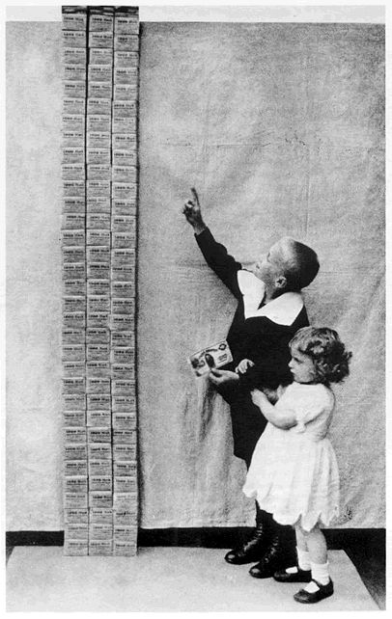
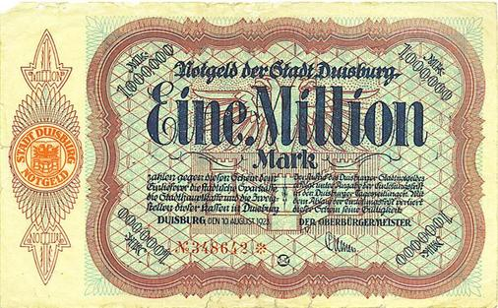
Early 1920’s
How to pay reparations?
Printed more money
Hyperinflation
Bad economic policies
Blamed allies, reparations,
and of course the Jews
Notes:
Print more money to support Ruhr
Hitler seized the first opportunity for action. On November 8 a rally was to be held in one of Munich's large beer cellars, the Buergerbraeukeller, to honor Kahr. Kahr was the featured speaker, along with General Lossow and Colonel Seisser, head of the police. Hitler surrounded the building with SA troops, broke in, took over the meeting, and melodramatically proclaimed: "The national revolution has broken out." Taking Kahr, Lossow, and Seisser into an adjoining room, Hitler pressured them to join him in overthrowing the national government. They refused until General Erich Ludendorff, who in Hitler's scheme for the new government was to be head of the army, came in to apply new pressure. Ultimately the three agreed and returned to the beer cellar with Hitler and Ludendorff to the acclaim of the audience. Hitler accepted their promises of support and allowed them to go free, much to his undoing. Circumstances changed dramatically for Hitler overnight. Although Ernst Roehm had seized the local army headquarters, the leadership of the army refused to support Hitler. Lossow, upon his release, telephoned Bavarian army headquarters for new troops to be sent to Munich to crush Hitler's revolt. Kahr also reneged on his promise. Hitler, faced with the complete collapse of his plans, tried a last desperate gamble by marching with Ludendorff and 2000 supporters through Munich to gain popular support for the coup.Their march was stopped by police barricades and after a brief gun battle the Hitler group, with the noticeable exception of General Ludendorff, ignominiously fled. The Beer Hall Putsch had collapsed. The leaders, including Hitler, were arrested. Some observers considered it the end of the upstart Austrian.The treason trial against Hitler, Ludendorff, and other leaders of the Kampfbund took place in February and March 1924. Considerable public attention became focused on the trial and gave Hitler the opportunity to establish his name outside of Bavaria. He used the publicity brilliantly to transform defeat into propaganda victory. At the trial, Hitler did not deny that he had planned to overthrow the national government. But he refused to admit that this had been an act of high treason. The real criminals, Hitler proclaimed, were the betrayers of Germany who had signed the Versailles treaty and perpetuated the Weimar Republic. Hitler also attacked the credibility of the state's chief witnesses, Kahr, Lossow, and Seisser, saying they all wanted the same thing he did. Hitler portrayed himself as the real patriot opposing the Weimar Republic, since he had had the courage to act: "I consider myself not a traitor but a German, who desired what was best for his people." But he was more than just a patriot, for he pictured himself as Germany's man of destiny:"I aimed from the beginning at something more than being a Minister. I wanted to become the destroyer of Marxism. I am going to achieve this task, and if I do, the title of Minister will be an absurdity for me."The right-wing judges were sympathetic to Hitler's words. Ludendorff was acquitted and Hitler was given the most lenient sentence possible for treason - five years in prison with an understanding of early probation.The putsch had failed, but Hitler had not. He would have time in prison to mull over the lessons of the past months and would emerge convinced that the real struggle for the soul of Germany was just beginning.

Slide 34
How bad was it?
Cost of a loaf of bread
1919 = 2 marks
1921 = 40 marks
1922 = 1500 marks
1923 = 4 million marks
Who was hurt the most?
Upper classes owned things (inflation proof)
Poor lived day to day
Middle classes because they saved money. If you had money saved in 1919 it was worthless now!

Slide 35
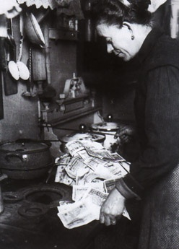
Hyperinflation

Slide 36
Late 1920’s
Hyperinflation recovery based upon American loans.
Dawes Plan
United States
War debts
loans
Charles Dawes
Britain and France
Weimar Republic
reparations

Slide 37
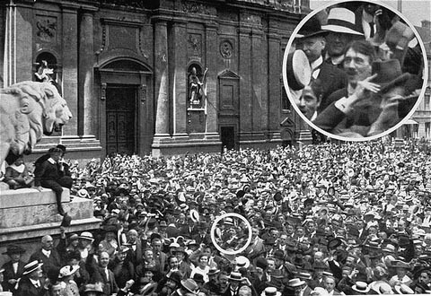
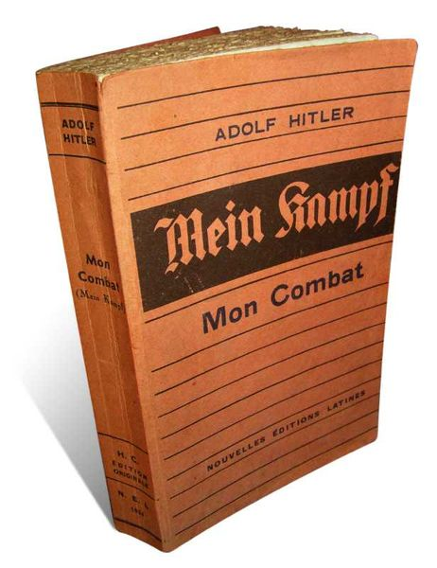
NSDAP
Post war Germany very bitter
Move to extremist political parties
Communist or Nationalist
Hitler spied on these groups for the Army, but liked the NSDAP
Charismatic speaker rises to lead
1923 Beer Hall Putsch
Fails and he goes to jail
Vows to gain power legally!
Mein Kampf – my struggle
Aryan myth
Lebensraum
Released to a new Weimar – prosperous
Extremist ideas not popular until…

Slide 38
The Crash
United States
War debts
loans
Britain and France
Weimar Republic
reparations
The whole system collapsed

Slide 39
Political Crisis
Mass unemployment
Coalitions collapse
Parties unwilling to compromise
Extremists gaining power (Nazis and Communists)
Gave simple solutions to complex problems
Remove Versailles
Create jobs
Restore German pride
Paramilitary groups roam, dominate cities

Slide 40
1932
Four parties vying for power
Nazis receive 37% of vote - 2nd
Hitler demands to be appointed Chancellor
President Hindenburg believes he can control him

Slide 42
1933-34
Feb. 1933, Reichstag burned
Hitler blames communists
Nazis win election
Vote to give Hitler dictatorial power
Hitler declares himself Fuhrer
Nazis vote to eliminate Reichstag…

Slide 43
As Dictator
The Third Reich
Public Works (like FDR)
Gestapo
Anti Semitism
Nuremberg Laws
Kristallnacht
Anti Christian (weakness)

Slide 44
Other Dictators around the World
Hirohito: Emperor Japan
People were unable to handle their new freedoms
Dictators offered simple solutions
No decisions or responsibility
Solved economic problems with military spending.
As Mussolini said “one minute on the battlefield is worth a lifetime of peace. Weaker nations deserve to fall victim to the powerful.”
Stalin: the man of steel, USSR
General Francisco Franco: military takeover of Spain aided by Mussolini and Hitler (practice for WW II?)

Slide 45
The Beginning of the End
As these dictators begin to consolidate their power, they start to push against the League of Nations
Japan attacked Manchuria. Idea of Empire (just like the Western powers). Greater East Asia Co Prosperity Sphere
Invasion continues into China. “Rape of Nanking”. Chinese fought back and were ‘punished’ by the Japanese. The holocaust no one knows about!
This newspaper headline talks about the two officers pictured who held a beheading contest…which of them could behead 100 victims fastest!

Slide 46
The Beginning of the End
In Spain 1936, Nationalists led by Franco stage uprising to overthrow Republican (like France Republican) government.
Franco aided by Hitler and Mussolini
For Germany and Italy, Spain was a testing ground for new methods of tank and air warfare.
First air attack on civilian target – Guernica.

