Slide 1
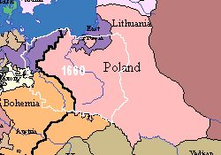
Poland
Major player because of its size and population #s!
John Sobieski III, only leader of significance.
When Ottomans attacked Vienna 1683, Sobieski led the forces that defended HRE.
Elected King.
Poland at its height under him – absorbs Lithuania.
Rebellions and infighting within his family led to anarchy.
By 1732 Prussia, Russia and Austria had created alliance that threatened Poland’s existence. (to be contd)

Slide 2
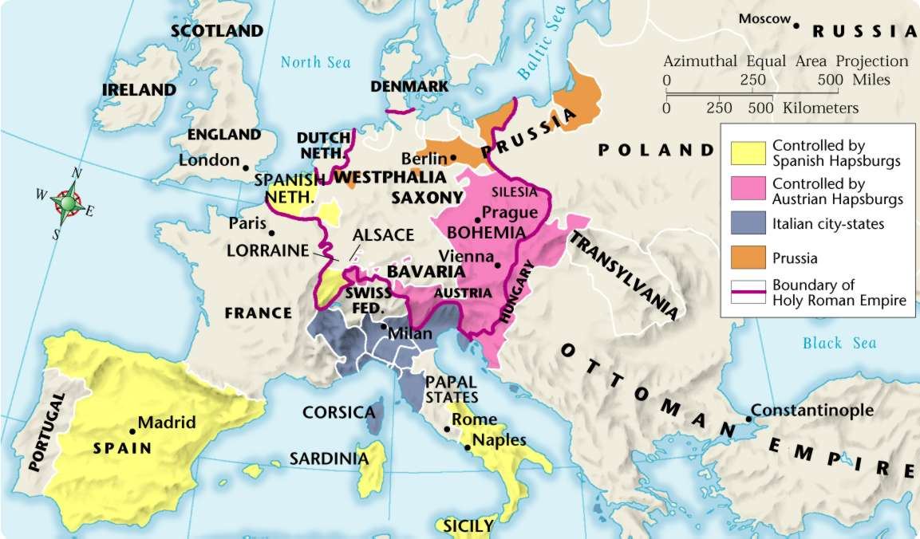
Europe After the Thirty Years’ War
4

Slide 3
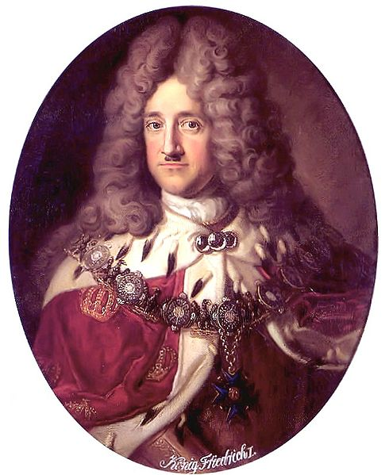
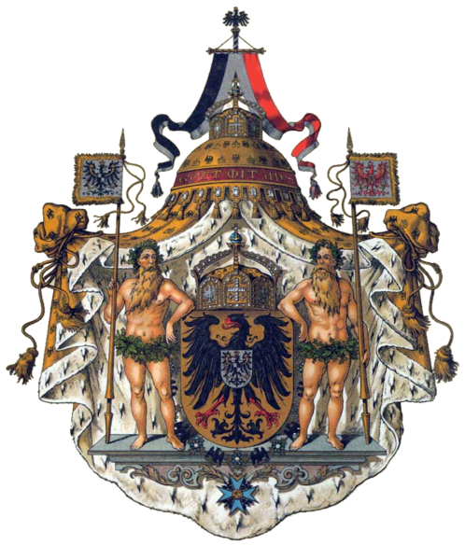
Albert
Prussian Royalty
House of Hohenzollern

Slide 4
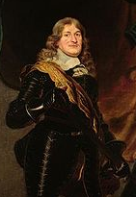
Frederick William
The Great Elector
After the Thirty Years’ War he increased power of Brandenburg-Prussia
Created a standing army as a result of country’s experience in 30 Years War
Wooed the Junkers (the nobles) by giving them special tax breaks, landownership, power over the peasants, etc.
  He gained absolute power with this Junker alliance.
Taxes collected by the army and then used for the army!

Slide 5
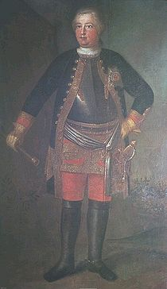
Frederick William I
Centralized the Prussian government
Brought in revenue and supported production and trade
Whipped the army into efficient fighting machine
Known as the “Royal Drill Sergeant” or the Soldier King
Liked his recruits tall—(hmmmm….) a special regiment nicknamed the Potsdam Giants.

Slide 6
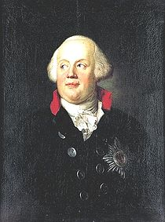
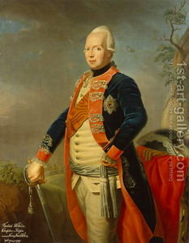
Frederick William II
Aka Frederick the Great—loved music, art, horses, and military stuff.
Rejected Austria’s pragmatic sanction and seized Silesia—sparked the War of the Austrian Succession.
(Next topic)
Prussia gains recognition!

Slide 7
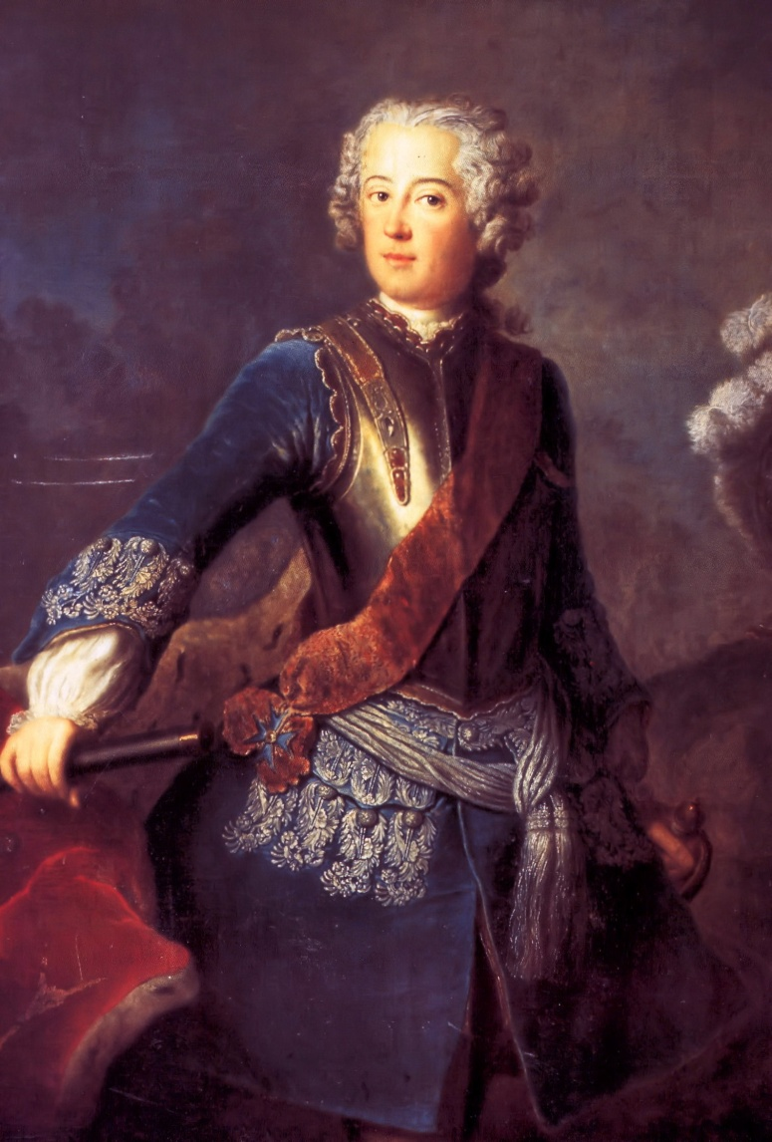
Prussia and Austria do not get along!
Maria Theresa's lifetime enemy, King Frederick II of Prussia, to whom she referred as "that evil man”
He always referred to her with the male pronoun

Slide 8
Austria
Hapsburgs struggling to control everything
Diversity in HRE – ethnic, cultural, religious
Charles VI inherits these problems
New law to ensure inheritance – women could take throne in event of no male heir
  Habsburg lands were bound by Salic law which prevented female succession.
WHY?
  Prevents struggle for power that might further weaken control
RESULT - PRAGMATIC SANCTION

Slide 9
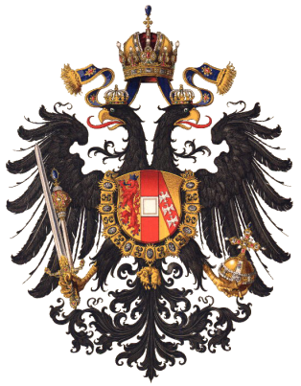
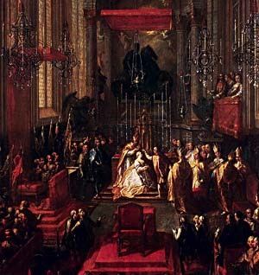
Pragmatic Sanction…
Maria Theresa being crowned King of Hungary, St. Martin's Cathedral.
Leads to
War of Austrian Succession

Slide 10
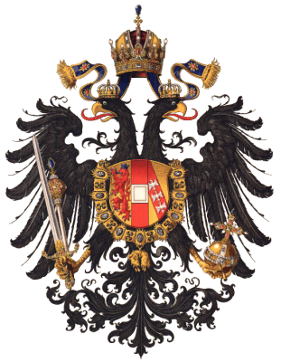

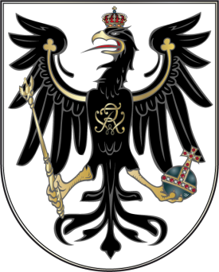
4
Austria and Prussia rise out of the ashes of The Holy Roman Empire
AUSTRIA
PRUSSIA
The Hapsburgs kept the title of Holy Roman emperors and expanded their lands.
Hapsburg monarchs worked hard to unite the empire, which included peoples from many backgrounds and cultures.
Maria Theresa won popular support and strengthened Hapsburg power by reorganizing the bureaucracy and improving tax collection.
The Hohenzollern family united their lands by taking over the states between them.
Hohenzollern kings set up an efficient central bureaucracy and reduced the independence of nobles.
Frederick William I created one of the best armies in Europe.
Frederick II used the army to strengthen Prussia.

Slide 11
Maintaining the Balance of Power
4
By 1750, the great powers of Europe included Austria, Prussia, France, England, and Russia.
These powers formed various alliances to maintain the balance of power.
Though nations sometimes switched partners, two rivalries persisted.
Prussia battled Austria for control of the
German states.
Britain and France competed for
overseas empire.

