Slide 1
Absolutism In France

Slide 2
Origins of Divine Right
Frenchman Jacques Benigne Bousset (1583 – 1645)
Kings ruled because they were chosen by God to do so by virtue of who they were born.
“God bestows power on the monarch and this legitimizes the autocratic rule of the King. He should therefore be obeyed in all things. No group, be they Parliament, or nobles have the right to participate in this rule. To question or oppose the King is to rebel against God’s purpose.”

Slide 3
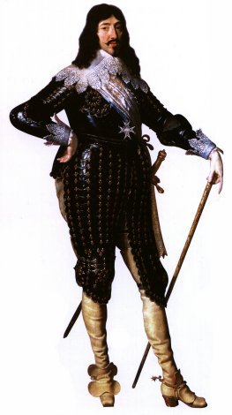
Louis XIII (r1610 – 1643)
Son of Henri IV. Came to throne age 9, after father’s assassination.
Relied on two principal advisors
Luynes and Richelieu (more of both to come)
His mother Marie de Medici ruled a Regent.
She played favorites and allowed her lovers to gain power at the expense of the monarchy

Slide 4
How Things Worked in France
Royal Council – monarch appointed (traditionally nobility of Blood) Often too many cooks to work effectively. Smaller body of top 6 – Counseil des Affaires.
Numerous “departments” to cover their piece of the pie – finance, justice, military etc.
Sovereign bodies known as ‘Parlements’, the most important of which was Parlement de Paris.

Slide 5
How Things Worked in France Contd.
If the King needed something these bodies did not support, he simply created a duplicate version loaded with supporters.
This creates a huge bureaucracy.
Henri IV had been strong enough to control all of these, but a minor…
So these bodies now began to assert themselves.
They were not alone. In the weakened times, the Huguenots did too.

Slide 6
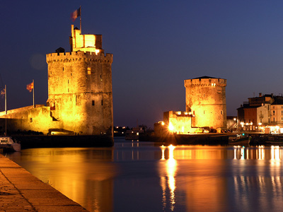
Huguenot Strongholds
Granted freedoms under Edict of Nantes.
The counter reformation created a defensive mentality among the Huguenots. They began to fortify the cities and regions they controlled.
Called “Circles”
These almost
became independent
states .
Seen as a threat to
Louis’ power.
LaRochelle – Huguenot “circle”

Slide 7
The Protestant Threat
Inherited from his father
Henri had promised Catholic Church return of some of its land (taken during religious wars) Who owned it?
French crown kept it, but Louis decides to return it!
H’s refuse to give it up. Louis forces them
trying to live up to daddy
Growing influence of devots (HC Catholics)
Gave him the chance to lead his army (he liked the feeling of power)
Upon return to Catholic hands, cemeteries were desecrated

Slide 8
French Religious Conflict AGAIN
Huguenots led by Rohan
Louis advised by Luynes who believed in DRK and that a strong foreign policy (empire) needed domestic stability and security
Luynes killed while accompanying King
Campaign failed – Peace of Montpellier
Upheld Nantes
Rohan pardoned.
Huguenot circles maintained.
Luynes replaced by Richelieu (Politique?)

Slide 9
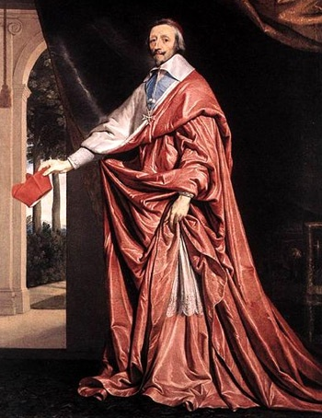
Richelieu
Huguenots dominate domestic actions
Seeks to strengthen military
Involves France in 30 Years War

Slide 10
Huguenots
Still had fortified cities
To Richelieu they represented republics within monarchy, and as a DRK guy he could not tolerate them.
View shared by the Catholics at court
Wanted France to be a unified entity to make it a potential ally if need be. For this he needed stability at home! Circles were not that!
Sought to destroy them!

Slide 11
War on the Huguenots
Huguenot strongholds in the S and W of France.
Richelieu set about systematically dismantling them.
Last to fall was LaRochelle.
Siege for a year. 25K reduced to 5K
Louis allowed to lead army into the city (keeps Richelieu in Louis’ good graces)
Grace of Alais
Protestants pardoned
Allowed freedom to worship, but lost political influence

Slide 12
Richelieu and the Military
Richelieu realizes the weaknesses of French military. Sets about rectifying
Navy – needed to protect interests abroad. Increase size to 40 ships from 20 in 7 years.
Army – modernized and better trained. New army did fight in 30 years war, but results were mixed.

Slide 13
Richelieu Conclusions
Was he a Politique?
Foreign Policy was to fight for France’s best interests no matter the enemy (30 Years War )
Domestic Policy likewise (Huguenot Circles)
His time in power saw him
A cardinal
Ally the protestants in Sweden
Act against Spain and the Hapsburgs

Slide 14
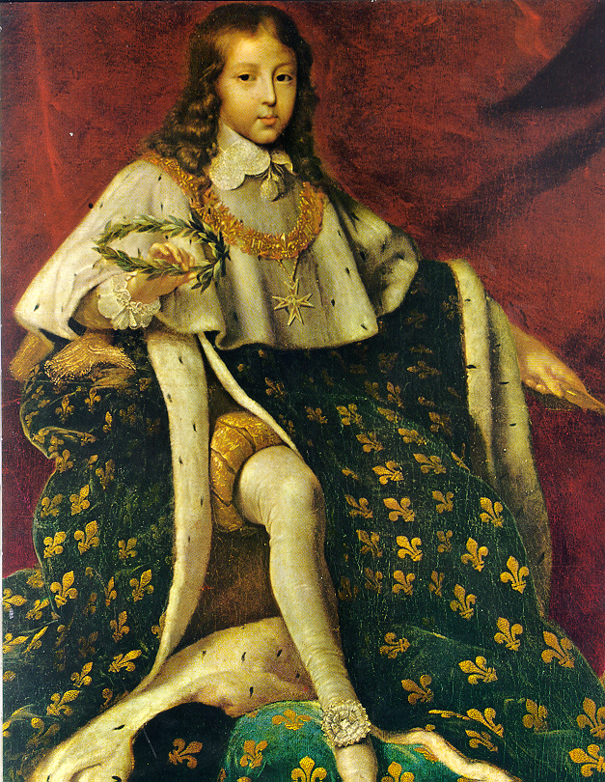
Louis XIV (r forever!!!) (1643 – 1715)
Comes to the throne age 5
Richelieu helps till his death 1649
Succeeded by Mazarin
Richelieu’s support of P in 30Yrs
War and food shortages following
made young king unpopular.
Led to Frondes: 5 year struggle
against royal family.
Louis moves the court from Paris to Versailles
Young Louis XIV

Slide 15
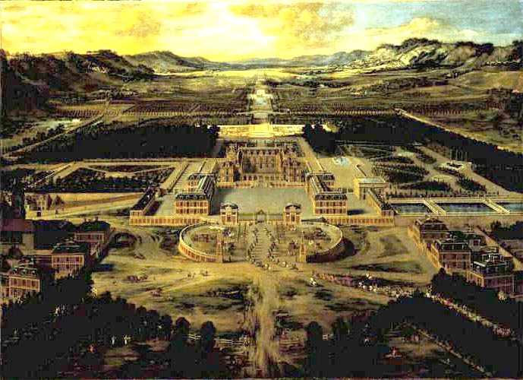
Louis XIII’s Old Chateau

Slide 16
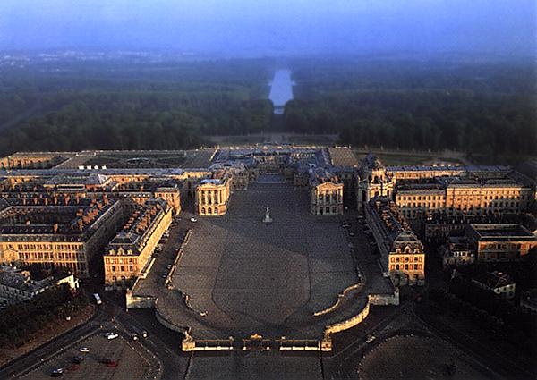
Versailles Today

Slide 17
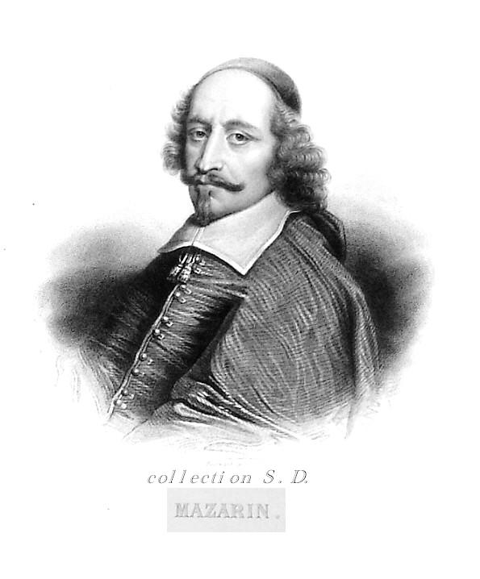
Mazarin
Saved Louis. Took him to Germany and helped him gain back the throne.
Becomes King’s teacher
Diplomacy
War
Kingship
Sets up the marriage of Louis to Maria Theresa (Sp).
6 kids but only 1 survives – Louis, Dauphin de France

Slide 18
Versailles:
Home of the
"Sun King"

Slide 19
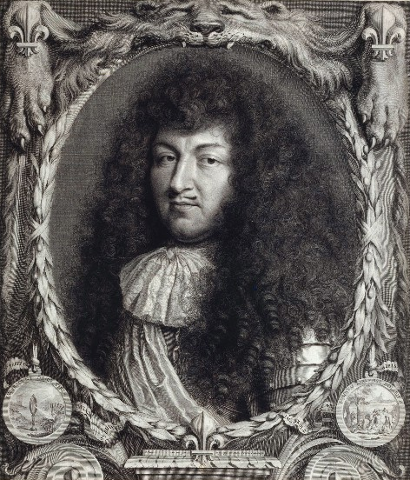
L’ouis XIV

Slide 20
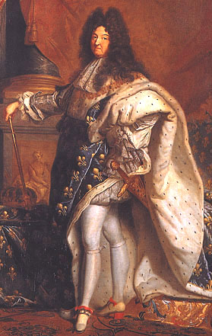
L’ etat c’est moi!
By Hyacinthe Rigaud

Slide 21
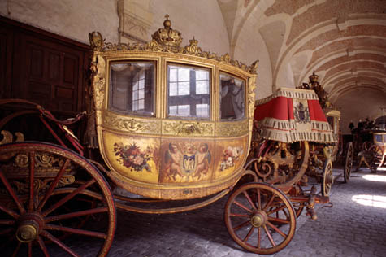
Louis XIV’s Carriage

Slide 22
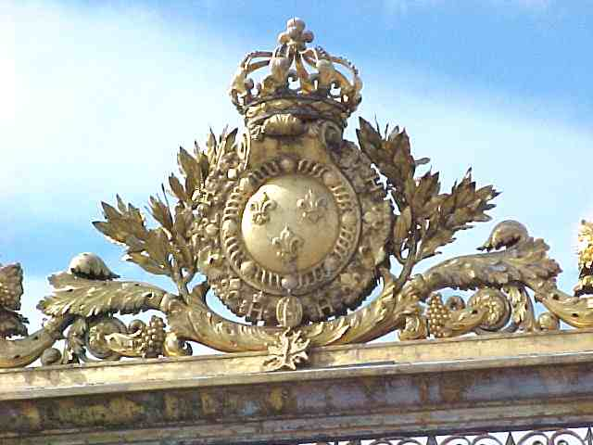
The Bourbon Family Crest

Slide 23
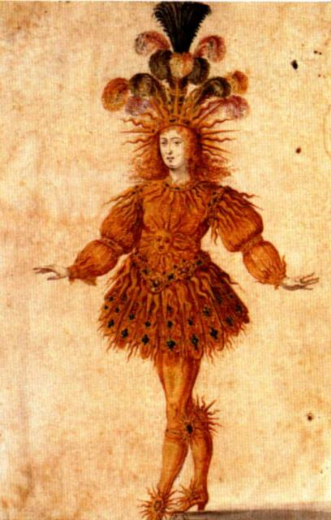
L’ ouis XIV as Apollo

Slide 24
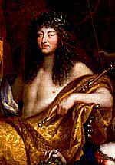
L’ ouis XIV as Apollo
by Jean Nocret, 1670

Slide 25
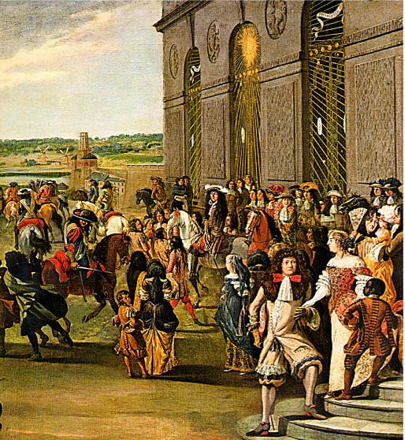
The Sun Symbol

Slide 26
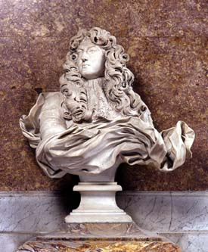
Louis XIV Gian Lorenzo Bernini, 1665

Slide 27
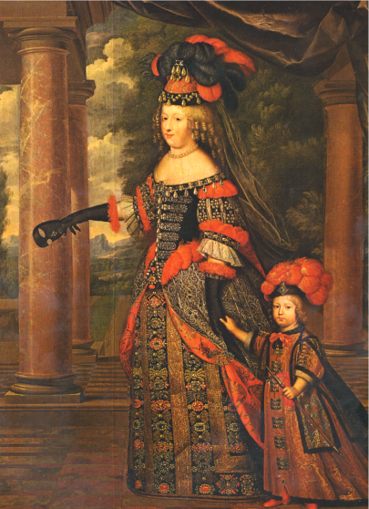
Marie Theresa & the Dauphin

Slide 28
Versailles Statistics
2,000 acres of grounds
12 miles of roads
27 miles of trellises
200,000 trees
210,000 flowers planted every year
80 miles of rows of trees
55 acres surface area of the Grand Canal
12 miles of enclosing walls
50 fountains and 620 fountain nozzles
21 miles of water conduits
3,600 cubic meters per hour: water consumed
26 acres of roof
51,210 square meters of floors
2,153 windows
700 rooms
67 staircases
6,000 paintings
1,500 drawings and 15,000 engravings
2,100 sculptures
5,000 items of furniture and objects d'art
150 varieties of apple and peach trees in the Vegetable Garden

Slide 29
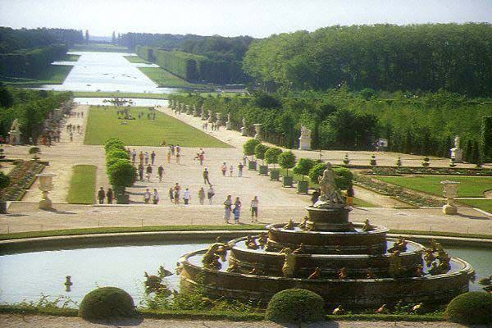
Palais de Versailles

Slide 30
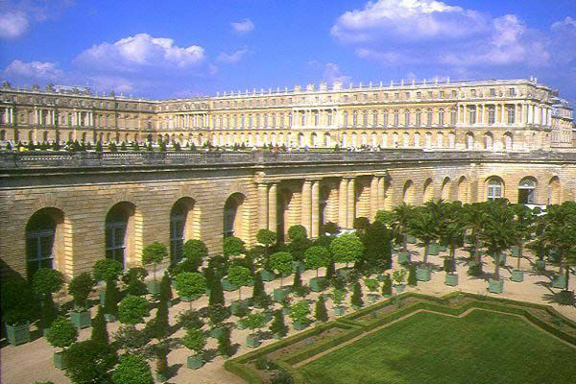
Palais de Versailles

Slide 31
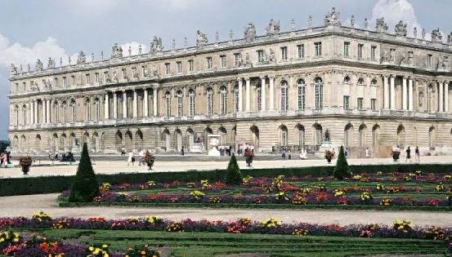
Versailles Palace, Park Side

Slide 32
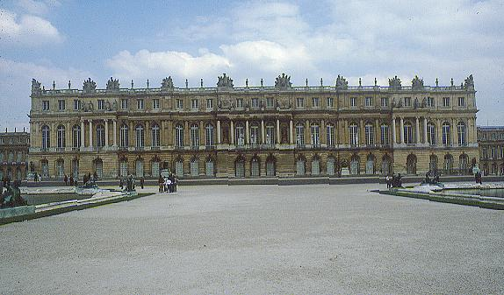
Garden View of Versailles

Slide 33
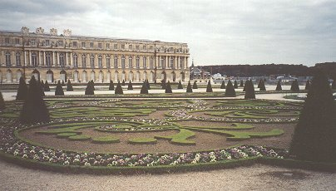
Chateau de Versailles

Slide 34
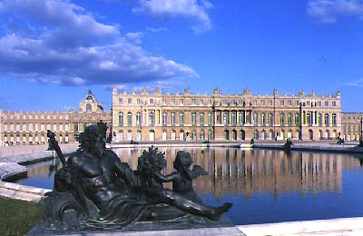
Chateau de Versailles

Slide 35
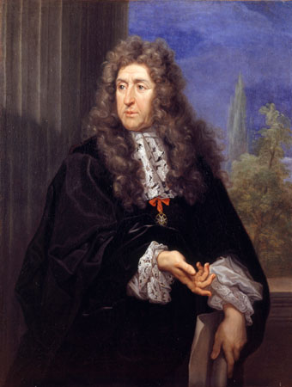
Andre Le Notre, Royal Gardener

Slide 36
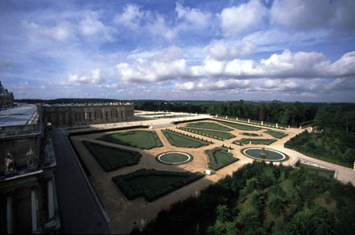
Versailles’ Northern Gardens

Slide 37
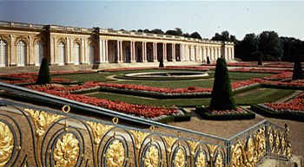
Gardens at Versailles

Slide 38
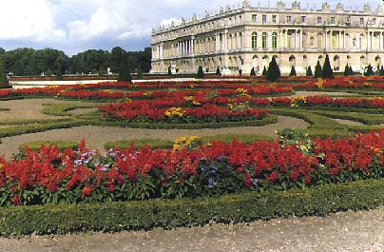
Chateau de Versailles Gardens

Slide 39
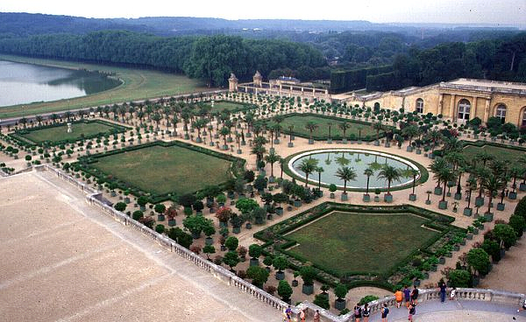
The Orangery

Slide 40
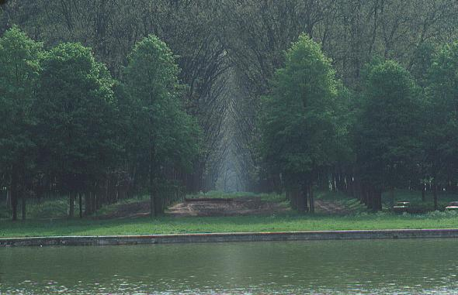
Grounds at Versailles

Slide 41
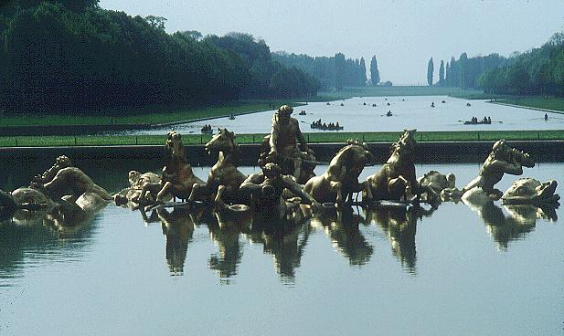
Fountains, Fountains, and More Fountains!

Slide 42
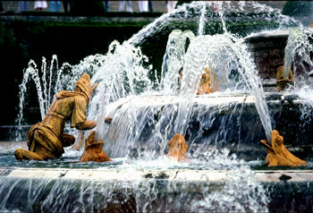
And More Fountains!

Slide 43
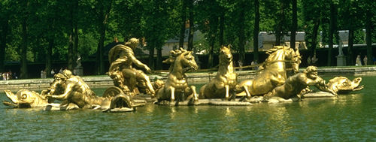
And More Fountains!

Slide 44
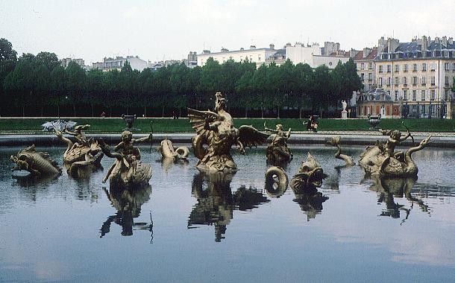
And Even More Fountains!!!

Slide 45
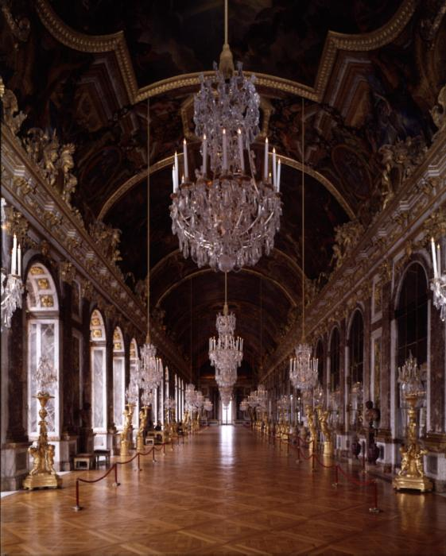
Hall of Mirrors

Slide 46
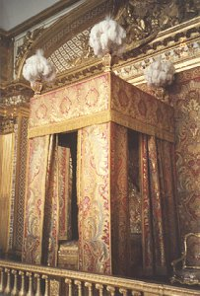
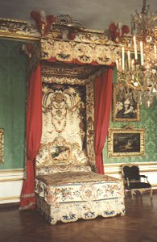
The King’s Bed
The Queen’s Bed

Slide 47
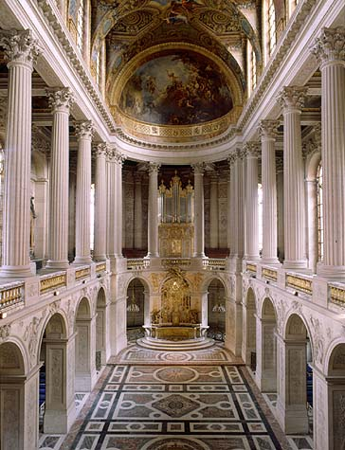
Louis XIV’s Chapel

Slide 48
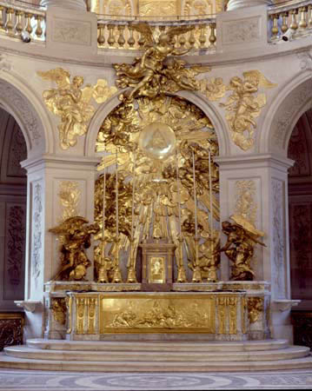
Louis XIV’s Chapel Altarpiece

Slide 49
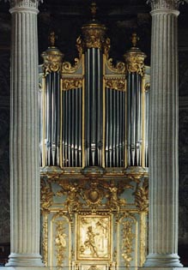
Organ in Louis XIV’s Chapel

Slide 50
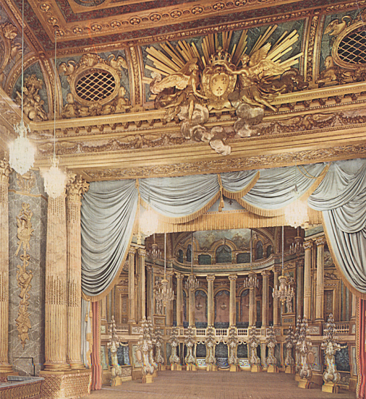
Louis XIV’s Opera Stage

Slide 51
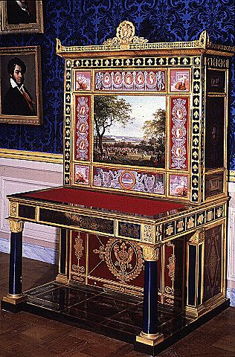
Cabinet with Views of Versailles, 19c

Slide 52
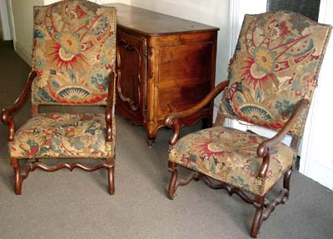
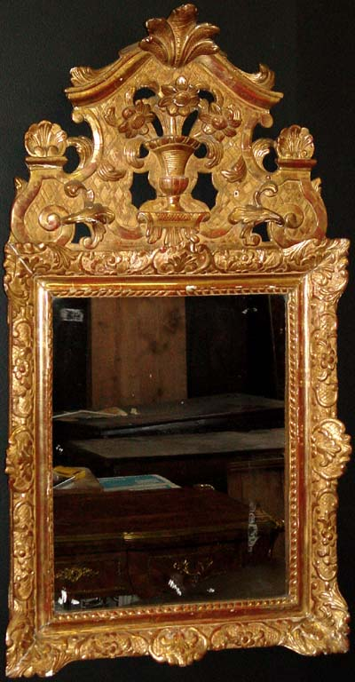
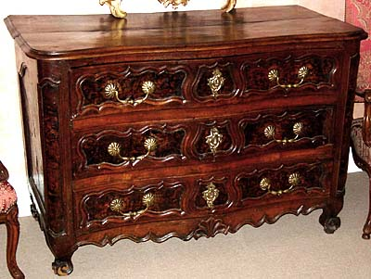
Louis XIV Furniture

Slide 53
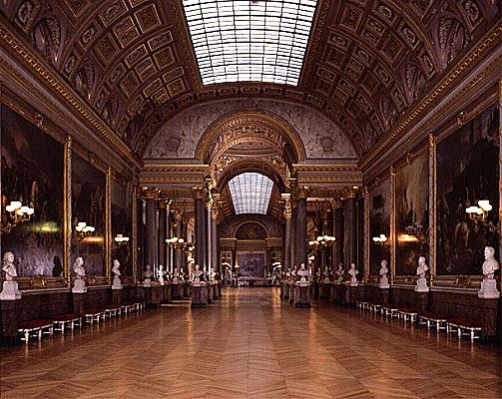
The Gallery of Battles

Slide 54
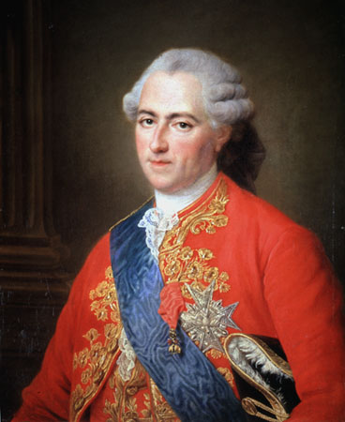
Louis XV [r. 1715 – 1774]

Slide 55
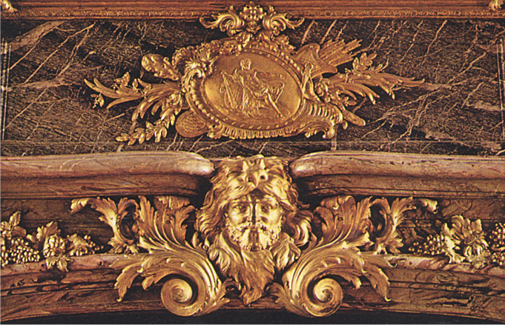
The “Hunts” of Louis XV

Slide 56
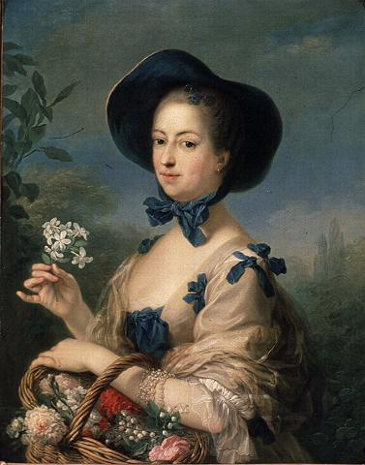
Madame de Pompadour

Slide 57
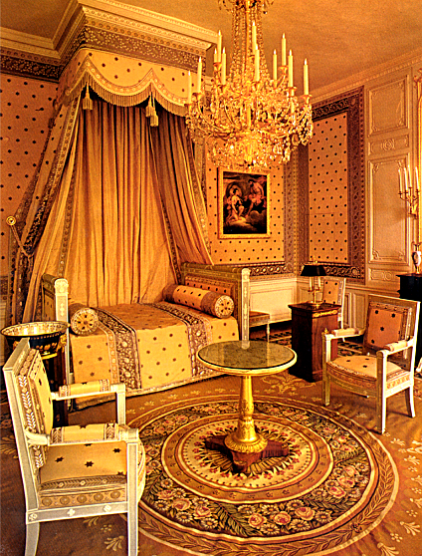
Madame de Pompadour’s Bedroom

Slide 58
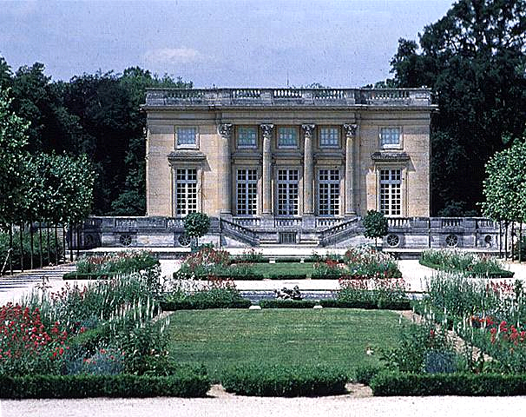
Petite Trianon, Madame de Pompadour’s Chateau

Slide 59
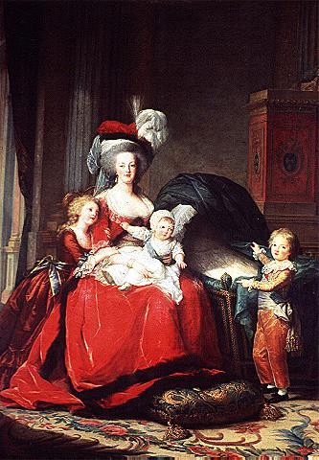
Marie Antoinette & Her Children

Slide 60
Marie Antoinette’s Boudoir

Slide 61
Marie Antoinette’s “Peasant” House

Slide 62
Marie Antoinette’s “Peasant’s Hut”

Slide 63
Marie Antoinette’s “Peasant’s Hut”

Slide 64
Louis XIV
Strong Catholic and believe the Church was an ally in controlling the country.
Despite this he persecutes Jansenists who were a Catholic Branch, especially as his reign went on.
Persecutes the Huguenots eventually
Tries to get them to convert by paying cash
Made it harder and harder to get Govt jobs
1685 Louis XIV revokes Edict of Nantes introduces Edict of Fontainebleu makes Protestantism illegal. 20K Protestants flee France. What was the impact?
Where else were there similar issues?

Slide 65
Jean-Baptiste Colbert
Had the task of funding Louis’ extravagant lifestyle.
Mercantalist!!
Improved transportation across the country and continued to strengthen military.
Reintroduced corvee. Labor tax for peasants to infrastructure

