Slide 1
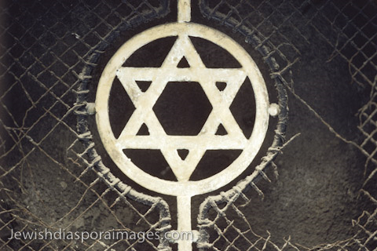
The Jews
Ongoing traditional discrimination, but depth depended on country
French recognized Jewish citizenship
A/H same
Eastern Europe the worst – Russia and Poland!
Treated as non entities
Limited areas to live in
Banned from jobs and higher education
Pogroms
1873 Stock crash. Jews blamed.
Persecution up (biological threat)
Zionist Congress (Herzel) – Create a Jewish home state

Slide 2
Socialism spreads
Growth of Unionism late 1800s. Led to creation of political parties based on worker’s rights. However; union movement and political action separated
WHY?
Unions issues about concrete issues not political doctrine
Universal male suffrage changes political scene. Workers could not be ignored!

Slide 3
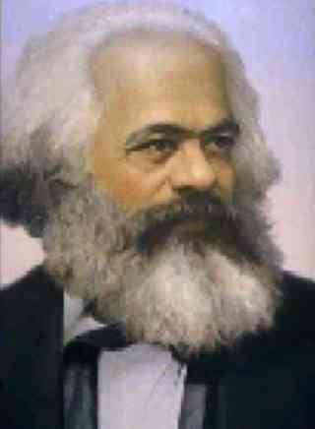
Division creates issue of how to make changes
Revolution
How to deal with ideas like nationalism.
Most working class nationalistic (WW I)
Parties were ideological so they tended to advocate revolt! (Like Brother/Comrade Karl)

Slide 4
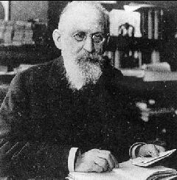
Democratically:
Germany began socialist ideas 1891 Erfurt program. Marxist without revolution.
Brother Bernstein revised Marx
“Evolutionary Socialism”
Pointed out that workers were patriotic and so would not support overthrow, but they wanted and needed rights!
SPD follows this idea

Slide 5
Socialism Organizes
First International
How to achieve goals
Split movement based on political status of nation.
Into what?
Which nations went for which?
2nd International 1889 and every 3 years from then on to discuss Marx.
May 1 becomes international strike day (Labour day for the rest of the world!)

Slide 6
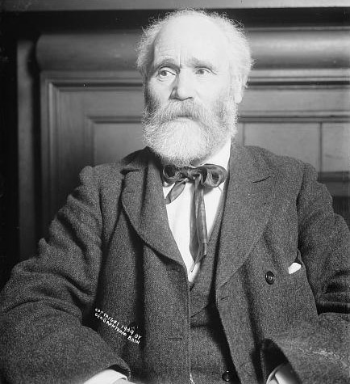
Socialism in Britain
Marxism adopted everywhere except GB. WHY?
Workers were gaining
Fabian Society created
Party of choice for workers – Liberals
What happened?
1892 Kier Hardie first Labour MP

Slide 7
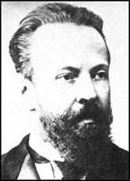
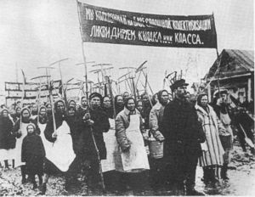
Sergie Witte
Russian Socialism
Moves to industrialize
French capital (this will play a role later.)
Higher taxes and did not help the bulk of the population (peasants)
A few did prosper and bought up land
Kulaks

Slide 8
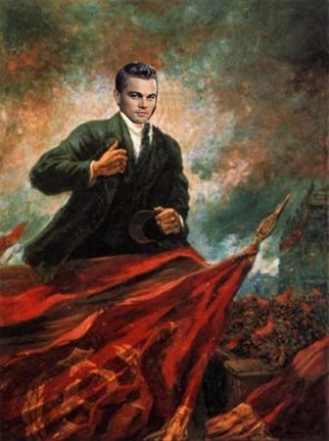
Lenin The Early Years
His brother member of People’s Will - executed – big influence.
Sentenced to 3 years Siberia made friends with Jules Martov
Moved to Geneva and published Iskra (spark)
“What Is To Be Done?”
Advocated small professional revolutionaries aided by large fringe.
Led to fallout with Martov
Split the party
Mensheviks
Bolsheviks

Slide 9
The 1905 Russian Revolution

Slide 10
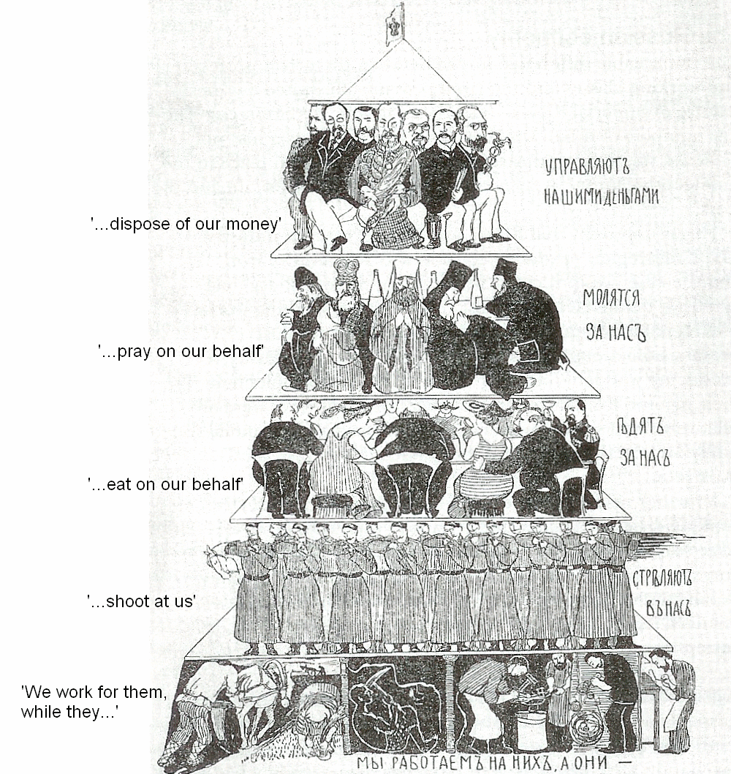
Early 20^{c}: Russian Social Hierarchy

Slide 11
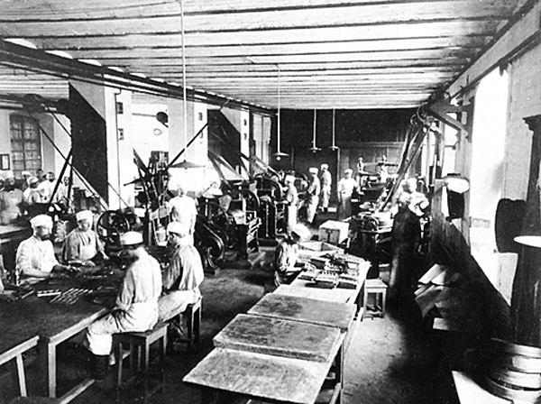
First Stages of Industrialization
An Early Russian Factory

Slide 12
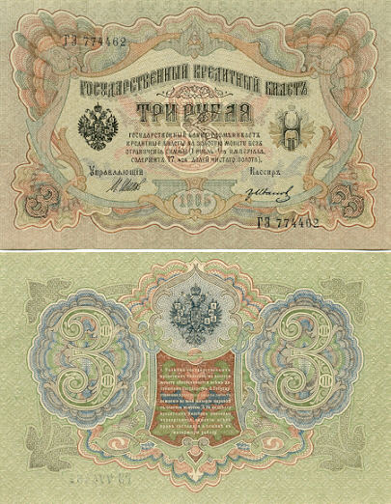
Weak Economy
1905 Russian Rubles

Slide 13
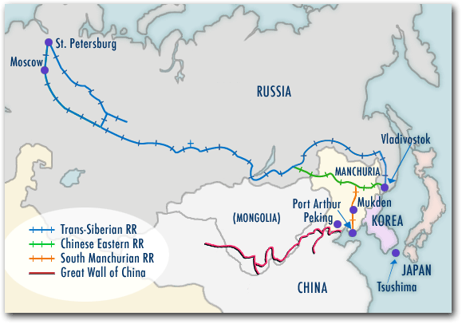
Extensive Foreign Investments & Influence
Building the Trans-Siberian RR [Economic benefits only in a few regions.]

Slide 14
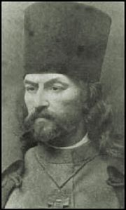
Unrest Among the Peasants & Urban Working Poor
Father Georgi Gapon:

Slide 15
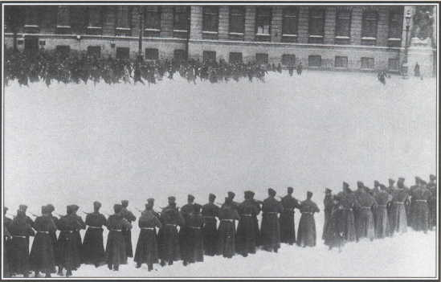
Bloody Sunday January 22, 1905
The Czar’s Winter Palace in St. Petersburg

Slide 16
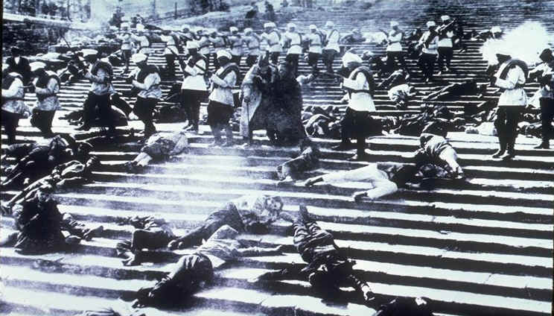
Russian Cossacks Slaughter The People in Odessa
Anti-Jewish Attacks

Slide 17
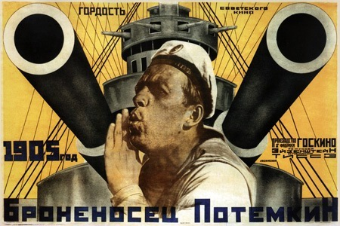
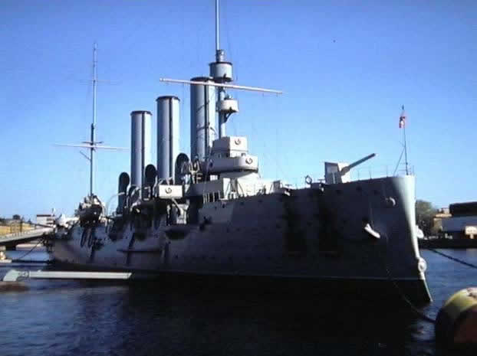
The Battleship Potemkin Mutiny [June, 1905]

Slide 18
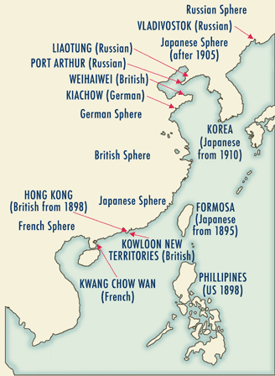
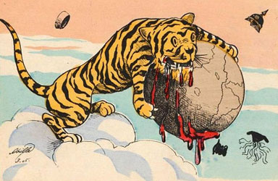
Russo-Japanese War [1904-1905]
The “Yellow Peril”

Slide 19
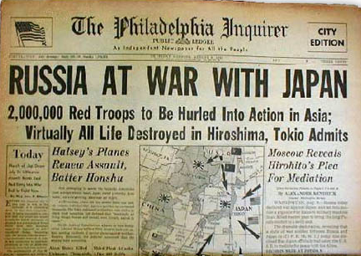
Russo-Japanese War [1904-1905]

Slide 20
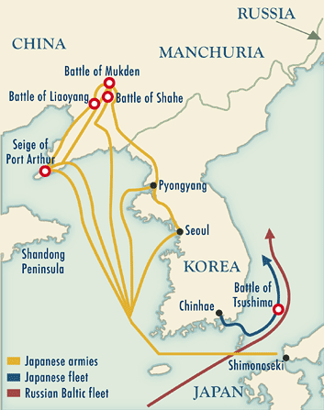
Russo-Japanese War [1904-1905]

Slide 21
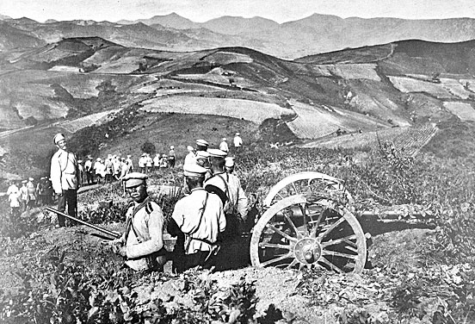
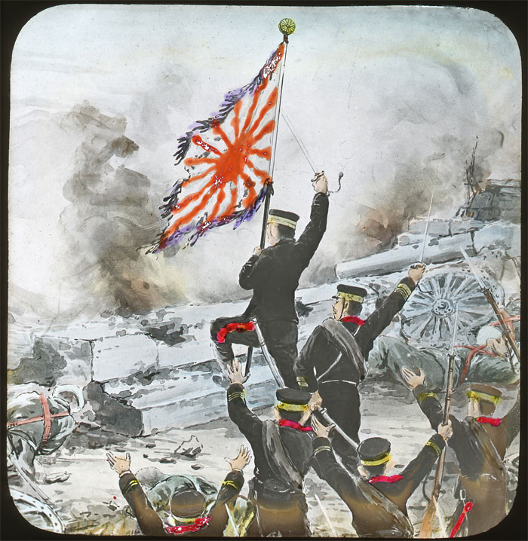
Russian & Japanese Soldiers

Slide 22
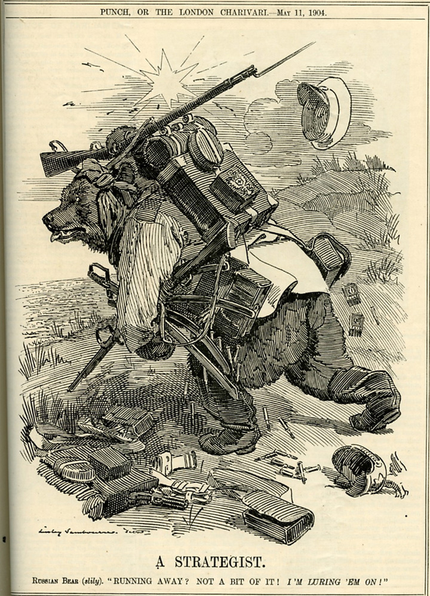
Russia Is Humiliated

Slide 23
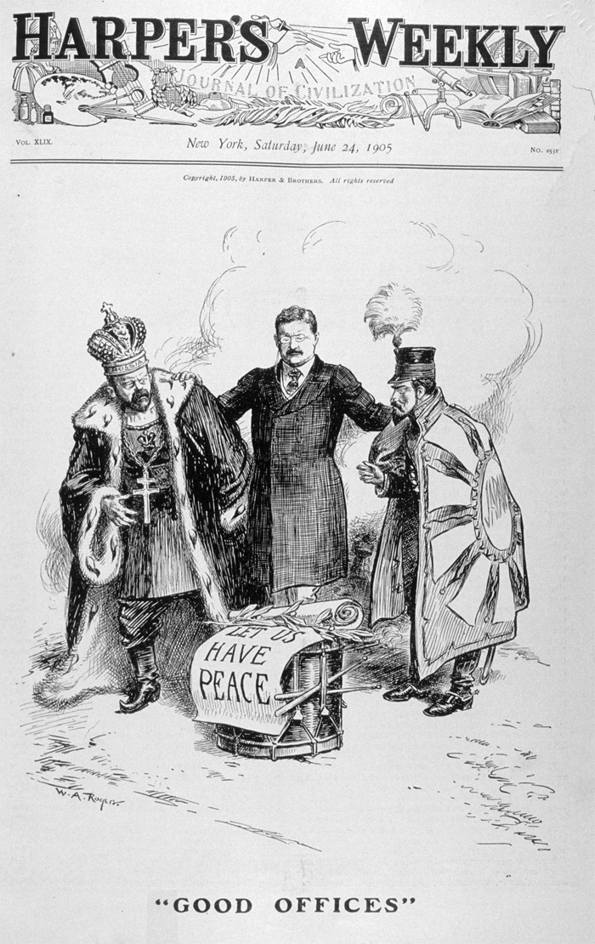
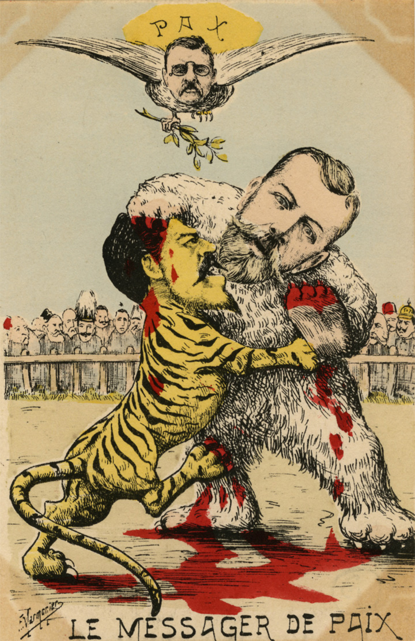
Treaty of Portsmouth [NH] - 1905
President Theodore Roosevelt Acts as the Peacemaker
[He gets the Nobel Peace Prize for his efforts.]

Slide 24
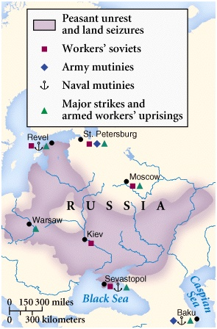
The Revolution Spreads

Slide 25
Results

Slide 26
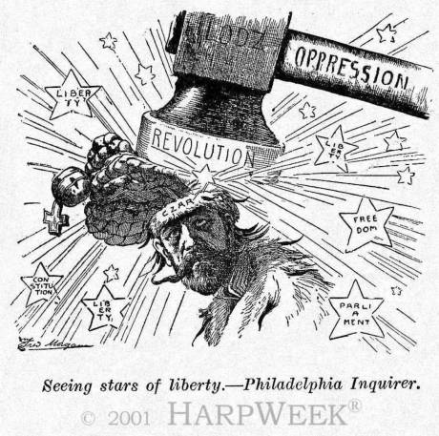
1. The Tsar’s October Manifesto
October 30, 1905

Slide 27
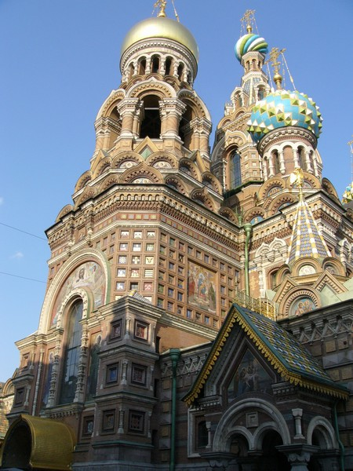
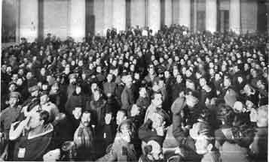
2. The Opening of the Duma: Possible Reforms?
1906
The first two tries were too radical.
The third duma was elected by the richest people in Russia in 1907.

Slide 28
The Russian Constitution of 1906
Known as the Fundamental Laws [April 23, 1906].
The autocracy of the Russian Tsar was declared.
The Tsar was supreme over the law, the church, and the Duma.
It confirmed the basic human rights granted by the October Manifesto, BUT made them subordinate to the supremacy of the law, and therefore…?

Slide 29
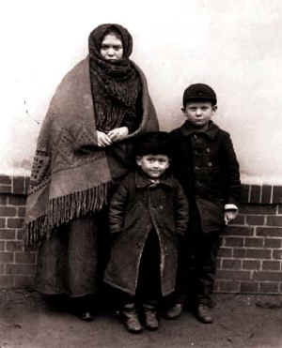
3. Jewish Refugees Come to America in 1906

Slide 30
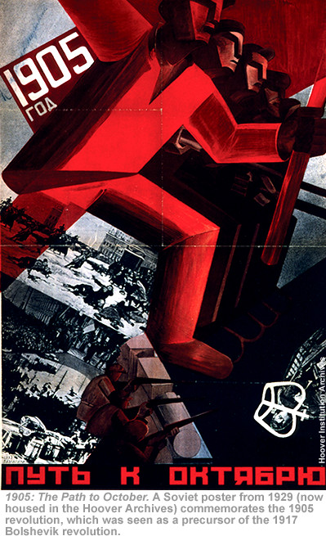
4. The Path to October, 1917

Slide 31
Why did the 1905 Revolution Fail?

